Slide 1
Applied Mathematics for Informatics
Ing. Tereza Horáková, Ph.D.
+ Ing. Petra Blahová
PEF 142
horakovat@pef.czu.cz

Slide 2
Subject content
Operations Research Methods
Applications
Theoretical basis
  Linear algebra
  Systems of linear equations
Operations Research Models
  Content, elements of models
  Solving process, algorithms
  Model results

Slide 3
Linear Algebra

Slide 4
Linear algebra
The branch of mathematics (abstract algebra) deals with
  Vectors
  Matrices
  Vector spaces
  Linear transformations and
  Systems of linear equations

Slide 5

IT application of vectors and matrices
Computer graphic and games – position, colors, lighting
ML and AI – text embeddings
Vector databases
Signal processing – audio, images, compression
Robotics and VR

Slide 6


Vectors and matrices
Vector
  Components (coordinates), each of which is dependent upon the particular coordinate system v=(v₁, v₂, …, v_{n})
  Mapping
Matrix
  Components (entries) in a rectangular table A=(a_{ij}) i=1,…,m, j=1,…,n
  Mapping
  The horizontal lines are called rows and the vertical lines columns.
  A matrix with m rows and n columns is called an m-by-n matrix (or m×n matrix) and m and n are called its dimensions.
  A set of vectors can be represented by a matrix
    columns (rows) represent vectors of the set
Example and graphical representation

Slide 7
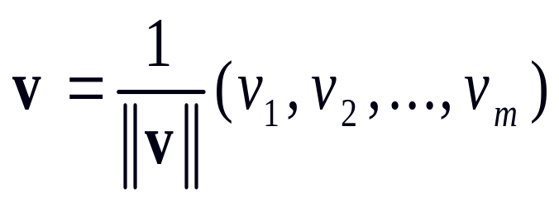
Vectors
Vector generaly v = (v₁, v₂, …, v_{n}), k ∈ R
Opposite vector -v = -1.v = (-v₁, -v₂, …, -v_{n})
Null vector 0 = (0, 0, ..., 0)
Unit vector e_{i} = (0, 0,…,1, 0,…,0)
  Vector lenght equal to 1

Slide 8
Vector basic operations
Addition and subtraction
Scalar multiplication
Vector multiplication
  Scalar product
  Cross product
Transposition
Length of vector

Slide 9
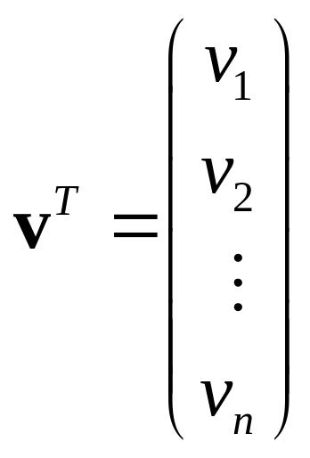
Transposition of vector
Row vector
v = (v₁, v₂, …, v_{n})
Column vector

Slide 10
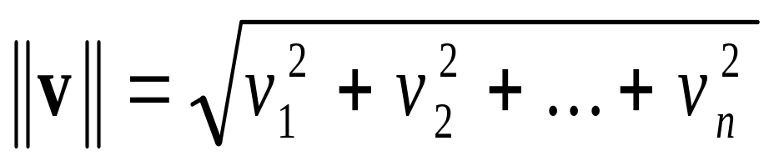
Vector length
v=(v₁, v₂, …, v_{n})
The length of v
Example and graphical representation

Slide 11
Addition and subtraction
v=(v₁, v₂, …, v_{n})
w=(w₁, w₂, …, w_{n})
The sum of v and w
v+w =(v₁+w₁, v₂ +w₂, …, v_{n} +w_{n})
Example and graphical representation

Slide 12
Scalar multiplication
v=(v₁, v₂, …, v_{n})
The multiplication of vector v by scalar a
a.v =(a.v₁, a.v₂, …, a.v_{n})
Example and graphical representation

Slide 13
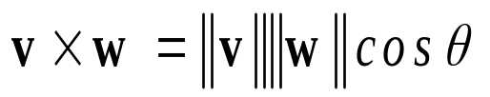
Scalar product - dot product
Vector multiplication
  v=(v₁, v₂, …, v_{n})
  w=(w₁, w₂, …, w_{n})
Multiplication of vectors v and w
  v.w^{T} = v₁.w₁+v₂.w₂+ … +v_{n}.w_{n}
Result of this multiplication is scalar
  (dimensionless quantity, pure number)
Numerical example

Slide 14
Perpendicular vectors
Vectors v and w perpendicular, if their scalar product is equal to zero
v.w^{T} = 0
Example and graphical representation

Slide 15
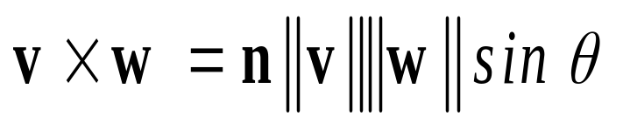
Vector product - cross product
v=(v₁, v₂, v₃)
w=(w₁, w₂, w₃)
Multiplication of vectors v and w
  where θ is the angle between v and w on the plane defined by the vectors, and n is a unit vector perpendicular to both v and w.
Result of this multiplication is vector.

Slide 16
Matrices
Square matrix if m = n
  m-by-m has dimension m
Rectangular matrix if m ≠ n ,
Row matrix if m =1
Column matrix if n=1
Zero or null matrix
  All entries are equal to 0
Opposite matrix

Slide 17
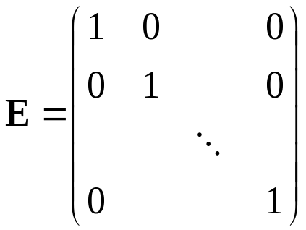

Matrices
Main diagonal of matrix
  Entries a₁₁, a₂₂ ,... a_{rr} , for r = min(m,n)
Diagonal matrix
  Square matrix with non zero elements on the main diagonal
Identity or unit matrix
  only diagonal entries are 1, others are 0
Triangular matrix
  Lower (left) and upper (right) triangular matrix

Slide 18
Matrix operations
Matrix addition
Scalar multiplication of matrix
Matrix multiplication
Matrix transposition
Elementary row operations
Inversion of regular matrix

Slide 19
Matrix addition
The usual matrix addition is defined for two matrices of same dimensions.
C = A + B
  The result of sum of two m-by-n matrices A and B, denoted by A + B, is again an m-by-n matrix computed by adding corresponding elements.

Slide 20
Matrix multiplication
Defined between two matrices only if the number of columns of the first matrix is the same as the number of rows of the second matrix.
C = A × B
  If A is an m-by-n matrix and B is an n-by-p matrix, then their product C is an m-by-p matrix which elements are equal to scalar product of proper row and column.
  c_{ij} = a_{i}*b_{j}
  Result is matrix

Slide 21
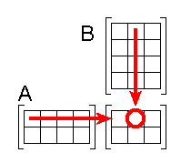
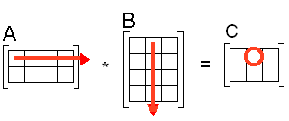
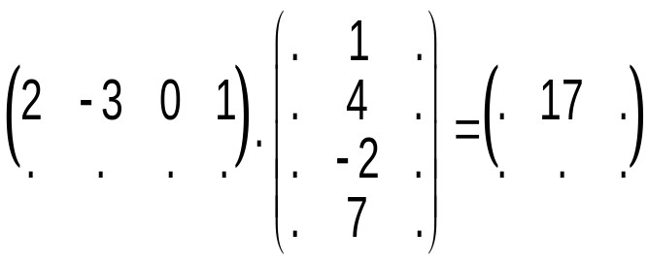
Matrix multiplication
-3
  c_{ij} = a_{i}*b_{j}

Slide 22
Scalar multiplication of matrix
The multiplication of a matrix and a scalar
  multiplication of each elements of matrix
  C = a.A
  Result is matrix
  If A is an m-by-n matrix C is again an m-by-n matrix

Slide 23
Matrix transposition
For all matrices
Columns changed to rows and vice versa
If A is m×n matrix with elementsa_{ij}, then transposed matrix A^{T} is n×m matrix with elements a_{ji}.

Slide 24
Abstract algebra - see worksheet
Theory of algebraic structures such as groups, rings, fields and vector space
Algebraic structure
  One or more sets of elements
  Operations
  Axioms - properties of operations

Slide 25
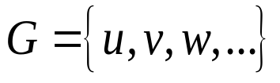
Group
(G, * )
  Nonempty set
  Binary operation *
    G * G → G
  The group axioms
    Associativity: u * (v * w)=(u * v) * w
    Identity element
    Inverse element
    Closure
    Abelian group – commutativity: v * w = w * v

Slide 26
Examples
Real numbers under addition
  Identity element - 0
  Inverse element – opposite number
Real numbers without zero under multiplication
  Identity element - 1
  Inverse element – reciprocal number

Slide 27
Nonexample
Integer numbers under multiplication
  Identity element
    integer number 1
  Inverse element
    reciprocal number, but it is not integer number

Slide 28
Field
(F,+, * )
The field is a set F with two operations + and *
that is
  Commutative group with respect to operation +
  Commutative group with respect to operation *
  Both operations are distributive and
  The additive identity (0) has no multiplicative inverse (one cannot divide by 0)

Slide 29
Example
Real numbers with addition and multiplication
  (F,+) Abel’s group
    Neutral element - 0
    Inverse element – opposite number
  (F, ×) (Abel’s) group
    Neutral element - 1
    Inverse element – inverted number
  Distributive laws

Slide 30
Vector space
Vector space over a field
(V, (F,+, * ), +, ×)
  field (F,+, * ),
  set of vectors V together with a set of scalars F and two operations
  vector addition: V + V → V
  scalar multiplication: F × V → V
  axioms

Slide 31
Vector space
Axioms
  Vector addition is associative: u+(v+w)=(u+v)+w
  Vector addition is commutative: v + w = w + v
  Additive identity element 0 exists in V
  Inverse element -v exists in V
  Scalar multiplication is associative
  Multiplicative identity 1 exists in F.
  Scalar multiplication distributes over vector addition
  a(v + w) = a v + a w.
  Scalar multiplication distributes over scalar addition
  (a + b)v = a v + b v.

Slide 32
Example
A typical application of vector space is the Cartesian coordinate system
  Vectors are the points in form
  x = (x₁, x₂, x₃)
  Scalars are real numbers
  Standard operations + and ×
    vector addition
      using the parallelogram rule
    scalar multiplication
      vector multiplied by real numbers

Slide 33
Vectors and Matrices
A set of vectors can be represented in a matrix
  Rows (columns) are vectors
Basis is a set of vectors
  Each basis is represented in a matrix

Slide 34
Linear combination of vectors
Sum of vectors multiplied by scalars
v₁, v₂, …, v_{n} vectors
a₁, a₂, …, a_{n} scalars
Linear combination of vectors
v = a₁.v₁+ a₂.v₂+ … + a_{n}.v_{n}
Result of this operation is vector

Slide 35
Linearly independent vectors
Vectors v₁, v₂, …, v_{n} are linearly dependent if there exist scalars a₁, a₂, …, a_{n} not all equal to zero, such that
0 = a₁.v₁+ a₂.v₂+ … + a_{n}.v_{n}
Otherwise, these vectors are linearly independent

Slide 36
Generators
Generators of vector space is a set of vectors that produce using linear combination of vectors this vector space.
The set of generators is a generating set if every vector in vector space can be represented as a linear combination of generators.

Slide 37

Basis
The set of generators is a basis if it is a generating set containing only linearly independent vectors.
The basis is minimal set of generators.
Standard basis or canonical basis – orthonormal vectors
Generátory a báze vektorového prostoru

Slide 38
Basis extension
Basis is a set of vectors
  Basis can be given by a matrix
  Each basis is represented by proper matrix
Every set of linearly independent vectors can be extended into basis.
These extensions are not unique.

Slide 39
Steinitz’s theorem
It is possible to change vectors in the set of generators.
  The new set has to be set of generators again.
It is possible to change vectors in the basis.
  The new set has to be basis again.
    The new set has to have the same number of elements.
  It means – it is possible to change the same number of vectors and linear independency must be satisfied.

Slide 40
Transformation of basis
Changing of vectors in basis
New vectors will be linear combination of some old basis vectors
Linear combination of vectors can be represented by multiplication of basis transformation matrix and matrix of basis

Slide 41
Vector coordinates
Let V be a vector space of dimension n
  Basis B = [b₁, b₂, ….b_{n}] of the vector space
  Vector v = (v₁, v₂, …,v_{m}) - componets of vector
Then for every vector there is a unique linear combination of the basis vectors that equals v
v = β₁ b₁ + β₂ b₂ + … + β_{n} b_{n}
Coeficients β₁, β₂, …, β_{n} are coordinates of vector v relative to B
v_{B} = (β₁ , β₂ , … β_{n} )
Example B = [b₁, b₂] = [(1,0,1), (1,1,0)] (Is it basis?)
v = (5,2,3)
v = 3 b₁ + 2 b₂ v_{B} = (3, 2)

Slide 42
Elementary row (column) operation
Add one row to another row
Multiplying row by a scalar
Interchange the rows
Omit the row
The same operations can be provided on the columns

Slide 43
Jordanian elimination
Jordanian elimination
  Choosing leading element – pivot on the main diagonal
  Replacing it by 1 using elementary operations on the row
  Other elements in column replace by 0 using elementary operations on the rows

Slide 44
Application of JEM
Linear dependency or independency of vectors
Rank of matrix
Inversion of matrix
Basis transformation
Solving of system of linear equations

Slide 45
Rank of matrix
The rank of a matrix A of type (m,n) is equal to the number of linearly independent rows (or columns) of the matrix
h(A)=min(m, n)
The square matrix A (n,n) is regular ⇔ h(A)= n
The square matrix A (n,n) is singular ⇔ h(A) < n

Slide 46
Rank of matrix
The rank of the matrix will not change
  if we change the order of the lines
  if we multiply the rows by a non-zero number
  if we add to the line a linear combination of the other lines
  if we omit a line that is a linear combination of the others' lines
  if we change the order of the columns
Determining the rank of the matrix
  we convert the matrix to a triangular matrix using elementary operations
  the rank of the matrix is ​​equal to the number of non-zero rows

Slide 47
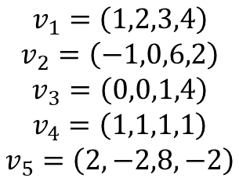
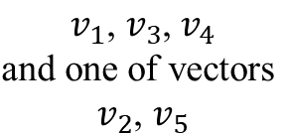
Basic vectors
1 | 2 | 3 | 4
-1 | 0 | 6 | 2
0 | 0 | 1 | 4
1 | 1 | 1 | 1
2 | -2 | 8 | -2
1 | 2 | 3 | 4
0 | 2 | 9 | 6
0 | 0 | 1 | 4
0 | -1 | -2 | -3
0 | -6 | 2 | -10
1 | 2 | 0 | -8
0 | 2 | 0 | -30
0 | 0 | 1 | 4
0 | -1 | 0 | 5
0 | -6 | 0 | -18
1 | 0 | 0 | 2
0 | 0 | 0 | -20
0 | 0 | 1 | 4
0 | 1 | 0 | -5
0 | 0 | 0 | -48
1 | 0 | 0 | 0
0 | 0 | 0 | 1
0 | 0 | 1 | 0
0 | 1 | 0 | 0
0 | 0 | 0 | 0
Which vectors can create basis
Basis contains
Why?
Rank of matrix

Slide 48
Inversion of regular matrix
Matrix A⁻¹ is called inverse matrix of a matrix A (n×n) if
A×A⁻¹ = A⁻¹×A = E
A square matrix A (n×n) is said to be invertible if there is a matrix A⁻¹ (n×n) such that
A×A⁻¹ = A⁻¹×A = E
  E is the identity (unit) matrix.
Inverzní matice, jednotková matice

Slide 49
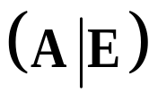
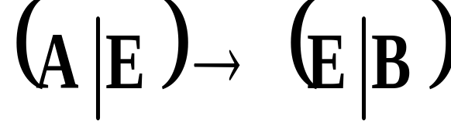
Finding inverse matrix
Perform the matrix transformation using Jordanian elimination
When this reduction is possible, B=A⁻¹ is inverse matrix of A
When this reduction is not possible, A is noninvertible

Slide 50
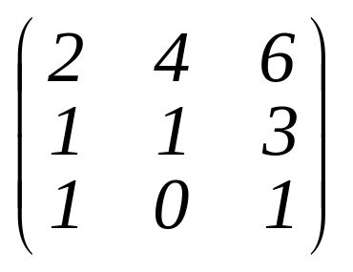
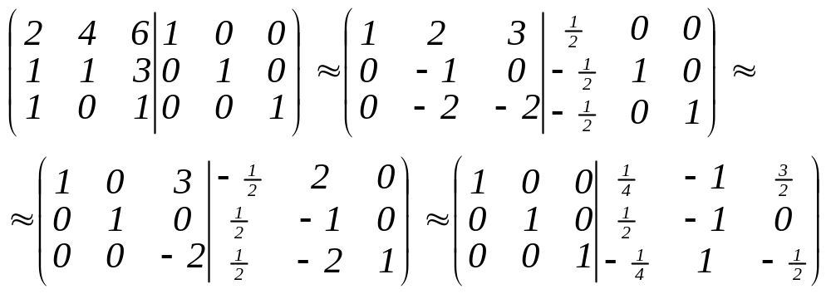
Inverse matrix calculation
Find inverse matrix for matrix A=
Check your calculation - provide matrix multiplication A×A⁻¹ = A⁻¹×A = E

