Slide 1
LINEAR PROGRAMMING
Mathematical models
Operations Research and Management (Decision) Science

Slide 2
Mathematical models
A mathematical model is a description of a system or problem using mathematical concepts, tools and language.
Mathematical model is a function, an equation, inequation, or system of equations or inequations, which represents certain aspects of the physical system or problem modelled.
Ideally, by the application of the appropriate techniques the solution obtained from the model should also be the solution to the system problem.

Slide 3
Application of system of linear equations
Problem I
Suppose that a farmer has 35 acres of farmland to be planted with either cauliflower or kohlrabi. The farmer wants to have 8 acres of cauliflower. Let 4000 CZK be the selling price of cauliflower per acre, and 2400 CZK be the price of kohlrabi.
He wants to have 104800 CZK of revenue.

Slide 4
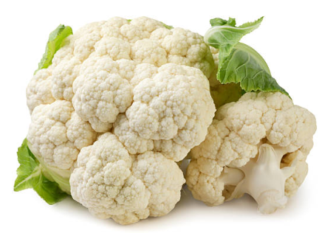
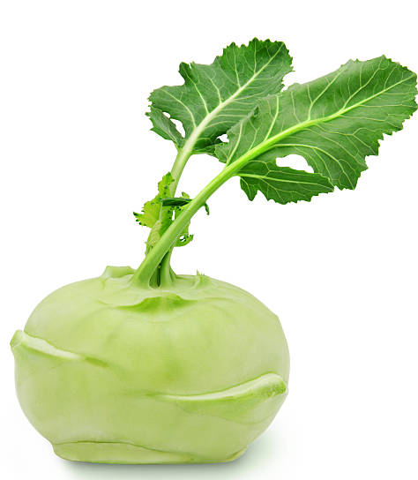
Application of system of linear equations
x1 - area of cauliflower (ar)
x2 - area of kohlrabi (ar)
Subject to:
  x1 + x2 = 35 (limit on total area)
  x1 = 8 (limit on area of cauliflower )
  5000 x1 + 2400 x2 = 104800 (desired revenue)
  x1 ≥ 0, x2 ≥ 0 (cannot plant a negative area).

Slide 5
Linear optimization model
Problem II
Suppose that a farmer has 35 acres of farm land to be planted with either cauliflower or kohlrabi. The farmer wants to have at least 8 acres of cauliflower. Let 5000 CZK be the selling price of cauliflower per acre, and 2400 CZK be the price of kohlrabi.
He wants to maximize his revenue.

Slide 6
Linear optimization model
x1 - area of cauliflower (ar)
x2 - area of kohlrabi (ar)
Maximize:
  5000 x1 + 2400 x2 → MAX (the revenue)
Subject to:
  x1 + x2 ≤ 35 (limit on total area)
  x1 ≥ 8 (limit on area of cauliflower )
  x1 ≥ 0, x2 ≥ 0 (cannot plant a negative area).

Slide 7
Terminology
Variables
  Decision variables
  Slack variables
  Artificial variables
Constraints also called conditions or restrictions
  Capacities or Capacity constraints
  Requirements or Requirement constraints
  Balance constraints
  Definitional constraints
Objective function also called criteria function

Slide 8
Terminology
Feasibility region
Search space
Choice set
Set of candidate solutions or
Set of feasible solutions
Objective function also called criteria function, cost function, energy function, or energy functional

Slide 9
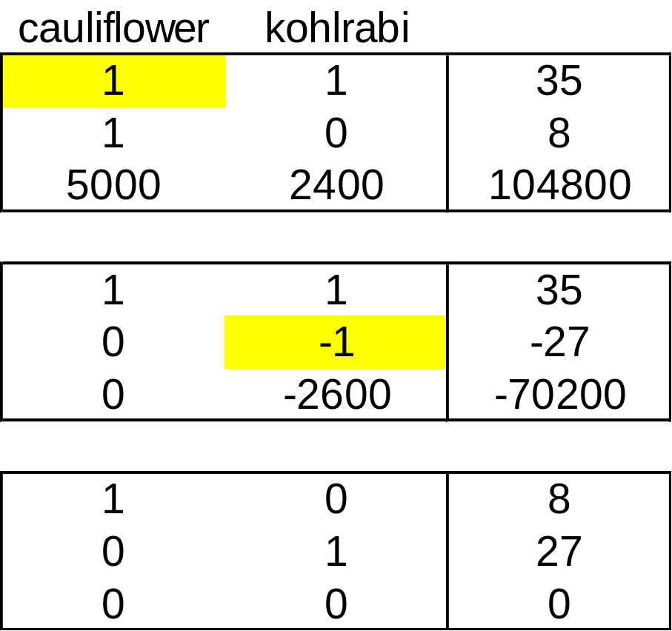
Solution of problem I

Slide 10
Solution of problem II
x1 - area of cauliflower (ar)
x2 - area of kohlrabi (ar)
x3 – reserve - slack of the whole area (ar)
x4 – surplus - slack of the desired cauliflower area (ar)
Maximize:
  5000 x1 + 2400 x2 → MAX (the revenue)
  Subject to:
  x1 + x2 ≤ 35 (limit on total area)
  x1 ≥ 8 (limit on area of cauliflower )
  x1 ≥ 0, x2 ≥ 0 (cannot plant a negative area).

Slide 11
Solution of problem II
x1 - area of cauliflower (ar)
x2 - area of kohlrabi (ar)
x3 – reserve - slack of the whole area (ar)
x4 – surplus - slack of the desired cauliflower area (ar)
Maximize:
  5000 x1 + 2400 x2 + 0x3 + 0x4 (maximize the revenue)
Subject to:
  x1 + x2 + x3 = 35 (limit on total area)
  x1 – x4 = 8 (limit on area of cauliflower )
  x1 ≥ 0, x2 ≥ 0, x3 ≥ 0, x4 ≥ 0 (cannot plant a negative area).

Slide 12
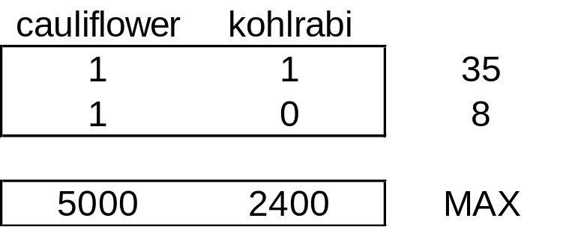
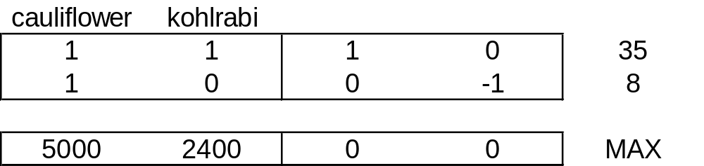
Model of problem II

Slide 13
Matrices as set of vectors
Column space of a matrix is the set of all possible linear combinations of its column vectors
  Space of solutions – all solutions as vectors x
  Column space – all linear combinations of activities
Row space of a matrix is the set of all possible linear combinations of its row vectors

Slide 14
Graphical representation A
Solution space
Convex polytop or polyhedral cone
  Bounded
  Unbounded

Slide 15
Feasibility region
Constraints
  Constraints as an equations
  Constraints as an inequations
Each constraint as halfplane (halfspaces)
Feasibility region
  Intersection of all halfplanes
Objective function
  Line of constant value of objective function

Slide 16
Convex polytop and objective function
Δf(x)

Slide 17
Convex polyhedral cone and objective function
Δf(x)

Slide 18
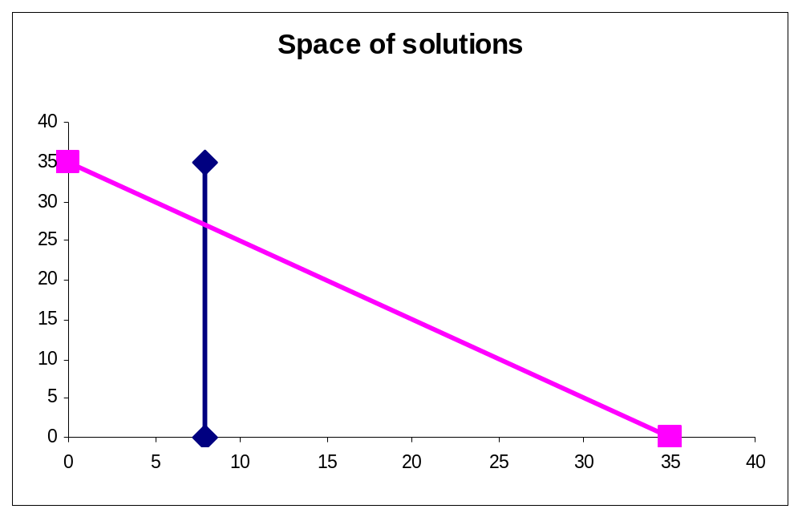
Solution of problem II
Set of feasible solutions - Feasibility region
Test of all points or analysis of criterion behaviour
maximize the revenue
5000 x1 + 2400 x2
Subject to:
x1 + x2 ≤ 35 (total area)
x1 ≥ 8 (area of cauliflower )
x1 ≥ 0, x2 ≥ 0

Slide 19
Fundamental Theorem of LP
If the optimal value of the objective function in a linear programming problem exists, then that value must occur at one (or more) of the corner points of the feasible region.
(If it occurs in at more than one corner, each convex linear combinations of these corner coordinates points have the optimal value too)
Δf(x)

Slide 20
Terminology
Feasible solution
Basic solution
Infeasible solution
Optimal solution
Alternative solution
Suboptimal solution

Slide 21
Fundamentals theorems
Basic solution of system of linear equations is represented by corner points of the feasible region.
If feasible solution of LP exists, basic feasible solution exists too.
Optimal solution of LP problem lies on the border of convex polytop (cone) of feasible solutions.
If optimal solution of LP exists, basic optimal solution exists too.

Slide 22
Existence of solution
Nonexistence of solution
  If the feasible region is empty (that is, there are no points that satisfy all the constraints), the feasible and also optimal solution do not exist.
  If the feasible region is unbounded and the objective function is incresing (decreasing) in the direction of unboundness of the feasible cone, then the maximum (minimum) value of the objective function does not exist, it is unbounded.
Existence of one or more solutions
  If the feasible region for a linear programming problem is bounded in the direction of incresing (decreasing) of objective fumction then the maximum (minimum) value of the objective function always exist.
  If two or more optimal solutions exist, than infinite number of solutions exist – linear combinations of some solution

