Slide 1
Holidays problem
Application of the decision model
Tutorial

Slide 2
Holidays problem
A group of friends wants to spend their holidays together.
They think of a week in the mountains, by the sea or by bike.
The success of the holidays depends on how much they can invest (much, little) and how the weather (nice, bad) will be.
At the sea they assume that the weather will always be good. Otherwise they expect 30% of nice weather.
They also expect a 60% chance that they will have rather little money on vacation.
How to decide?

Slide 3
Step One –
Decision makers
The first rational decision maker who is interested in the outcome
  Three friends as a decision maker
The second decision maker
  weather and disposable money, the weather will not be bad and the money will not be enough just for bad holidays
Irational decision maker - nature

Slide 4
Step Two – Possible decision alternatives
How do friends have options?
  week in the mountains
  week by sea
  week by bike
There are three possible decision alternatives, three strategies.

Slide 5
Step Two – Possible decision alternatives
What is nature's choice? Combinations of the following
    Nice x Bad weather
    A lot of money x A little money
So there are four possible strategies
    A lot of money and nice weather
    A lot of money and bad weather
    A little money and nice weather
    A little money and bad weather

Slide 6
The basic structure of the decision model
We will build a decision table
Money | A lot |  | A little
 | 40% |  | 60%
Weather | nice | bad | nice | bad
 | 30% | 70% | 30% | 70%
Mountains | great week and we'll save | bad, but we'll at least save | we will enjoy it, but we will save little | bad, and we will not even save
Sea | great week, but we will not save | great week, but we will not save | nice see, but we will not save | nice see, but we will not save
Bike | great week and we'll save | bad, but we'll at least save | we will enjoy it, but we will save little | bikes, rain and we will not even save

Slide 7
Step Three - Evaluating the results of the decision
The quantification of the results is missing in the decision table
We have no evidence other than the requirement for a nice holiday and for the saved money.
For example, we can choose the following rating scale
      3 cool week and we will save
      2 cool week but we will not save
      1 we will enjoy it, but we will save little
      0 nice see, but we will not save
      -1 bad, but we'll at least save
      -2 bad, and we will not even save
      -3 bikes, rain and we will not even save

Slide 8
The basic structure of the decision model
Possible quantification of payoffs for each combination the decision alternative and state of nature according to the defined scale
Money | A lot |  | A little
 | 40% |  | 60%
Weather | nice | bad | nice | bad
 | 30% | 70% | 30% | 70%
Mountains | 3 | -1 | 1 | -2
Sea | 2 | 2 | 0 | 0
Bike | 3 | -1 | 1 | -3

Slide 9
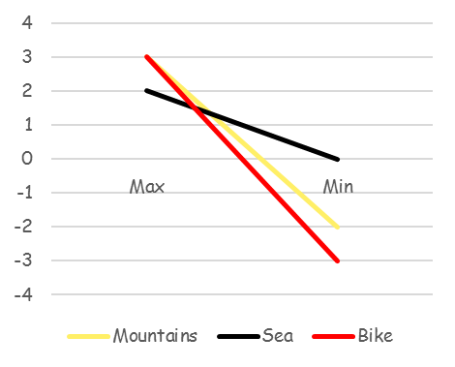
Step Four – Dominance of decision alternatives
Outcome dominance
  Is there any alternative whose all results are better than all results of another alternative?
No dominating alternative
 | Max | Min
Montains | 3 | -2
Sea | 2 | 0
Bike | 3 | -3

Slide 10
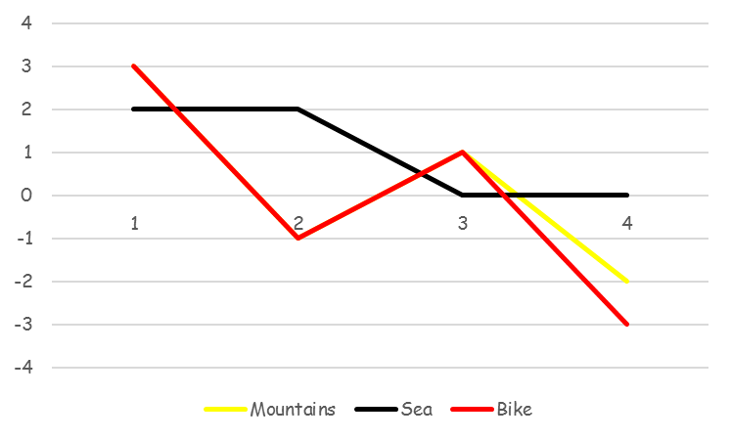
Step Four – Dominance of decision alternatives
Event dominance
  Is there an alternative that promises a better outcome for each state of nature?
State of nature | 1 | 2 | 3 | 4
Mountains | 3 | -1 | 1 | -2
Sea | 2 | 2 | 0 | 0
Bike | 3 | -1 | 1 | -3

Slide 11
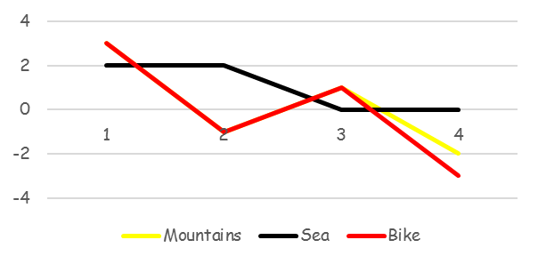
Step Four – Dominance of decision alternatives
There is no alternative dominates to all others depending on the states of nature.
  Week by sea seems to be the best, it's just a little worse than the other two alternatives.
  However, week on the mountain dominates the alternative bike week, under the fourth condition being better, othewise being the same.
States of nature | 1 | 2 | 3 | 4
Mountains | 3 | -1 | 1 | -2
Sea | 2 | 2 | 0 | 0
Bike | 3 | -1 | 1 | -3

Slide 12
Step Four – Dominance of decision alternatives
Probabilistic dominance
  Is there an alternative that promises better results with a higher probability?
It is necessary to know the probabilities of the states of nature, and hence the payoffs of individual alternatives
Money | A lot |  | A little
 | 40% |  | 60%
Weather | nice | bad | nice | bad
 | 30% | 70% | 30% | 70%
Probabilities of states of nature | 0,4 x 0,3 | 0,4 x 0,7 | 0,6 x 0,4 | 0,6 x 0,7
 | 0,12 | 0,28 | 0,24 | 0,42

Slide 13
Step Four – Dominance of decision alternatives
Probabilistic dominance
  Is there an alternative that promises better results with a higher probability?
  We have to calculate the probabilities with which each alternative provides a payoffs of at least x.
Mountains | Payoffs x | Partial probabilities | Cummulative probabilities
 | ≥ -2 |  | 1
 | > -2 | 42% | 58%
 | ≥ -1 |  | 58%
 | > -1 | 28% | 30%
 | ≥ 1 |  | 30%
 | > 1 | 18% | 12%
 | ≥ 3 |  | 12%
 | > 3 | 12% | 0%

Slide 14
Step Four – Dominance of decision alternatives
Probabilistic dominance
  Is there an alternative that promises better results with a higher probability?
  We have to calculate the probabilities with which each alternative provides a payoffs of at least x.
Sea | Payoffs x | Partial probabilities | Cummulative probabilities
 | ≥ 0 |  | 1
 | > 0 | 60% | 40%
 | ≥ 2 |  | 40%
 | > 2 | 40% | 0%

Slide 15
Step Four – Dominance of decision alternatives
Probabilistic dominance
  Is there an alternative that promises better results with a higher probability?
  We have to calculate the probabilities with which each alternative provides a payoffs of at least x.
Bike | Payoffs x | Partial probabilities | Cummulative probabilities
 | ≥ -3 |  | 1
 | > -3 | 42% | 58%
 | ≥ -1 |  | 58%
 | > -1 | 28% | 30%
 | ≥ 1 |  | 30%
 | > 1 | 18% | 12%
 | ≥ 3 |  | 12%
 | > 3 | 12% | 0%

Slide 16
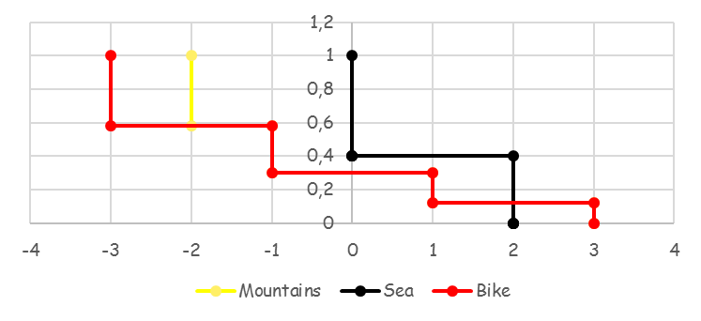
Step Four – Dominance of decision alternatives
Probabilistic dominance
  Risk Profile - A graph of cumulative probabilities of individual payoffs of individual alternatives
No alternative dominates according to the probabilistic dominance the others, the best outcomes with the highest probability promises a week at sea (except the highest outcome).

Slide 17
Decision making under uncertainty - Hurwitz criterion
This criterion evaluates each alternative based on its best (V) and worst payoffs (v), which combines with respect to the degree of optimism and pessimism.
If the degree of optimism (optimistic-pessimistic index) is t, the degree of pessimism is 1- t
The evaluation of the alternative is then t.V + (1- t).v
Alternatives can be analyzed for different values t.
Hutwitz criterion
 |  |  | t =
 | Max | Min | 0 | 0.2 | 0.4 | 0.6 | 0.8 | 1
Mountais | 3 | -2 | -2 | -1 | 0 | 1 | 2 | 3
Sea | 2 | 0 | 0 | 0.4 | 0.8 | 1.2 | 1.6 | 2
Bike | 3 | -3 | -3 | -1.8 | -0.6 | 0.6 | 1.8 | 3

Slide 18
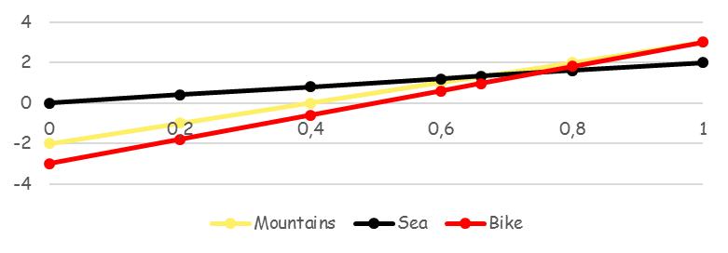
Decision making under uncertainty – Hurwitz criterion
From both the table and the chart, it is clear that friends should go to the sea, only with high optimism can be recommended holidays in the mountains (it can be calculated that t must be greater than 0.67).
Hutwitzovo kritérium
 |  |  | t =
 | Max | Min | 0 | 0.2 | 0.4 | 0.6 | 0.8 | 1
Mountains | 3 | -2 | -2 | -1 | 0 | 1 | 2 | 3
Sea | 2 | 0 | 0 | 0.4 | 0.8 | 1.2 | 1.6 | 2
Bike | 3 | -3 | -3 | -1.8 | -0.6 | 0.6 | 1.8 | 3

Slide 19
Decision making under uncertainty – Savage criterion
Minimax regret criterion
This criterion selects an alternative based on possible regret - the value of the loss of the selected decision under the given state of nature
From the best payoff is subtracted the actual payoff
The decision maker chooses the least of the biggest losses
From this perspective, it is best decision to go to the sea.
Savage criterion
Max for states of nature | 3 | 2 | 1 | 0 | Max | Min
Mountains | 3-3=0 | 2-(-1)=3 | 1-1=0 | 0-(-2)=2 | 3
Sea | 3-2=1 | 2-2=0 | 1-0=1 | 0-0=0 | 1 | 1
Bike | 3-3=0 | 2-(-1)=3 | 1-1=0 | 0-(-3)=3 | 3

Slide 20
See the Excel file AMI_T4_DM_Holidays.xls
with the calculation and graphical description of the different decision-making approaches.

