Slide 1
COMPONENT SOFTWARE DESIGN Lecture 2: C# Language, part 1
Jiří Brožek
brozekj@pef.czu.cz

Slide 2
C# Language
C# - see sharp (C♯)
created by Microsoft, Ecma and ISO standards
part of the Common Language Infrastructure (CLI)
shared base class library
current version C# 11

Slide 3
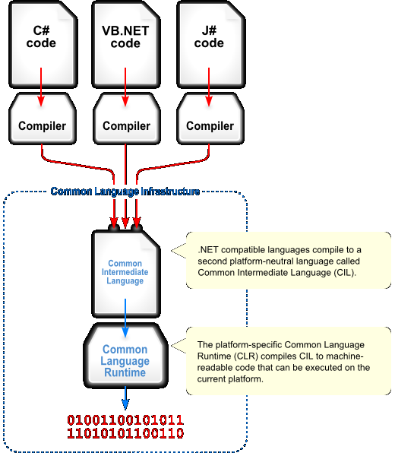
Common Language Infrastructure
Source: Jarkko Piiroinen

Slide 4
C# Syntax

Slide 5
Naming
naming conventions for different aspects of the language
based on naming used in .NET Framework
correct naming makes the code easier to read and understand

Slide 6
Naming
namespace – MyHttpNamespace
assembly – MyOwnAssembly
class – MyXmlClass
exception class – MyOwnException
interface – IMyInterface
properties – MyProperty
parameters and variables – myVariable
private/protected variables – _myVariable

Slide 7
Statements
basic unit of code
variable definition, method call, program control flow structure, object creation, assigning value to a variable…
usually terminated by semicolon
statement block
can be nested
limits the scope of variables defined within them

Slide 8
Example – statements and blocks
int myVar;
myVar = 5;
MyClass myInstance = new MyClass();
private void Method(int input)
{
int variableInsideAMethod = 5;
if (input == 5)
{
int limitedScopeVariable = 6;
Process(limitedScopeVariable);
}
}

Slide 9
Comments
allow inline documentation of the source code
ignored by the compiler
3 styles
single-line comments
begin with //
multi-line comments
start with /* and ends with */
all the text between the start and end is a comment
XML documentation comments
used for generating of XML documentation
single-line comments start with ///
multi-line comments start with /** and end with */

Slide 10
Example - comments
// this is a single-line comment
/*
This is another style of comment.
It allowes to type more lines of text inside a comment.
*/
/// <summary> some summary </summary>
/// <remarks>
/// This is a XML comment created using single-line comments.
/// </remarks>
/** <summary> some summary </summary>
<remarks>
This is a multi-line XML comment.
</remarks>
*/

Slide 11
Case sensitivity
C# is case sensitive for all language members
int myVar = 5;
int MyVar = 6;
// causes error during compilation
system.console.writeline("Hello");
// correct
System.Console.WriteLine("Hello");

Slide 12
Variables
used to store values
all variables must be declared with explicit type
class/instance variables
public, protected, internal, protected internal, private
local variables
parameters

Slide 13
Types
.NET contains many data types that can be used
C# internal data types are aliases for .NET data types
public void DeclaredWithAlias()
{
int i = 42;
}
public void DeclaredWithoutAlias()
{
System.Int32 i = 42;
}

Slide 14
Integer data types
C# type | .NET type | bits | range
sbyte | System.SByte | 8 | -128 to 127
byte | System.Byte | 8 | 0 to 255
short | System.Int16 | 16 | -32 768 to 32 767
ushort | System.UInt16 | 16 | 0 to 65 535
char | System.Char | 16 | Unicode characters from 0 to 65 535
int | System.Int32 | 32 | -2 147 483 648 to 2 147 483 647
uint | System.UInt32 | 32 | 0 to 4 294 967 295
long | System.Int64 | 64 | -9 223 372 036 854 775 808 to 9 223 372 036 854 775 807
ulong | System.UInt64 | 64 | 0 to 18 446 744 073 709 551 615

Slide 15
Floating point and other data types
C# type | .NET type | bits | Precision | range
float | System.Single | 32 | 7 places | 1,5⋅10⁻⁴⁵ to 3,4⋅10³⁸
double | System.Double | 64 | 15-16 pl. | 5,0⋅10⁻³²⁴ to 1,7⋅10³⁸
decimal | System.Decimal | 128 | 28-29 pl. | 1,0⋅10⁻²⁸ to 7,9⋅10²⁸
C# type | .NET type | bits | range
bool | System.Boolean | 32 | true/false not related to any integer number
object | System.Object | 32/64 | platform dependent (pointer to an object)
string | System.String | 16⋅length | Unicode string with no upper bound

Slide 16
Control structures
control program flow
conditional statements
if, switch
iteration statements
do, while, for, foreach
jump statements
break, goto, return, yeild

Slide 17
if
conditional statement
if ( „condition“ ) if-body [else else-body]
int a = 6;
if (a > 0)
{
System.Console.WriteLine(“Greater than zero“);
}
else if (a < 0)
{
System.Console.WriteLine(“Smaller than zero“);
}
else
{
System.Console.WriteLine(“Zero“);
}

Slide 18
switch
allows forking of code based on the value of control variable
switch(airplane)
{
case 747:
nickname = "Jumbo";
break;
case 777:
nickname = „Triple Seven";
break;
default:
nickname = „none";
break;
}

Slide 19
do
iteration statement
do „body“ while („condititon“)
int i = 0;
do
{
i++;
} while (i < 10);

Slide 20
while
while („condition“) body
int i = 0;
while (i < 10)
{
i++;
}

Slide 21
for
for („initialization“, „condition“, „iteration“) body
for (int i = 0; i <= 10; i++)
{
System.Console.WriteLine(i);
}

Slide 22
foreach
iteration through enumerable collection
string[] alphabet = {"Alpha", "Bravo", "Charlie"};
foreach (string item in alphabet)
{
System.Console.WriteLine(item);
}

