Slide 1
COMPONENT SOFTWARE DEVELOPMENT Lecture 10: Design patterns, part 2
Jiří Brožek
brozekj@pef.czu.cz

Slide 2
Facade
structural pattern
usage: when the subsystem becomes too complicated
on higher level provides unified interface to all interfaces of the subsystem
the client doesn‘t have to communicate with all the subsystems, but only with the facade that knows the structure of subsystems and relays the calls to particular receivers
WARNING: in this context the term „facade interface“ means the protocol of the facade – all facades must be implemented as classes!

Slide 3
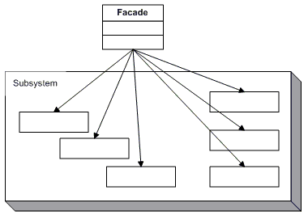
Facade

Slide 4
Facade – example
Facade
eg.: mortgage approval system
subsystem classes
implement subsystem functionality
execute operations delegated to them by the facade
they neither don‘t know about facade‘s existence nor have any links to it
eg.: different departments of a bank

Slide 5
Composite
structural pattern
allows creating tree-like „part-whole“ hierarchy comprising of simple and composed objects
composed object = collection of objects where each object can be either simple or composed object
starting node (the root)
contains references to its children:
simple objects (leaves)
composed objects (branches)
pre-requisite: there must be an unified interface for both simple and composed objects

Slide 6
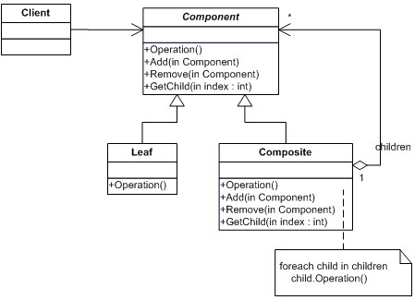
Composite – Skladba

Slide 7
Composite – example
root: computer
leaves: particular undividable components (monitor, mouse, keyboard, memory, hard drive, graphics card, motherboard, power supply, …)
computer
monitor
keyboard
mouse
computer case
motherboard
graphics card
memory
…

Slide 8
State
behavioral pattern
change of object‘s behavior based on change of its internal state
classes encapsulating different behavior
object knows its current state and uses its methods
to work correctly, all the states must have the same protocol
the pattern is not responsible for state changes

Slide 9
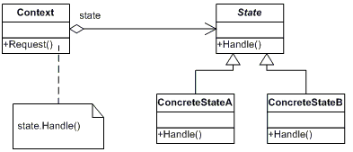
State – Stav

Slide 10
Strategy
behavioral pattern
pre-requisite for its application is existence of more than one approach to solving a problem
strategies (objects) have the same protocol
the context object contains reference to one of the strategies
usual behavior:
choose the strategy
client assigns the strategy to the context object
client communicates with the context object only
the Strategy pattern should only be used when its result is directly linked to the client responsible for choosing the strategy

Slide 11
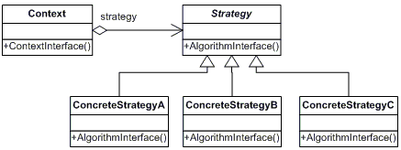
Strategy

