Slide 1
COMPONENT SOFTWARE DESIGN Lecture 1: Introduction to the Object-Oriented Paradigm
Jiří Brožek
brozekj@pef.czu.cz

Slide 2
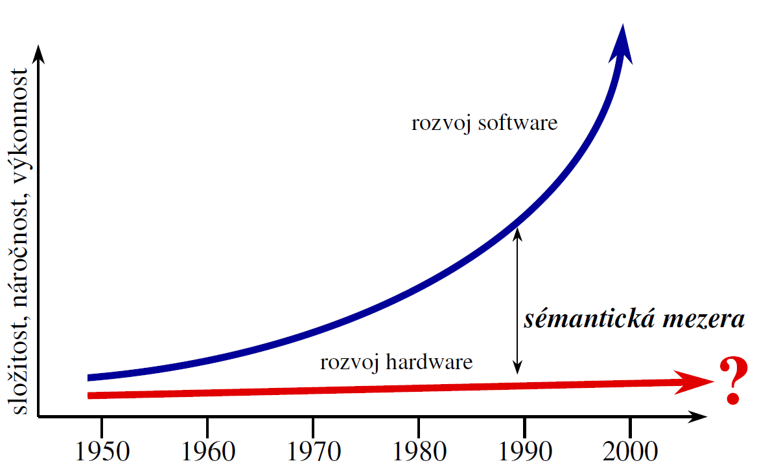
In the beginning… The Semantic Gap
Complexity, performance
Software Evolution
SEMANTIC GAP
Hardware Evolution
Source: Merunka V. – lectures in Object Methods and Techniques

Slide 3
Introduction
„classic“ programming
sequence of commands
procedural programming
object-oriented programming (OOP)
hidden data
methods
object cooperation

Slide 4
Basic terms of the OOP
inheritance
object
class
encapsulation
method
message passing
polymorphism
abstraction
Deborah J. Armstrong: The Quarks of Object-Oriented Development.

Slide 5
Object
„entity“ containing data and behavior
identity
distinguishes one object from another
state
describes data part of an object
behavior
describes methods bound to the object‘s protocol
protocol = set of all messages that can be send to an object invoking some of its behavior

Slide 6
Encapsulation
related to data
all the data inside an object are invisible to the outer world
data can be made accessible using „accessor methods“
so called getters/setters
static vs. dynamic data

Slide 7
Class
„template“ for object creation
defines state and behavior parts of an object
instance variables contain data ⇒ state
methods ⇒ behavior
Instance
an object created using the „template“
for example
Student class – describes common properties and behavior of all students
instance of the Student class – anyone of you

Slide 8
Polymorphism
polys + morphé = many + shapes/forms
multiple form of polymorphism
ad-hoc polymorfismus
method can work with arguments of different type
method/operator overloading
parametric polymorphism
method is coded without dependency on particular type
templates in C++, generics in C# or Java
subtype polymorphism

Slide 9
Subtype polymorphism
ability of a subtype to react to the same messages as the supertype
Liskov substitution principle
if S is a subtype (subclass) of T, then any instance of type S can substitute instance of the type T without changing the functionality of the program
implemented using inheritance

Slide 10
Polymorphism – another point of view
the ability of two or more different object to react to the same message
3 types
classic
objects A and B receive message m from object X and both react to it
state (different states of one object)
object X sends message m to object A in different points in time and object A reacts according to its current state
subjective
object X receives message m from objects A and B a X reacts differently for each sender

Slide 11
Inheritance
object can be based on another existing object
allowes code segmentation and reusability
„classic“ inheritance
object is defined by class, class inherits from another class
Inheritance between objects
object inherits from another object
superclass, base class
parent – class we inherit from
Subclass
child – class that inherits from another

Slide 12
Methods & Message Passing
Method
part of object‘s behavior
visible vs. hidden
can implement dynamic data part of an object
can make a static data accessible (getter/setter)
executable from outside the object only if it is bound to a message contained in the object‘s protocol

Slide 13
Abstraction
abstraction = looking for common properties or features
generic (abstract) classes
generic „interfaces“
Usage
more complex class hierarchies
definition of behavior common for more than one class
…

