Slide 1
COMPONENT SOFTWARE DEVELOPMENT Lecture 9: Design patterns, part 1
Jiří Brožek
brozekj@pef.czu.cz

Slide 2
Design pattern
solution to a problem in software design
description of a solution or template
→ not a library or source code

Slide 3
Classification of design patterns
creational
solve problems with object creation
structural
aimed on class or module structure of the system
the goal is to make the code more comprehensible and better structured
behavioral
related to the behavior of the system

Slide 4
Singleton
the simplest design pattern
the aim is to make sure that only one instance of a class exists and provide means for working with it
instantiated only once
private or protected parameterless constructor
instance only accessible via static method
cannot be used for inheritance
many ways of implementation – be careful, some may be thread unsafe!

Slide 5

Singleton

Slide 6
Singleton
public sealed class Singleton
{
private static Singleton _singleton;
private Singleton() {} // private constructor
public static Singleton GetInstance()
{
if (_singleton == null) // lazy instantiation
{
_singleton = new Singleton();
Console.WriteLine ("Singleton instantiated");
}
return _singleton;
}
}

Slide 7
AbstractFactory
creational pattern
encapsulates family of similar „factories“ for creating a family of objects

Slide 8
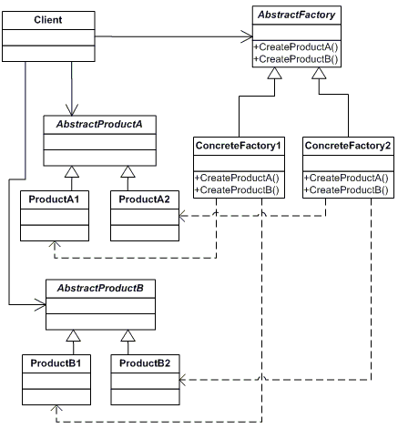
AbstractFactory

Slide 9
Adapter
structural pattern
changes protocol of a class to one expected by the system

Slide 10
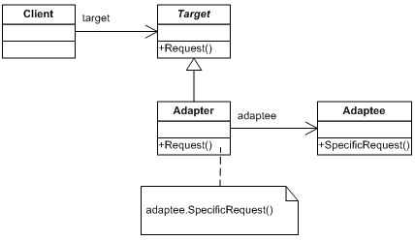
Adapter

Slide 11
Adapter - Adaptér
class Target
{
public virtual void Request()
{
Console.WriteLine("Target Request()");
}
}
class Adapter : Target
{
private Adaptee _adaptee = new Adaptee();
public override void Request()
{
_adaptee.SpecificRequest();
}
}
class Adaptee
{
public void SpecificRequest()
{
Console.WriteLine("Adaptee SpecificRequest()");
}
}

Slide 12
Decorator
structural pattern
dynamicaly adding more features to an existing object
alternative to creating subtypes

Slide 13
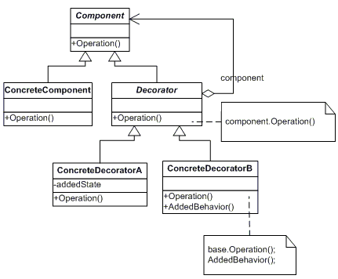
Decorator

