Slide 1
Lecture 8
Usability testing and UI lab

Slide 2
Usability testing
According to Jakob Nielsen Usability test metrics we try to test UI:
  Learnability: How easy is it for users to accomplish basic tasks the first time they encounter the design?
  Efficiency: Once users have learned the design, how quickly can they perform tasks?
  Memorability: When users return to the design after a period of not using it, how easily can they reestablish proficiency?
  Errors test: How many errors do users make, how severe are these errors, and how easily can they recover from the errors?
  Subjective Satisfaction: How pleasant is it to use the design?
Source:http://www.nngroup.com/articles/usability-101-introduction-to-usability/

Slide 3
Usability lab testing
Lab usability tests measure a user’s ability to complete tasks.
In a typical usability test the user attempts to complete a task or set of tasks to using product (software or a product):
  Software testing
  Package testing (open the box with goods and try to use that)
Source: http://www.kaushik.net/avinash/lab-usability-testing-what-why-how-much/

Slide 4
Usability lab testing
A typical study will have approx. eight to twelve participants.
Lab tests are conducted by usability researchers.
Tests can be conducted with live version of the software, beta versions, on-screen HTML, PowerPoint prototypes or with paper printouts.

Slide 5
Usability lab architecture
Specially designed room for Usability testing is called a usability lab.
The lab is split into two rooms that are divided by a one-way mirrored window
that allows observers to watch the test without being seen by the test subject.
It's problematic...

Slide 6
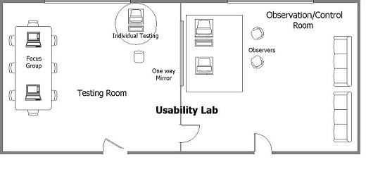
Usability lab

Slide 7
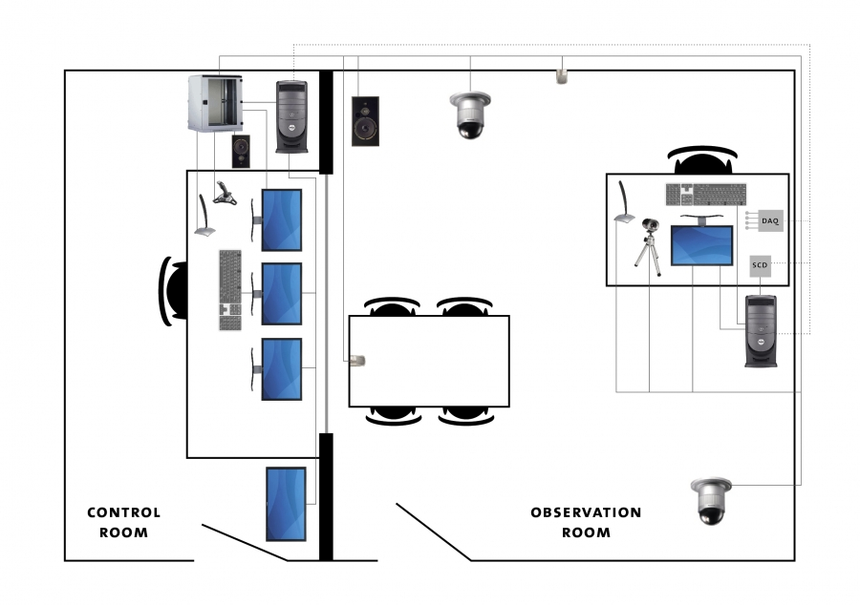
Usability lab

Slide 8
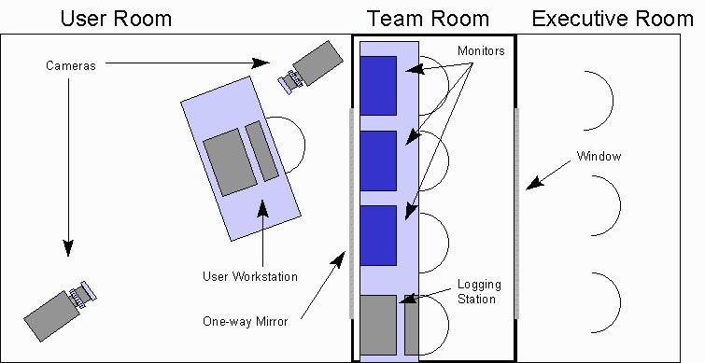
Usability lag

Slide 9
Conventional UI lab problems
During the use of conventional UI Lab we gained a lot of problems:
  Small test capacity (during one session we can test only one – two participants)
  Time consuming test (to test 12 participants consumes approx. 3 months of work)
  Thanks time consuming test is the benefit gained from UI testing delivered very lated (customer don't want to wait so long)
  To hire study participants is problematic (consumes time)

Slide 10
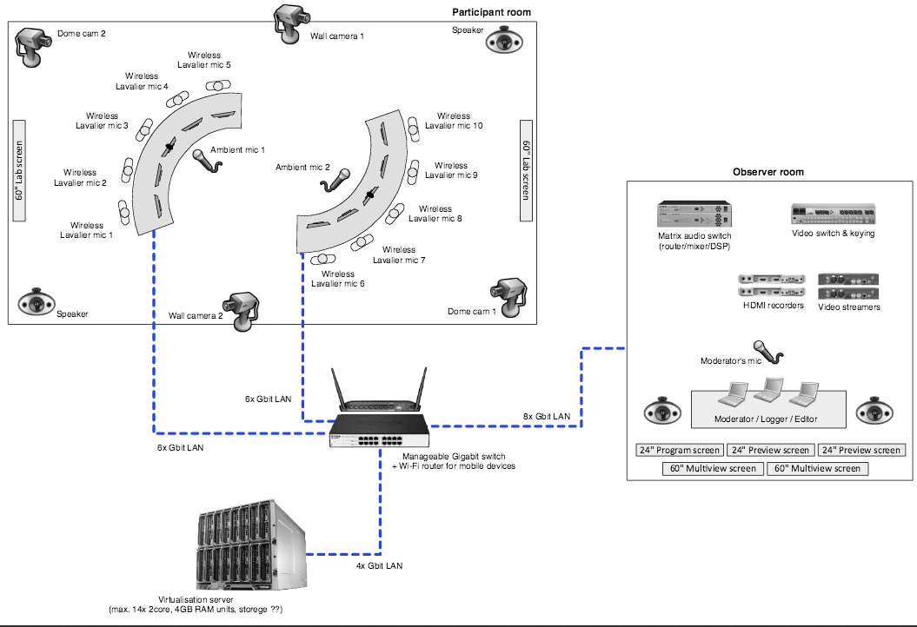
Collaborative lab design

Slide 11
Collaborative lab
Reduces time necessary for one study
Study can be transmitted via internet TV streams to the stakeholder just in time
All tests are recoding, is possible to switching between participants
BENEFIT #NO1:
  We can test the UI in the real collaborative environment, that is more close the working teams reality, than conventional UI Lab

Slide 12
UI Test scenario example
Visit main processes page and try to open model (Study Request). Follow the processes steps:
  Learnability test:
  According to the model try to describe(Learnability test). How can study applicant achieve the main goal:
    Which steps must be completed for successful application?
    Which steps are mandatory?
    Which steps must be finished by order?
    Which steps can be finished unordered?
    How many external actors contribute into the process?

Slide 13
UI test scenario example
Visit main processes page and try to open model (Study Request). Follow the processes steps:
  Efficiency test
  According to the model try describe:
    Which steps must be done by study department for study application of applicant arriving from other university during first year of magister study?
    Which steps must be ordered?
    Which steps can be done unordered?
    How many actors are affected via this request?

Slide 14
UI test scenario example
Visit main processes page and try to open model (Study Request). Follow the processes steps:
  Memorability test (must be done at the end of test)
  According to the process highlight the main steps, which must be done ordered:
    Highlight core process activity.
    Is the activity core for applicant and study department to?
    Or importance of activities is different according to point of view of applicant and study department?

Slide 15
UI test scenario example
Visit main processes page and try to open model (Study Request). Follow the processes steps:
  Errors test
  This test is done by research team.
    During the participant work the usability observers checks tasks and notes all errors during the test.
    This errors must be noted, because after the study must be completed participant interview accorded found errors.
    Number of errors will be important for calculation of quality UI

Slide 16
UI test scenario example
Visit main processes page and try to open model (Study Request). Follow the processes steps:
  Subjective Satisfaction Test
  During the errors interview the observer asks participant, which task was difficult for accomplish the goal.
  We can suppose, there exists close correlation between number of errors and participant satisfaction.

Slide 17
UI test report
Finally the study is necessary to prepare UI test report. This report contains:
  List of founded UI bugs.
  List of gained recommendations.
  List of suggestion what should be improved or do better.
  List of task involved for other study.

Slide 18
UI lab visit
Let's to go to the lab!

