Slide 1
System Dynamics
1st lecture

Slide 2
Why Systems Thinking?
Many real-world problems are complex:
Traffic congestion
Economic cycles
Healthcare systems
Climate change
Linear solutions often fail.

Slide 3
Characteristics of Complex Systems
Many interacting elements
Feedback loops
Delays between cause and effect
Nonlinear relationships
Unintended consequences

Slide 4
What is System Dynamics?
A method for understanding complex systems over time.
Developed by Jay W. Forrester at MIT.
Focus:
System structure
Feedback loops
Simulation

Slide 5
Key Concepts
Systems
Feedback loops – R/B
Stocks and flows – Changes over time
Delays
Dynamic behavior – modeling systems

Slide 6
Reinforcing Feedback Loop
Reinforcing loops produce growth or decline.
Example:
more customers → more recommendations → more new customers
This creates a self-reinforcing cycle.
Examples in practice:
diffusion of innovations
growth of social networks
viral marketing
These loops often produce exponential growth/decay.

Slide 7
Balancing Feedback Loop
Balancing loops work in the opposite way. They stabilize the system.
Example:
more customers → greater workload for employees → lower service quality → fewer recommendations
The system therefore tends to move toward equilibrium.
Examples include:
thermostats regulating temperature
inventory management
market price adjustments

Slide 8
Change over time
Stock = accumulated quantity
Example: number of customers
Flow = processes changing stocks
Example: new customers, lost customers

Slide 9
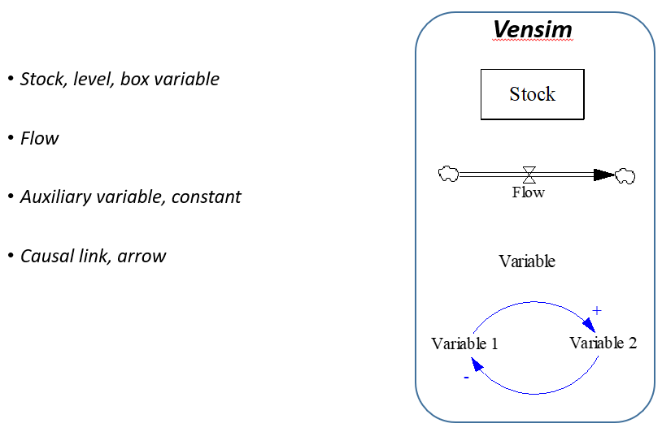
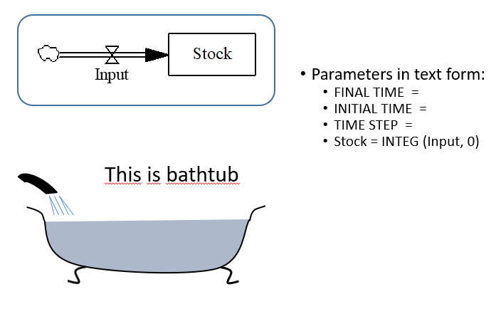
Stock and Flow Diagram

Slide 10
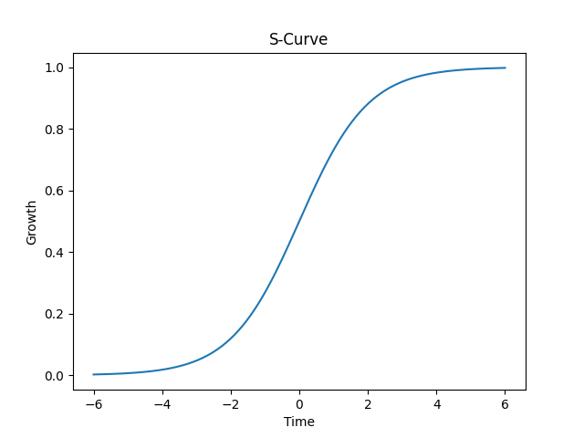
S-Curve of Growth

Slide 11
Stages of S-Curve
1. Early stage – slow growth
2. Rapid growth – reinforcing loops dominate
3. Slowing growth – balancing loops appear
4. Saturation – limits to growth

Slide 12
Delays in system
Another important concept is time delay.
A delay occurs when the consequences of a decision appear only after some time.
Examples:
marketing campaigns influence sales after several weeks
education affects economic productivity after many years
infrastructure investments take years to produce results
Delays often make systems difficult to manage, because decision-makers may not immediately see the consequences of their actions.

Slide 13
Modeling systems
System dynamics uses models to represent and analyze systems.
Two common types of models are used.
CLD and SFD

Slide 14
CLD
Causal loop diagrams
Causal loop diagrams visualize relationships between variables.
Example:
Marketing → Customers → Recommendations → Customers
These diagrams help reveal the structure of a system.

Slide 15
Stock and flow diagram
Simulation models
The next step is building computer simulation models.
These models allow researchers and managers to:
test strategies
explore future scenarios
evaluate policy decisions
Common tools used in system dynamics include:
Vensim
Stella
AnyLogic

Slide 16
CLD vs SFD
CLD | SFD
shows relationships between variables | models change over time
conceptual model | quantitative model
uses feedback loops | uses stocks and flows
does not use equations | contains mathematical equations
suitable for discussion | suitable for simulation

Slide 17
Traffic Congestion Example
More roads → faster traffic → more people drive → congestion returns.
Example of induced demand.

Slide 18
Student Activity
Discuss in groups:
What variables influence congestion?
What feedback loops exist?
Why do simple solutions fail?

Slide 19
Applications of SD
Business strategy
Marketing diffusion
Public policy
Urban planning
Environmental systems

Slide 20
The Beer Game (MIT Simulation)
Classic supply chain simulation.
Participants:
• Retailer
• Wholesaler
• Distributor
• Factory
Demonstrates:
• delays
• demand amplification (bullwhip effect)
• importance of system thinking
Notes:
The beer distribution game (also known as the beer game) is an educational game that is used to experience typical coordination problems of a supply chain process. It reflects a role-play simulation where several participants play with each other. The game represents a supply chain with a non-coordinated process where problems arise due to lack of information sharing.^{[1]} This game outlines the importance of information sharing, supply chain management and collaboration throughout a supply chain process. Due to lack of information, suppliers, manufacturers, sales people and customers often have an incomplete understanding of what the real demand of an order is. The most interesting part of the game is that each group has no control over another part of the supply chain. Therefore, each group has only significant control over their own part of the supply chain. Each group can highly influence the entire supply chain by ordering too much or too little which can lead to a bullwhip effect. Therefore, the order taking of a group also highly depends on decisions of the other groups.^{[2]}

Slide 21
Key Takeaway
System behavior emerges from structure.
Feedback loops and delays shape dynamics.

