Slide 1
Operation Research and System Analysis
Systems dynamics III

Slide 2
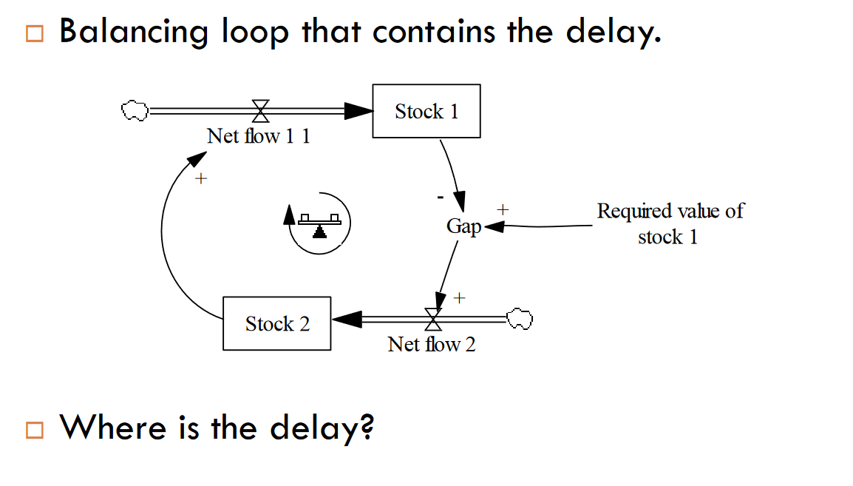
Simple oscillator

Slide 3
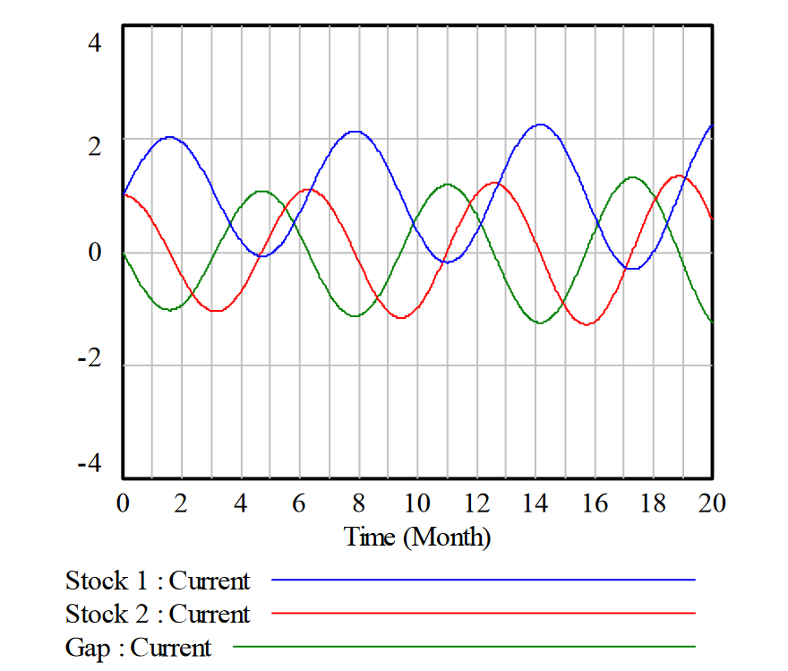
Simple oscillation

Slide 4
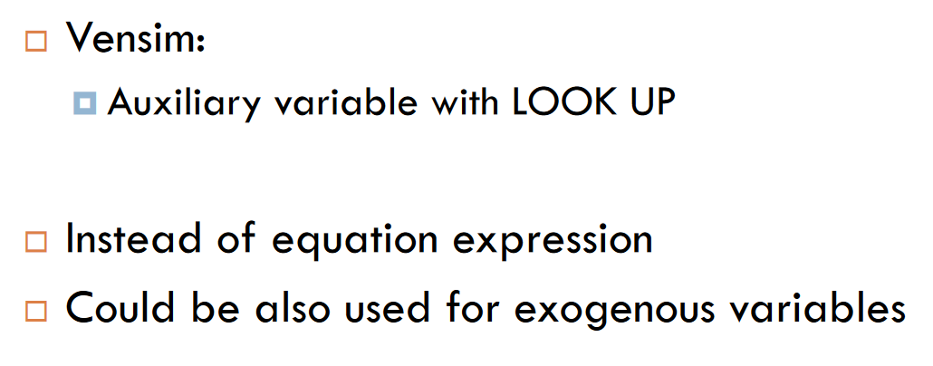
Graphical function

Slide 5
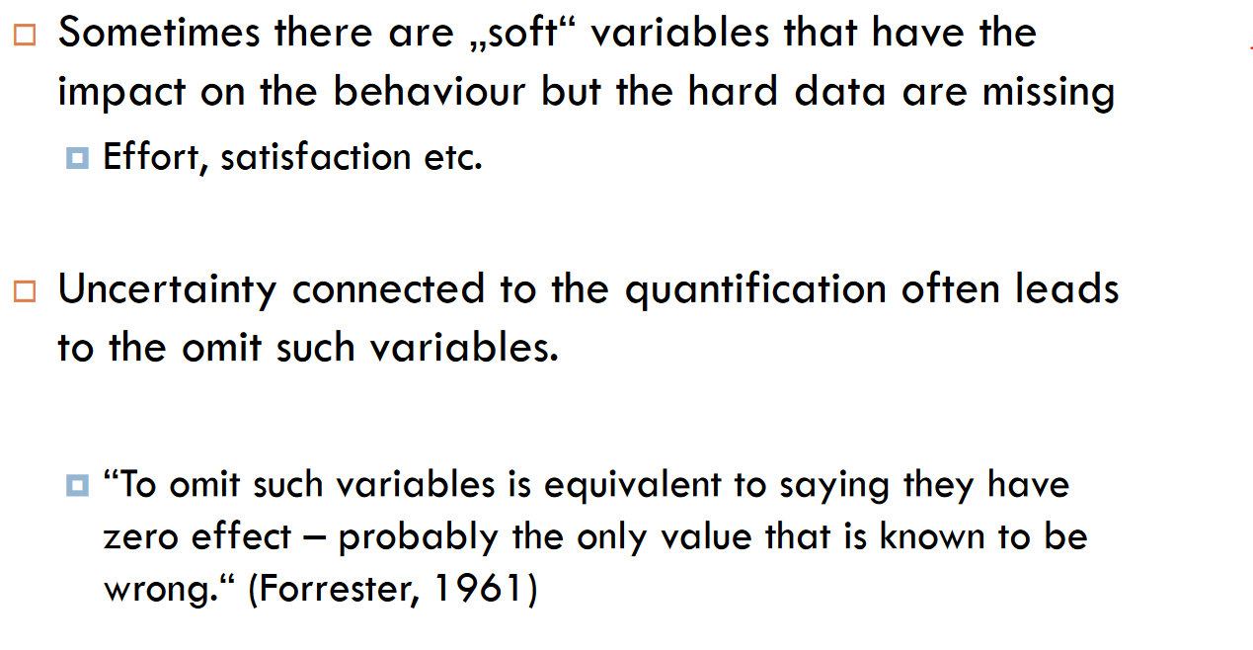
Graphical function – soft variables

Slide 6
Task 2.1
In year 1500, the global population was approximately 458 million people. 580 million people in 1600, 682 million people in 1700, 978 million people in 1800, 1650 million people in 1900, 5978 million people in 2000, and 7758 million people in 2020.
Use a <time> shadow variable and a LookUp variable that will contain the real data.
Build a simple model (Popul1) in Vensim with a net population increase and an annual growth rate equal to 0.54%.
dt = 0.125
Compare the progress.

Slide 7
Task 2.2
Combining multiple facts into a single stream (such as births and deaths) is generally considered bad practice
Popul2:
Divide birth and death into two streams.
Use an annual birth rate of 0.031 and an average life expectancy of 35 years.
Run the simulation, if the progress until 1800 is OK, proceed to the next step.

Slide 8
Task 2.3
Popul3:
Depending on the time, change the life expectancy:
35 by 1800, then increases linearly to 50 in 1950 and 70 in 2000.

Slide 9
Task 2.4
Popul4:
Create a very simple model of world wealth
For simplicity, we express wealth using GDP
And we'll use a state variable for that.
For the future, remember that both of these approaches are wrong.
In 1500 world wealth was $430 billion (in 2011 prices)
Build a simple reinforcing loop with a GDP growth rate of 1.075% (for reference, in 2015 world wealth was approximately $108.12 trillion)

Slide 10
Task 2.4
Build a simple reinforcing loop with a time-dependent GDP growth rate (varying linearly between the following points):
1500: 0.07%
1820: 0.6%
1950: 2.5%
1980: 6%
1990: 2%
2021: 5%

Slide 11
Task 2.4
Now relate the birth rate to GDP
Create a GDP per capita variable
Transform the birth rate again into a graphical function dependent on GDP per capita:
HDP per capita | Birth rate
0.440367 | 0.028819
1.22324 | 0.032
1.89602 | 0.0307
20 | 0.0307

Slide 12
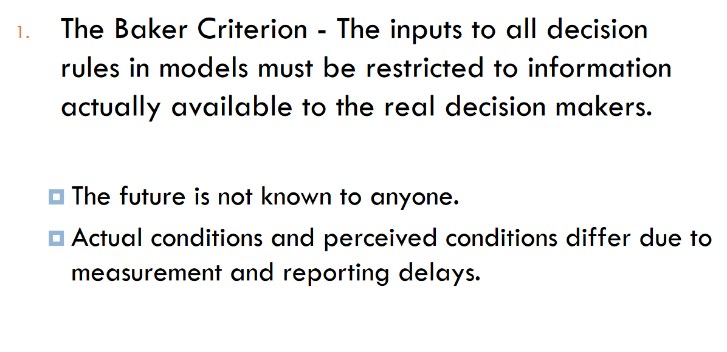
SD modelling - decision making

Slide 13
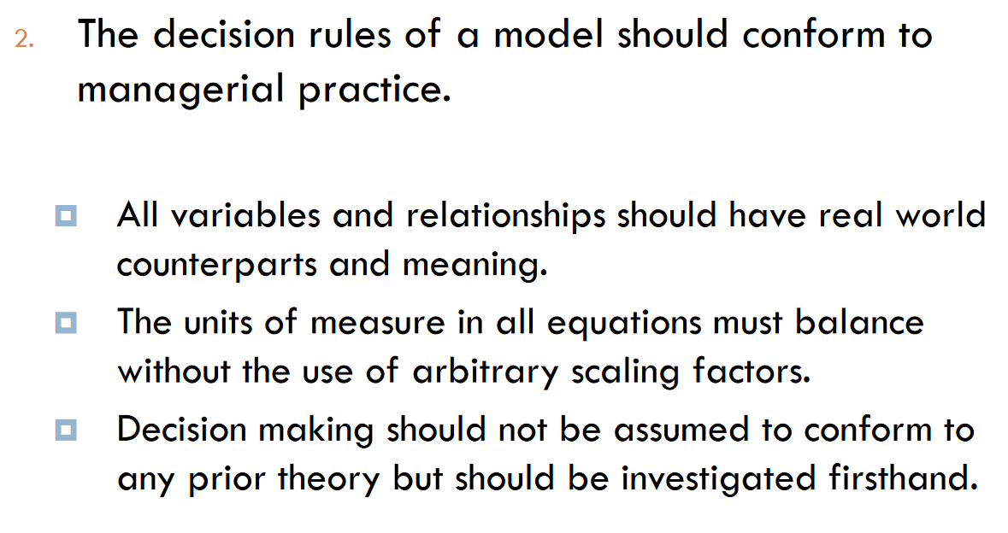
SD modelling - decision making

Slide 14
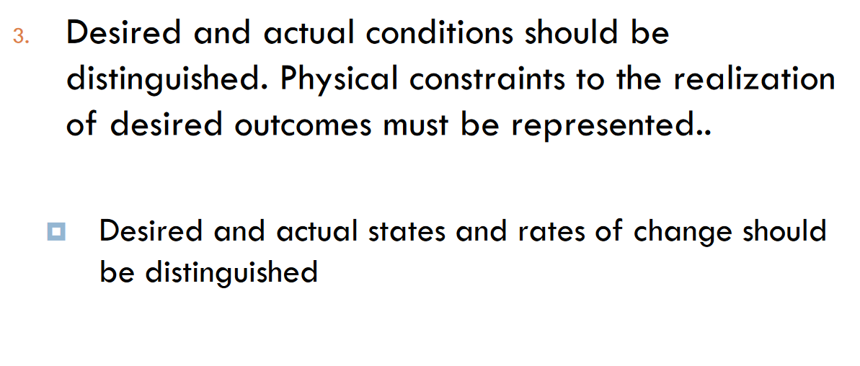
SD modelling - decision making

Slide 15
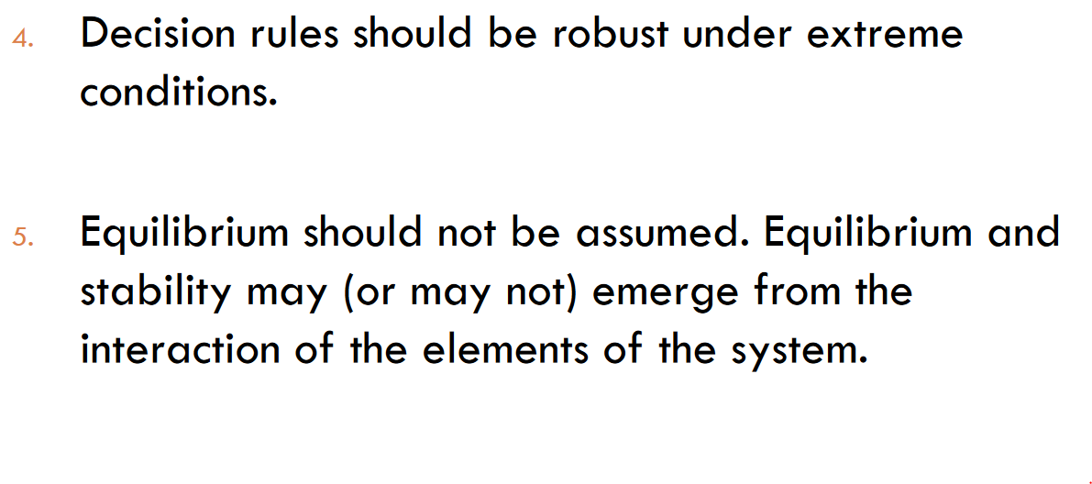
SD modelling - decision making

Slide 16
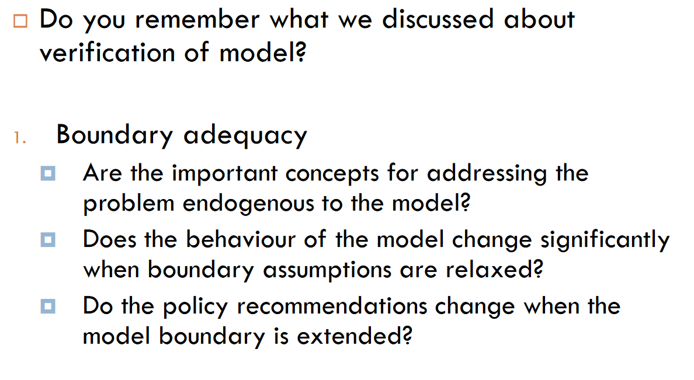
Testing the model

Slide 17
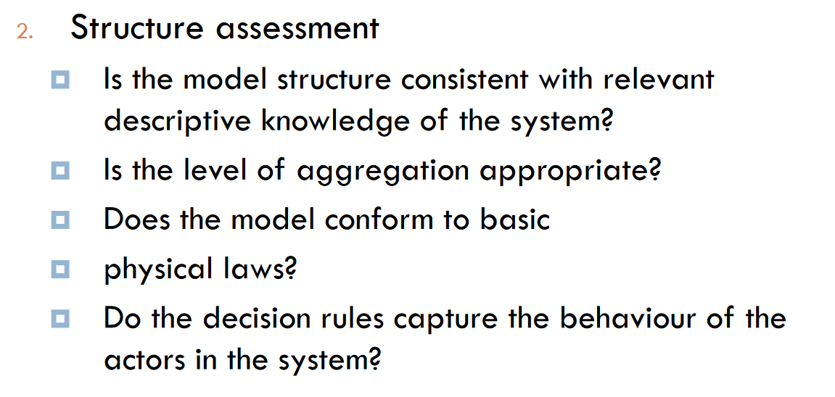
Testing the model

Slide 18
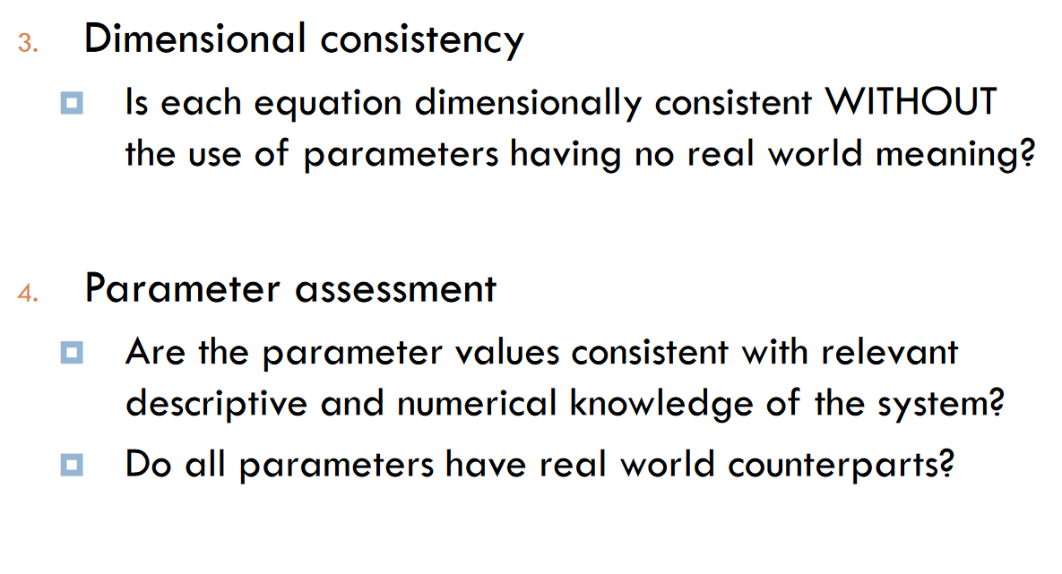
Testing the model

Slide 19
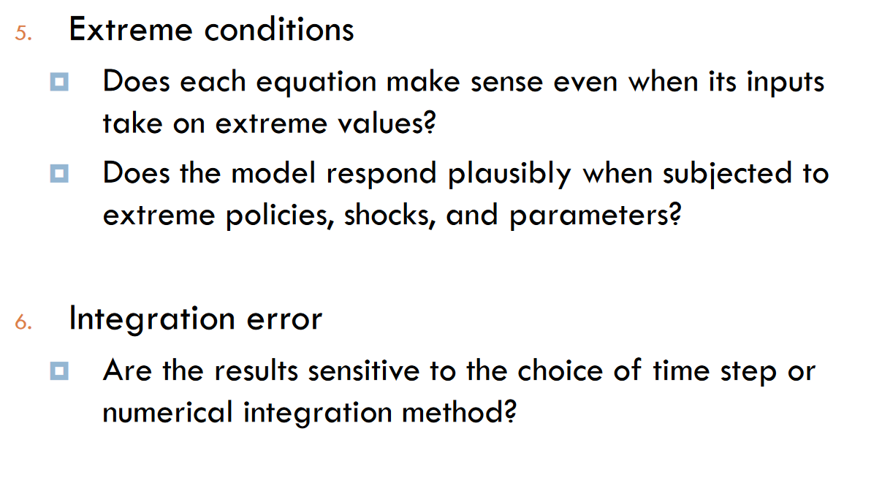
Testing the model

Slide 20
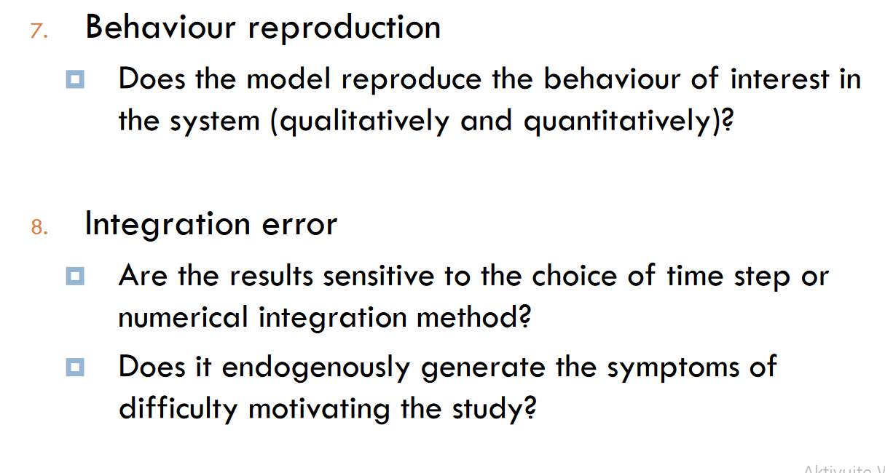
Testing the model

Slide 21
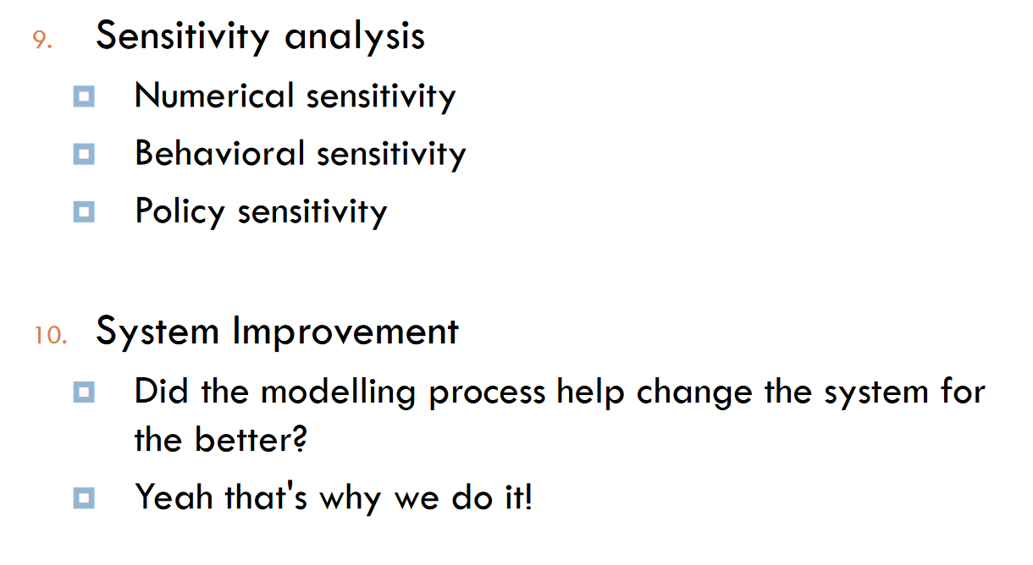
Testing the model

Slide 22
Thank you for your attention.

