Slide 1
Random Forest
by Sachin Sharma
Unrestricted

Slide 2
Decision Tree Vs Random Forest
Decision Tree
Decision support tool that uses a tree-like model of decisions and possible consequences.
There is a possibility of overfitting of data.
Gives less accurate results.
Simpler and easier to understand, interpret and visualize.
Random Forest
An ensemble learning method that operates by constructing multitude of decision trees at training time and outputting the class depending on the individual trees.
Reduces risk of overfitting.
Gives more accurate results.
Comparatively more complex.

Slide 3
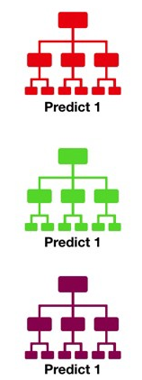
Random Forest
A | B | F | G | H
a1 | 1 | F1 | 12 | Y
a2 | 2 | F2 | 23 | N
a7 | 7 | F6 | 65 | Y
A | B | C | D | E | F | G | H
a1 | 1 | C1 | .0 | 11 | F1 | 12 | Y
a2 | 2 | C2 | .1 | 22 | F2 | 23 | N
a3 | 3 | C3 | .2 | 33 | F3 | 4 | Y
a4 | 4 | C1 | .3 | 44 | F4 | 45 | Y
a5 | 5 | C2 | .4 | 22 | F5 | 45 | N
a6 | 6 | C4 | .3 | 33 | F6 | 46 | N
a7 | 7 | c3 | .2 | 24 | F6 | 65 | Y
A | F | G | H
a1 | F1 | 12 | Y
a5 | F5 | 45 | N
a6 | F6 | 46 | N
a7 | F6 | 65 | Y
A | B | C | H
a5 | 5 | C2 | N
a6 | 6 | C4 | N
a7 | 7 | c3 | Y

Slide 4
Random Forest…
Used for both Classification and Regression
Combined wisdom of all weak models
Uses Voting, Average and Weighted Average of all models to predict

