Slide 1

Hotel Management System API
A RESTful backend solution built with ASP.NET Core Web API (.NET 8) — powering hotel operations through clean architecture, robust data management, and scalable design.
ASP.NET CORE 8
EF CORE
SQL SERVER
SWAGGER UI
REPOSITORY PATTERN
Group 6-
Aditya Bharadwaj
Shivansh Agrawal
Chitresh Malhan
Jasnoor
Himanshu

Slide 2
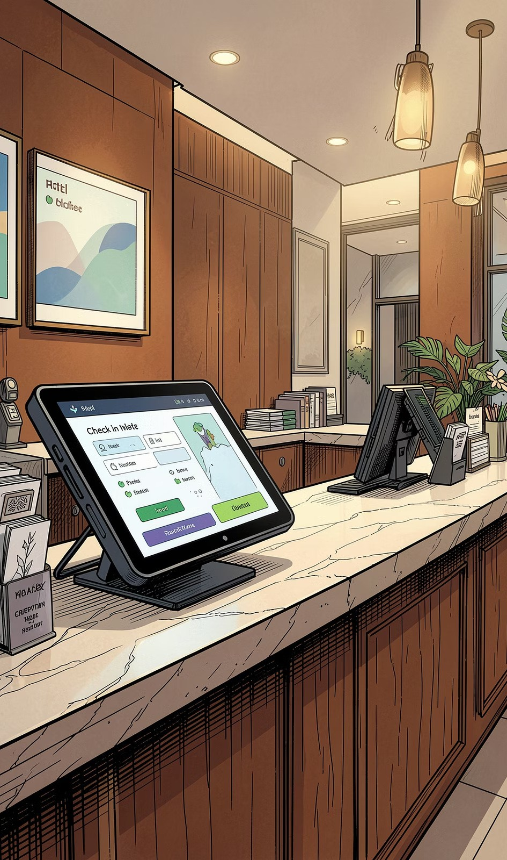
Project Overview
The Problem
Manual hotel operations are error-prone, slow, and difficult to scale. Fragmented systems for rooms, reservations, and payments create data silos and poor guest experiences.
The Solution
A centralized REST API that automates hotel management — from room inventory and amenities to reservations, payments, and guest reviews — with a clean, layered architecture.
Core Objectives
Full CRUD operations across all hotel entities Search and filter capabilities for hotels and rooms Structured validation and consistent error handling Swagger-based API documentation and testing

Slide 3
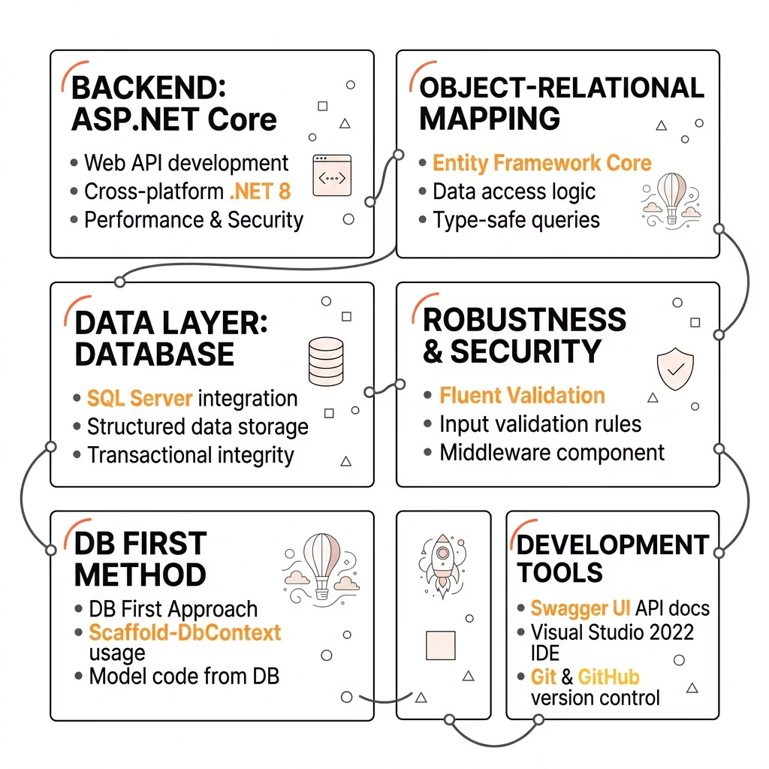
Technology Stack
Key Design Decisions
DB First Approach
Database designed first, then scaffolded into EF Core models using Scaffold-DbContext — ensuring schema-driven development.
Repository + Service Pattern
Separates data access from business logic, improving testability and maintainability across the codebase.
Swagger UI
Auto-generated interactive API docs — enabling live testing without Postman or external tools.

Slide 4
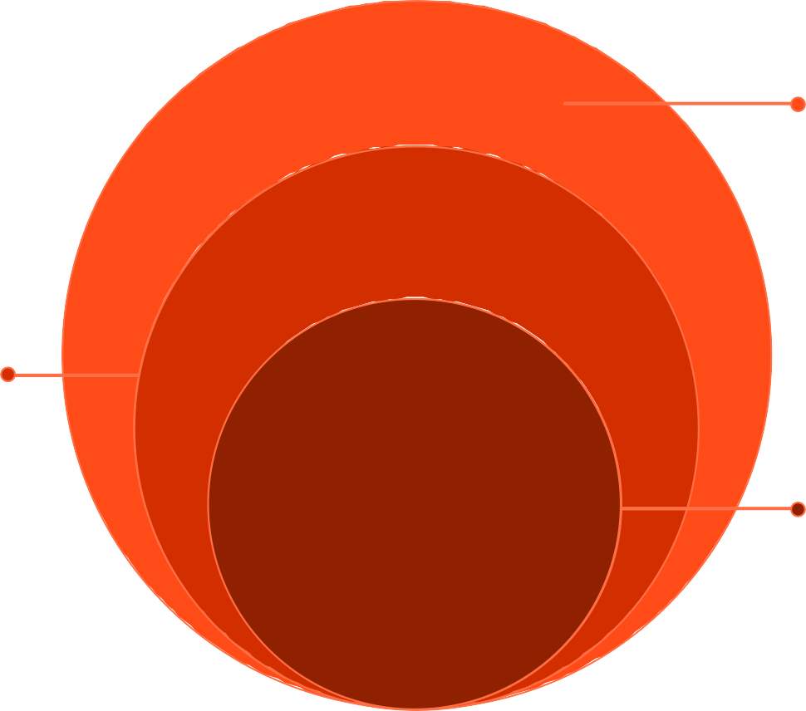
System Architecture
A strict layered architecture ensures separation of concerns, testability, and clean boundaries between each responsibility in the system.
Application Surface
API controllers and service layer enforce rules
Data Access
DbContext and repositories abstract EF
Core
Core Persistence
SQL Server for relational storage
Each layer communicates only with its immediate neighbor — controllers never touch the database directly, and repositories never contain business rules. This makes unit testing straightforward and the system easy to extend.

Slide 5
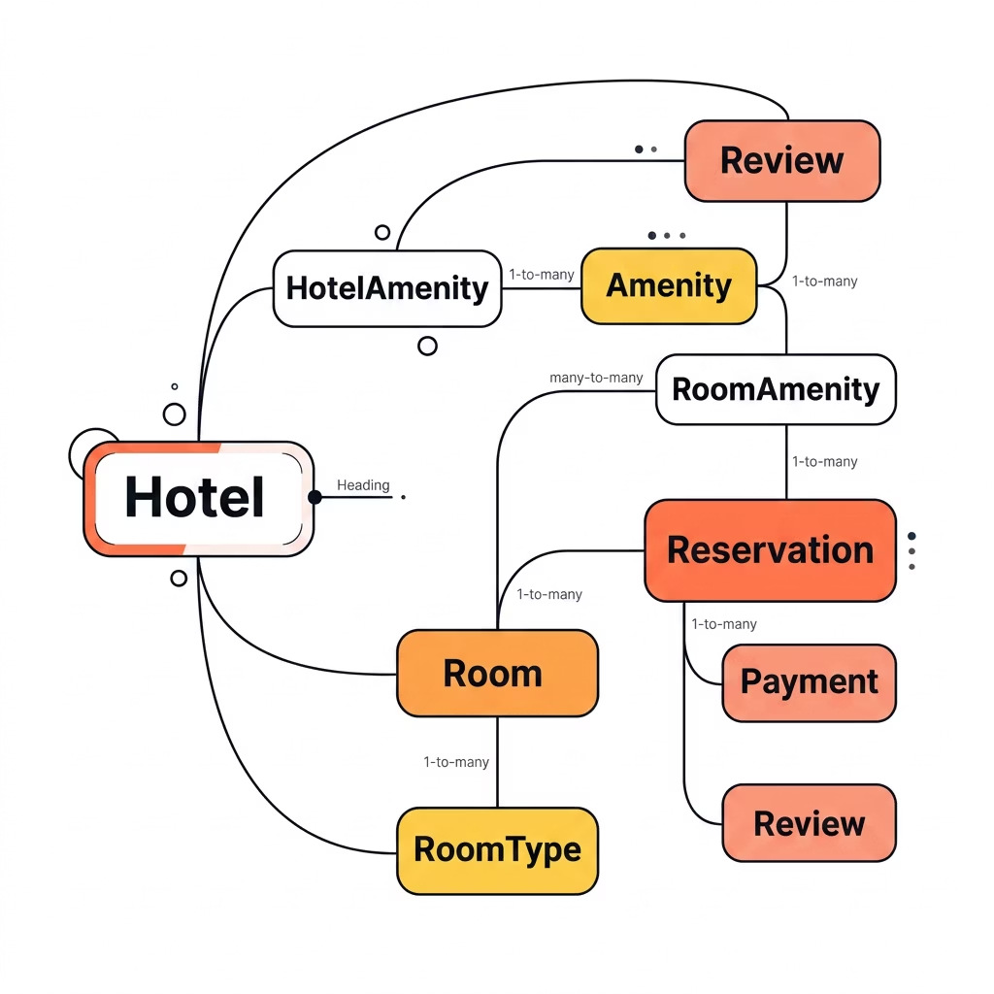
Database Design
Core Entities
Hotel & Room
Hotel stores location, rating, and contact.
Room tracks number, type, price, and availability.
Amenities
HotelAmenity and RoomAmenity junction tables resolve many-to-many relationships cleanly.
Reservation & Payment
Reservations link guests to rooms with date ranges. Payments track status: Pending, Completed, Refunded.
Review
Guest feedback tied to reservations, enabling verified review data per hotel.

Slide 6
Hotel Module APIs
The Hotel module exposes a complete RESTful interface for managing hotel records, including search and filtering capabilities.
GET /api/hotels
Retrieve all hotels with optional pagination.
GET /api/hotels/{id3
Fetch a single hotel by its unique identifier.
POST /api/hotels
Create a new hotel record with validated DTO payload.
PUT /api/hotels/{id3
Fully update an existing hotel's details.
DELETE /api/hotels/{id3
Remove a hotel — with cascade rules enforced.
GET /api/hotels/search
Search by location, name, or rating using query parameters.

Slide 7
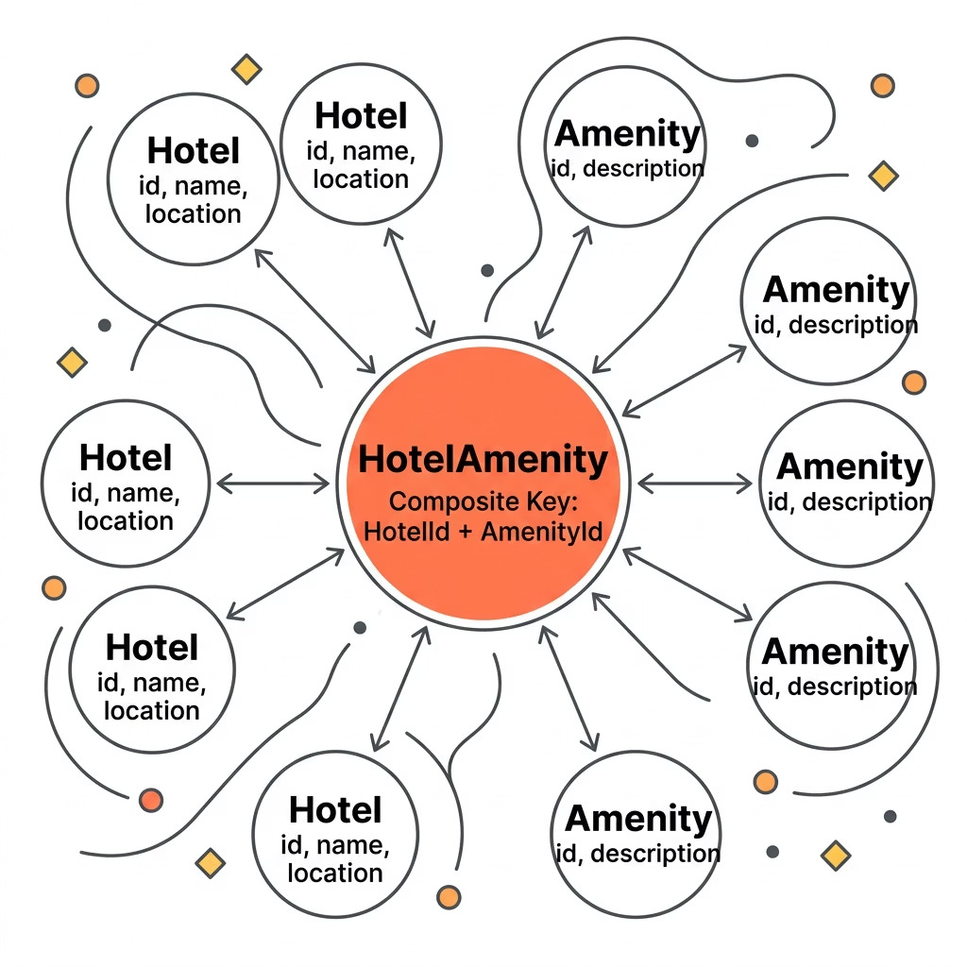
Hotel Amenity Module APIs
Many-to-Many Relationship Handling
Amenities are shared across hotels. The HotelAmenity junction entity resolves this relationship, enabling flexible assignment and querying from either direction.
GET
/api/hotelamenities
List all hotel-amenity assignments.
POST
/api/hotelamenities
Assign an amenity to a hotel.
DELETE
/api/hotelamenities
/{hotelId3/{amenityI d3
Remove a specific hotel-amenity link.
GET
/api/hotelamenities
/hotel/{hotelId3
Get all amenities for a hotel.
GET
/api/hotelamenities
/amenity/{amenityI d3/hotels
Find all hotels offering a specific amenity.

Slide 8
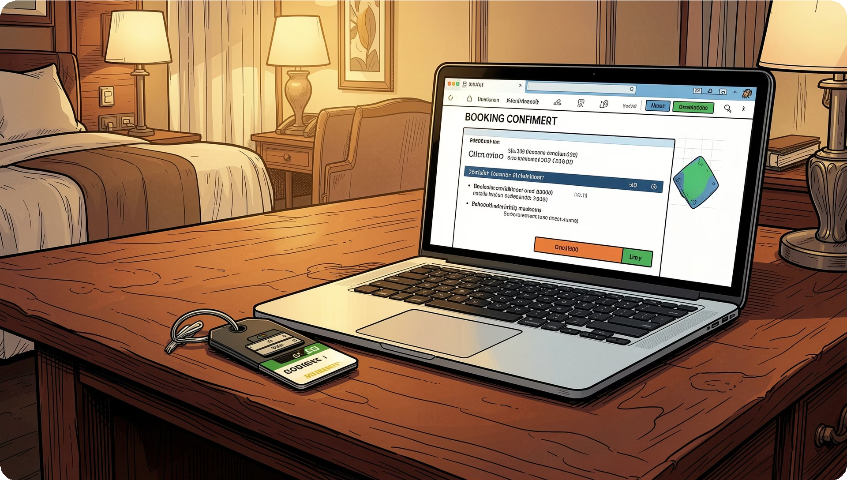
Reservation & Payment Modules
Reservation Workflow
01
Check Availability
Validate room availability for requested date range.
02
Create Reservation
Persist reservation linked to Room and guest details.
03
Process Payment
Record payment with status: Pending → Completed / Refunded.
04
Confirm Booking
Return confirmed reservation with payment reference.

Slide 9

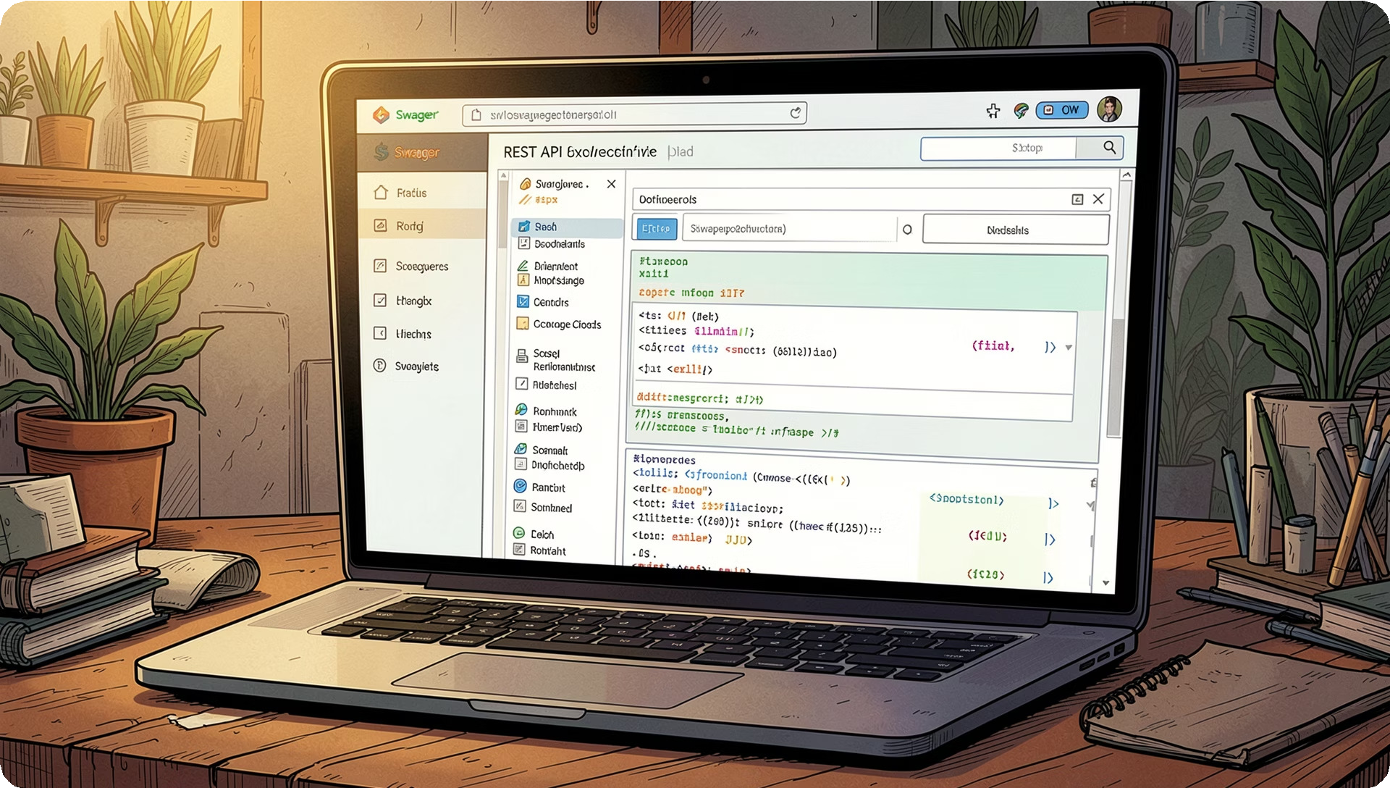
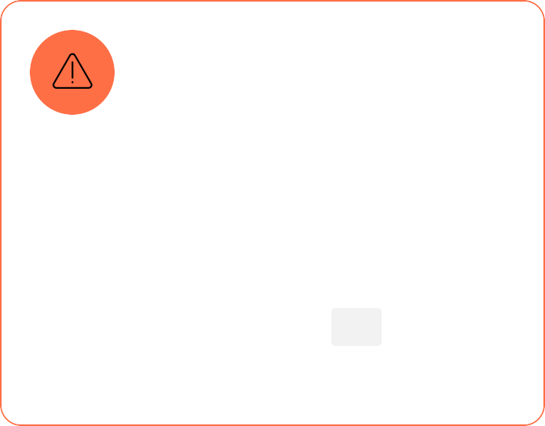

Validation, Error Handling & Swagger Testing
Validation & Middleware
Fluent Validation
DTOs validated before reaching service layer. Returns 400 Bad Request with field-level errors.
Exception Middleware
Global middleware catches unhandled exceptions, logs details, and returns consistent 500 error responses.
Swagger UI
Interactive docs at /swagger — test endpoints, inspect schemas, and validate responses live.

Slide 10


Challenges, Learnings & What's Next
Challenges & Solutions
DB First Scaffolding
Used Scaffold-DbContext with careful namespace configuration to align generated models.
Many-to-Many Mapping
Explicit junction entities with composite keys replaced implicit EF Core many-to-many.
Future Enhancements
Cloud Deployment
Deploy to Azure or AWS with CI/CD pipelines and Docker containerization.
Email Notifications
Automated booking confirmations and reminders via SMTP or SendGrid.

