Slide 1

Process Mining Virtual Internship
by
H.Taaliya Muskan
Roll No. 214G1A32B2
Department of Computer Science and Engineering (Data Science)
Srinivasa Ramanujan Institute of Technology
(Affiliated to JNTUA & Approved by AICTE) (Accredited by NAAC with ‘A’ Grade & Accredited by NBA (EEE, ECE & CSE)
Rotarypuram Village, B K Samudram Mandal, Ananthapuramu – 515701.
2023 - 2024

Slide 2

Contents
Course Objective
Introduction
Technology
Applications
Modules
Real Time applications
Learning outcomes
GitHub Link
Queries

Slide 3
Course Objectives
Understanding patterns and taking preventative measures: Comparative and predictive process mining.
By this end of the course we can learn how to apply the correct patterns ,trends
and procedures to solve the problem with in short period of time.
It provides capabilities for real-time to Process and task Mining, Planning are Simulation, visual and daily management, and action flows.

Slide 4
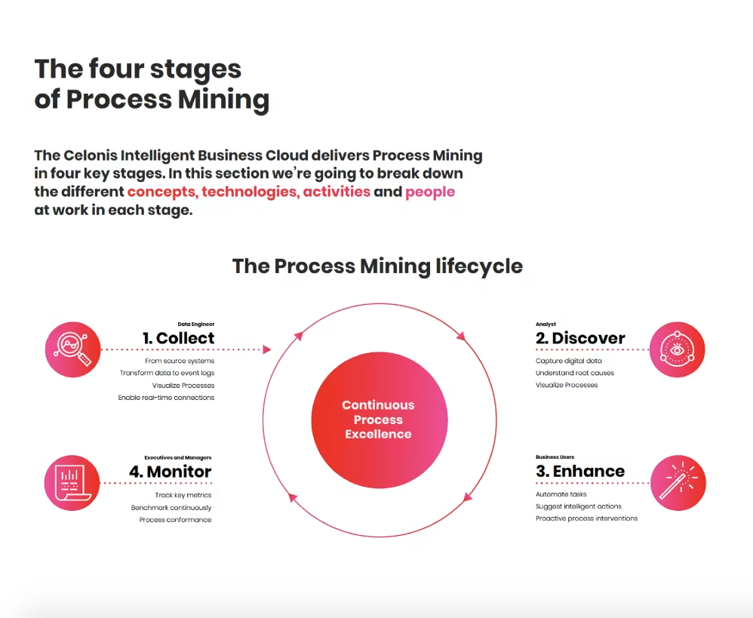
Introduction
Process mining is a technique designed to discover, monitor and improve real processes (i.e., not assumed processes) by extracting readily available knowledge from the event logs of information systems.
There are four stages of Process Mining . They are

Slide 5
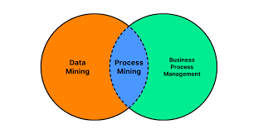
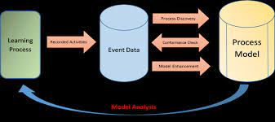
What is Process Mining
Process mining is a set of techniques for the analysis of operational processes based on event logs extracted from company’s databases, information systems, or business management software such as enterprise resource planning (ERP), customer relationship management (CRM), electronic health records (EHR), etc. In simple words, it’s about finding out how the processes are actually performed to discover problems and areas for improvement.

Slide 6
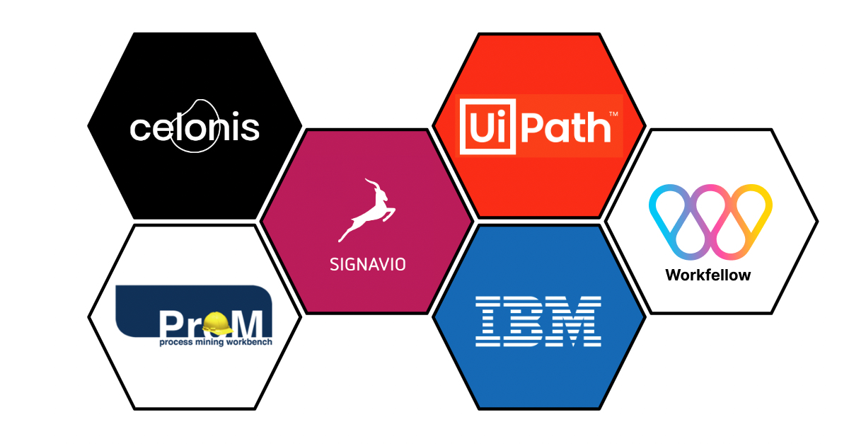
Technology
Celonis is a German data processing company that offers software as a service (SaaS) to improve business processes. It is headquartered in Munich, Germany and New York, United States.
The Celonis Execution Management System(EMS) provides companies a modern way to run their business processes entirely on data and intelligence. Process mining is a technique to analyze and track processes.

Slide 7
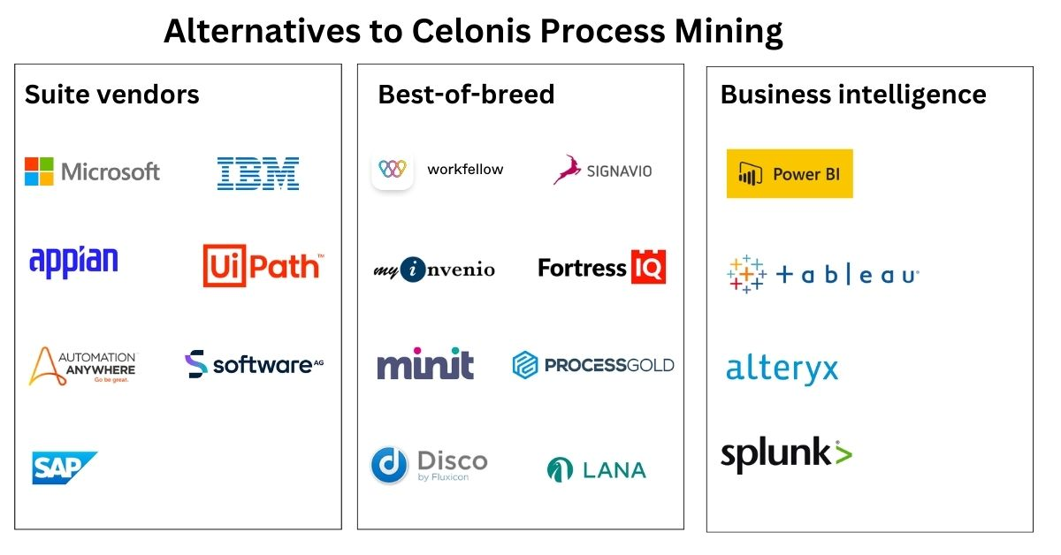
Contd…
Best Process Mining Tools and Software
Celonis
Fluxicon
Pega
UiPath

Slide 8
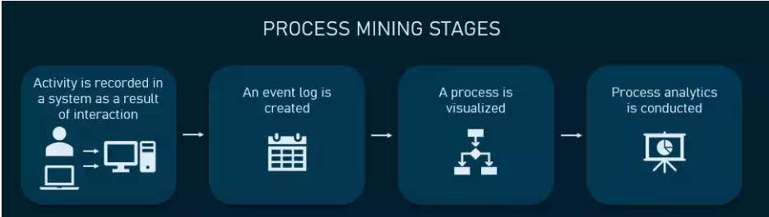
Modules
Process mining is a set of techniques used for obtaining knowledge and extracting insights from processes by the means of analyzing the event data, generated during the execution of the process. This training track provides both the theoretical and applied foundations around Process Mining.
Main Stages in Process Mining:
Activity or interaction.
Event Log.
Visualized.
Process Analytics

Slide 9
Process Mining Fundamental
Gain insight into the theoretical and applied foundations of Process Mining
There are a number of ways Process Mining can be applied:
Automated business process discovery/mapping – tracking event logs to identify the activities performed by employees, and defining a process around these activities
Performance analysis/process optimization – an enterprise can boost performance by analysing information from the event log to determine opportunities and adapt or improve process models according to the data of the real process
Operational support – directly influencing and improving the process not by changing the model but by providing data-driven support in the form of warnings, predictions, or recommendations.
.

Slide 10
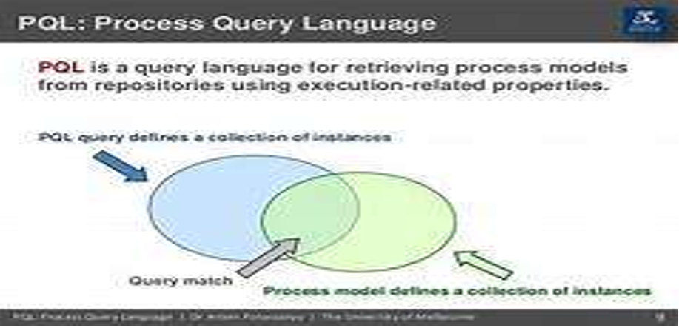
Introduction to PQL
PQL (Process Query Language) Queries are an essential component ofprocess mining. They allow analysts to extract valuable insights from process data.
PQL Queries enable you to explore and analyze process behavior, identify bottlenecks, measure performance, and discover patterns with inthe data. By using PQL Queries, you can ask specific questions about yourprocess and obtain meaningful answers.

Slide 11
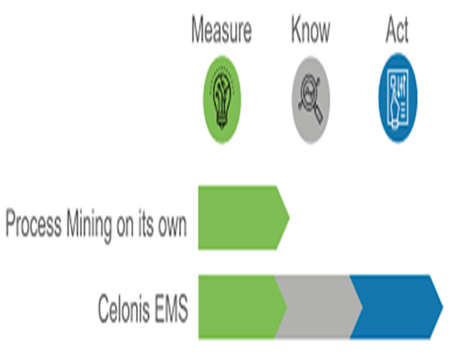
Get Data into EMS
EMS (Event Management System) plays a crucial role in process mining as it serves as the central repository for process data.
Get data into EMS involves integrating data from various sources such as ERP systems, databases, log files, and other data formats.

Slide 12
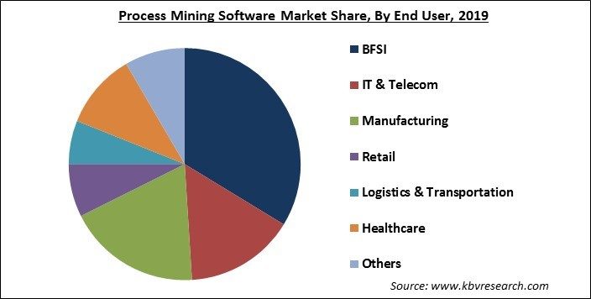
Applications
Business Process Improvement.
Compilance Auditing
Customer Journey Analysis
Fraud detection
Logistics and Transportation
Telecommunications Process Optimization
Supply Chain Management

Slide 13
Real time applications
Healthcare: Process mining can be used to analyze patient carepathways and identify bottlenecks or inefficiencies in hospital workflows. It can help optimize patient flow, reduce waiting times,and improve resource allocation.
Manufacturing: Process mining can be applied to analyze production processes and identify areas for improvement. It can helpoptimize production cycles, reduce waste, and enhance overall operational efficiency.
Finance: Process mining can be used to analyze financial processes, such as invoice processing or loan approvals. It can helpidentify process bottlenecks, streamline workflows, and improve compliance with regulatory requirements.
Customer service: Process mining can be applied to analyzecustomer service processes, such as call handling or complaint resolution. It can help identify areas for improvement, optimize response times, and enhance customer satisfaction

Slide 14
Learning outcomes
Improved process efficiency: By analyzing event logs and process data, process mining can identify bottlenecks, inefficiencies, and deviations in business processes. This information can help organizations optimize their processes and improve overall efficiency.
Process Discovery: Process mining techniques can automatically discover and visualize the actual process flows based on event logs. This helps organizations gain a better understanding of their processes, identify process variants, and uncover hidden patterns or deviations.
Conformance checking: Process mining can compare discovered process models with predefined process models or business rules to assess compliance. It can identify deviations, non-compliance, and potential risks, enabling organizations to take corrective actions

Slide 15
Contd…
generating general business benefits.
enabling reduced costs.
improving customer experience.
Process Discovery.

Slide 16
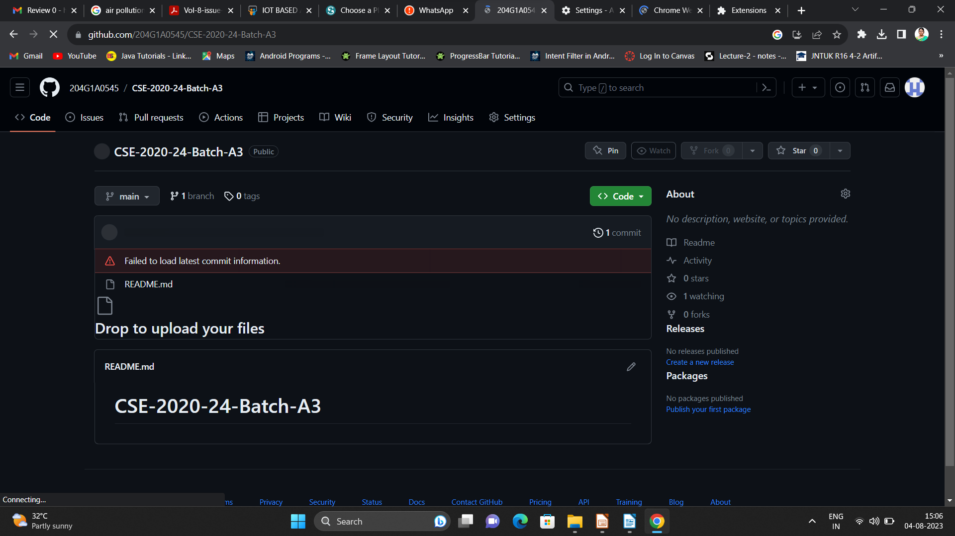

Git Hub Dashboard
Repository Name Like: Summer Internship - I
Under that include document, presentation and Certificate(Pdf).

Slide 17
Any Queries?

Slide 18
Thank You!!!

