Slide 1
CS5228 KNOWLEDGE DISCOVERY AND DATA MINING
Bank data | Group 9
Ding Jinhua
Duan Junxu
Wang Yuying
Wu Miao

Slide 2
Agenda
Data Preprocessing
Classification Methodology and Experiments
Evaluation and Discussion
Conclusion

Slide 3
Data Processing - Data Exploration & Cleaning
Data Size
21 input variables
1 output variable
Training data size: 30891x22
Test data size: 10297x22
Data Type
Binary
Categorical
Numeric
Null
Missing value
na.omit
centrallmputation()
Outliers

Slide 4
Data Processing –Feature Selection
Feature selection
The R pacakge, Caret, generate a correlation matrix and remove attributes with an absolute correlation of 0.75 or higher.
The “importance” function of the randomforest package to identify the importance rank for attributes. Benchmark is 2 variables, MeanDecreaseAccuracy, MeanDecreaseGini.

Slide 5
Data Processing – Imbalanced Dataset
Over-sampling
Generate more entries for minority class (“yes”)
SMOTE
Under-sampling
Select entries from majority class(“no”)
Randomly selected
Best Radio：1:3

Slide 6
Classification Methodology and Experiments
Basic Classification Models
Logistic Regression Model
Decision Tree Model(Regular)
Neural Network
And more…

Slide 7
Classification Methodology and Experiments
Models Based on Ensemble Learning
XGBOOST
ADABOOST
RANDOM FORREST
CART

Slide 8
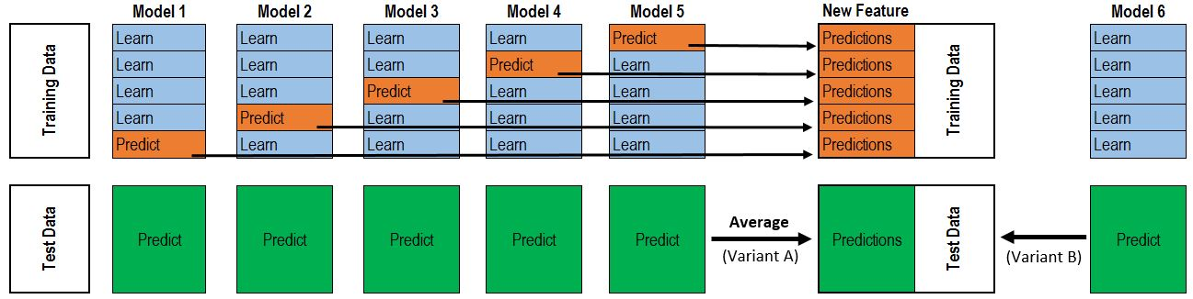
Classification Methodology and Experiments
STACKING
LAYER 1 CLASSIFIER :ADABOOST, RANDOM FOREST, XGBOOST
LAYER 2 CLASIFIER : LOGISTIC REGRESSION/XGBOOST
Train
Predict
Test
Prediction

Slide 9

Classification Methodology and Experiments
Voting
Majority Voting
Weighted Voting

Slide 10
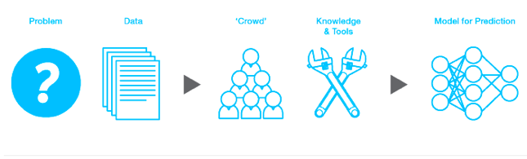
Evaluation and Discussion
 | TPR/Recall | FPR | Accuracy | MCC | F1 Score | Precision
Random Forest | 0.812 | 0.088 | 0.900 | 0.615 | 0.656 | 0.550
Logistic Regression | 0.714 | 0.089 | 0.893 | 0.558 | 0.611 | 0.534
CART | 0.761 | 0.077 | 0.904 | 0.605 | 0.651 | 0.569
Neural Network | 0.845 | 0.116 | 0.879 | 0.585 | 0.622 | 0.492
ADABoost | 0.804 | 0.081 | 0.906 | 0.626 | 0.667 | 0.569
Xgboost | 0.871 | 0.104 | 0.893 | 0.624 | 0.657 | 0.527
Ensemble_voting 1 | 0.574 | 0.025 | 0.908 | 0.639 | 0.677 | 0.826
Ensemble_voting 2 | 0.577 | 0.025 | 0.908 | 0.640 | 0.679 | 0.823
Ensemble_stacking | 0.808 | 0.084 | 0.903 | 0.621 | 0.662 | 0.561
Who Will Subscribe the Term Deposit?
Model Comparison
Ensemble Voting Wins

Slide 11
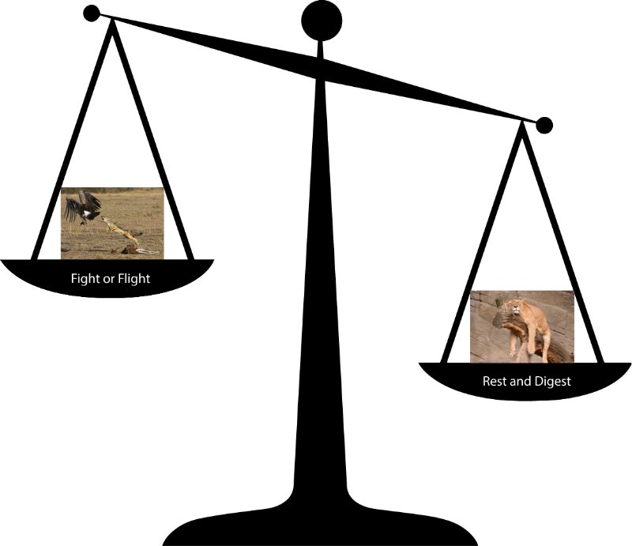
Evaluation and Discussion
 | Random Forest | Logistic Regression | CART | Neural Network | Xgboost | ADABoost
Accuracy | 0.900 | 0.893 | 0.904 | 0.879 | 0.906* | 0.893
MCC | 0.615 | 0.558 | 0.605 | 0.585 | 0.624 | 0.626*
FPR at TPR≅0.95 | 0.985 | 0.2709 | 0.2419 | 0.6254 | 0.1797* | 0.9982
Cost vs Benefit?
Model Comparison through FPR @TPR=0.95
XGBoost Wins

Slide 12
Conclusion - Recommendations for Bank
Construct an efficient and complete customer information system
Train staffs to increase their telemarketing skills

Slide 13
Conclusion - Recommendations for Future Studies
Select the most suitable model with the most compatible feature selection method
Use different models with different advantages on prediction

Slide 14

THANK YOU

