Slide 1
1.经典域适应方法
2.域适应理论
3.深度网络域适应
4.对抗网络域适应
[1]. TCA (2010) week1
[2]. JDA (2013) week2
[3]. ARTL (2014) week2
[4]. NIPS 2006 / ML 2010年 week3
[5]. 龙明盛博士论文第三章 (2014) week3
[6]. 实验文章 (2013) week4
[7]. DAN (2014) week4
[8]. JMMD (2017) week5
[9]. DSN (2016) week5
[10]. GAN (2014) week6
[11]. DANN (2014) week6
[12]. MCD (2018) week7
[13]. MDD (2019) week7
注：
1.阅读顺序为1-2-3-4 or 1-3-2-4
2.相邻的相同颜色论文安排在同一周
3.标红的文章表示需要进行实验

Slide 2
[1] Pan, S. J., Tsang, I. W., Kwok, J. T., and Yang, Q. Domain adaptation via transfer component analysis.IJCAI 2009.(link:http://www.cs.ust.hk/~jamesk/papers/ijcai09.pdf)
[2] Long, M., Wang, J., Ding, G., Sun, J., and Yu, P. S. Transfer feature learning with joint distribution adaptation. In ICCV, 2013.
[3] Long, Mingsheng, J. Wang, G. Ding, S. Pan and P. Yu. “Adaptation Regularization: A General Framework for Transfer Learning.” IEEE Transactions on Knowledge and Data Engineering 26 (2014): 1076-1089.
[4-1] Ben-David, S., Blitzer, J., Crammer, K., and Pereira, F. Analysis of representations for domain adaptation. NIPS, 2007.
[4-2] S. Ben-David, J. Blitzer, K. Crammer, A. Kulesza, F. Pereira, and J. W. Vaughan, “A theory of learning from different domains,” Machine Learning, vol. 79, no. 1-2, pp. 151–175, 2010.
[5] 龙明盛，迁移学习问题与方法研究
[6] J. Yosinski, J. Clune, Y. Bengio, and H. Lipson, “How transferable are features in deep neural networks?” in NIPS 2014, pp. 3320–3328.
[7] M. Long, Y. Cao, J. Wang, and M. I. Jordan, “Learning transferable features with deep adaptation networks,” in ICML 2015, pp. 97–105.

Slide 3
[8] M. Long, H. Zhu, J. Wang, and M. I. Jordan, “Deep transfer learning with joint adaptation networks,” in ICML 2017, pp. 2208–2217.
[9] Bousmalis, Konstantinos, George Trigeorgis, N. Silberman, D. Krishnan and D. Erhan. “Domain Separation Networks.” NIPS (2016).
[10]Goodfellow, I., Pouget-Abadie, J., Mirza, M., Xu, B., Warde-Farley, D., Ozair, S., Courville, A., and Bengio, Y. Generative adversarial nets. In Advances in Neural Information Processing Systems (NeurIPS), 2014.
[11-1] Ganin, Y. and Lempitsky, V. Unsupervised domain adaptation by backpropagation. In International Conference on Machine Learning (ICML), 2015. Ganin, Y., Ustinova, E.,
[11-2 ]Ajakan, H., Germain, P., Larochelle, H., Laviolette, F., Marchand, M., and Lempitsky, V. Domain-adversarial training of neural networks. Journal of Machine Learning Research (JMLR), 17:2096–2030, 2016.
[12]Saito, K., Watanabe, K., Ushiku, Y., and Harada, T. Maximum classifier discrepancy for unsupervised domain adaptation. In IEEE Conference on Computer Vision and Pattern Recognition (CVPR), pp. 3723–3732, 2018.
[13] Bridging Theory and Algorithm for Domain Adaptation ICML 2019

Slide 4
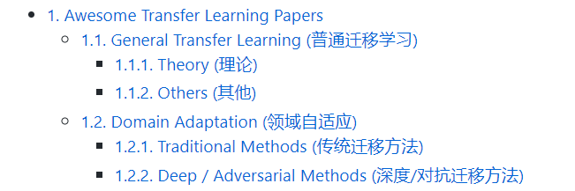

近三年顶会论文推荐
建议每周精读一篇，泛读七篇
[1] https://github.com/jindongwang/transferlearning/blob/master/doc/awesome_paper.md#domain-adaptation-%E9%A2%86%E5%9F%9F%E8%87%AA%E9%80%82%E5%BA%94

Slide 5
近三年顶会论文推荐
[1] https://github.com/zhaoxin94/awsome-domain-adaptation#distance-based-methods
[2] https://github.com/barebell/DA
[3]https://github.com/dududuAA/Transfer-learning-materials

