Slide 1
Generalization error bound for unsupervised domain adaptation under different discrepancy measure 2020.09

Slide 2
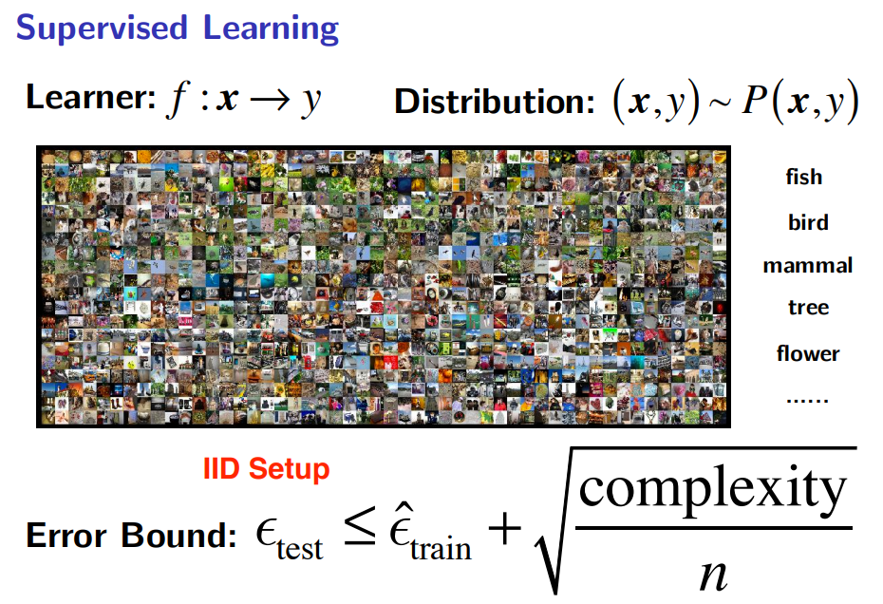

Slide 3
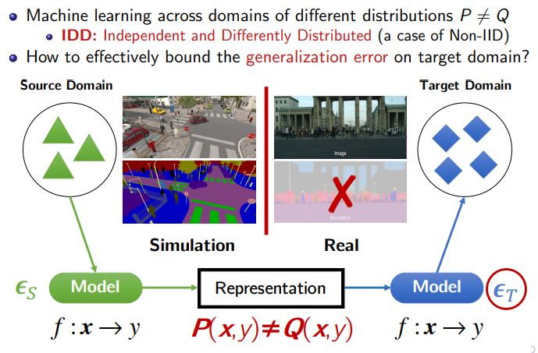

Slide 4


Theory
Algorithm
Performance
$H$-distance
DANN
82.9
$H∆H$-distance
MCD
86.5
Discrepancy
Distance
Labeling function shift
Margin Disparity Discrepancy
MDD
88.9

Slide 5
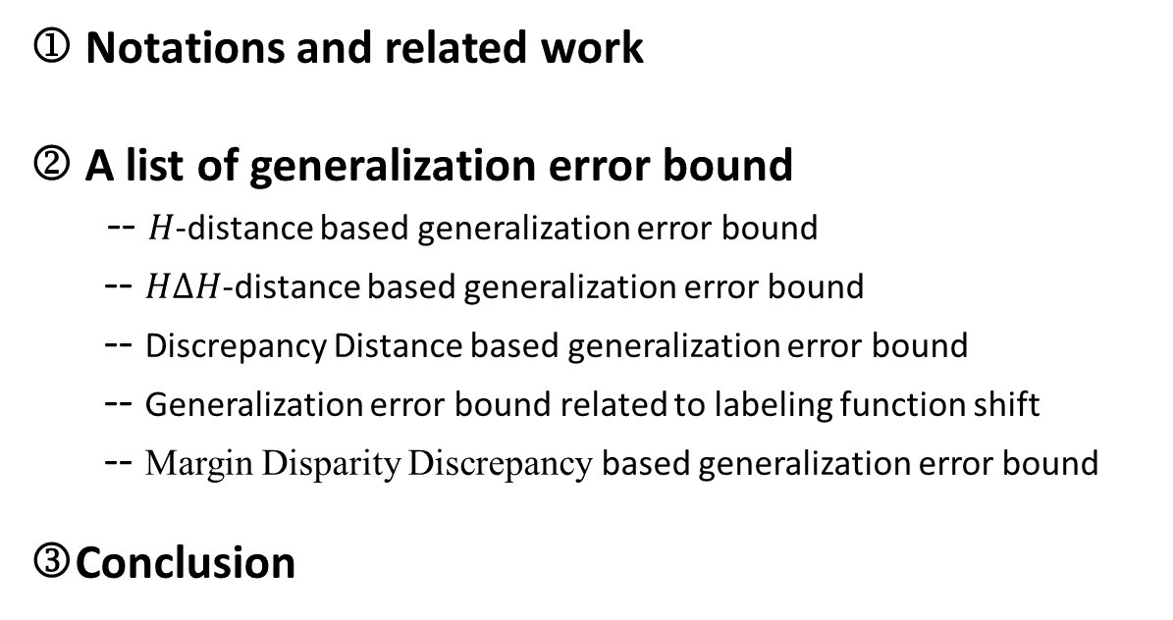
Outline
 Notations and related work
 A list of generalization error bound
-- $H$-distance based generalization error bound
-- $H∆H$-distance based generalization error bound
-- Discrepancy Distance based generalization error bound
-- Generalization error bound related to labeling function shift
-- Margin Disparity Discrepancy based generalization error bound
Conclusion

Slide 6

Related Work
$H$-distance based
Divergence-based learning bound
…
Margin Disparity Discrepancy based
𝑂𝑝𝑡𝑖𝑚𝑎𝑙 Transport based
Theory
Learning bounds with
integral probability metrics
Maximum Mean Discrepancy based
PAC-Bayesian theory for
domain adaptation[1]
[1] Germain, P., Amaury Habrard, F. Laviolette and Emilie Morvant. “A PAC-Bayesian Approach for Domain Adaptation with Specialization to Linear Classifiers.” ICML (2013).

Slide 7






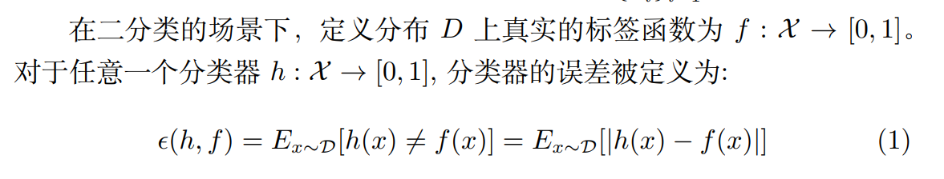




Notations
特征和标签空间：
或
源域分布和源域样本集：$P,$
目标域分布和目标域样本集：$Q,$
分类器h在源域上的误差和经验误差：
分类器h在目标域上的误差和经验误差：

Slide 8

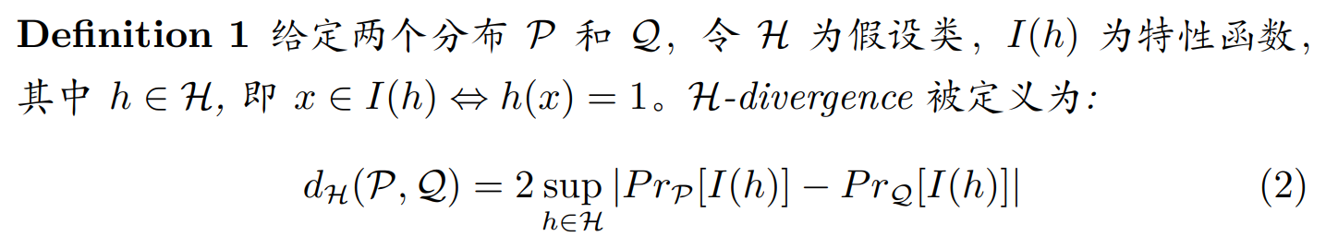
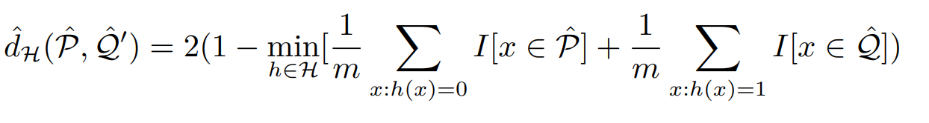
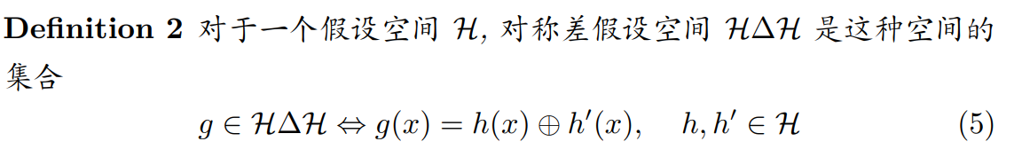
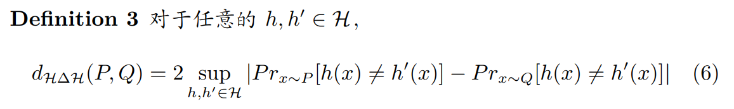





1-2. $H$-distance and 𝐻∆𝐻-distance based generalization error bound
A-distance（VLDB2004, NIPS 2006）:
$$H∆H$$
$$H$$
$H$-distance(ML2010)
经验$H$-distance ：
$$A$$
$H∆H$-distance (NIPS2007,ML2010)
[2]Kifer, D., Shai Ben-David and J. Gehrke. “Detecting Change in Data Streams.” VLDB (2004).
[3] Shai Ben-David, John Blitzer, K. Crammer, and Fernando C Pereira. Analysis of representations for domain adaptation. In NIPS, 2006.
[4]Blitzer, John, K. Crammer, A. Kulesza, Fernando C Pereira and Jennifer Wortman Vaughan. “Learning Bounds for Domain Adaptation.” NIPS (2007).
[5]Shai Ben-David, John Blitzer, Koby Crammer, Alex Kulesza, Fernando C Pereira, and Jennifer Wortman Vaughan. A theory of learning from different domains. Machine Learning, 79:151–175, 2009.

Slide 9
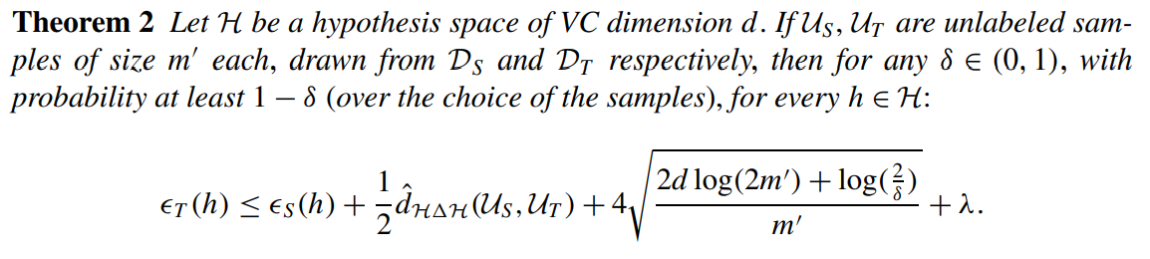


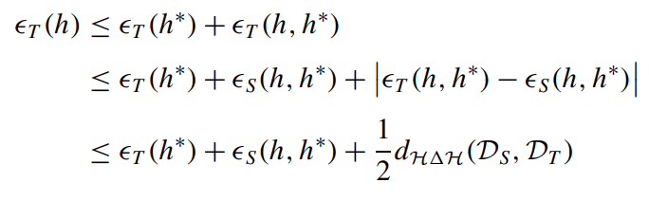

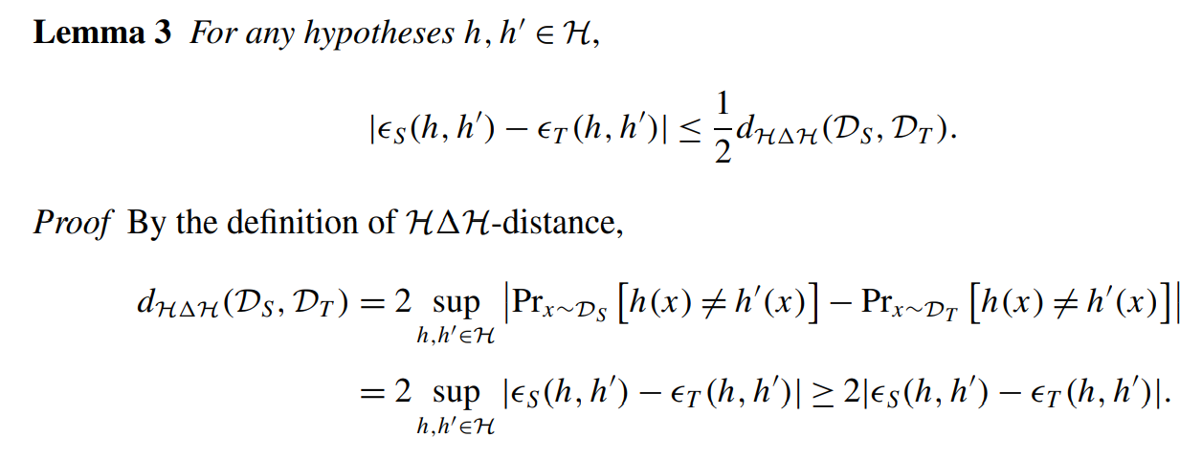
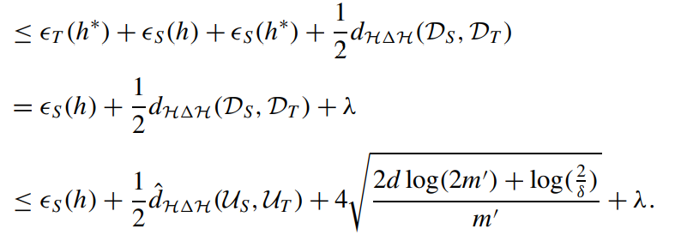
1-2. $H$-distance and 𝐻∆𝐻-distance based generalization error bound
证明:
上界
$$∧$$

Slide 10
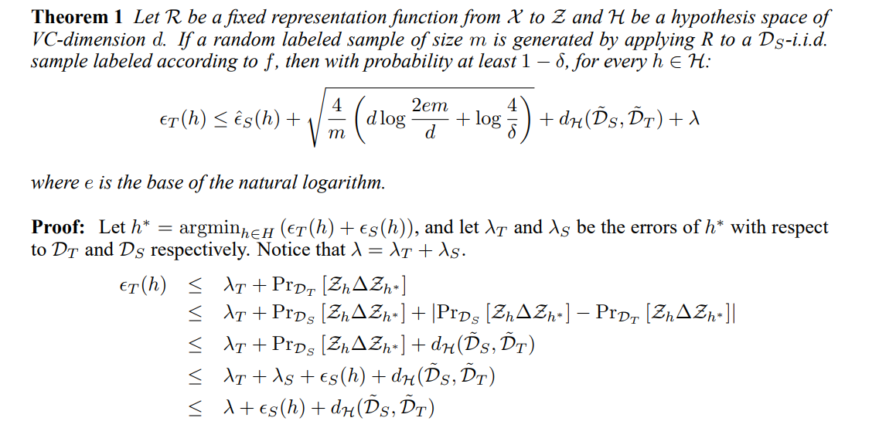
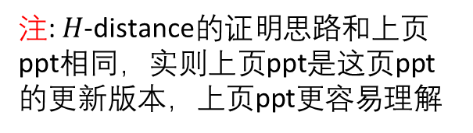
1-2. $H$-distance and 𝐻∆𝐻-distance based generalization error bound
注: $H$-distance的证明思路和上页ppt相同，实则上页ppt是这页ppt的更新版本，上页ppt更容易理解
[3] Shai Ben-David, John Blitzer, K. Crammer, and Fernando C Pereira. Analysis of representations for domain adaptation. In NIPS, 2006.

Slide 11
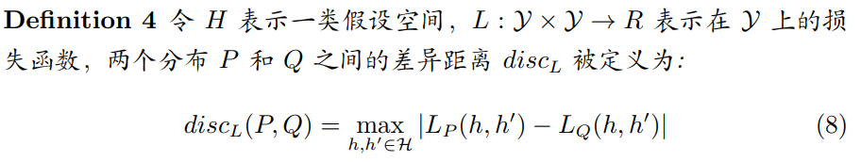
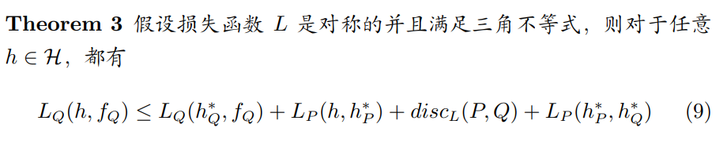


3. Discrepancy Distance based generalization error bound
1.将损失函数从 0-1 损失函数扩展到任意满足三角不等式的损失函数
2. 在之前的理论中，假设是在源域和目标域上存在一个联合最优分类器，而在此理论中，作者是假设源域和目标域各自存在一个最优分类 器，并且这两个分类器之间差异很小。
类似
[6]Yishay Mansour, Mehryar Mohri, and Afshin Rostamizadeh. Domain adaptation: Learning bounds and algorithms. ArXiv, abs/0902.3430, 2009.

Slide 12

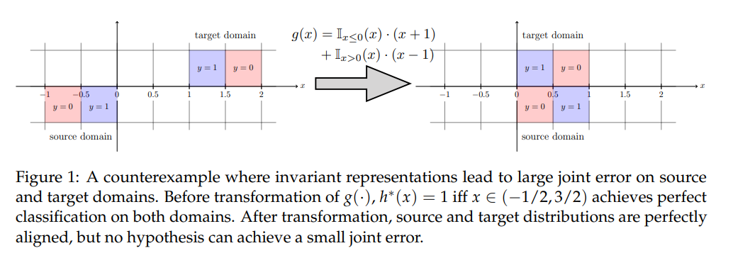

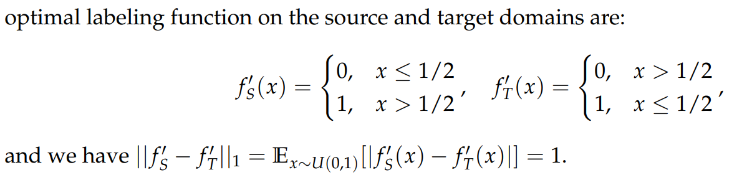

4. Generalization error bound related to labeling function shift
一个针对之前理论的反例
之前的假设
在这个反例中
[7] Han Zhao, Remi Tachet des Combes, Kun Zhang, and Geoffrey J. Gordon. On learning invariant representation for domain adaptation. ICML 2019

Slide 13
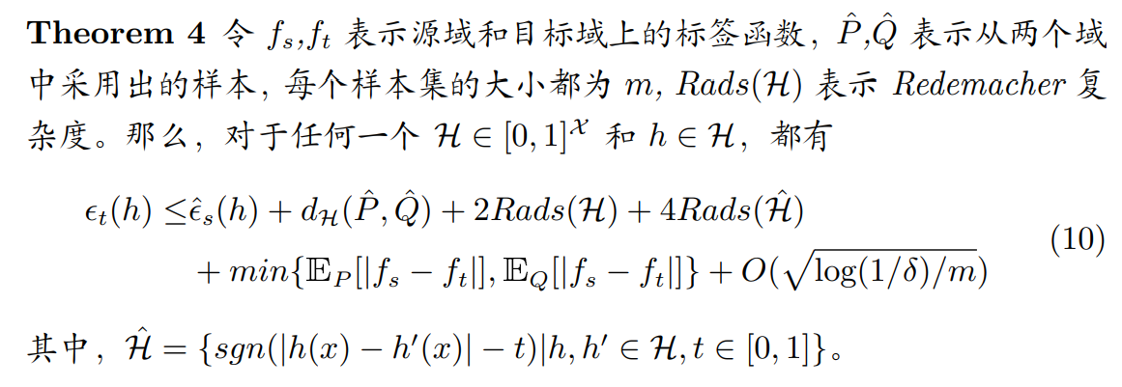
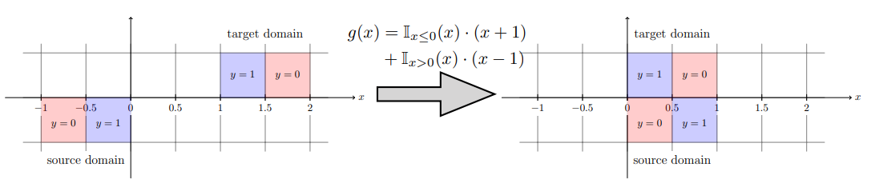
4. Generalization error bound related to labeling function shift
基于该理论可以解释之前的反例

Slide 14
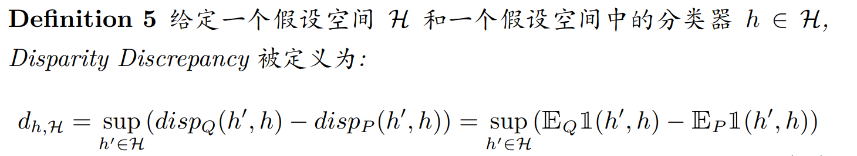
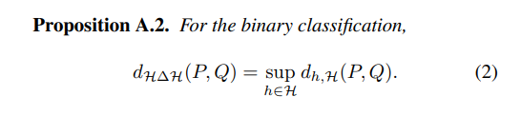

5. Margin Disparity Discrepancy based generalization error bound
1. 之前的理论需要对两个分类器都进行遍历，没有必要
2. 之前的理论关注于二分类问题，实际中都是多分类问题
[8]Zhang, Yuchen, T. Liu, Mingsheng Long and Michael I. Jordan. “Bridging Theory and Algorithm for Domain Adaptation.” ICML (2019).

Slide 15
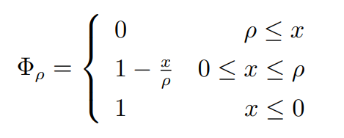


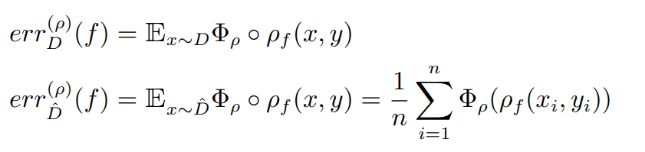
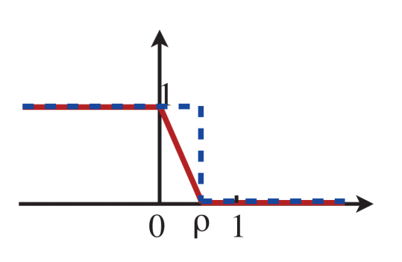
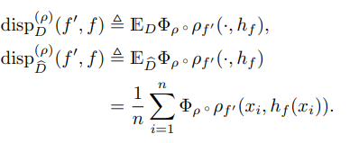
5. Margin Disparity Discrepancy based generalization error bound
1. 之前的理论需要对两个分类器都进行遍历，没有必要
2. 之前的理论关注于二分类问题，实际中都是多分类问题
标签函数
间隔:

Slide 16
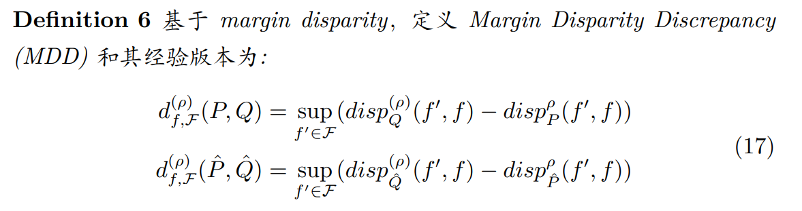
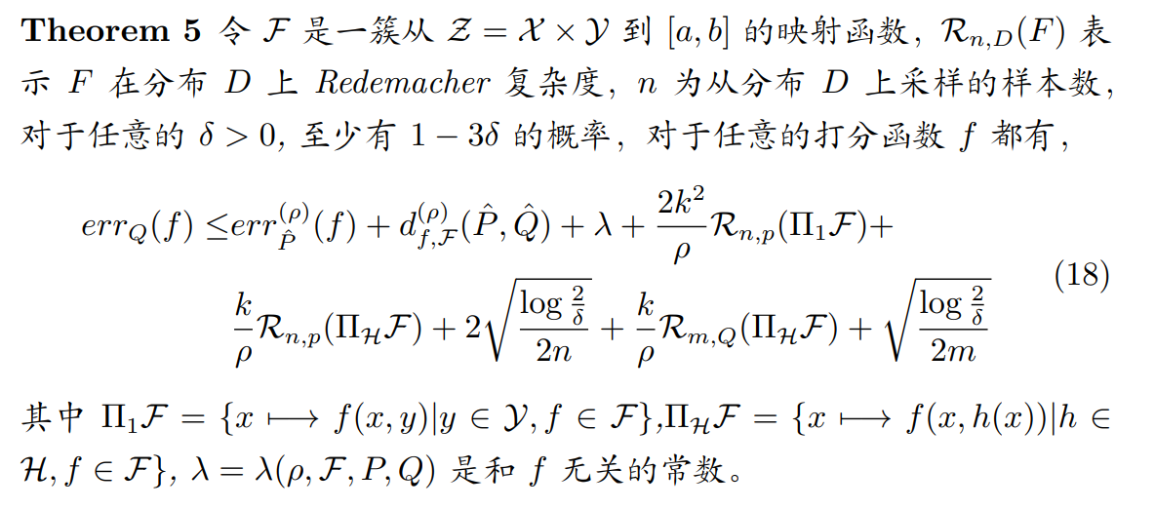
5. Margin Disparity Discrepancy based generalization error bound

Slide 17
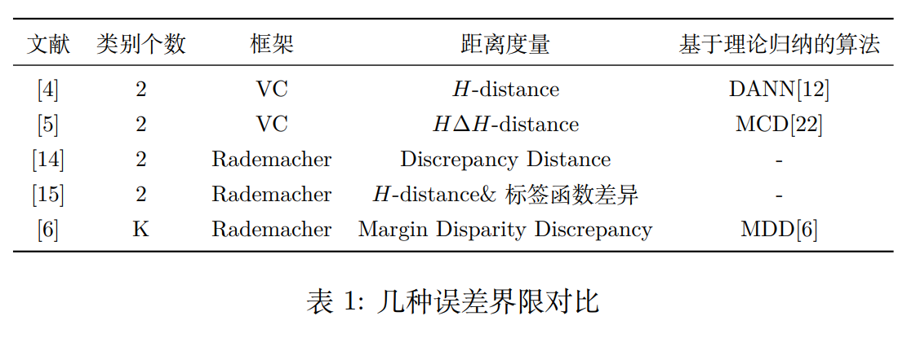
Conclusion

Slide 18
Reference
[1] Germain, P., Amaury Habrard, F. Laviolette and Emilie Morvant. “A PAC-Bayesian Approach for Domain Adaptation with Specialization to Linear Classifiers.” ICML (2013).
[2]Kifer, D., Shai Ben-David and J. Gehrke. “Detecting Change in Data Streams.” VLDB (2004).
[3] Shai Ben-David, John Blitzer, K. Crammer, and Fernando C Pereira. Analysis of representations for domain adaptation. In NIPS, 2006.
[4]Blitzer, John, K. Crammer, A. Kulesza, Fernando C Pereira and Jennifer Wortman Vaughan. “Learning Bounds for Domain Adaptation.” NIPS (2007).
[5]Shai Ben-David, John Blitzer, Koby Crammer, Alex Kulesza, Fernando C Pereira, and Jennifer Wortman Vaughan. A theory of learning from different domains. Machine Learning, 79:151–175, 2009.
[6]Yishay Mansour, Mehryar Mohri, and Afshin Rostamizadeh. Domain adaptation: Learning bounds and algorithms. ArXiv, abs/0902.3430, 2009.
[7] Han Zhao, Remi Tachet des Combes, Kun Zhang, and Geoffrey J. Gordon. On learning invariant representation for domain adaptation. ICML 2019
[8]Zhang, Yuchen, T. Liu, Mingsheng Long and Michael I. Jordan. “Bridging Theory and Algorithm for Domain Adaptation.” ICML (2019).

