Slide 1
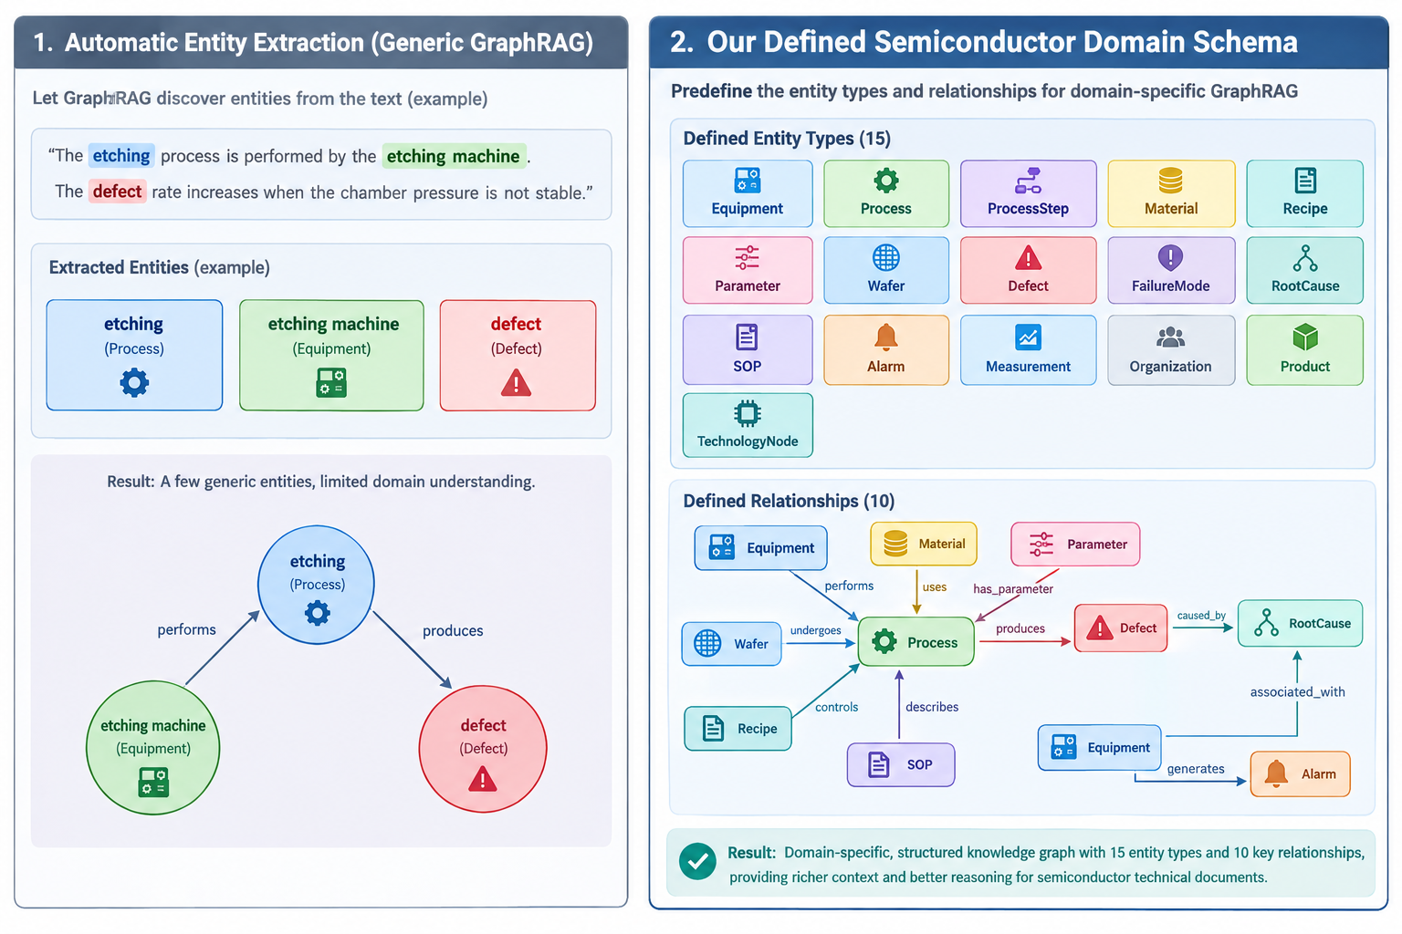
特定领域

Slide 2
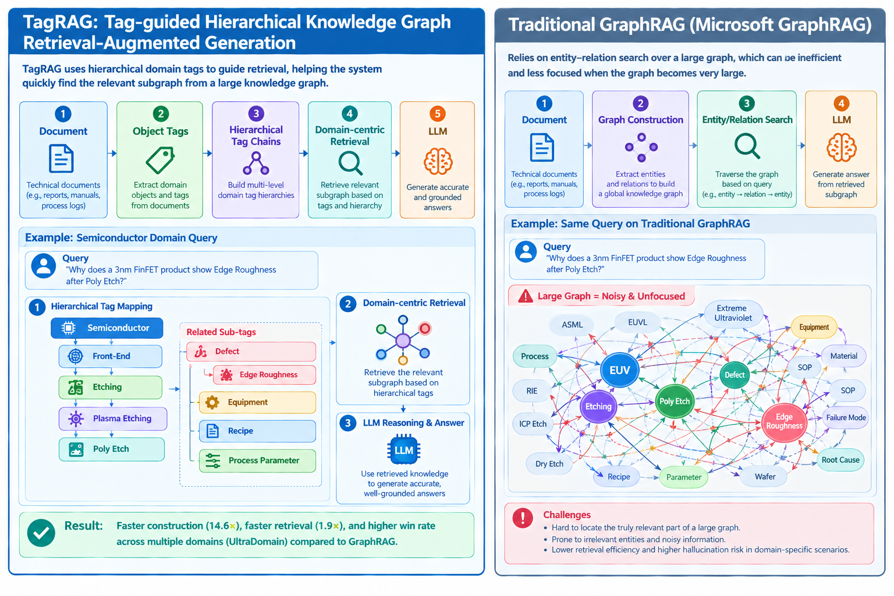
tag

Slide 3
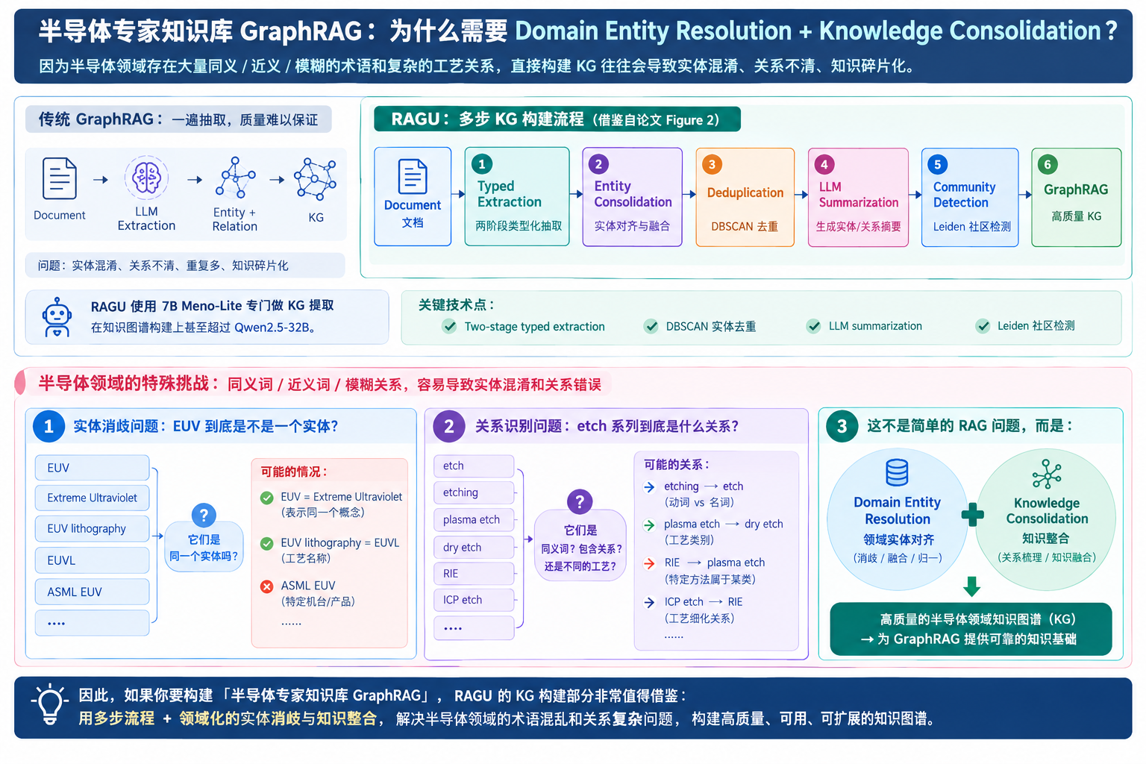
ragu

Slide 4
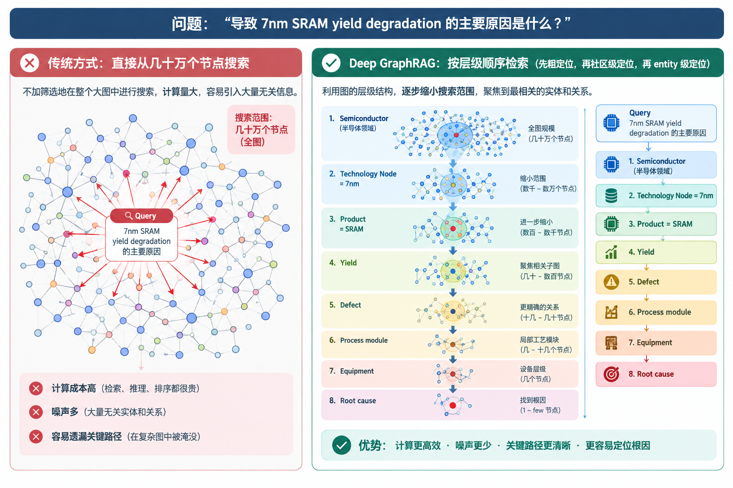
deep

Slide 5
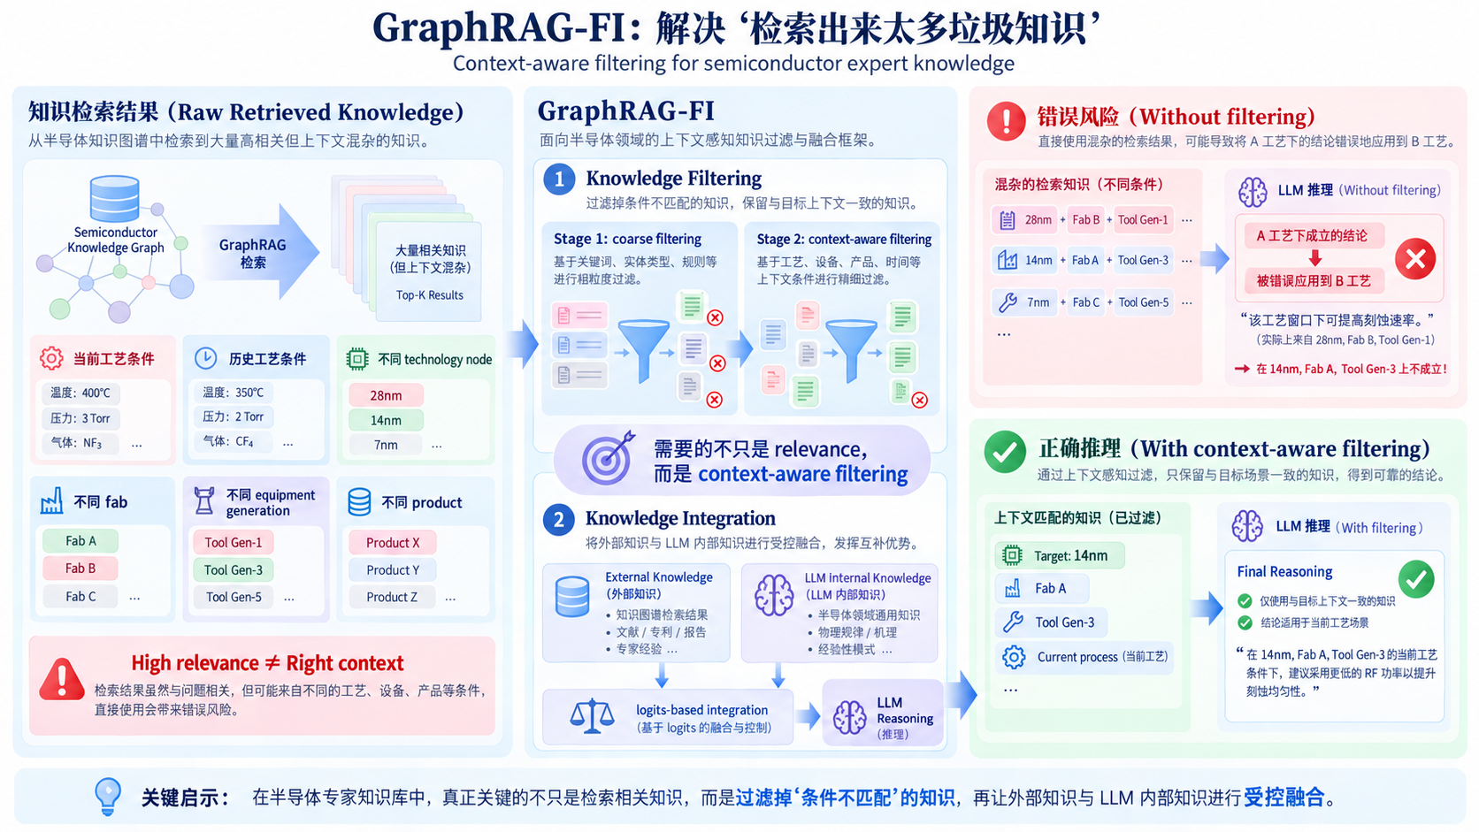
Empowering GraphRAG with Knowledge Filtering and Integration

Slide 6
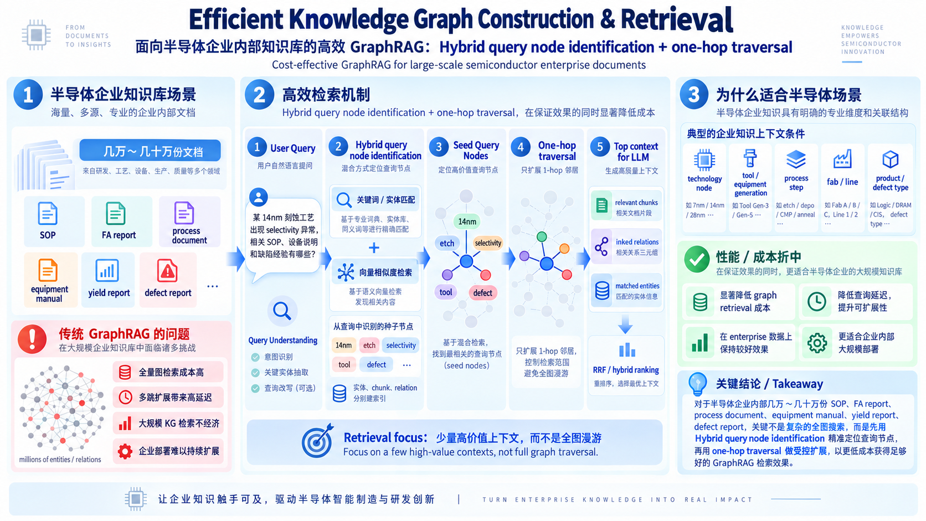
Efficient Knowledge Graph Construction

Slide 7
半导体

Slide 8

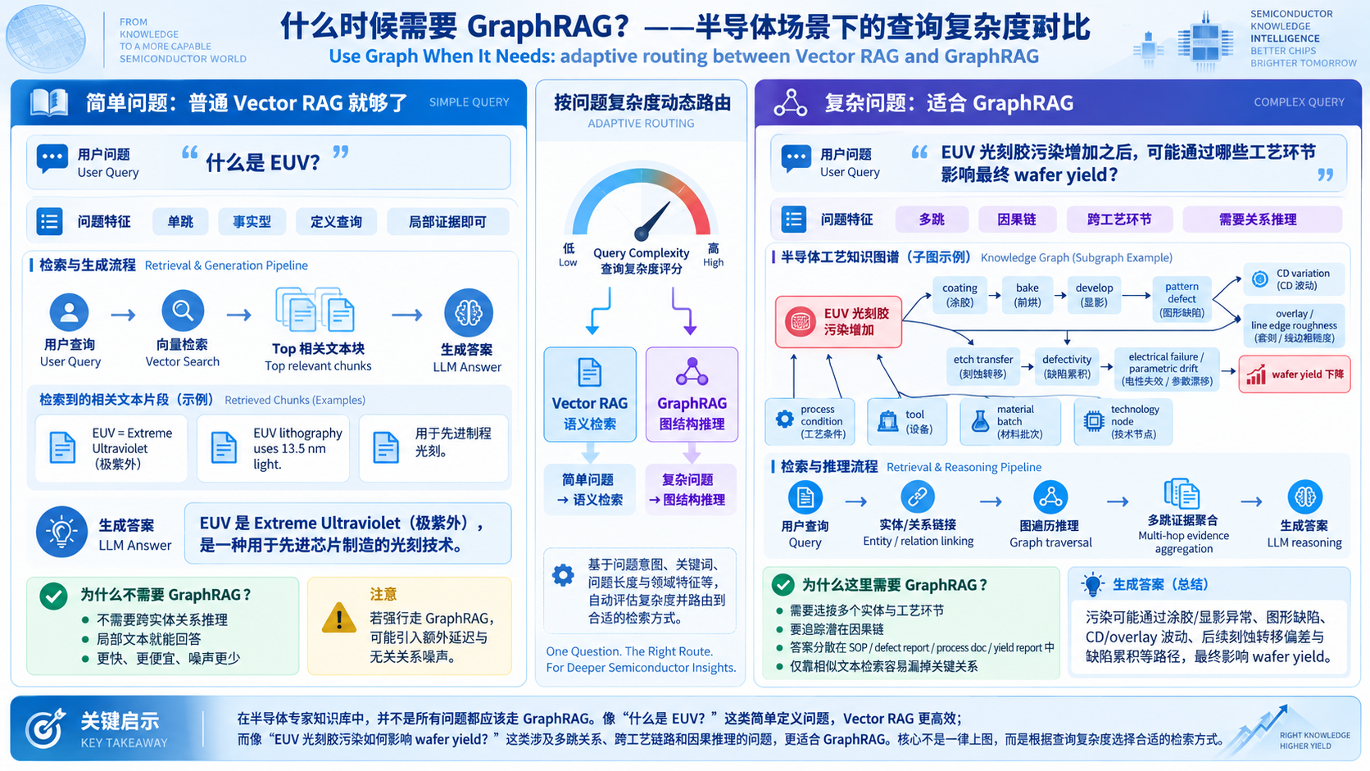

Slide 9
