Slide 1
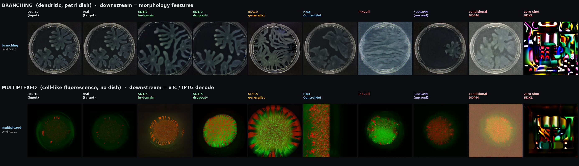
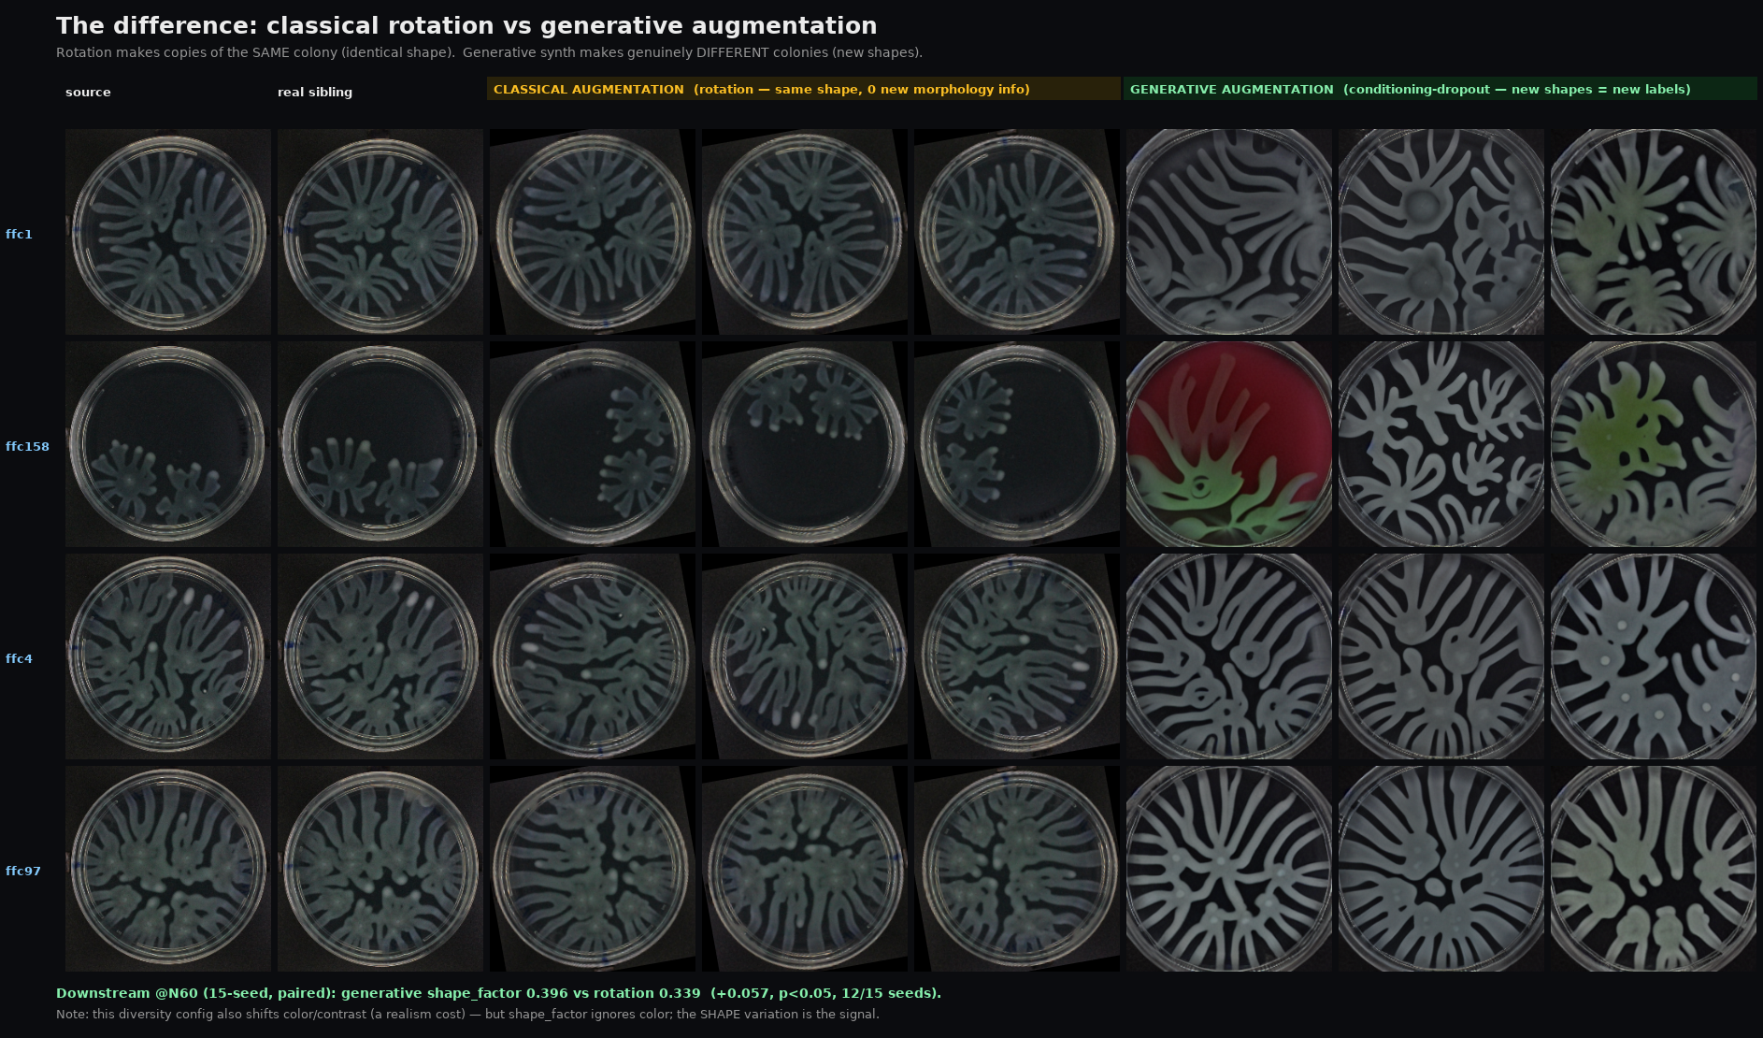
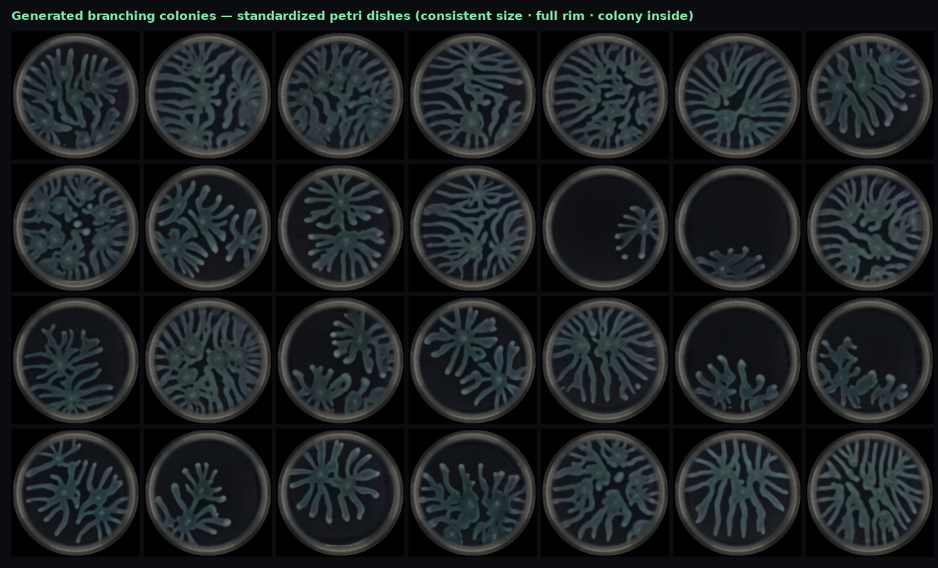
Best augmenter = an in-domain SD1.5
Exhaustive backbone search across two colony domains — nothing newer beats it, and conditioning-dropout SD1.5 is the only augmenter that beats plain rotation on the metric that matters.
EVERY MODEL (columns) × EVERY DATASET (rows) — now complete on both domains, aligned to one source condition
① THE WIN — rotation vs generative
② PRESENTATION — standardized dishes
③ VERDICT
Best overall: in-domain SD1.5
(conditioning-dropout, s1.0/g7)
Branching image CMMD (lower = better)
SD1.5 3.2 · Flux 4.8 · DDPM 9.8 · GAN 15.4 · PixCell 49.8 · zero-shot 71
Only model to beat rotation (downstream)
shape_factor +0.05 (branching) · aTc decode +0.045 (multiplexed)
Multiplexed image CMMD: dropout 7.97 beats in-domain 12.6 too.
“Newer backbone” never won; smarter diversity on SD1.5 did.

