Slide 1
Branching augmenter: corrected backbone comparison
In-domain SD1.5 is the best realism augmenter — Flux does not beat it even fully scaled
Three findings from a methodology pass (prompted by your feedback):
1. Image realism/CMMD — a properly in-domain SD1.5 wins decisively (CMMD 3.4 vs Flux 4.8–8.8), and holds even against Flux's fully-escalated best (bf16, 3× ControlNet capacity).
2. Diversity — Flux wins, modestly (0.27 vs 0.25), partly by generating less-coherent structure.
3. Downstream utility (15 seeds) — rotation ≈ SD1.5 ≈ Flux; no augmenter significantly beats plain rotation.
Sarthak · 2026-10-07 · branching domain, 410-pair split, 28 held-out test conditions

Slide 2
What changed since the last update
The earlier “Flux beats SD1.5” result did not survive two fixes you flagged
Prior claim (Sept):
“Flux augmenter Pareto-dominates SD1.5 on realism, CMMD, and diversity, and is the best downstream augmenter.”
Two problems:
• Baseline was out-of-domain. Flux was compared to a generalist SD1.5, not one trained on branching. The branching-specialized SD1.5 is far stronger.
• Downstream was 5-seed noise. The “best augmenter” gap (0.019) was ~5–8× smaller than the swing from which conditions get sampled.
Corrected here:
• Same-split comparison. SD1.5 retrained from scratch on the identical 410-pair branching split as Flux; scored identically.
• 15-seed downstream. Paired across all arms; error bars reported.
• Flux given its best shot. Escalated fp8→bf16 base, CN2→CN6 capacity, full 20k-step training — to rule out “Flux was just under-trained.”
Net: the headline reverses. Your instinct that SD1.5 “usually did well on branching” was right.

Slide 3
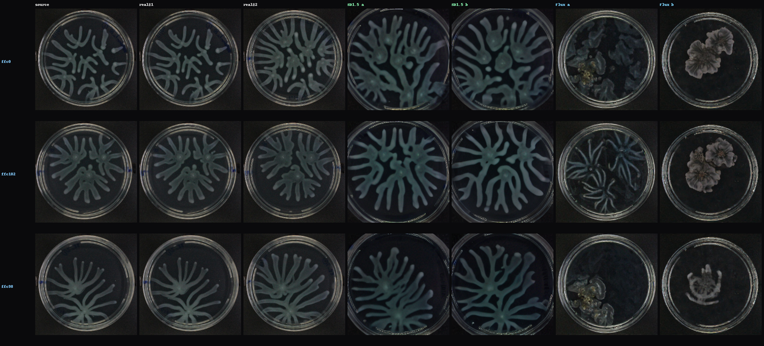
The fair comparison
Both backbones see exactly the same data and the same evaluation
Train: identical 410 replicate-pairs (branching), test conditions excluded from both. Eval: 4 samples/source on 28 held-out conditions, scored vs real replicates.
Metrics: realism = LPIPS(gen→real-sibling) ÷ real-vs-real floor (lower=better) · CMMD = CLIP distribution distance (lower=better) · diversity = mean pairwise LPIPS among a model's own samples (higher=better).
Addresses: “it depends how you split train/test” — now it doesn't; the split is shared and fixed.
Sample conditions by a fixed rule (evenly spaced across sorted test set), not hand-picked — 3 of 28 shown.

Slide 4
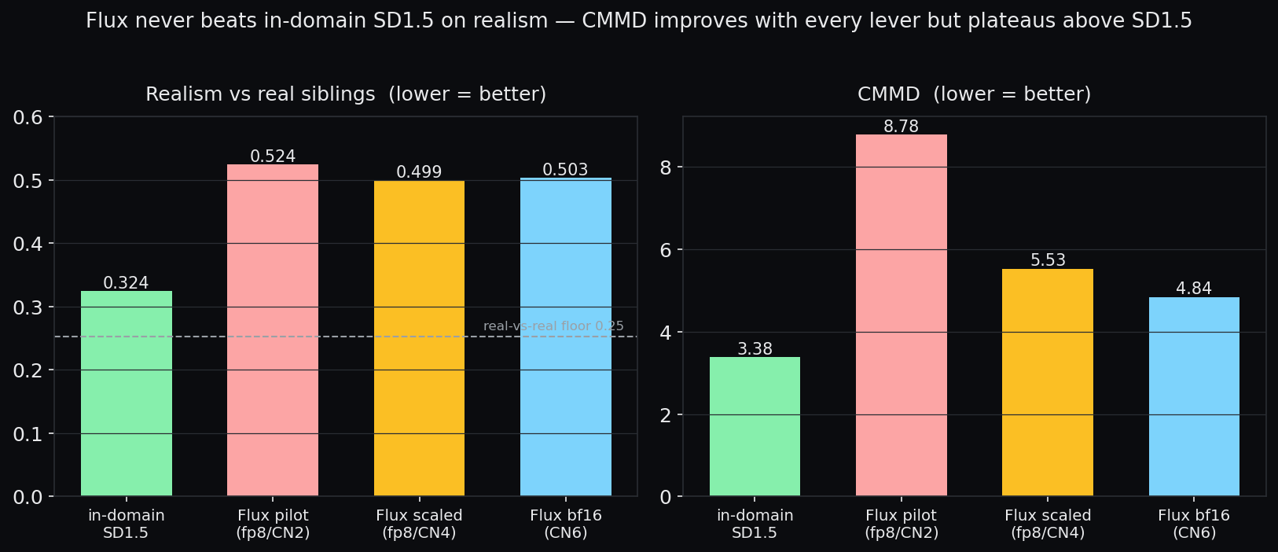
Image quality: SD1.5 wins, and the win is robust to scaling Flux
The escalation ladder:
Each Flux lever (capacity, bf16 base, training) lowers CMMD —
8.78 → 5.53 → 4.84
— approaching but never reaching SD1.5's 3.38.
But realism plateaus at ~0.50, far above SD1.5's 0.324 (near the real-vs-real floor).
So it's not under-trained Flux — the gap is structural.
Flux bf16/CN6: 48GB GPU, full bf16 base (no quantization loss), 1.4B-param ControlNet, 20k steps.

Slide 5
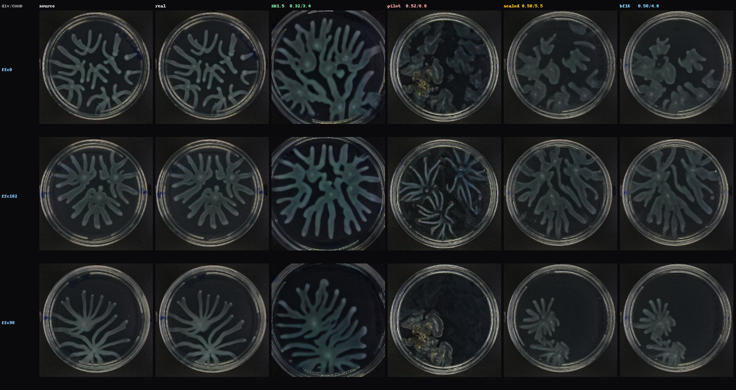
Why — the structure tells the story
Left→right: Flux improves with every lever, but SD1.5 keeps the fullest branches
SD1.5 = most complete dendritic structure (slightly over-bright). Flux pilot→scaled→bf16 = steadily crisper and color closer to real, but branches stay fainter/less complete — the realism deficit.

Slide 6
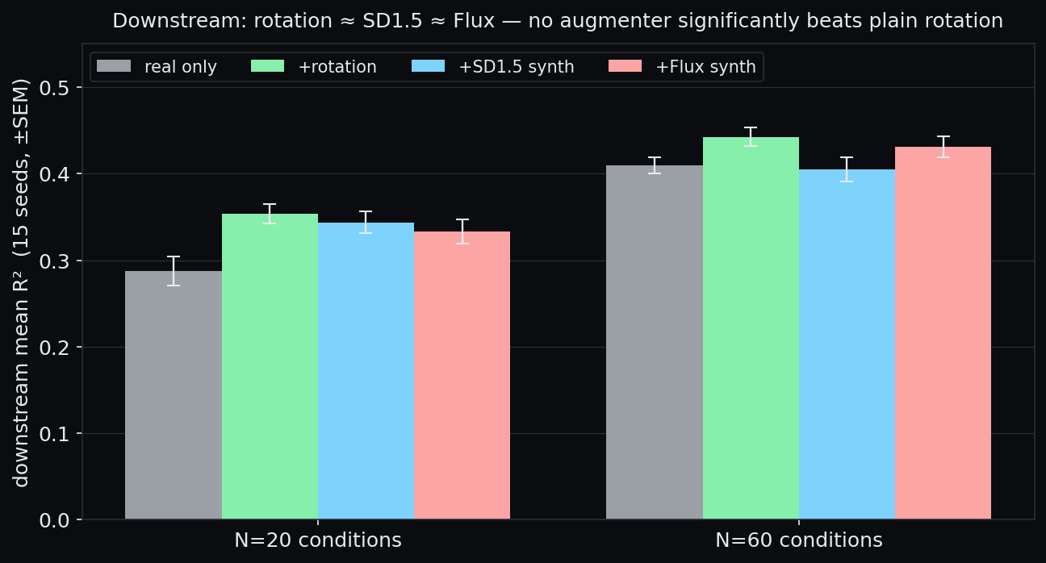
Downstream utility: no augmenter beats plain rotation
Predicting colony morphology under scarcity — 15 seeds, paired, ±SEM
Every augmenter helps over real-only,
but rotation is as good as either generative model — all within error bars.
Answers: “does it depend which conditions you pick?”
Yes — strongly. A single arm's R² swings ~0.10–0.17 across condition draws, while the best augmenter-vs-rotation gap is ~0.02. Condition choice dominates; that's why 5 seeds misled.
The earlier “Flux = best augmenter @0.458” regressed to 0.431 at 15 seeds; rotation held at 0.443.

Slide 7
Conclusion & next steps
Bottom line:
• For branching, a branching-specialized SD1.5 is the better augmenter — most realistic, and rotation already covers the downstream gain.
• Flux's advantage is diversity only, and it costs realism; scaling narrows but does not close the gap.
• The contribution is the evaluation that caught the artifact: in-domain baselines, condition-subset sensitivity, a capacity/precision escalation to rule out under-training.
Open / proposed:
• Your bio-oriented metrics as the downstream tiebreaker — colony-feature R² may miss biology that a domain metric would catch.
• Validate the multiplexed (cell-like) domain, where the backbone verdict flipped before (PixCell CMMD 5.8 < SD1.5 12.6).
• If diversity is the goal, training-time conditioning-dropout on SD1.5 may buy it without Flux's realism cost.

