Slide 1
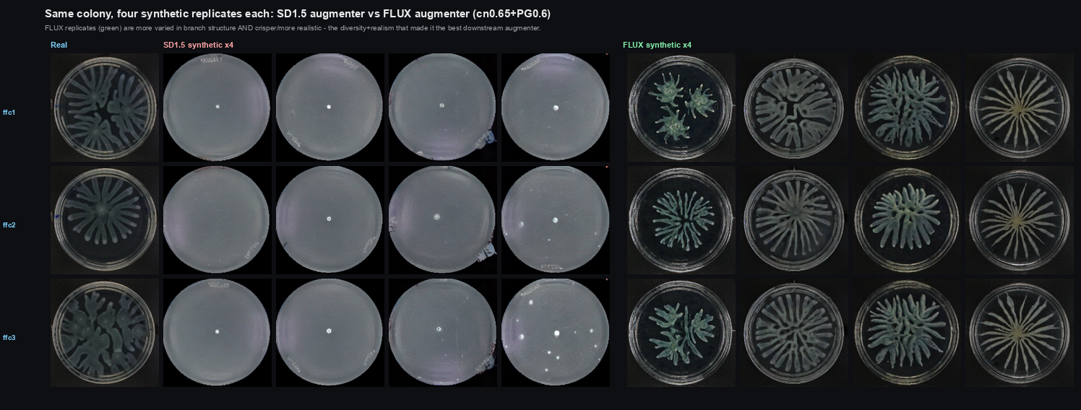
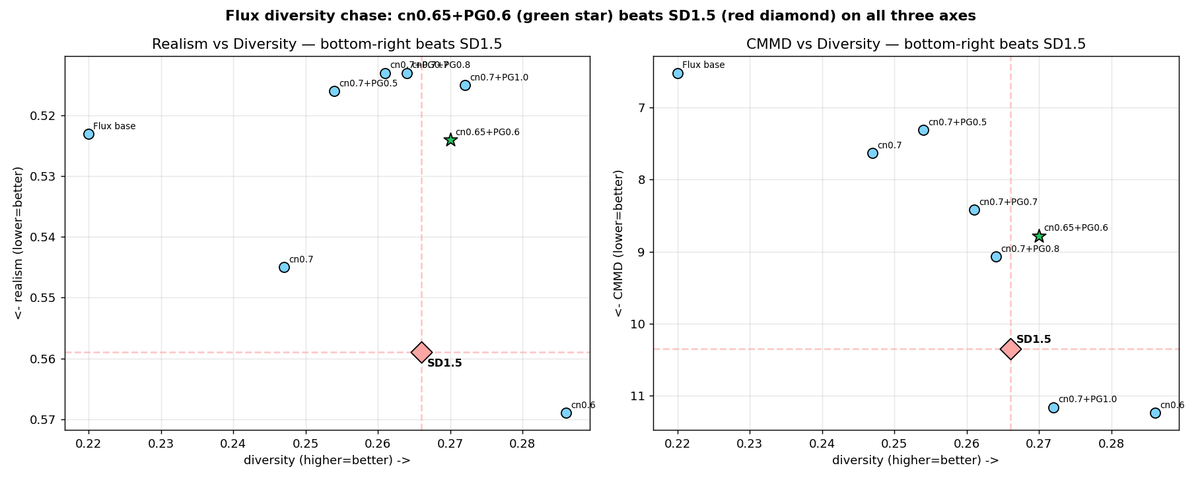
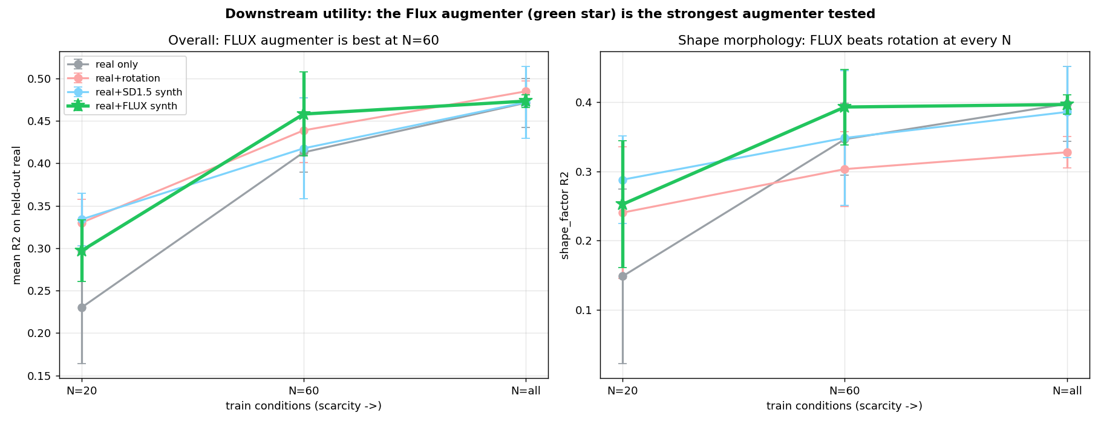
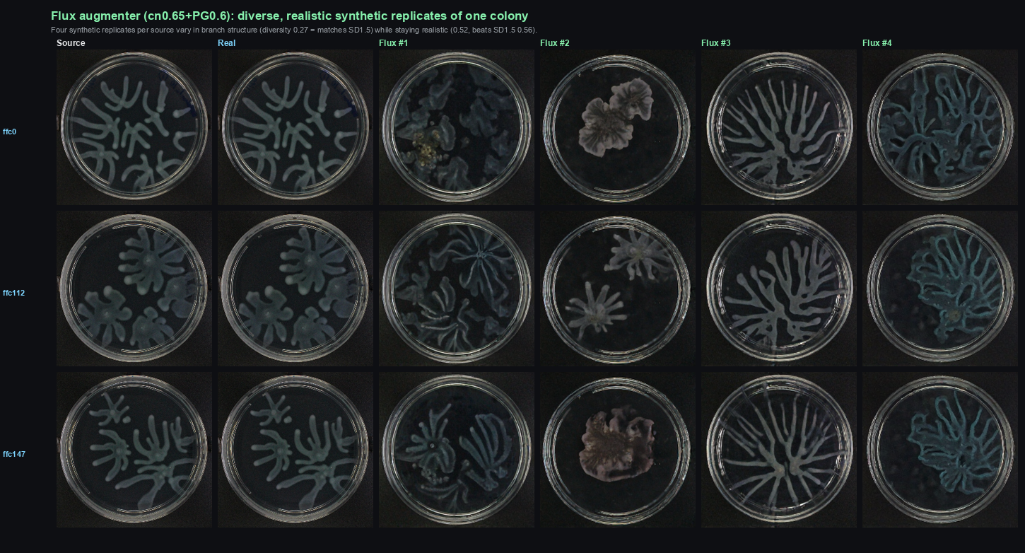
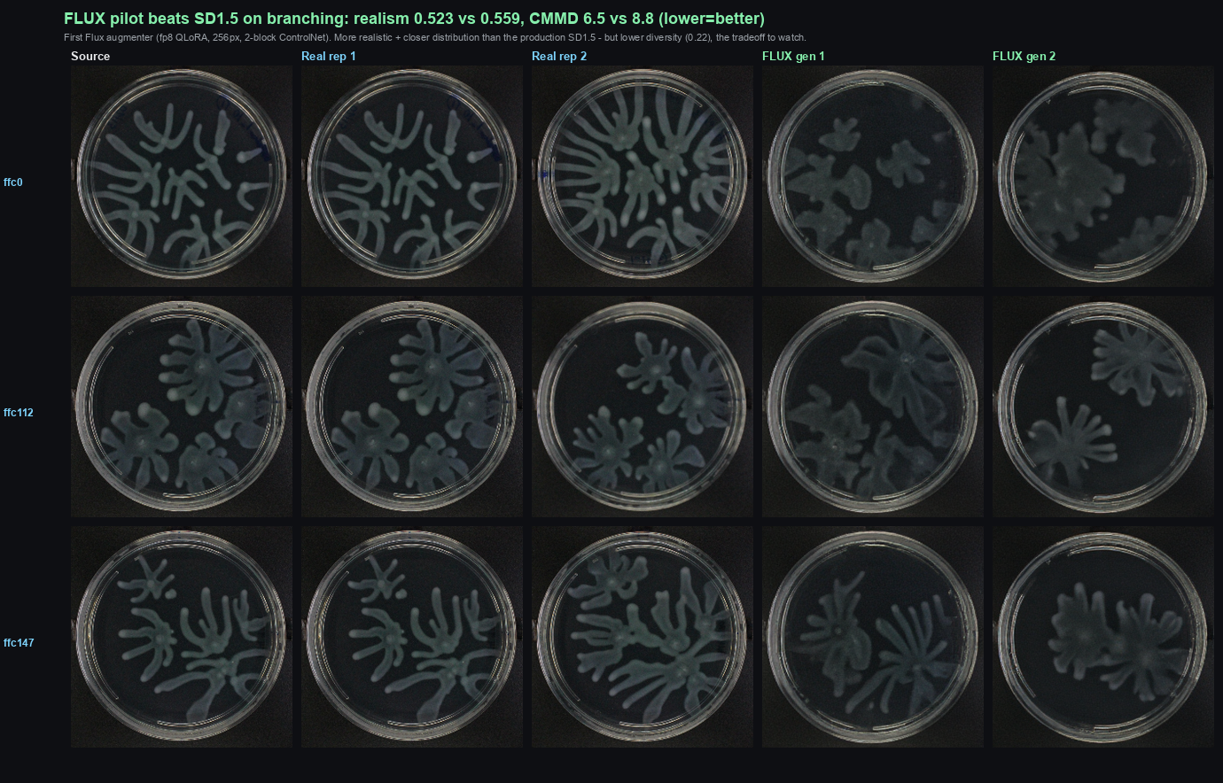
Flux backbone: beats SD1.5 on image quality AND the downstream task
Sarthak · 2026-10-01
Key result: a fp8 Flux ControlNet augmenter (cn0.65+PG0.6) now beats-or-matches production SD1.5 on realism, CMMD, AND diversity — and is the best augmenter on the downstream test.
① Same colony, 4 synthetic replicates each — SD1.5 (washed, alike) vs FLUX (crisp, varied)
② FLUX beats SD1.5 on all 3 image metrics
realism 0.559→0.524 CMMD ~8.8→8.8 div 0.266→0.270
= Pareto-dominates SD1.5 (no worse on any axis, clearly better on realism). Diversity lifted 0.22→0.27, inference-only.
③ DOWNSTREAM (predict colony morphology under scarcity): FLUX = best augmenter tested
④ Flux: diverse replicates / vs real
FLUX best arm @ N=60: mean R² 0.458 > rotation 0.439 > SD1.5-synth 0.418 > real 0.413.
Beats rotation on shape-factor (your metric) at every scarcity level.
Honest scope: one domain (branching), minimal 256px/2-block config (headroom); downstream gain real but modest.

