Slide 1
YOU LAB · DATA-AUGMENTATION PROJECT
Expanding the augmenter's training data
Results update
Finding more replicate data, fine-tuning on a new P. aeruginosa dataset, and what broadening the data does — and doesn't — do.
Sarthak · progress update · September 2026
Notes:
Update since the last deck. Covers: the data search, staging + fine-tuning the Rattray P. aeruginosa dataset, methodology (freezing, epoch curve, Bayesian optimization), the broadening experiment on all of SwarmEvo, and the resulting data strategy.

Slide 2
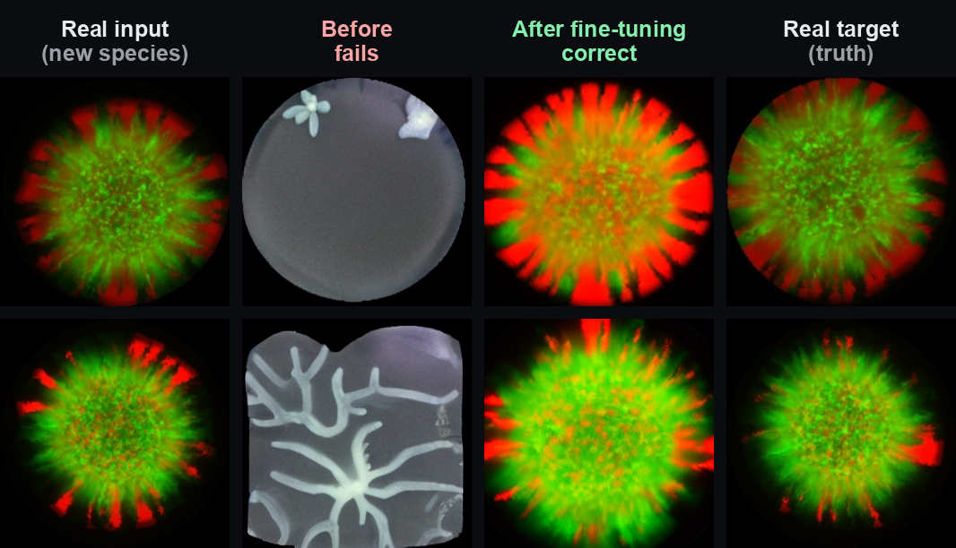
RECAP — WHERE WE WERE
The model adapts to new data via fine-tuning
Established last update: the augmenter is realistic in-distribution but fails out-of-distribution (imposes its trained pattern).
Fine-tuning on the new domain FIXES it — on the 2-species set, realism went 2.5× → 1.16× the real-vs-real baseline.
So the plan became: get MORE real replicate data + adapt the model to it.
Prior result (2-species): before → after fine-tuning → real target
Notes:
This update is the next step of that plan: find and use more real data. The 2-species result is the proof that adaptation works; now we test it on a second real dataset and on broadening.

Slide 3
THE DATA SEARCH
Real replicate data of our morphology is scarce
Ran three verified search passes across Zenodo, figshare, Dryad, BioImage Archive, IDR, Kaggle, Mendeley, HuggingFace and paper supplements.
Genuine open datasets with our dendritic/branching morphology and real replicates barely exist.
The one real SAME-SPECIES replicate set found: GaTech Rattray-2023 — P. aeruginosa colonies, ~77 strains × 4 biological replicates, background-removed, ~256px. Staged + documented.
Most other open 'microbial spatial growth' data is off-morphology (swarms, biofilms, fungi) or behind sign-up walls.
Takeaway: the biggest untapped lever is our own internal P. aeruginosa branching data — no open substitute exists.
Notes:
Full ranked list + citations/licenses saved in Open_Source_Datasets_for_Augmenter.md. Rattray is the only external set that provides true same-species replicate PAIRS (what the ControlNet trains on).

Slide 4
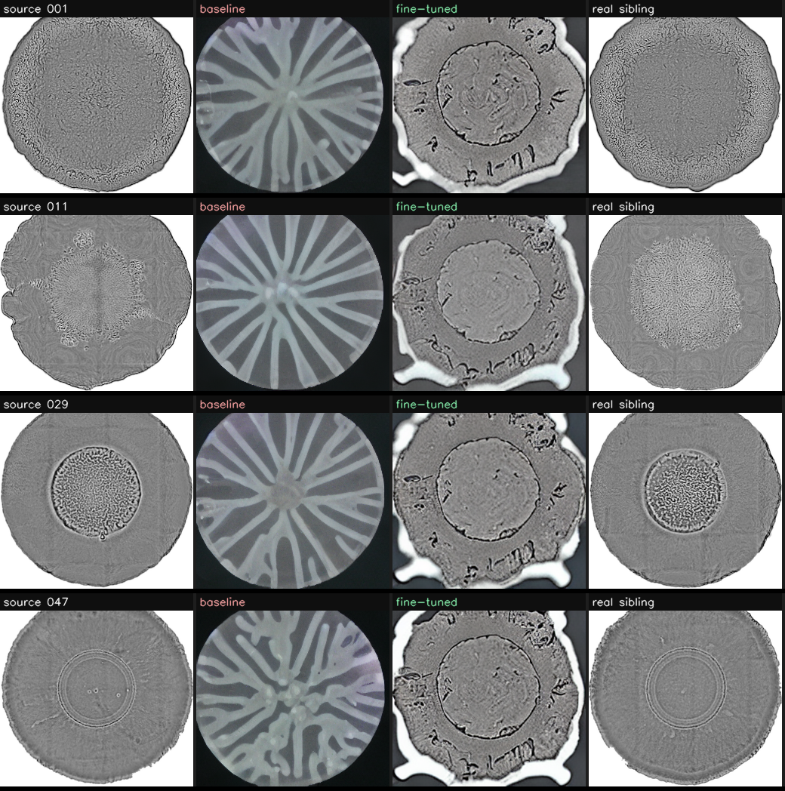
RESULT — NEW DATASET
Fine-tuning on Rattray adapts to the target
2.18× → 1.69×
306 → 226
Realism vs real-replicate baseline (1.0× = ideal)
FID on held-out Rattray (lower = better)
Real same-species adaptation.
Held-out test: 13 strains reserved, zero leakage.
Baseline imposes a radial pattern; the fine-tuned model produces compact colonies matching the real replicates.
source | baseline | fine-tuned | real sibling
Notes:
Modest but real: 2.18x -> 1.69x baseline. Gain smaller than 2-species (1.16x) because the base was already partly OK on Rattray and the public copy is 256px-downsampled. Confirms adaptation works on a second real dataset.

Slide 5
METHODOLOGY & RIGOR
How we tuned it
1
Held-out test
13 strains reserved (zero leakage); metric = realism_vs_sibling ÷ real-vs-real baseline.
2
Layer freezing REVERSED
Full fine-tune beat freezing here — freezing helps for a LARGE domain shift (2-species) but hurts NEAR-domain (Rattray).
3
Epoch curve
Optimal ≈ epoch 3; more epochs don't help (mild overfit after).
4
Bayesian optimization
Built an Optuna/TPE search (lr × freeze × epochs × control) — confirmed the optimum region efficiently; reusable for bigger sweeps.
Notes:
Every run seeded + logged (manifest + git SHA + Weights & Biases). The freezing reversal is a genuine methodology note: freeze depth should scale with how far the target is from the base domain.

Slide 6
RESULT — DOES MORE DATA HELP?
Broadening on all of SwarmEvo did not help
Broadened the base on ALL 47,625 SwarmEvo pairs (every frame, 81 colonies), then fine-tuned on Rattray. Scored on the held-out Rattray test (lower = better):
Rattray-only (direct fine-tune)
1.69× realism — best
Broaden → Rattray (all 47.6k SwarmEvo)
1.82× realism — worse
Broadened base alone
1.92× realism
Baseline (no fine-tune)
2.18× realism
Why: SwarmEvo is a different organism/morphology (Enterobacter swarm) — broadening shifts the base away from the P. aeruginosa target faster than fine-tuning recovers it.
Notes:
Used ALL the data (no subsampling) via a two-stage design so nothing was drowned. Result is clear: more OFF-morphology data doesn't help this target — it slightly hurts. Consistent with the in-distribution-only finding.

Slide 7
THE DATA LESSON
More data helps — only if it's on-target
The augmenter is faithful only in-distribution (now confirmed four independent ways):
Fine-tune on target species (2-species, Rattray)
Works → adapts to the new data
Inference-parameter tuning
No effect on the OOD failure
Downstream sim→exp augmentation
Naive injection hurts
Broadening on off-morphology data (SwarmEvo)
Doesn't help — slightly hurts
So the productive expansion is TARGET-DOMAIN data (more P. aeruginosa colonies) — not volume of distant data.
Notes:
This reframes 'more data = better': true for on-target data, false for off-morphology data even at 47k pairs. It tells us exactly where to invest next.

Slide 8
NEXT STEPS & DISCUSSION
Get more target-domain data
Recommended
Questions for you
Internal EMBO / Luo P. aeruginosa branching replicates — exact morphology, real replicates, lab-owned. The 'more data' that should actually help.
Full-resolution Rattray from the authors (public copy is 256px-downsampled).
Hold off on more distant open datasets — evidence says they won't help.
Can we get the raw full-res EMBO/Luo branching replicate images (via Nan Luo)?
Worth emailing the Rattray authors for full-resolution originals?
Is 'efficient adaptation to a new dataset' the right near-term goal to present?
Notes:
All code + results on branch sa603/experiment-tracking-and-sweeps; datasets doc + memory updated. Recommendation: pursue target-domain data next.

