Slide 1
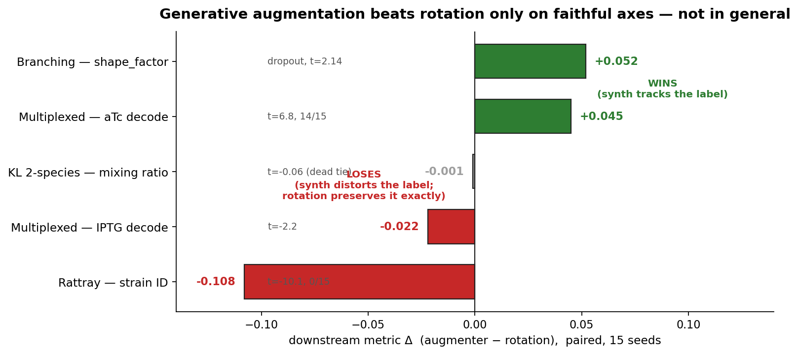
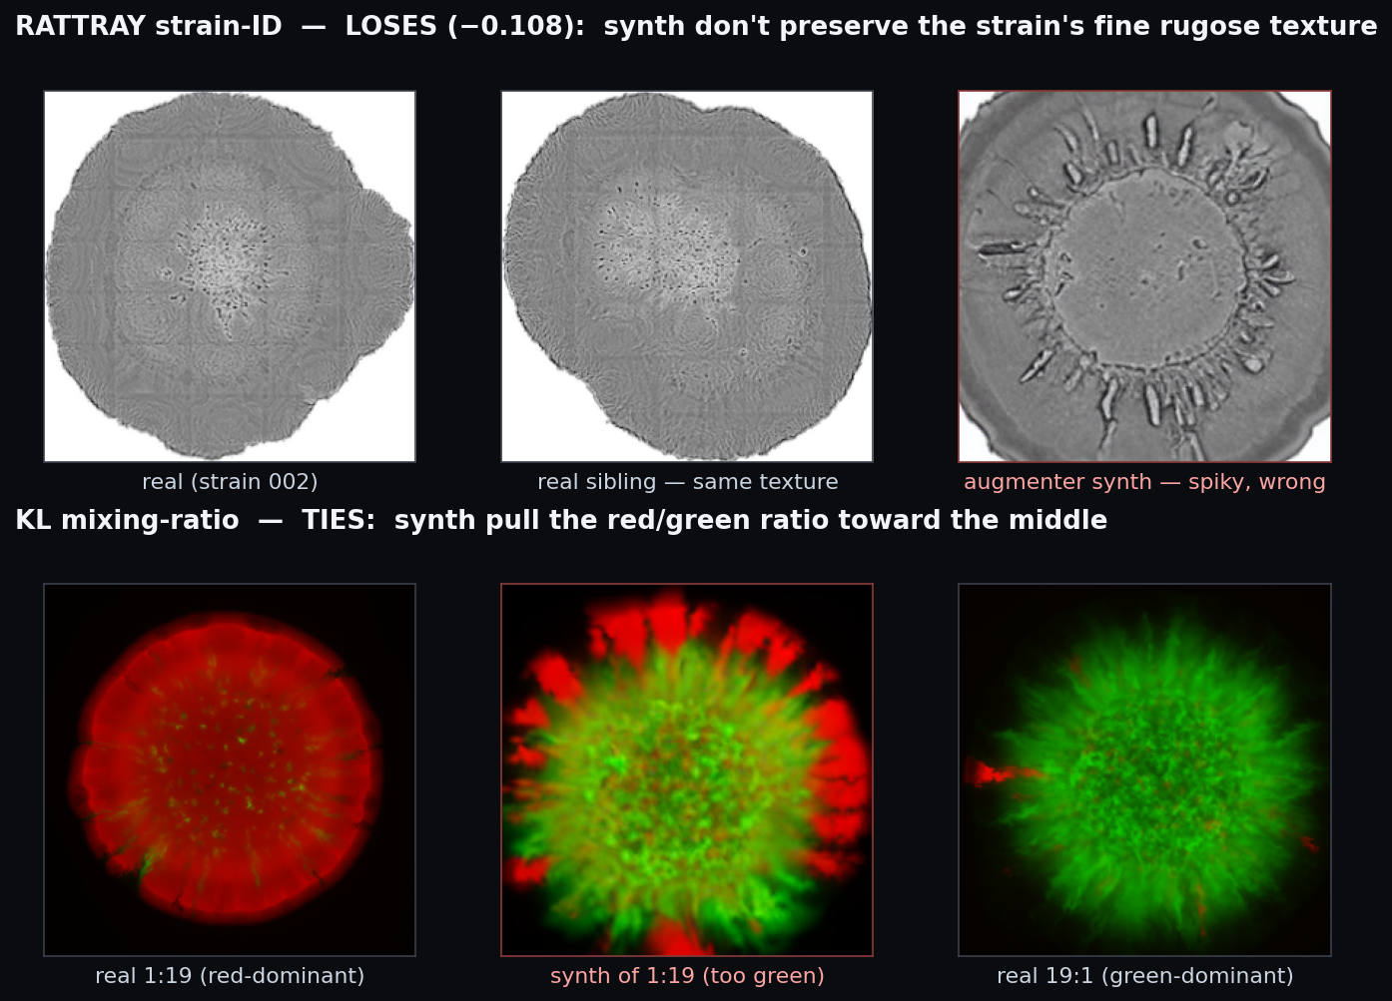
Does the augmenter's edge generalize? Only where it's faithful to the label.
Wider-dataset test — 2 new datasets + a strengthen check. Generative augmentation beats rotation on faithful axes; ties or loses where its synthetic variation distorts the label.
WHY — the synth are realistic but LABEL-UNFAITHFUL (seeing is believing)
THE RESULT — downstream Δ vs rotation, per dataset (paired, 15 seeds)
VERDICT
Axis-specific, not general.
WINS where synth tracks the label
branching shape +0.052 · mux aTc +0.045
TIES / LOSES where synth distorts it
KL ratio −0.001 · rattray strain −0.108 · mux IPTG −0.022
Mechanism: the augmenter regresses toward the mean colony and loses the extreme label value; rotation is label-invariant, so it preserves the label exactly.
A boundary condition — maps where the method helps, and why.

