Slide 1
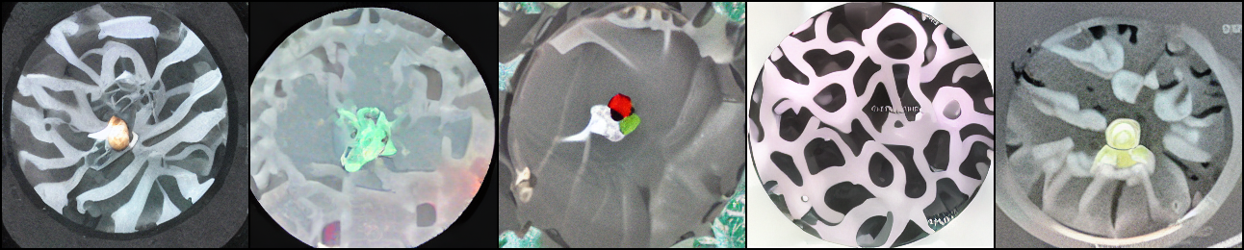
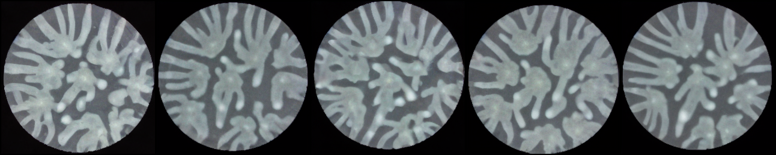
YOU LAB · DATA-AUGMENTATION PROJECT
Generative augmenter for bacterial-colony replicates
Progress Update
start of training — noise
end — realistic P. aeruginosa branching
Trained from scratch — 3 days, 375k steps → it learned the distribution.
Sarthak · progress update · Aug 24, 2026

Slide 2
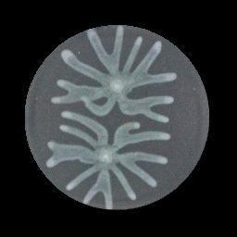
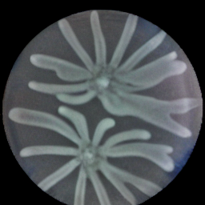
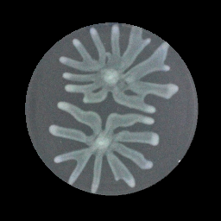
RESULT 1
It works within its training domain
On held-out colonies it generates plausible new replicates; varied, not memorized.
real source (input)
generated replicate
real sibling (truth)
0.31
0.23
0.25
generated vs real replicate (LPIPS)
real-vs-real baseline → only ~1.3× apart
sample diversity — not mode-collapsed
Mean LPIPS (a learned perceptual image distance) from each generated image to the other real replicates of that colony.
The same LPIPS, but measured between two real replicates:
how much real ones naturally differ (the yardstick).
Mean LPIPS between the model's two generated outputs for a single input source.

Slide 3
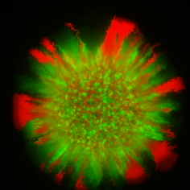
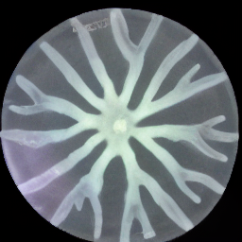
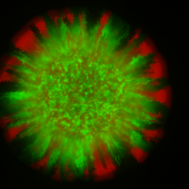
RESULT 2 · THE KEY FINDING
But it fails on a new species (out-of-distribution)
It ignores the input and imposes its trained branching. Here, it skips the fluorescence and hallucinates tendrils.
real source — 2-species co-culture
generated — wrong
real sibling (truth)
74 → 346
1.3× → 2.3×
FID (realism) — 4.7× worse
realism vs real-replicate baseline
FID: distance between the InceptionV3 feature distributions of the generated vs. real image sets.
The realism LPIPS divided by the real-vs-real baseline — how many times farther fakes sit than reals do.

Slide 4
IN PROGRESS · NEXT STEPS
Fine-tuning on the new data to close the gap
1
Carved a clean held-out test split (no leakage) to measure improvement honestly.
2
Built the fine-tune + auto-scoring pipeline; resumes our model, sweeps learning rate.
3
First fine-tune ran: trained all 4 epochs, salvaged 3 checkpoints.
4
Next: score fine-tuned vs baseline → does it close the gap? then sweep LR / epochs.

