Slide 1
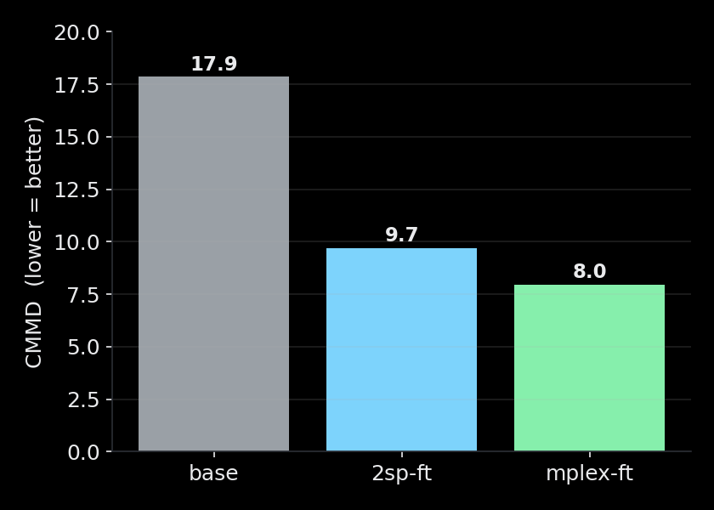
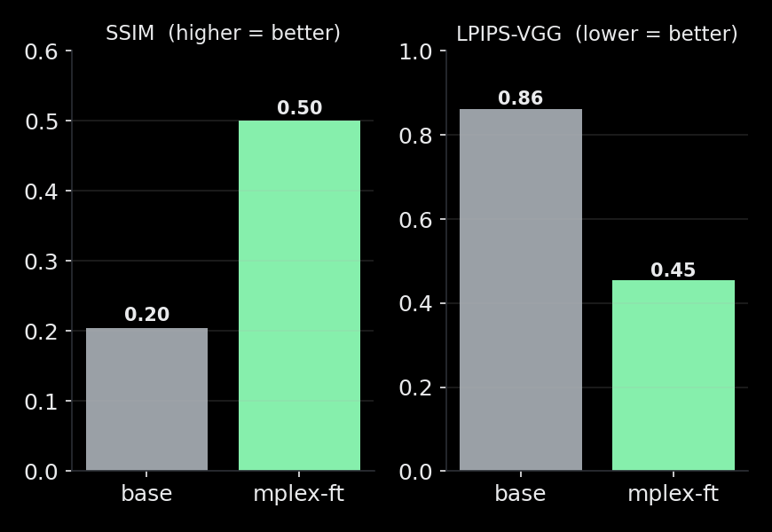
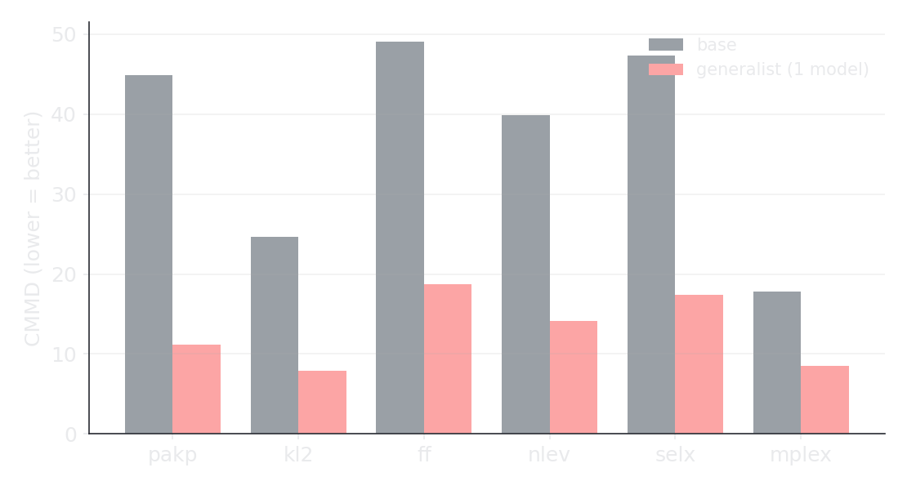
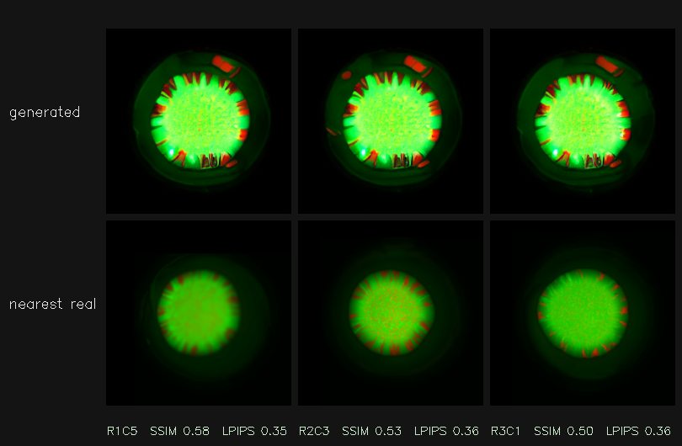
Augmenter — metrics update (CMMD + per-sample)
Sarthak · September 2026
Distribution (CMMD): base 17.9 → fine-tuned 8.0
Individual samples: SSIM ↑, LPIPS ↓ with fine-tuning
One generalist model: better CMMD on all 6 domains
Each generated replicate vs its nearest real sample
copy_rate = 0.0 across all 60 runs (novel, not memorized) · CMMD corroborates LPIPS and is stable where FID isn't · Flux ControlNet runs on our A5000 (feasible next backbone)

