Slide 1
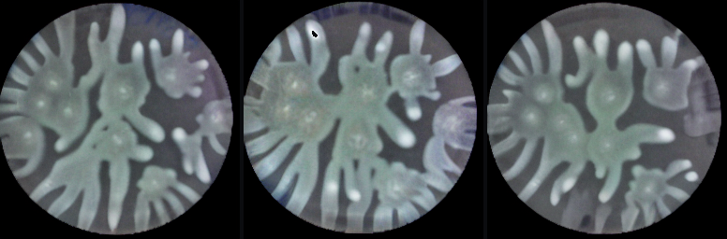
YOU LAB · DATA-AUGMENTATION PROJECT
Generative augmenter for bacterial-colony replicates
Results update
Fixing out-of-distribution generation — and testing whether the synthetic data helps downstream models.
In-distribution: synthetic colony replicates generated by the augmenter — realistic and varied
Sarthak · progress update · August 2026
Notes:
Update on the replicate-to-replicate ControlNet + Stable Diffusion augmenter. Covers 5 experiments plus the reproducible pipeline. Full written detail in RESULTS_DEEP_DIVE.md.

Slide 2
BACKGROUND
What the augmenter does
A ControlNet + Stable Diffusion model. Input: one experimental colony image. Output: new, plausible synthetic replicates of the same colony.
Purpose: beat experimental data scarcity — turn a few real images into many realistic ones.
Your model was trained from scratch (~3 days, 375k steps) on P. aeruginosa branching-colony data.
In-distribution it works well: outputs are realistic and diverse (not mode-collapsed).
Synthetic colony replicates generated in-distribution — realistic and varied
Notes:
The model is spatially conditioned on the input colony via ControlNet. In-distribution, generated replicates sit ~1.3-1.4x as far (LPIPS) from real replicates as real replicates are from each other — nearly as realistic as real, and diverse.

Slide 3
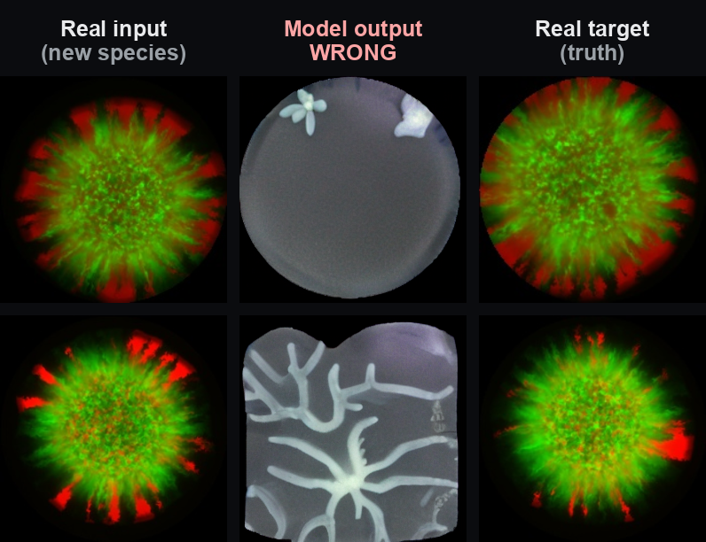
THE PROBLEM · THE STARTING POINT
It fails on a new species (out-of-distribution)
2.5×
How much worse than real replicate variation (OOD)
Baseline = 1.0× — as far apart as real replicates are.
On a species never seen in training (a 2-species fluorescence co-culture), the model ignores the input.
It strips the fluorescence and paints its trained grayscale branching pattern instead.
This out-of-distribution failure is the central problem we set out to fix.
What you're seeing: the model ignores the fluorescent input and paints its trained grayscale branches.
Notes:
Metric: realism_vs_sibling (LPIPS generated-to-real) divided by baseline_real_vs_real (LPIPS real-to-real). 1.0x = as realistic as real. OOD baseline = 2.5x; FID 359.

Slide 4
APPROACH
Five experiments on a reproducible pipeline
1
Fine-tuning
Adapt the model to the new species
2
Layer freezing
Freeze early layers during fine-tuning
3
Inference sweep
Tune sampling knobs (guidance scale, control strength)
4
Downstream utility: sim→exp
Does synthetic data help the predictor?
5
Downstream utility: exp→seed
Inverse task; correspondence-preserving
Plus — reproducible pipeline: fixed seeds, per-run manifests, Weights & Biases tracking, and disk fixes so every run is logged and repeatable.
Notes:
Experiments 1-3 target the OOD failure directly. Experiments 4-5 test the harder, more valuable question: does synthetic data actually improve downstream models.

Slide 5
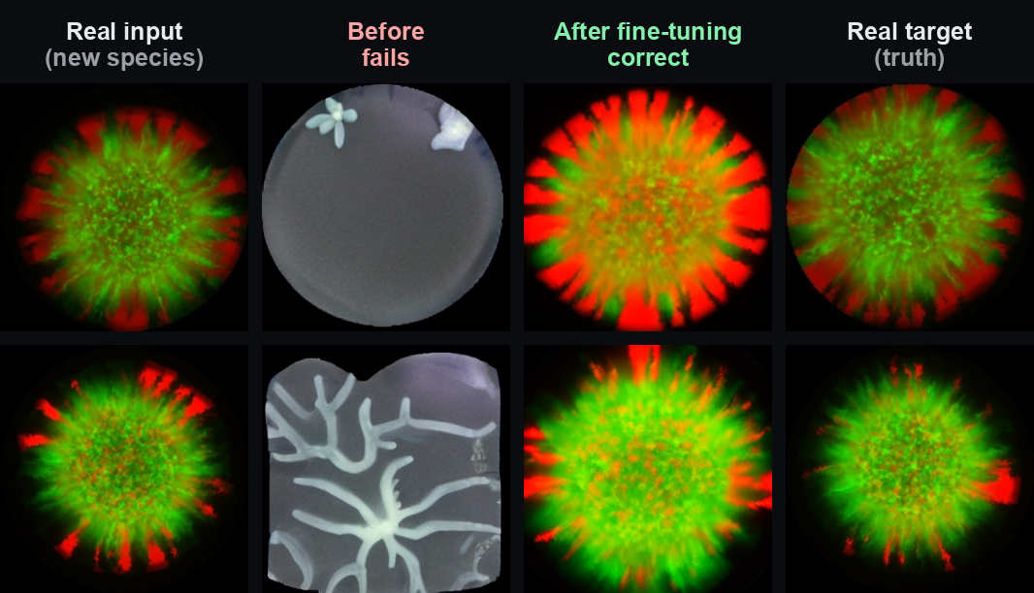
RESULT 1 · THE KEY POSITIVE
Fine-tuning fixes the OOD failure
359 → 85
2.5× → 1.16×
FID on the new species (lower = better)
Realism vs real-replicate baseline (1.0× = ideal)
Fréchet distance between generated and real image sets.
Nearly indistinguishable from real replicate variation.
Fine-tuning on the new species restores faithful generation, correct fluorescence, right structure, diversity intact.
Layer freezing helps (Kinshuk's suggestion): freezing early layers beat full fine-tuning (FID 89.6 vs 98.8) and adapted more stably, reproduced exactly across seeds.
What you're seeing: after fine-tuning, outputs match the real target's fluorescence and structure.
Notes:
Caveat for Kinshuk: this is ADAPTATION, not zero-shot — tested on held-out data of the same species it was fine-tuned on. True zero-shot is still open. FID is noisy on small test sets; we lean on realism/baseline. The lr5e-6 freezing run reproduced exactly across two independent jobs.

Slide 6
RESULT 2 · INFERENCE TUNING
Which lever actually fixes OOD?
2.54×
≈ 2.5×
1.16×
Baseline — no change
Inference tuning (scale + strength) — no help
Fine-tuning — fixes it
OOD realism ÷ real-replicate baseline (1.0× = as realistic as real; lower is better)
We swept the guidance scale (9 → 15.1) and control strength across 9 configurations — none fixed OOD.
Raising control strength made OOD worse (it amplifies the wrong trained prior); raising scale barely moved it and hurt in-domain quality.
Takeaway: the failure lives in the learned weights, not the sampling knobs — so fine-tuning is the lever, not inference settings.
Notes:
The scale knob is classifier-free guidance, which mostly changes sharpness here (empty prompts). The knob that governs input-adherence is control strength — turning it up makes OOD worse. Default (scale 9, strength 1) is already optimal in-domain.

Slide 7
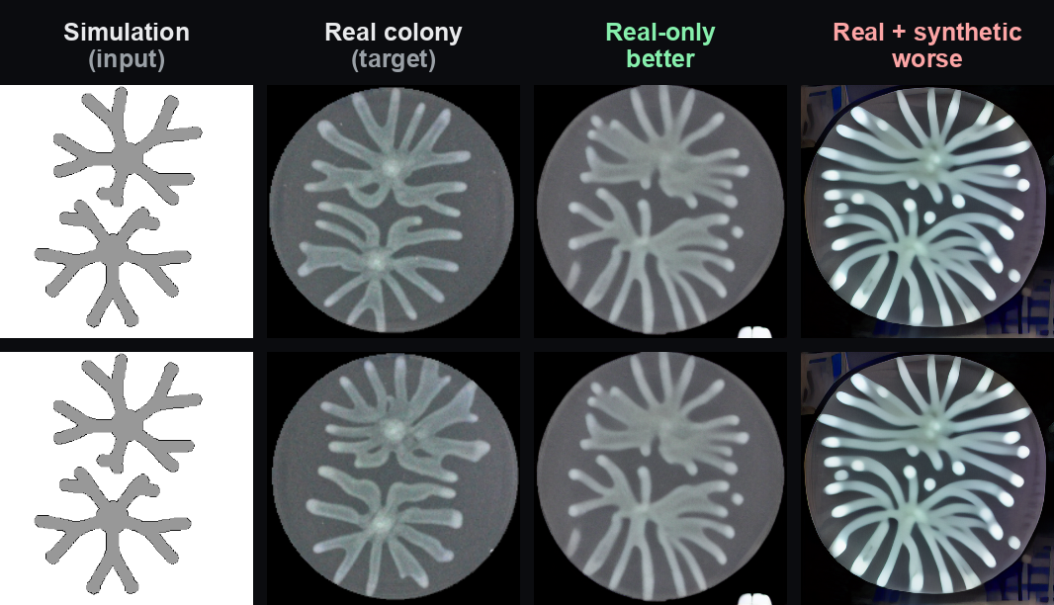
RESULT 3 · DOWNSTREAM UTILITY
Naive synthetic augmentation hurt the predictor
0.39 → 0.20
Downstream accuracy (SSIM): real-only → real+synthetic
Adding synthetic data made the predictor worse.
Test: train the lab's sim→exp predictor on real-only vs real+synthetic; evaluate on real held-out data.
Adding synthetic data halved accuracy — it collapsed to a generic radial pattern.
Cause (a design flaw we own): pairing diverse replicates with a single simulation broke the input↔output correspondence.
Shows naive injection hurts — not that synthetic data can't help this task.
What you're seeing: adding synthetic data pushed predictions toward a generic radial pattern — worse.
Notes:
A: SSIM 0.392 / LPIPS 0.378. B: SSIM 0.195 / LPIPS 0.490. The synthetic replicates were diverse but all paired to one simulation, so the model learned one-sim-to-many-colonies noise and reverted to a generic prior. A correspondence-preserving injection could behave differently.

Slide 8
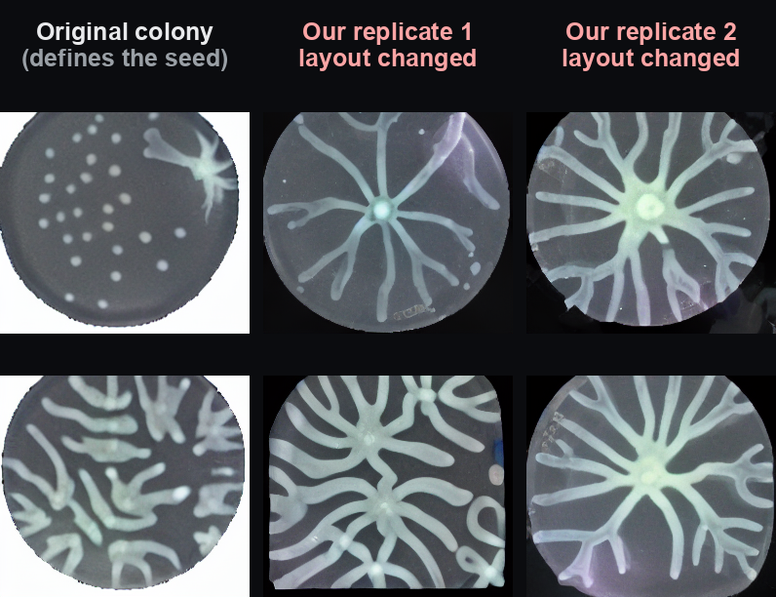
RESULT 4 · DOWNSTREAM UTILITY
Second task: stopped at a pre-flight check
The exp→seed inverse task is a better fit: many replicates legitimately map to one seed (correspondence-preserving).
But it requires the augmenter to PRESERVE colony locations in its replicates.
It doesn't: on these inputs it again imposed a generic radial branch — locations not preserved.
So we stopped before training, saving ~a day of compute. (The lab's exp→seed model is already trained on synthetic data.)
What you're seeing: a valid replicate must keep the colony layout — but ours redraw it entirely.
Notes:
The inputs here (scattered multi-colony dishes) are out-of-distribution for the augmenter, so it hallucinated its prior. 'Stopped', not 'impossible' — a fine-tuned augmenter might preserve locations. The pre-flight visual gate is a reusable lesson.

Slide 9
THE THROUGH-LINE
The augmenter is faithful only in-distribution
In-distribution replicates
Faithful, realistic, diverse
New species (out-of-distribution)
Imposes branching prior → fine-tuning fixes it
Inference-parameter tuning
No knob fixes OOD (strength makes it worse)
Downstream sim→exp augmentation
Naive injection breaks correspondence → hurts
Downstream exp→seed augmentation
Doesn't preserve layout on OOD inputs → gated
Bottom line: not yet a plug-in downstream augmenter — unless first fine-tuned to the target distribution (which works).
Notes:
Out-of-distribution — whether a new species or a new spatial layout — the model imposes its trained branching prior and ignores the input. That single mechanism explains every negative result. The fix is adaptation.

Slide 10
NEXT STEPS & DISCUSSION
Where to go next
Recommendations
Questions for you
Fine-tune-then-augment: adapt the augmenter to the downstream domain first, then re-test utility.
Redesign downstream injection to preserve input↔output correspondence.
Flow matching (SD3 / FLUX): a stronger backbone, but not a targeted OOD fix — a later pilot, not now.
Escalate the lab-wide disk issue (youlab group is 99% full).
Is efficient adaptation to a new species a satisfying result, or is the bar zero-shot / proven downstream utility?
Worth a correspondence-preserving downstream redesign, or fine-tune-then-augment first?
Any appetite for the SD3 flow-matching pilot?
How should we handle the shared-disk situation?
Notes:
All code + results are committed to the branch sa603/experiment-tracking-and-sweeps. A full written deep-dive (RESULTS_DEEP_DIVE.md) accompanies this deck.

