Slide 1
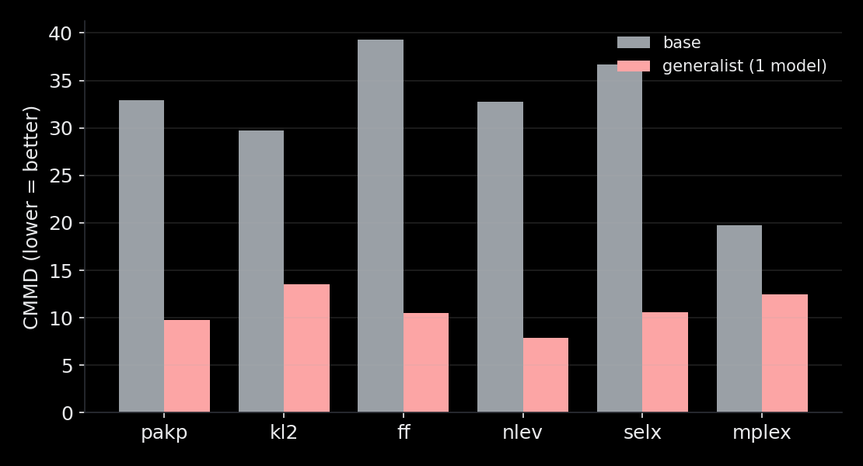
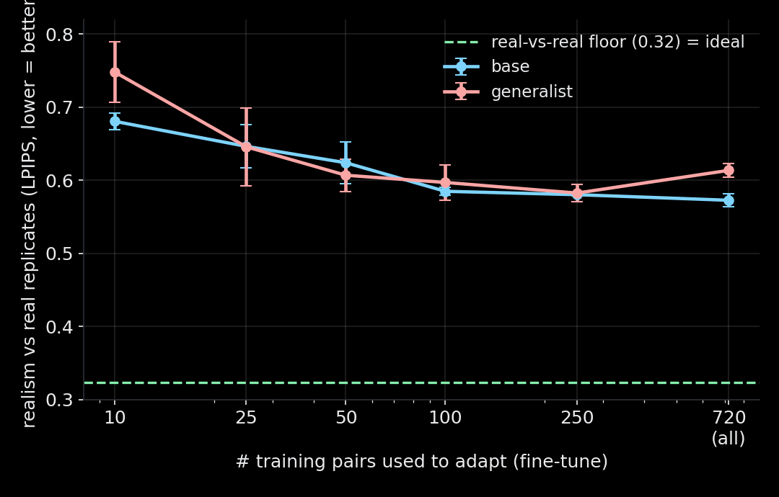
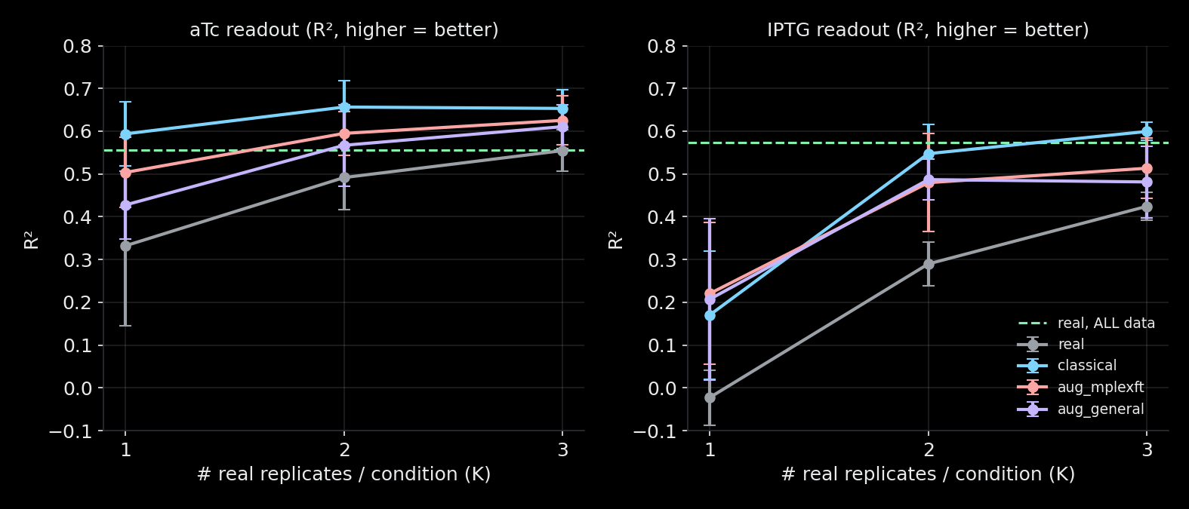
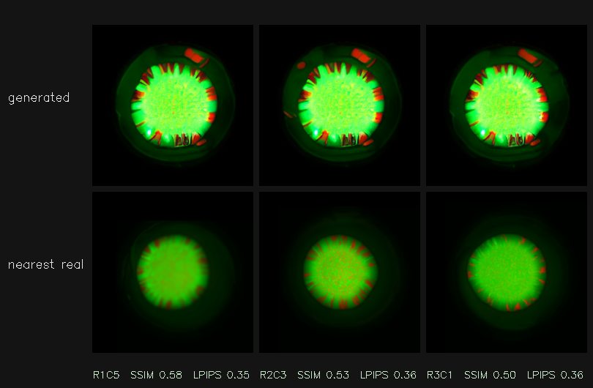
Augmenter — results update (adaptation + downstream)
Sarthak · September 2026
One model improves realism (CMMD) on all 6 datasets
Adapts to a new dataset with ~100 image pairs
Synthetic data improves the aTc/IPTG readout
Generated replicate vs its nearest real (copy_rate = 0)
Realistic & novel on your CMMD (copy_rate 0) · adapts with ~100 pairs · improves the sensing readout (rescues IPTG when scarce) · classical rotation competitive on this rotation-friendly task

