Slide 1
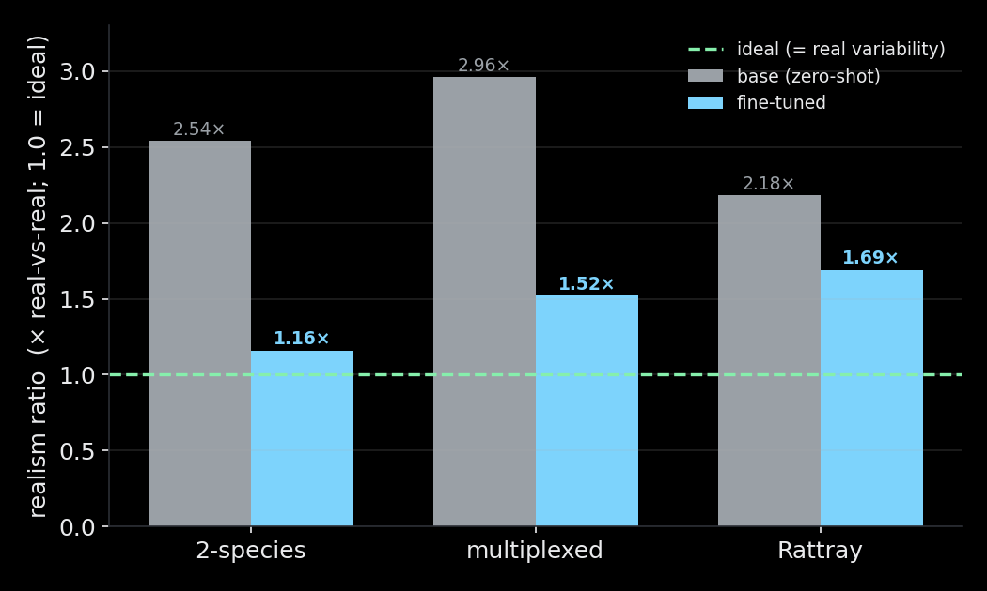
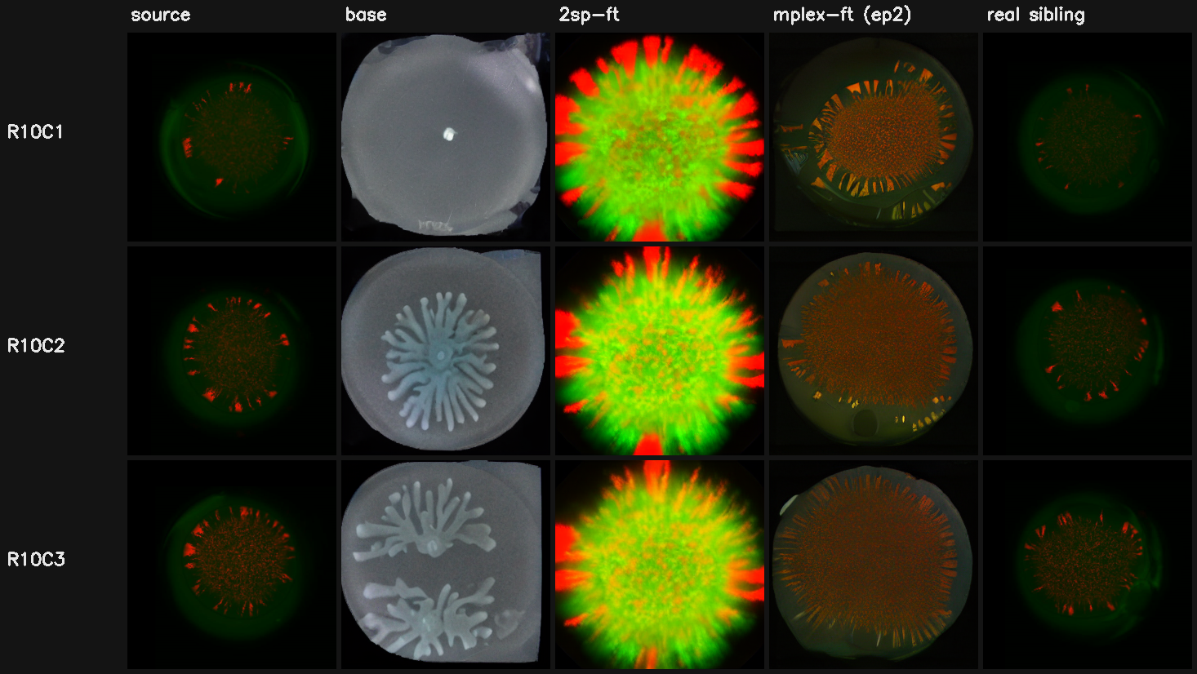
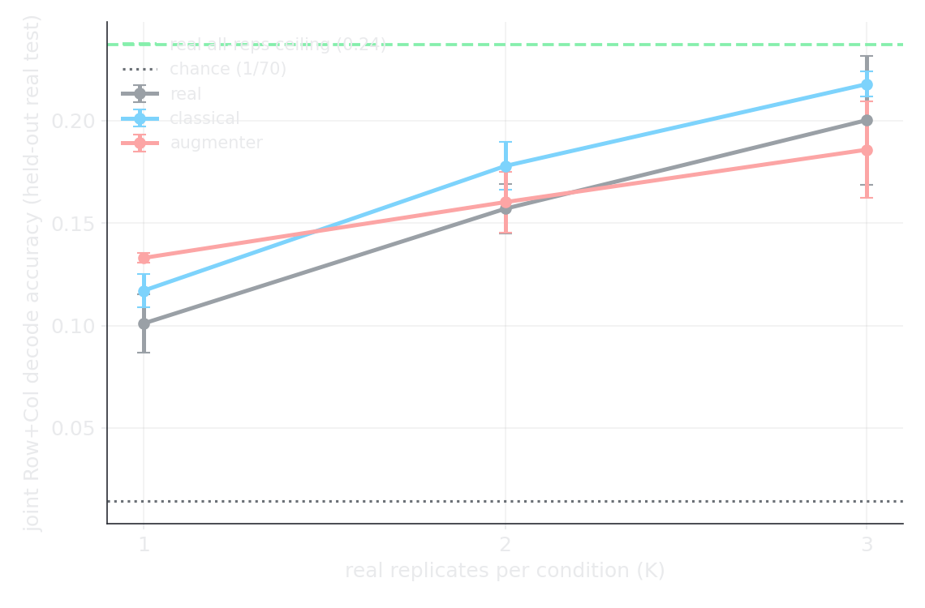
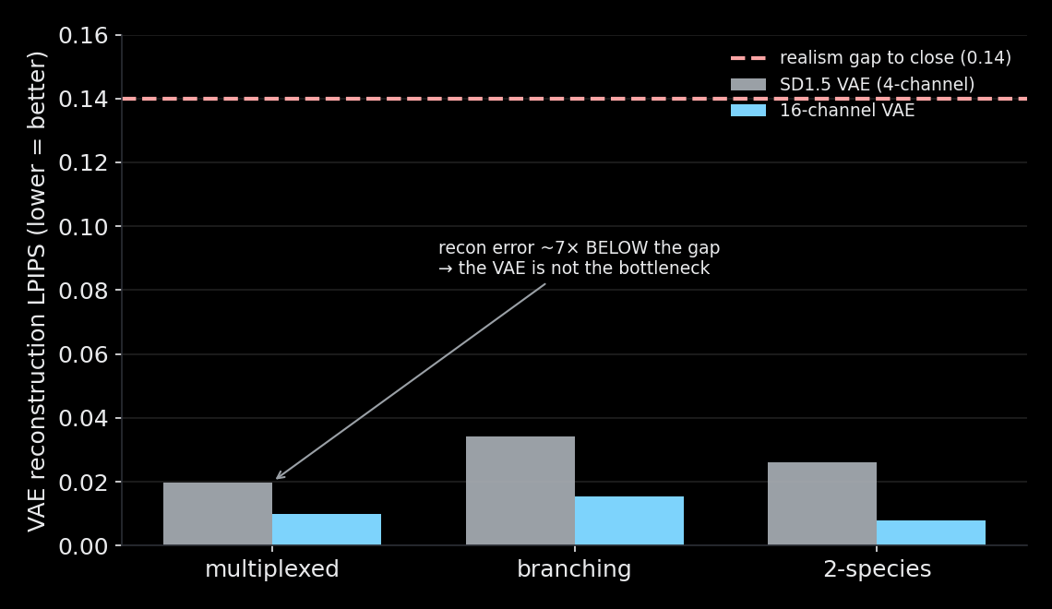
Replicate Augmenter — results at a glance
Sarthak · September 2026
Fine-tuning closes the OOD gap — 3 domains
Base fails; fine-tune reproduces the pattern
Helps a real task only at extreme scarcity (K=1)
The ceiling is the generator, not the VAE
Bottom line: adapts to any domain · data solved (400 GB internal) · downstream value gated by generator realism

