Slide 1
REPLICATE-TO-REPLICATE AUGMENTER
Project Update
Can synthetic bacterial-colony replicates beat experimental data scarcity?
Sarthak Agrawal · for Kinshuk · September 2026
Notes:
Update covering everything since the last review: the fine-tune lever confirmed on 3 domains, a generalist model, a large internal data find, an honest downstream-utility result, and why the SD1.5 realism ceiling is generative (not the VAE).

Slide 2
EXECUTIVE SUMMARY
Where the augmenter stands
Fine-tuning adapts it to ANY domain
Closes the out-of-distribution gap on all three tested domains (2-species 2.5→1.2×, multiplexed 3.0→1.5×, Rattray 2.2→1.7×).
Data scarcity is solved — internally
399 GB of on-target colony replicate data found on the cluster; 4,500+ ready replicate pairs. No outreach needed.
One generalist model transfers across domains
Beats the base on 4 of 6 domains and fixes mode-collapse everywhere — a strong universal default.
Downstream usefulness is realism-gated
Synthetic replicates help a real task only under extreme scarcity (1 real/condition); classical augmentation matches them beyond that.
The realism ceiling is generative, not the VAE
A cheap diagnostic refuted the flow-matching rationale (the VAE reconstructs patterns fine) — saving a multi-day build.
Replicate Augmenter · Project Update · Sept 2026
2

Slide 3
RECAP
The method, and the problem it hit
THE METHOD
THE PROBLEM
Feed one real replicate image in as a spatial control; a ControlNet + Stable Diffusion model generates NEW, realistic replicates of the same condition — capturing plate-to-plate biological variability, not copying the input.
In-distribution it is faithful — ~1.3× the real replicate-to-replicate variability (≈ideal).
Out-of-distribution it fails: it ignores the input and paints its trained pattern, at 2.5–3.0× (far from real).
One real plate → many training-quality plates.
Closing that OOD gap is the whole project.
Replicate Augmenter · Project Update · Sept 2026
3

Slide 4
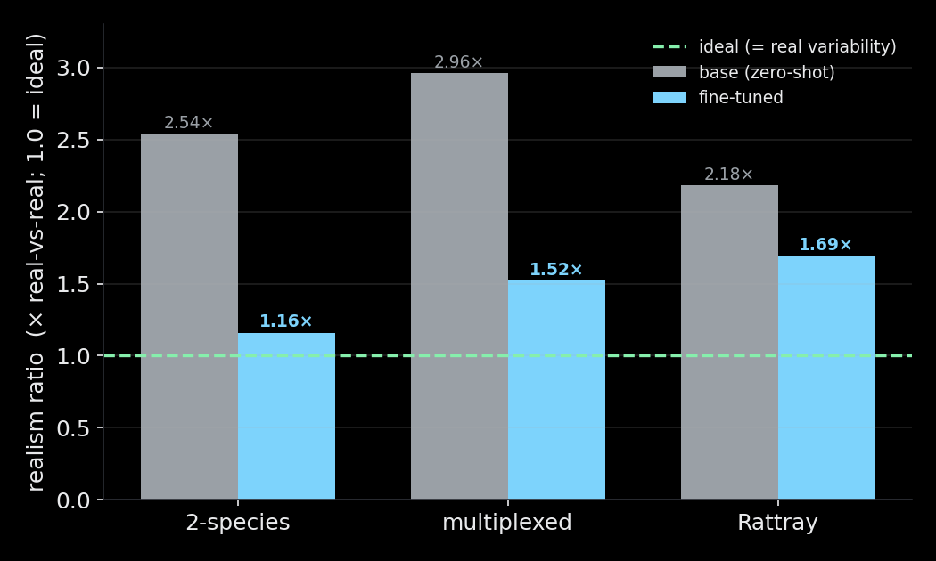
RESULT 1 · THE CORE LEVER
Fine-tuning closes the OOD gap — on every domain
What this shows
A few epochs of fine-tuning on target data moves realism from 2.2–3.0× toward the ideal 1.0×.
Confirmed on 3 independent domains — the recipe is robust and predictable.
Inference-only knobs (guidance, control strength) cannot do this; fine-tuning is required.
Gain scales with domain distance: 2-species (biggest shift) improves most.
Replicate Augmenter · Project Update · Sept 2026
4

Slide 5
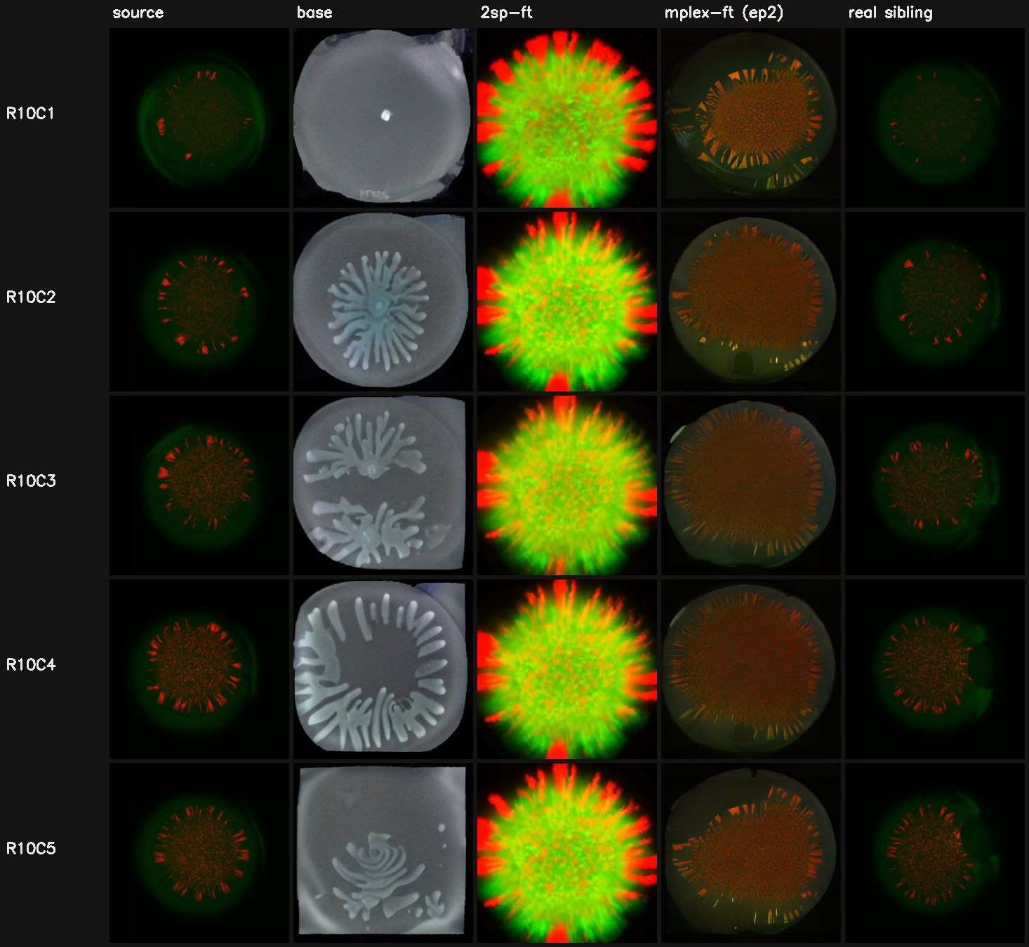
RESULT 1 · EXAMPLE
Multiplexed sensing: base fails, fine-tune reproduces it
Reading the panel (left → right)
source — the real input replicate
base — washed grayscale dish (ignores the input)
2sp-ft — wrong pattern (green radial ‘bursts’)
mplex-ft — correct sparse red-dot pattern
real sibling — a held-out real replicate
Realism 2.96× → 1.52× · FID 314 → 105
Only the multiplexed-fine-tuned model reproduces the right pattern class.
Replicate Augmenter · Project Update · Sept 2026
5

Slide 6
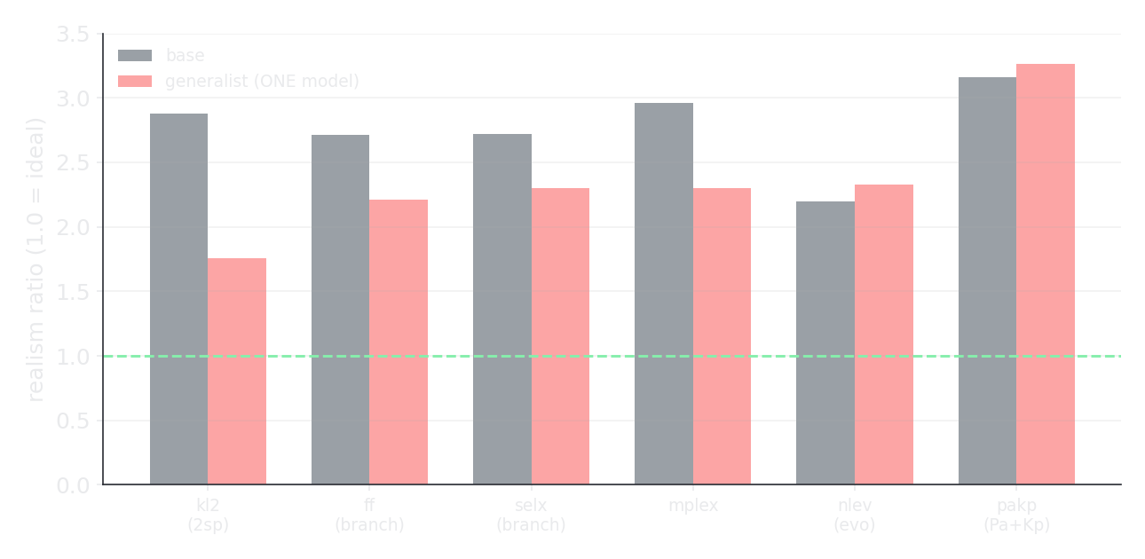
RESULT 2 · ONE MODEL FOR ALL DOMAINS
A generalist: positive cross-domain transfer
One model, six domains
Beats the base on 4/6 domains (kl2 2.9→1.8×).
Improves FID ~2× and fixes mode-collapse on all 6 (diversity 0.14→0.26).
Trained only on internal on-target data — distant datasets (SwarmEvo) did NOT help.
Trade-off: a specialist still wins per target.
Best used as a strong default and a warm-start base.
Replicate Augmenter · Project Update · Sept 2026
6

Slide 7
RESULT 3 · THE DATA PROBLEM, SOLVED
399 GB of on-target replicate data — on the cluster
The biggest lever from our findings was more target-domain data. It turned out to be internal, needing no outreach:
Dataset
Organism / type
Conditions
Replicate pairs
EmrahPaKp
P. aeruginosa + K. pneumoniae
125
1,988
KL 2-species
2-species co-culture (cropped)
29
1,096
Final_folder
core branching replicates
195
514
NL_evolution
branching evolution library
84
504
Selected_Exps
selected branching experiments
183
374
+ multiplexed
(already built)
70
1,932
≈ 4,500 internal replicate pairs across 5 experimental domains (+ multiplexed) — exactly the on-target data our findings said was the only thing that helps.
Replicate Augmenter · Project Update · Sept 2026
7

Slide 8
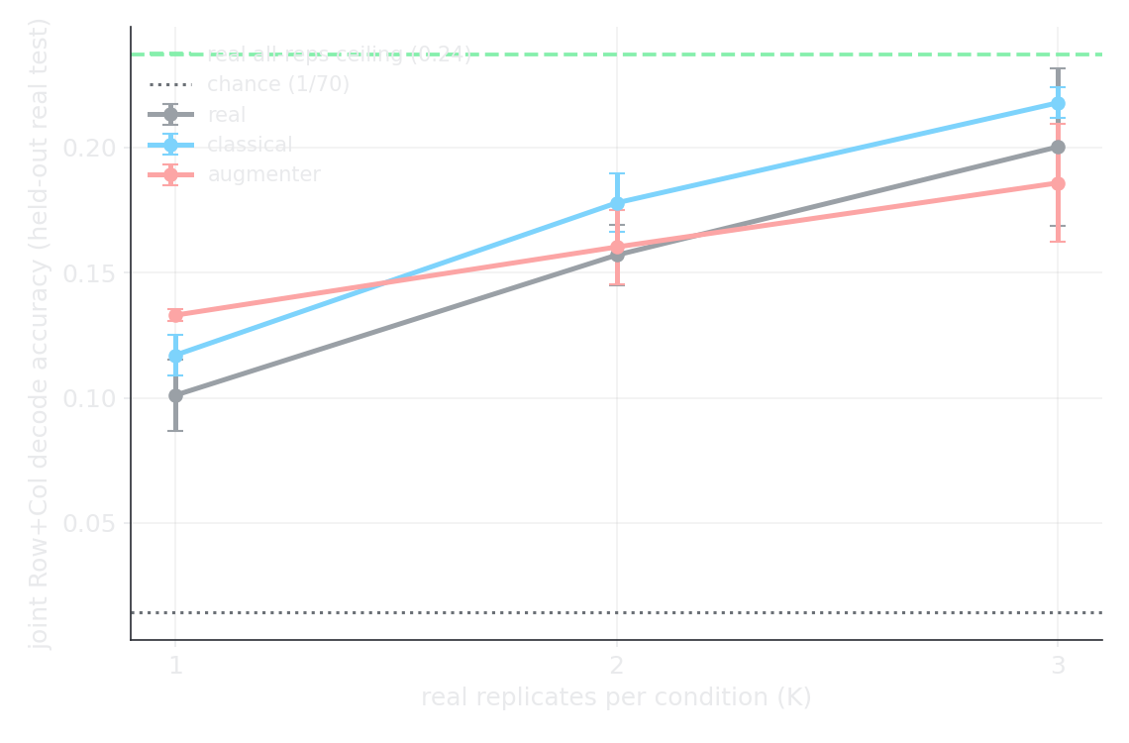
RESULT 4 · THE HONEST ONE
Does the synthetic data actually help a task?
Multiplexed input-decoder, data-scarce
Task: read Row + Column back out of the pattern, trained on K real reps/condition.
Augmenter WINS only at K=1 — ~2× the gain of classical rotation from a single replicate.
At K≥2 the differences are within noise; classical rotation trends best.
Two downstream tests now, no clear win beyond extreme scarcity.
Realism ≠ utility. Usefulness is gated by how good the augmenter is.
Replicate Augmenter · Project Update · Sept 2026
8

Slide 9
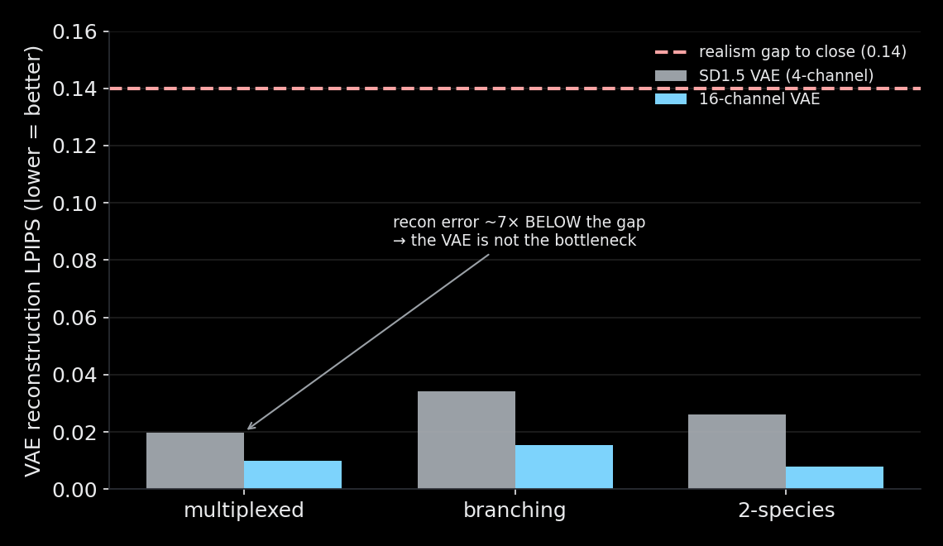
RESULT 5 · WHY — AND A BUILD WE AVOIDED
The ceiling is generative, not the VAE
A cheap diagnostic before a big build
Hypothesis: SD1.5's VAE can't represent sparse patterns → try a flow-matching backbone (SD3.5, 16-ch VAE).
Test: even the 4-ch VAE reconstructs at LPIPS 0.02 — ~7× below the 0.14 realism gap.
So the VAE is NOT the bottleneck; SD3.5's headline advantage wouldn't help.
Warm-start also confirmed 1.52× is init-independent — a generation limit.
The cheap test saved a multi-day SD3.5 build.
Replicate Augmenter · Project Update · Sept 2026
9

Slide 10
BOTTOM LINE & NEXT STEPS
Where we are — and what would help
What we know
What would help from you
The augmenter reliably adapts to any domain and makes realistic, diverse replicates.
Data is no longer the blocker — 4,500+ on-target pairs in hand.
Its downstream value today is real but confined to extreme scarcity (K=1).
Pushing realism higher on SD1.5 is capped by the generator, not the VAE or data.
Condition metadata for a strong-augmenter domain (e.g. 2-species) so we can test utility where the augmenter is near-perfect (1.16×).
Your read: is distributional realism (FID) good enough for the intended use, or is per-replicate fidelity essential?
Priorities among the internal datasets — which experiments matter most to augment.
Go / no-go on a full SD3.5 build to test the flow-matching generator (multi-day, uncertain).
Replicate Augmenter · Project Update · Sept 2026
10

