Slide 1
Predicted deep-sea coral habitat suitability for the U.S. West Coast
Houze Liu: liu.hou@husky.neu.edu

Slide 2
Background
Deep sea corals are found up to 6,000 m (20,000 ft) below the ocean’s surface, where the water is icy cold and the light dim or absent.
Deep-sea corals are homes for many other creatures, may produce chemicals that can be used as new medicines, help us understand climate change and are part of species diversity ecosystem .
Damage from fishing gear, especially equipment that trawls the sea bottom, poses a major threat to deep-sea corals.

Slide 3
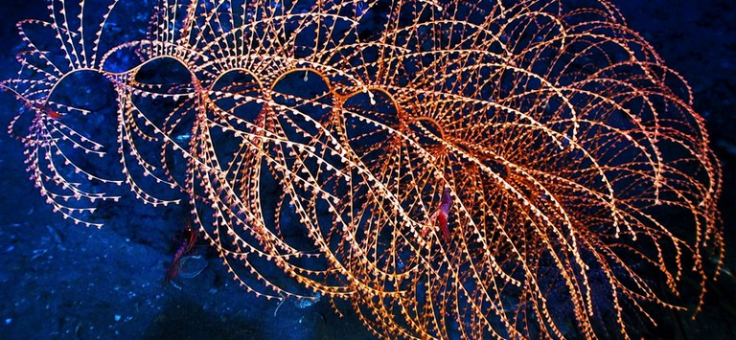
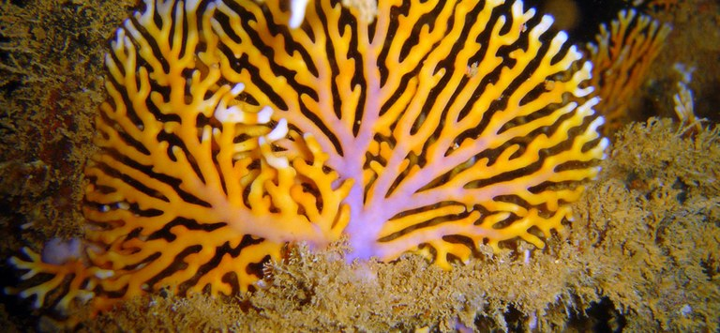
Iridogorgia
Lace Coral

Slide 4
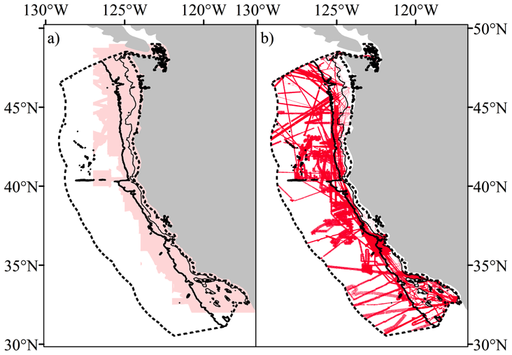
Project Goals
Predictive habitat models for deep-sea corals for the U.S. West Coast (California, Oregon and Washington). Model results are intended to assess potential coral habitat suitability.
Black: known habitat
Red: Predictive habitat

Slide 5
User Cases
Input:
Location(latitude, longitude, depth): a single point or a map
Output:
1.Probobility of certain coral habitat: Deep-sea coral research. To acknowledge scientists where in the ocean they could find certain corals with high possibility
2.Coral habitats map: Deep-sea coral protection. To establish marine protected areas (MPAs) to protect from fishing.

Slide 6
Methodology
Collect and preprocess deep-sea coral data
Feature selecting
Build preliminary model
Change to different models; develop more complex models; collect more data
Fix hypothesis

Slide 7
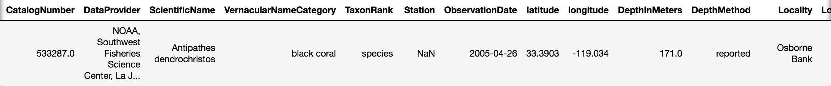
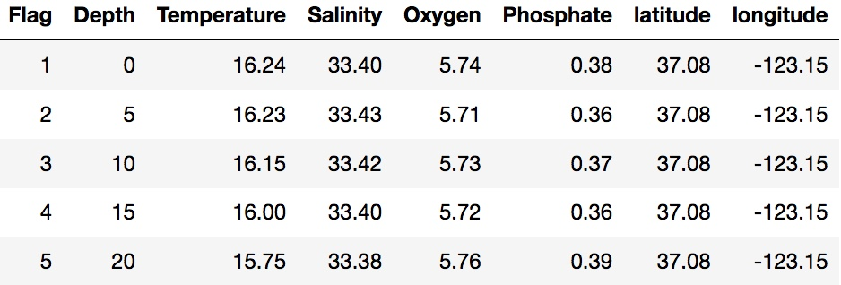
Database Description
513372 rows, 20 columns consists of Date, Location Info(latitude, longitude and depth etc.), String as well.
567258 rows, 8 columns consists of Temperature, Salinity, Oxygen, and Phosphate, Location Info as well

Slide 8
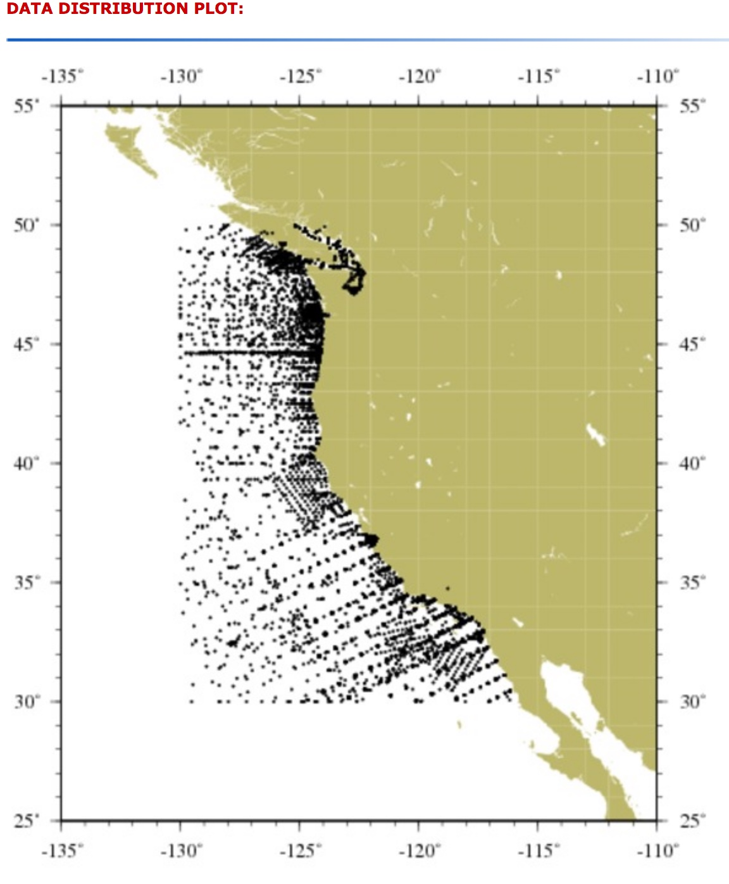
Available Data
Using latitude and longitude to concatenate two databases
Build relationship between Depth and Salinity, Oxygen and Phosphate
Features: latitude, longitude, depth, salinity, oxygen and phosphate

Slide 9
Data Sources & Repository
Deep-sea corals data: https://deepseacoraldata.noaa.gov/website/AGSViewers/DeepSeaCorals/mapSites.htm
Ocean environment database: https://www.nodc.noaa.gov/OC5/SELECT/dbsearch/dbsearch.html
Github: https://github.com/HouHouHouHouHouHou/7390

Slide 10
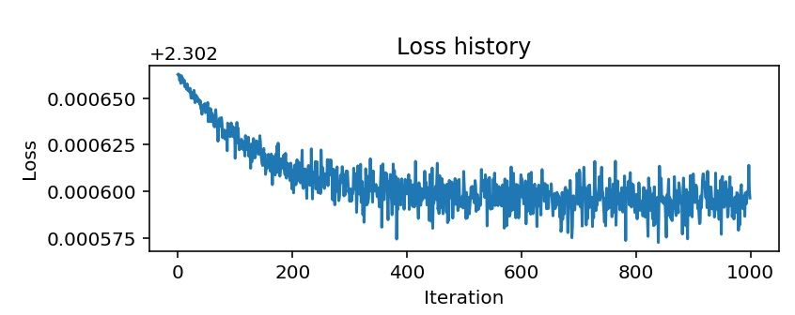
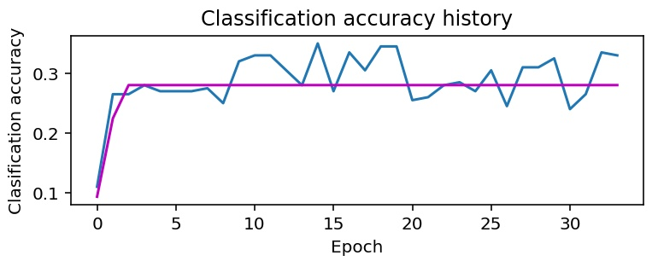
Milestones So Far
Data Processing: Process row data and concatenate two data files using location information(latitude, longitude and depth). Relative algos: RandomForestRegressor, K-means, Hierarchical clustering, IsolationForest, LocalOutlierFactor
Preliminary Model:
Multiclass SVM: Pro- straightforward, fast, always find global minimum; Con- hard to play with kernel trick
Softmax Classifier: Pro- probability on all classes; Con- might be bogged if dataset is too complex
Neural Network: Pro- control dimensionality of features; Con- suffer from the existence of multiple local minima solutions, hard to tune

Slide 11
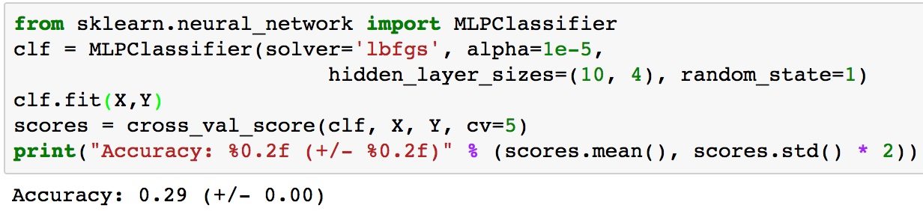
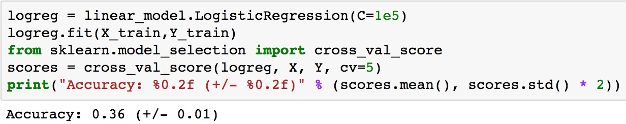
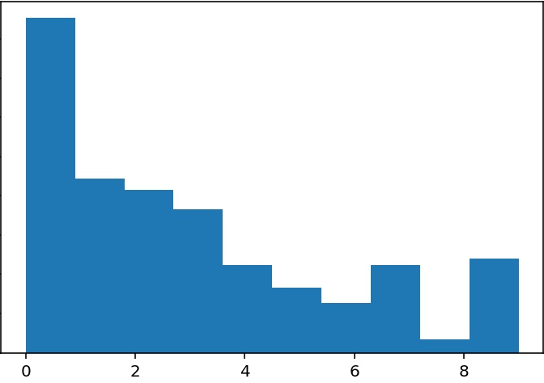
Acceptance Criteria
Accuracy reaches 50%
F1 score reaches 0.7
Draw a suitability map

Slide 12
Reference
[1] S. Ross et al., UNCW, NOAA/USGS DISCOVRE Cruise: Deep-sea Corals
[2] Alex Rogers, PhD, British Antarctic Survey, Cambridge: The Biology, Ecology and Vulnerability of Deep Water Coral Reefs
[3] Lumsden SE, Hourigan TF, Bruckner AW, Dorr G (Eds.) (2007) : The State of Deep Coral Ecosystems of the United States. NOA ATechnical Memorandum CRCP-3. Silver Spring MD
[4] Rogers AD (1999): "The biology of Lophelia pertusa (Linnaeus 1758) and other deep- water reef-forming corals and impacts from human activities.”
[5] John M. Guinotte, Andrew J. Davies (2014) Predicted Deep-Sea Coral Habitat Suitability for the U.S. West Coast

Slide 13
Q & A
Thank you!

