Slide 1






findash
S&P 500
Houcine.dev

Slide 2
overview
FinDash is an interactive financial dashboard designed to give users a comprehensive and intuitive view of the S&P 500. It acts as a one-stop solution for stock market enthusiasts, allowing them to explore, analyze, and predict market trends easily.
Houcine.dev

Slide 3
objectives
Provide an interactive dashboard that displays key stock market data.
Allow investors to analyze portfolio trends over time.
Offer predictive insights (such as future prices and Value at Risk).
Present financial statements and company metrics clearly.
Houcine.dev

Slide 4
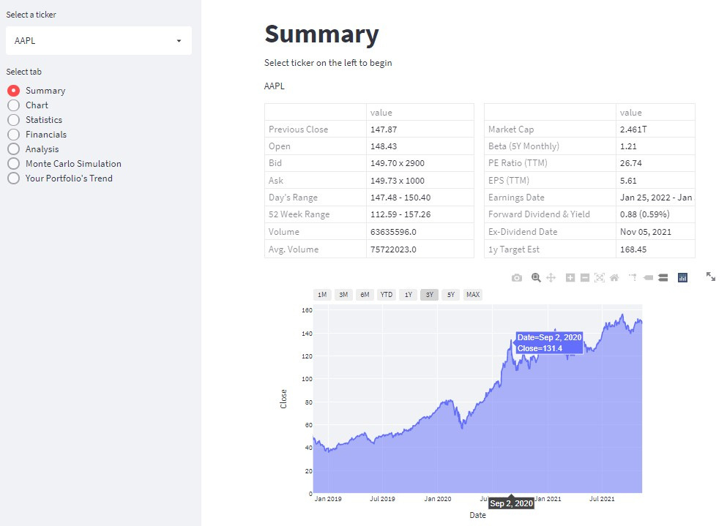
Dashboard Structure
Tab 1
View key statistics.
Visualize the trend of closing prices for a selected period.
Houcine.dev

Slide 5
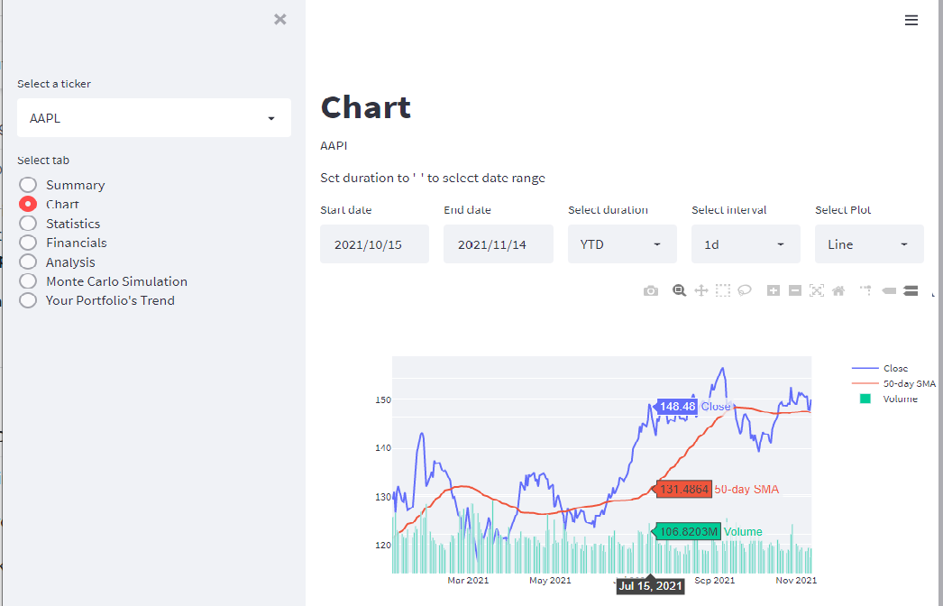
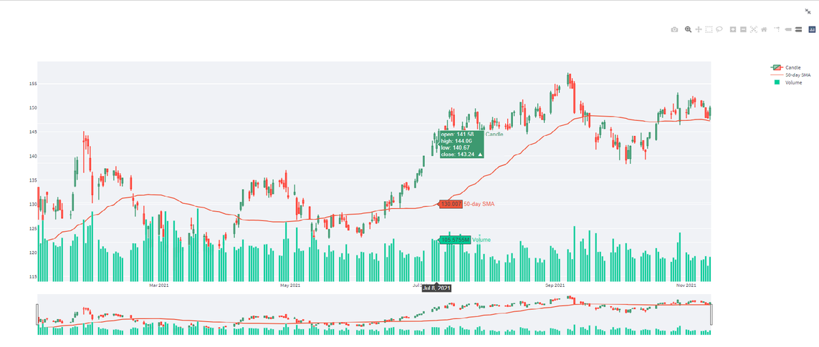
Dashboard Structure
Tab 2
Display three plots in one figure.
Allow users to customize parameters and hover to see datapoints
Houcine.dev

Slide 6
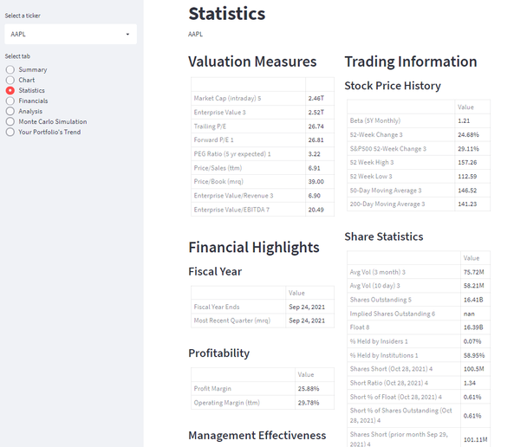
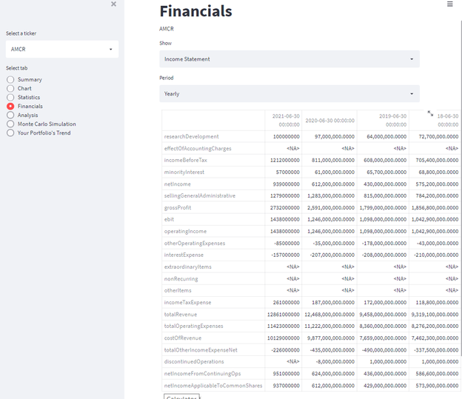
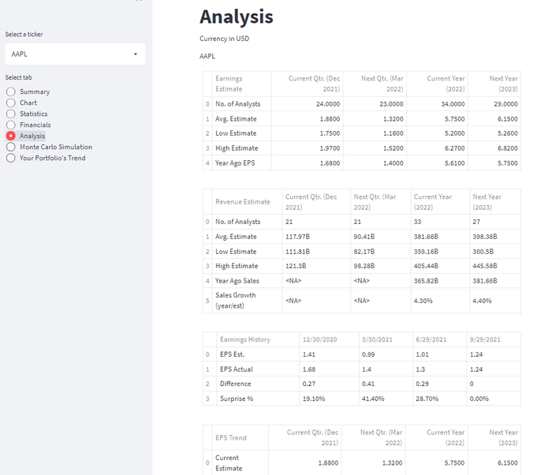
Dashboard Structure
Tab 3-4-5
Contain detailed financial statements and analysis tools.
Include options for period selection and labeled data.
Houcine.dev

Slide 7
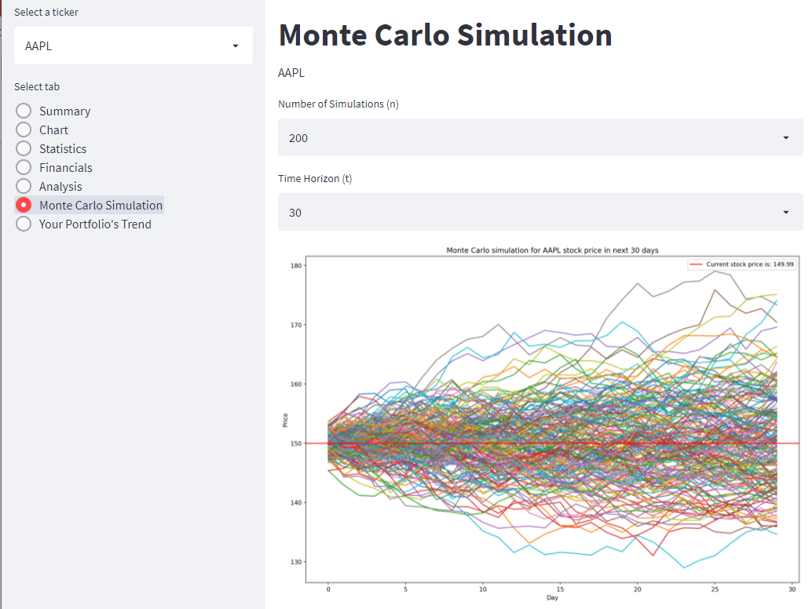
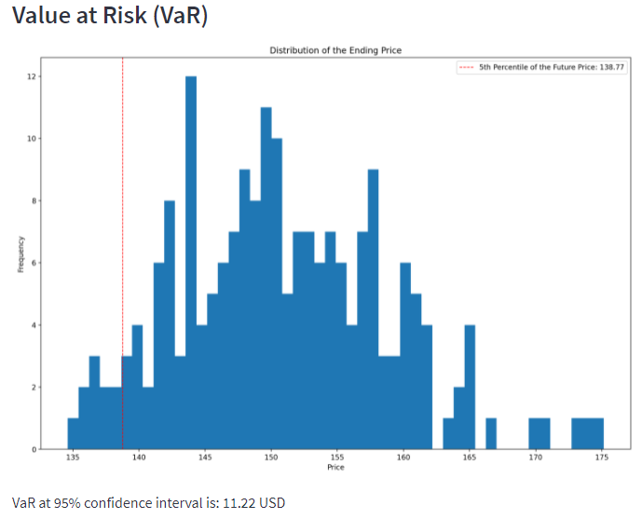
Dashboard Structure
Tab 6
Offers stock price prediction tools.
Users can choose between time horizon or number of intervals.
Automatically calculates Value at Risk (VaR).
Houcine.dev

Slide 8
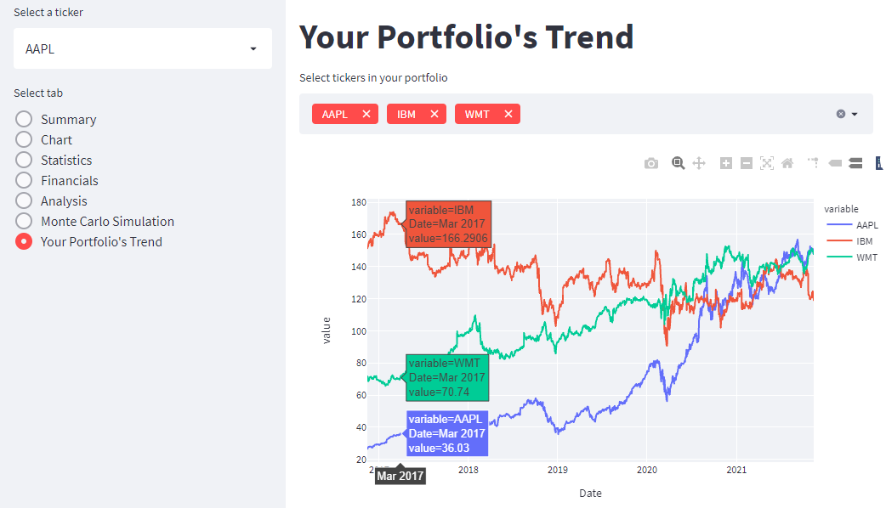
Dashboard Structure
Tab 7
Displays price trends for all stocks in the user’s portfolio
Houcine.dev

Slide 9
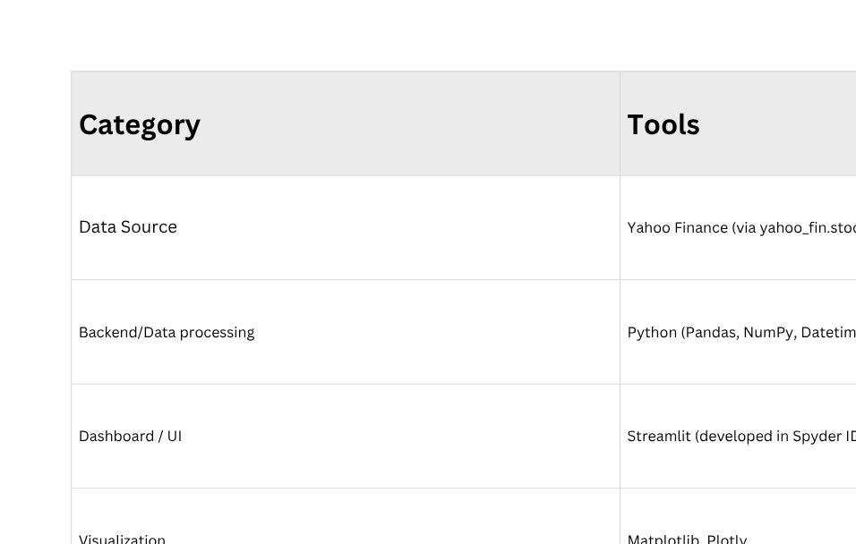
Dashboard Structure
How It Works
Data Scraping: Pulls live and historical data from Yahoo Finance APIs.
Data Processing: Cleans and transforms data using Pandas & NumPy.
Visualization: Generates interactive charts with Plotly (with hover and selection features).
Prediction: Provides forecasted stock prices and risk analysis.
Dashboard Display: Combines everything into an interactive, multi-tab dashboard built with Streamlit.
Houcine.dev

