Slide 1

May not be used without permission from Responsive Learning Technologies
info@responsive.net © March 2010.

Slide 2

The Supply Chain Game

Slide 3
Overview
You will need to read all the pages on the assignment web site for important details:
Introduction
Markets
Operations
Assignment
Instructions

Slide 4
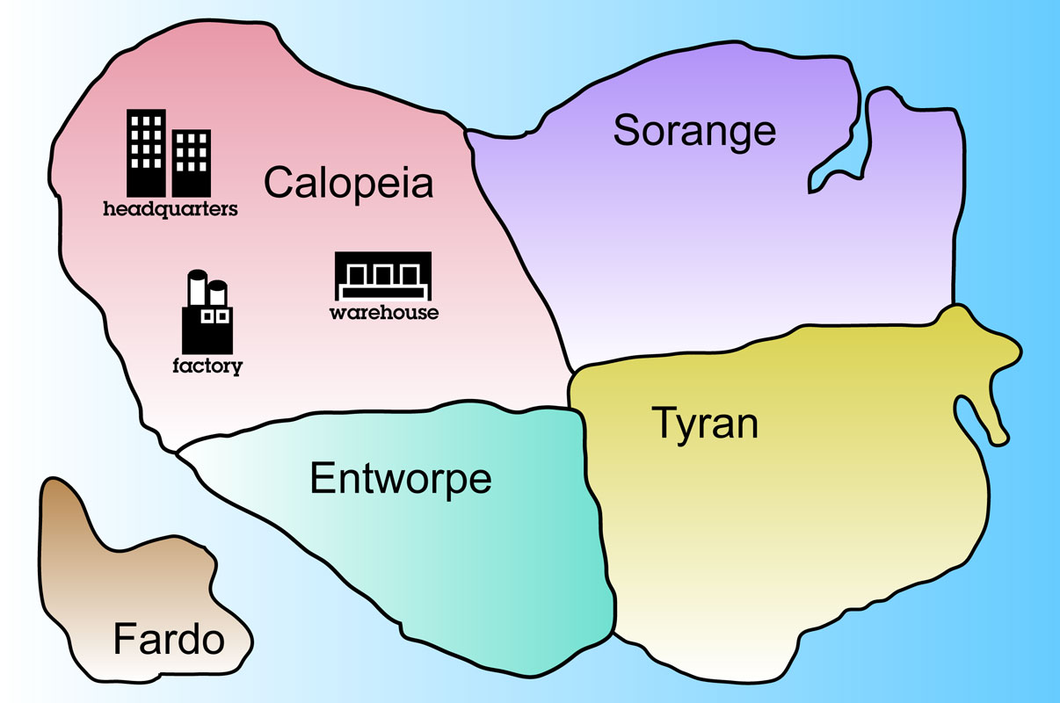
Demand
Customer orders materialize throughout each simulated day

Slide 5
Fulfillment
Orders are filled from the warehouse as soon as possible
☺

Slide 6
Penalties
Orders taking longer than 1 simulated day to fill are lost to competitors
☹

Slide 7
Orders
The warehouse pulls production from the factory

Slide 8
Production
The factory produces one batch at a time and completes each batch all at once

Slide 9
Shipping
When each batch is complete, it is shipped to the warehouse

Slide 10
Modeling Inputs
Revenue
Product revenue: $1450 per drum
Interest: 10% per year, compounded daily
Expense
production cost: $1500 + $1000 x batch size
shipping cost: $150 per drum for mail or $15,000 per truck (one truck can hold up to 200 drums)
finished goods holding cost: $100 per drum per year
customer fulfillment costs: $150 per drum

Slide 11
Decisions
Determine factory batch size (order quantity)
Set reorder point to trigger orders
Select shipping mechanism: mail or truck
Add capacity to the factory

Slide 12
Login to the Simulation
Enter team name
Enter password
Click Submit
Team ID:
Password:
yourteamhere
•••••
submit

Slide 13

Click On…
warehouse, to view finished goods inventory and shipments to customers

Slide 14
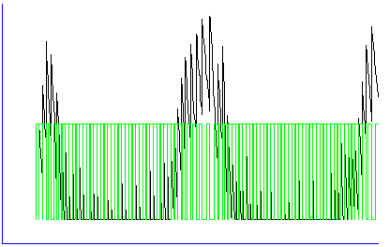
Download Data for Analysis
Finished Goods Inventory at or destined for the warehouse in Calopeia, by current location
mail details truck details
276.166
213.376
150.584
67.752
24.94
-37.671
-64 17 96 179 260 341 422 503 564 665
days
drag mouse over region of interest to zoom in plot
warehouse mail truck
download

Slide 15
Click On…
headquarters, to view demand, lost demand, and cash balance

Slide 16
Click On…
factory, to view work-in-process inventory

Slide 17
Good Luck !

