Slide 2
Project Update
18/04/24

Slide 3
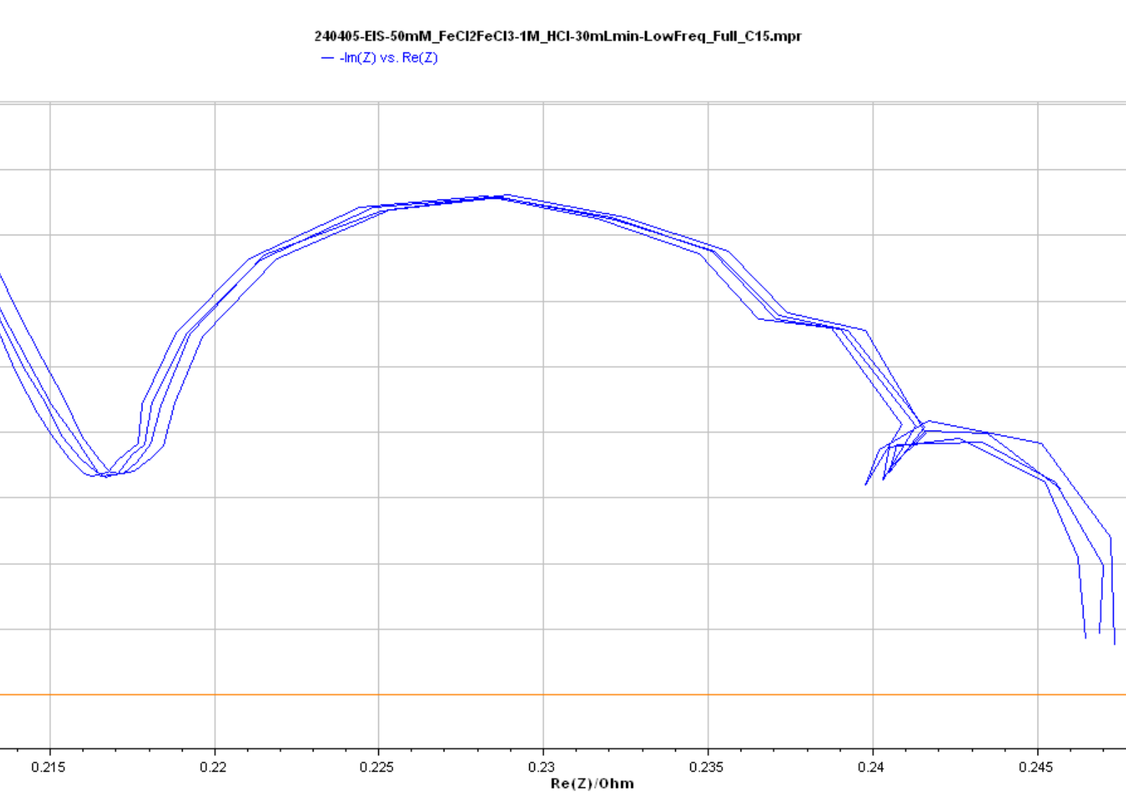
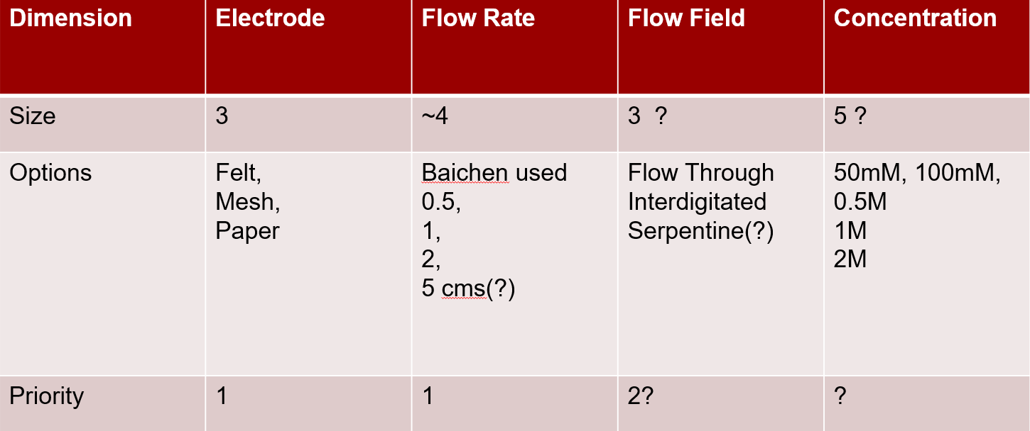
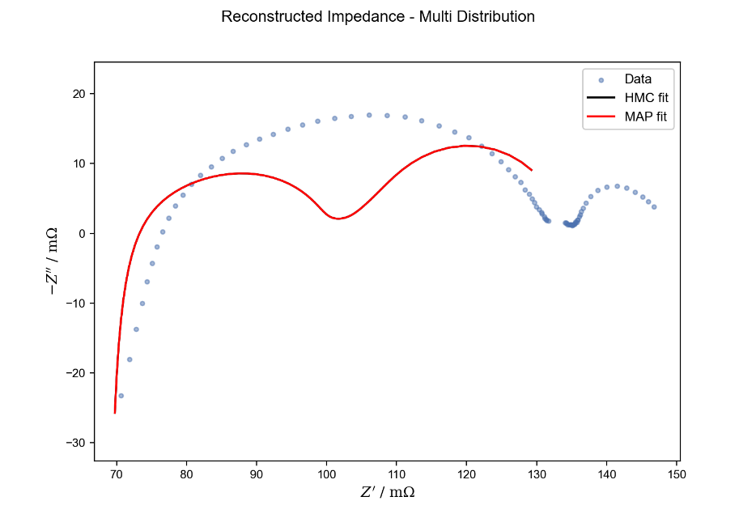
Last time:
Issues with low frequency readings.
Assumed to be pump related from consistency
Try dampeners.
Decision on experiment parameters
Electrode – Concentration – Flow rate
Modelling issues on Baichen Full Cell data
Try Symmetric cell data

Slide 4
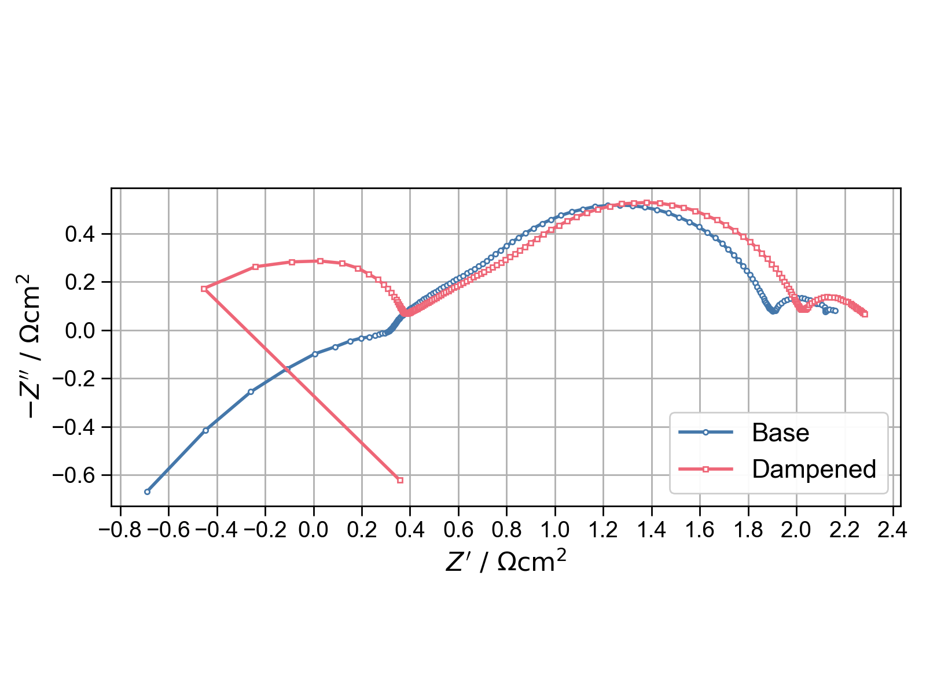
Dampening
Felt electrode, 5.39cm2
50mM FeCl2, 50mM FeCl3
1M HCl
20mL/min
920kHz – 25mHz
20 points per decade

Slide 5
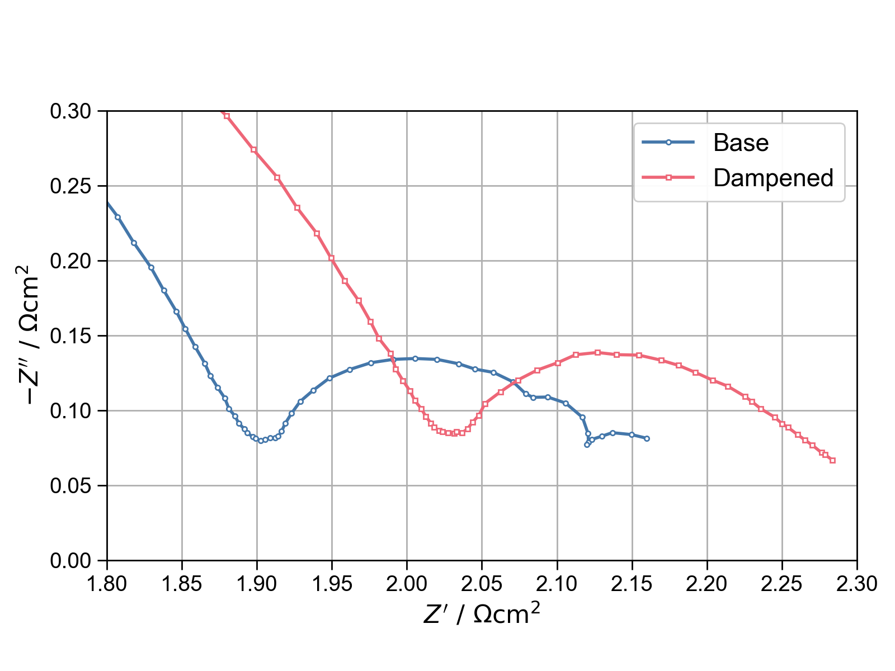
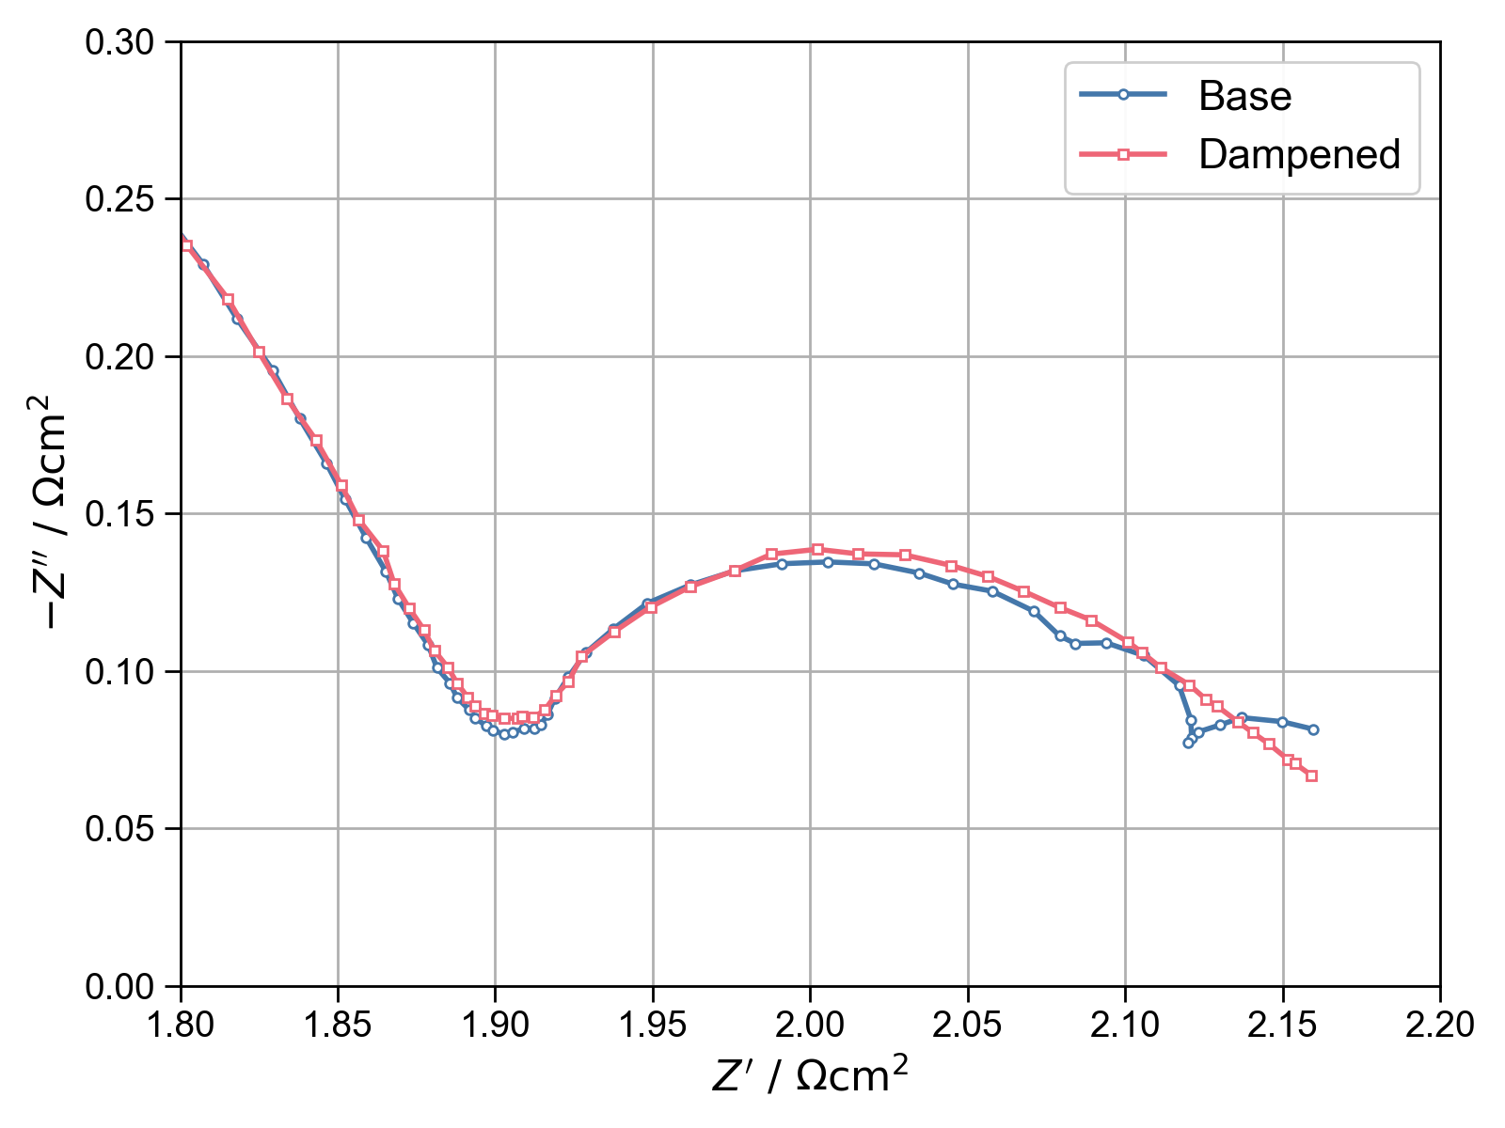
Dampening

Slide 6
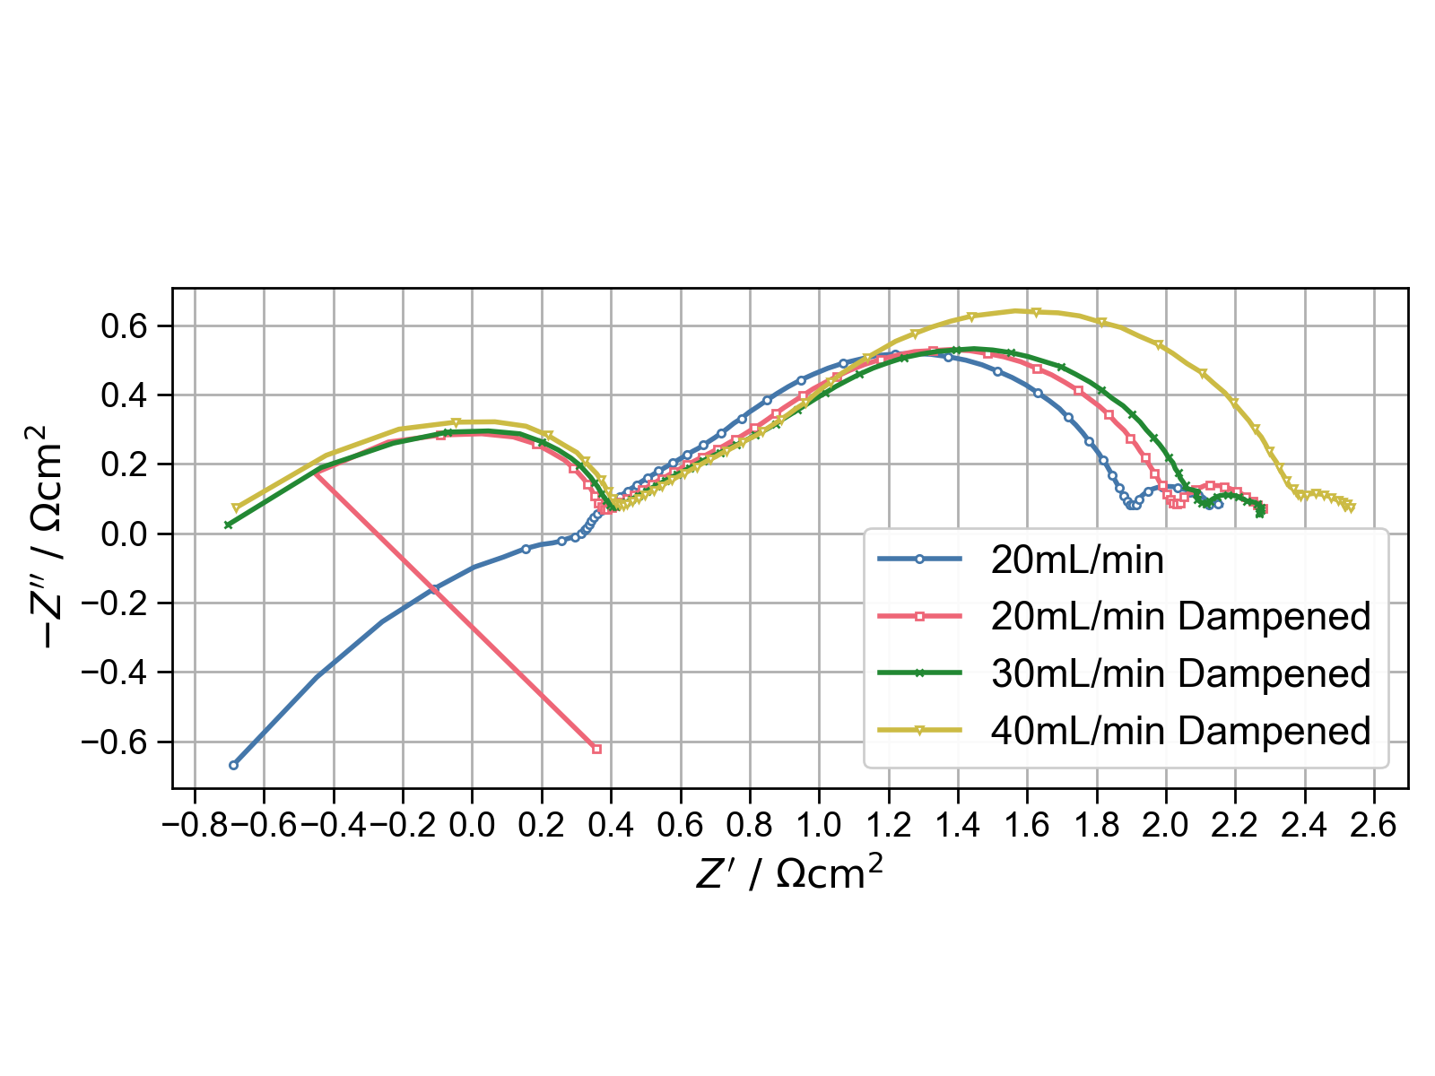
Sidestep
Unexpected behaviour in initial tail
Only difference is from attaching dampeners.
This effect was not observed in subsequent experiments
40mL/min was measured a couple of days later (weekend), which is the likely cause of the notable increase in R_ct

Slide 7
Cell maintenance-
Visual inspection of components, especially current collectors and carbon-blocks
Setup empty cell
Fresh, large batch of 1M HCL
Pump through for ~30min
New, fresh 1M HCL solution
Repeat ad nauseum
Pump Calibration
Set pump to fixed volume
Pump milli-Q water into beaker
Measure the weight of pumped water vs. supposed weight.
Calibrate accordingly
1M Fe2/Fe3 1M HCl Electrolyte
Flow velocities based on Baichen:
v_e = 0.5, 1, 2, (5) cm/s
He calculated volumetric flow rates as:
Q = v_e * A_cross (no porosity correction)
A_cross = h_e * l_e * (1 - compression ratio)
Using Baichens presented reasonable compressions:
Felt: 30%, Cloth: 20%, Paper: 20%
Leads to the following table of flow rates in mL/min:
Electrode/Flow Velocity | 0.5 cm/s | 1 cm/s | 2 cm/s | 5 cm/s
Felt | 12.10 | 24.15 | 48.30 | 120.75
Cloth | 2.24 | 4.48 | 8.96 | 22.41
Paper | 1.11 | 2.22 | 4.44 | 11.10

Slide 8

Experiments
Electrodes | Concentrations | Flow Rates
Felt Cloth Paper | 100mM 0.5M 1M | 5mL/min 10mL/min 20mL/min 50mL/min 100mL/min?
Initial idea for flow rates was to follow Baichens approach. Listed as Flow Velocities:
0.5 cm/s
1 cm/s
2 cm/s
5 cm/s
Now either im very bad at Phys 1, Baichen was using flow rates much higher than the pump im using is capable of, or he was off by an OoM.
Chosen rates based on [1] and [2]
[1] Sun, J., Guo, Z., Pan, L., Fan, X., Wei, L., & Zhao, T. (2023). Redox flow batteries and their stack-scale flow fields. In Carbon Neutrality (Vol. 2, Issue 1). Springer. https://doi.org/10.1007/s43979-023-00072-6
[2] Milshtein, J. D., Tenny, K. M., Barton, J. L., Drake, J., Darling, R. M., & Brushett, F. R. (2017). Quantifying Mass Transfer Rates in Redox Flow Batteries. Journal of The Electrochemical Society, 164(11), E3265–E3275. https://doi.org/10.1149/2.0201711jes

Slide 9
So far
Cell | Electrode (5.29cm^2) | Concentration | Notes
1. Felt-50mM | Felt. Thermally Treated. 2.5mm thick. Compressed to ~1.7mm (32%) | 50mM Fe2+/Fe3+ | Parameters a bit all over the place. Used to determine approach for following cells.
2. Felt-0.5M | See Above (Re-assembled) | 0.5M Fe2+/Fe3+ | 500mL Electrolyte batch made, used for all subsequent cells of this conc.
3. N/A | Cloth. ELAT Hydrophilic*. 0.406mm thick. Compressed to ~0.37mm (9%) | 0.5M Fe2+/Fe3+ | Failed. Was not able to get cell assembly airtight. Used alternative spacers (Fiber?) instead of Teflon.
4. Cloth_x2_0.5m | Cloth. ELAT Hydrophilic*. 0.406mm thick. Double layer. Compressed to ~0.70mm (15%) | 0.5M Fe2+/Fe3+ | Didn’t locate thinner Teflon spacers. Used thinnest I could find with 2x electrode.
5. Cloth_x1_0.5m | Cloth. ELAT Hydrophilic*. 0.406mm thick. Compressed to ~0.33mm (19%) | 0.5M Fe2+/Fe3+ | Located thinner Teflon spacers.
* https://www.fuelcellstore.com/activated-cloth?search=1591002-3&description=true

Slide 10
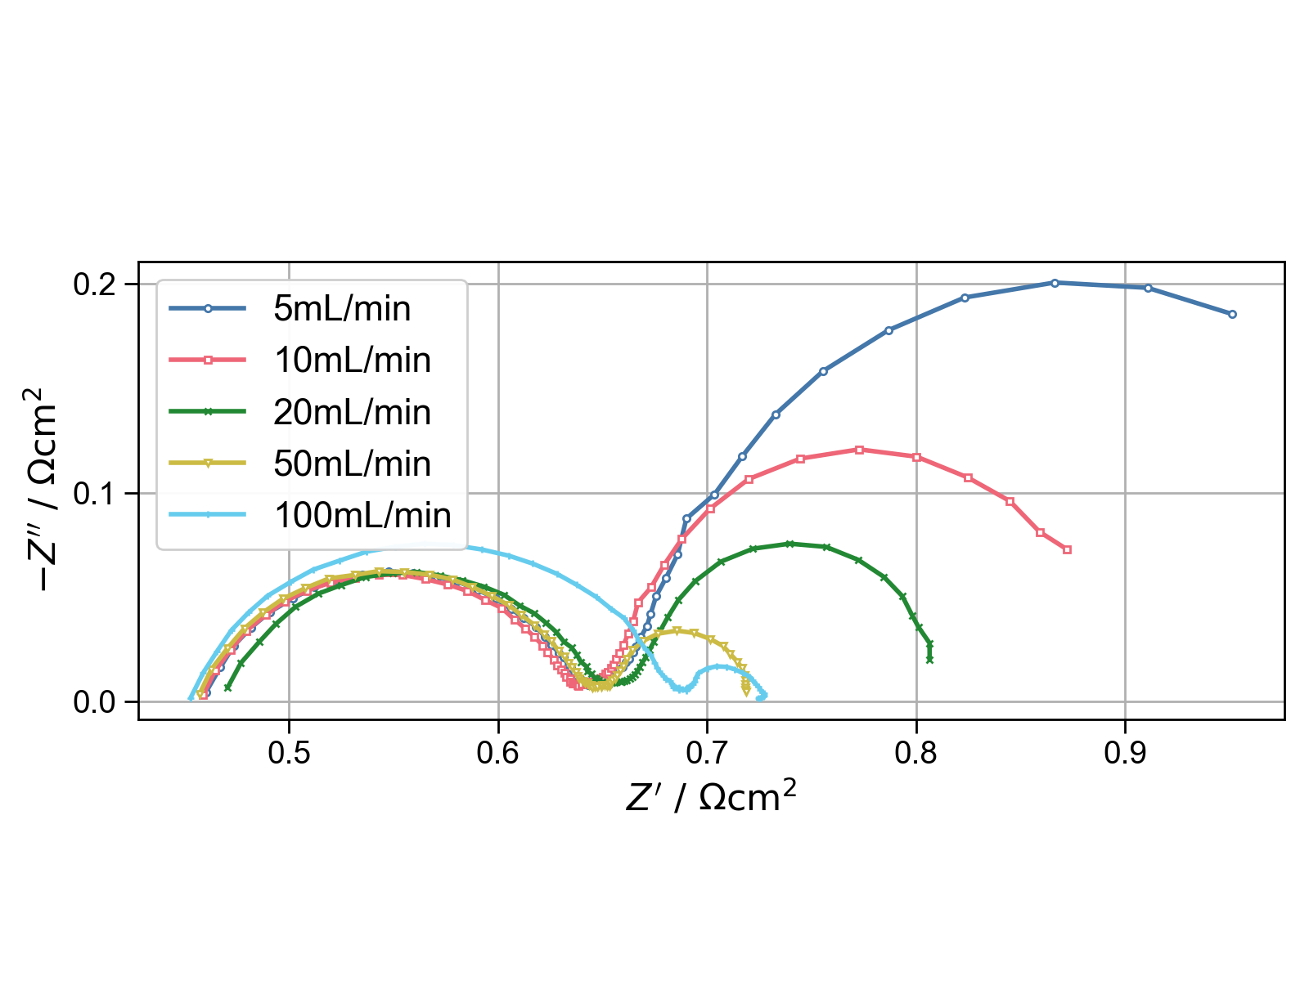
Cell 2. Felt – 0.5
saadsd
920kHz – 25mHz
V_a = 5mV
10 points per decade.
Avg of 3 readings per point.
Clearly doesn’t capture the entire diffusion span for the lower flow rates.

Slide 11
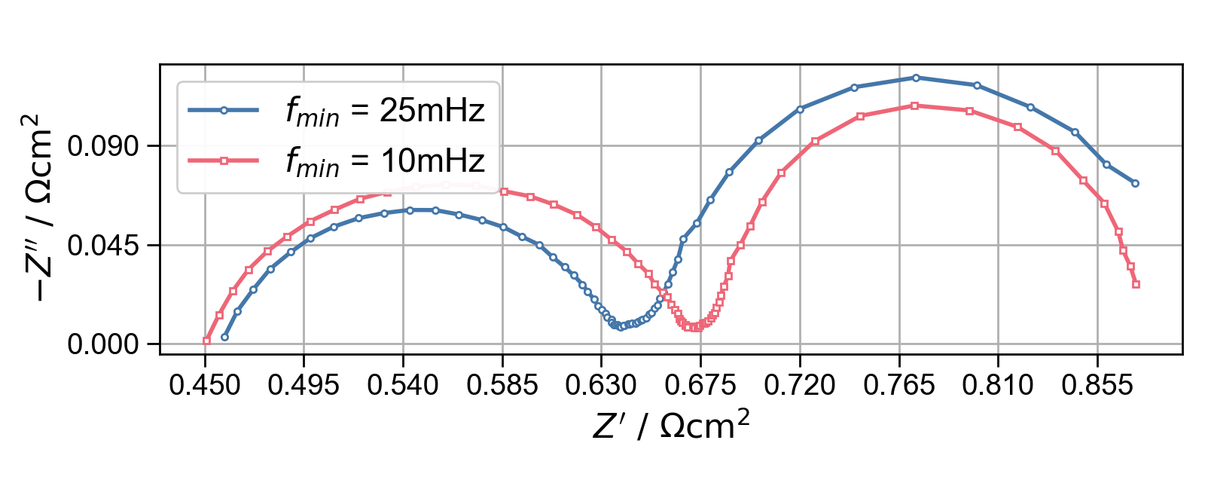
Cell 2. Felt – 0.5
10mL/min
Blue takes ~45min (3x ~15min)
Red almost 3x that
Have not tested extrapolation tools yet, but know they exist

Slide 12
Remainder
Baichen symmetric cell modelling
Modelling of IRFB sets
Paper electrodes in 0.5M
New conc.

