Slide 2
Project Update
13/05/24

Slide 3
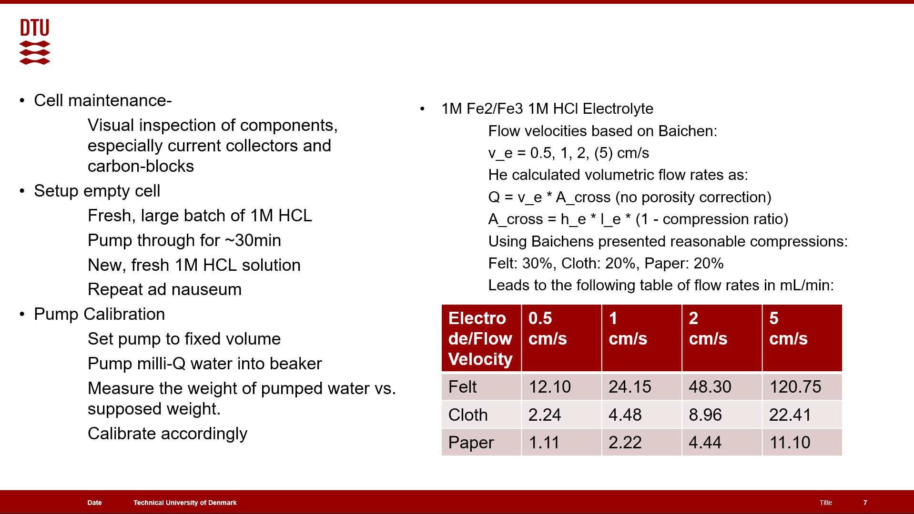
Last time:

Slide 4
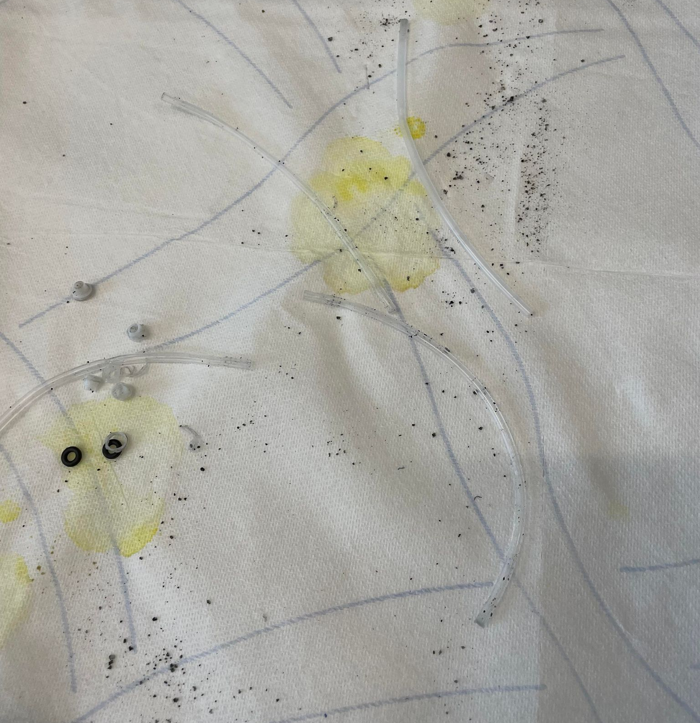
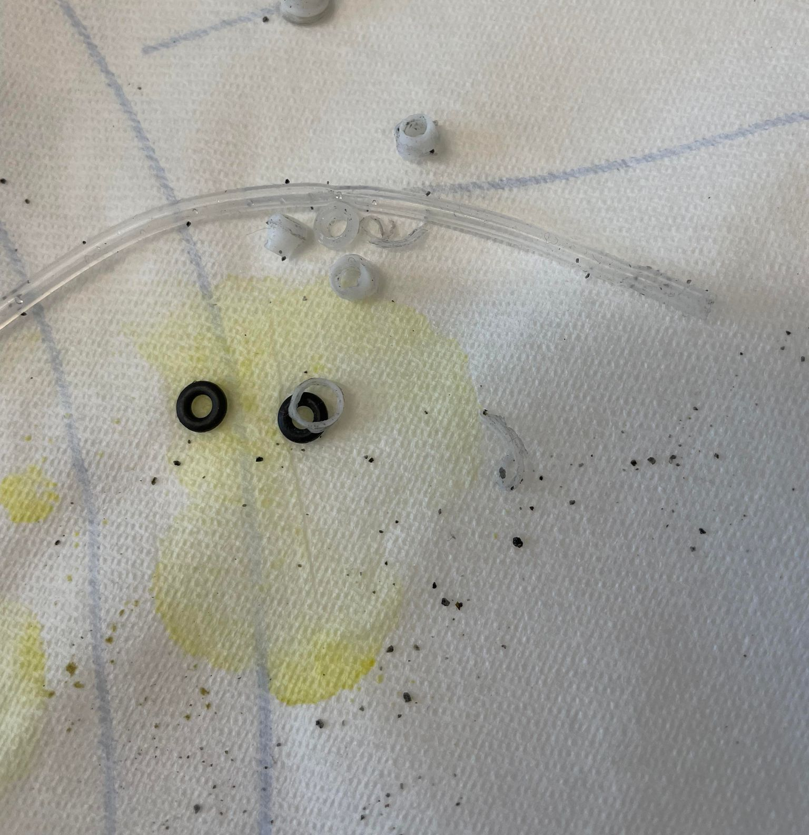

Slide 5
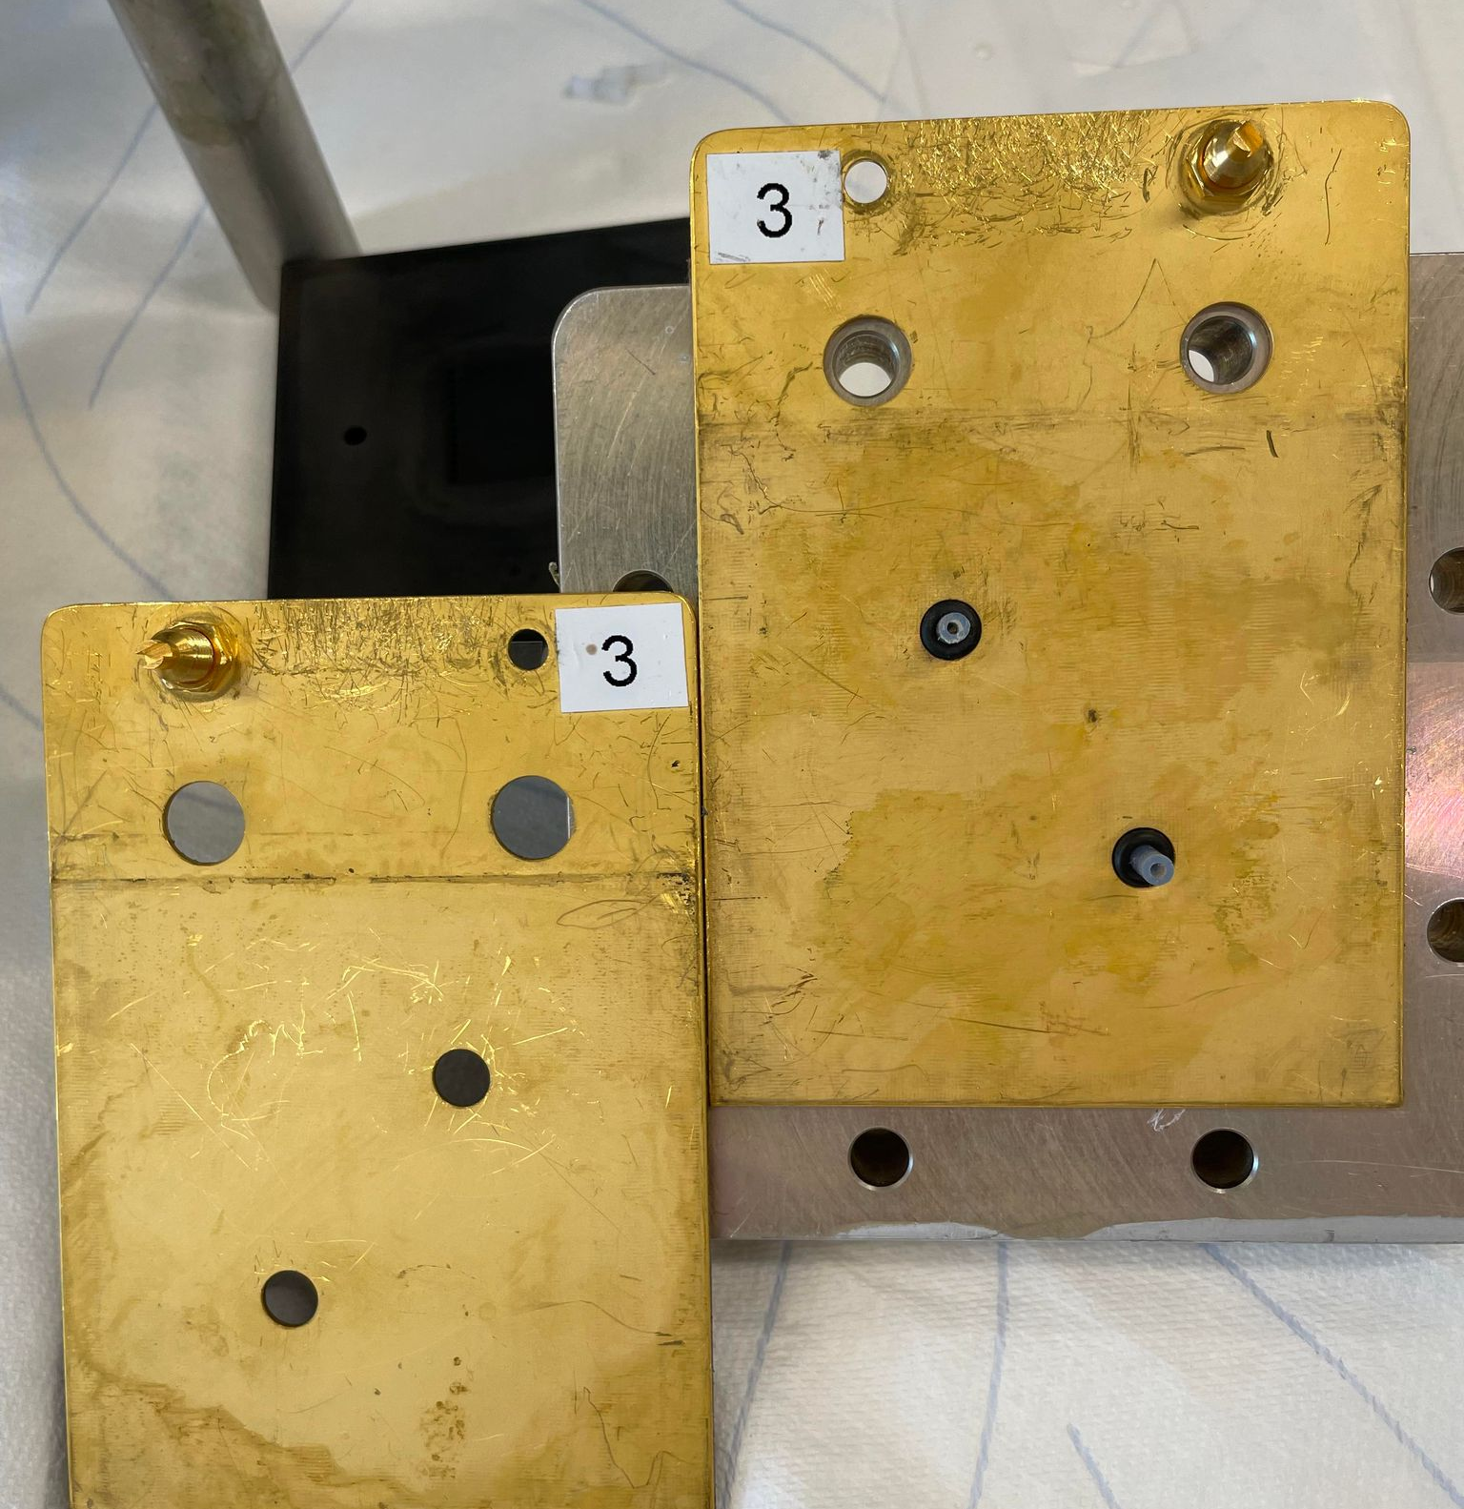
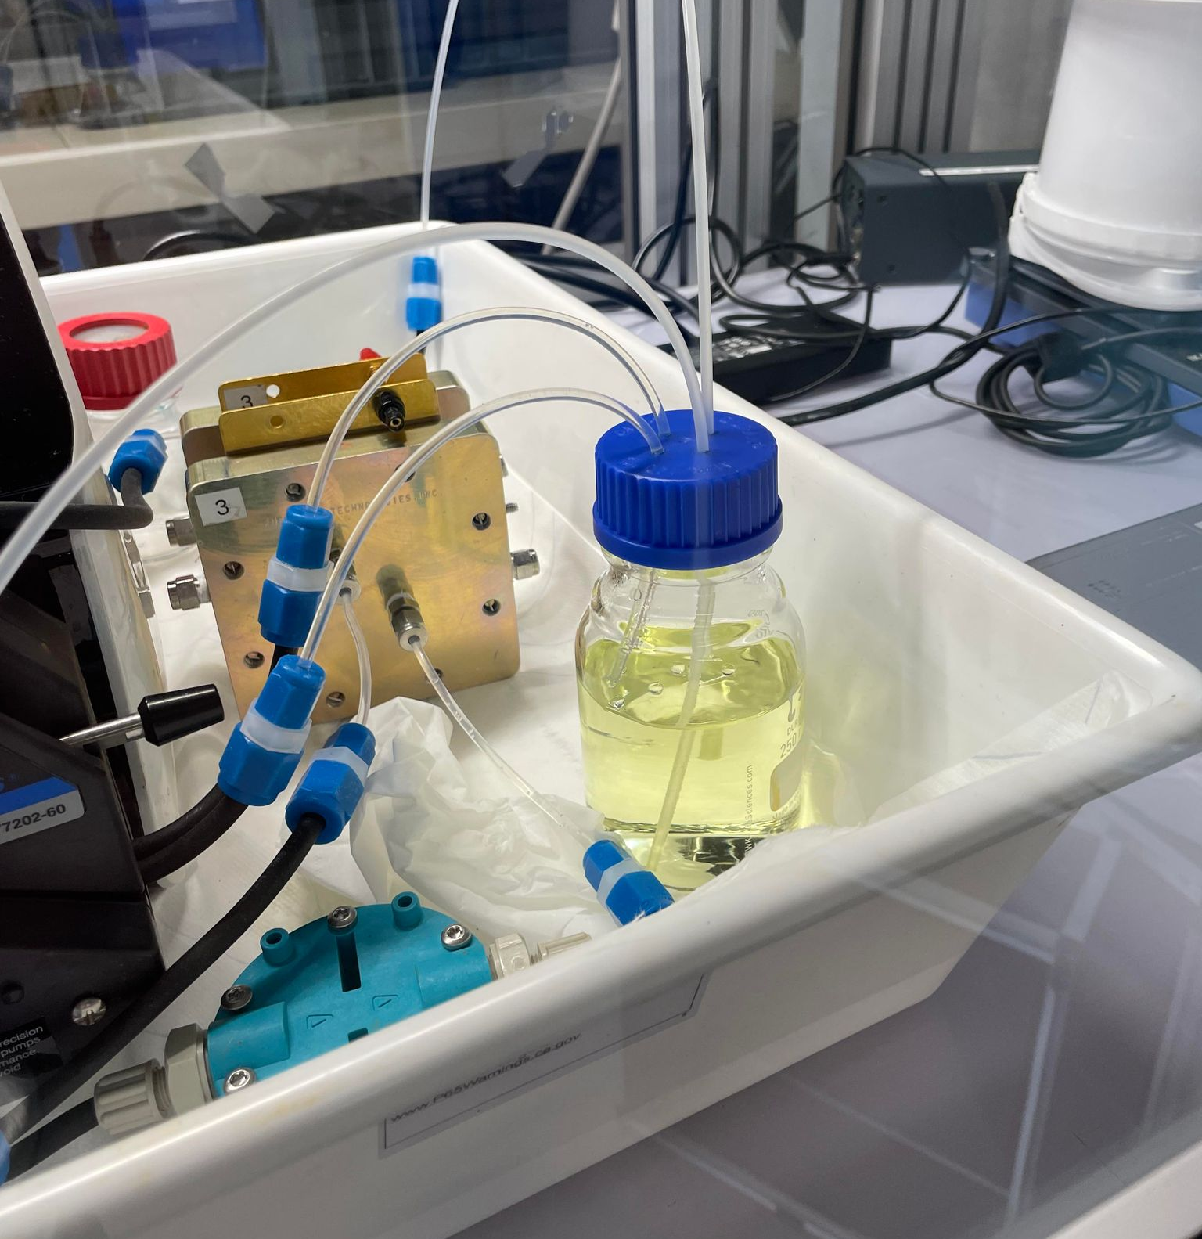

Slide 6
Pump calibration
Used pumps built-in method.
Dispenses specified fixed volume.
Measure weight of dispensed water
Input actual volume of water dispensed
Repeat until satisfactory
Used both tubes simultaneously. Asked to dispense 20mL each into separate beakers.
First run yielded 18mL +- 0.1mL (by weight) from both.
Gave adjustment to pump and repeated
20mL +- 0.1mL. Repeated again with same result
Asked for 40mL from both. Got 40mL +- 0.1mL.
Satisfactory

