Slide 1
Pre Processing
Sooroush Riazi
DAY 3

Slide 2
OUTLINE
Introduction to Data Preprocessing
Data Cleaning and Handling Missing Values
Strategies for Handling Missing Values
Detecting and Handling Outliers
Z Score
IQR
Visualization
Data Integrity
Duplicated Records
Feature Inconsistencies:

Slide 3
OUTLINE
Data Transformation Techniques
Why Scaling and Normalization
Scaling and Normalization
Handling Categorical Data (Covered in Feature engineering)
Feature Engineering
Feature Creation
Feature Selection
Feature Extraction
Encoding Categorical Features
Resampling
OverSampeling
Undersampeling

Slide 4

Introduction to Data Preprocessing
Welcome to the Data Preprocessing course! In the exciting field of data science, working with raw data is like having a block of marble – full of potential, but in need of sculpting to reveal its true beauty. This is where data preprocessing comes into play.
INTRODUCTION
Session 1

Slide 5

Why Data Preprocessing Matters
essential first step in any data science project. It involves meticulously cleaning, transforming, and refining raw data to ensure it's accurate, consistent, and suitable for analysis.
Data preprocessing is not just about tidying up data; it's about setting the stage for success. Clean and properly prepared data leads to more accurate insights, robust models, and meaningful conclusions. Whether you're predicting stock prices, analyzing social media trends, or diagnosing medical conditions, your data's quality will heavily influence the outcome.

Slide 6
Data Cleaning and Handling Missing Values
Just as a painter prepares their canvas before creating a masterpiece, data scientists must meticulously clean and repair their datasets to ensure accurate and meaningful analyses.
Data, like any other raw material, can come with imperfections. These imperfections might manifest as missing values, outliers, or inconsistencies.

Slide 7
Handling Missing Values
Missing data is a common challenge in real-world datasets. It can arise due to various reasons.
errors during data collection
system failures
participants' reluctance to provide certain information
Regardless of the cause, missing data can significantly impact the validity of our analyses.

Slide 8


Strategies for Handling Missing Values
Deletion
Listwise Deletion: Removing entire rows with missing values. While simple, it might lead to loss of valuable information.
Pairwise Deletion: Removing specific columns with missing values while retaining other columns. This can introduce bias if not handled carefully.
Imputation
Mean, Median, Mode: Replacing missing values with the mean, median, or mode of the corresponding feature. Simple but effective, these methods maintain the dataset's general characteristics.
K-Nearest Neighbors (KNN) Imputation: Predicting missing values based on the values of k-nearest neighbors in a multidimensional space.

Slide 9
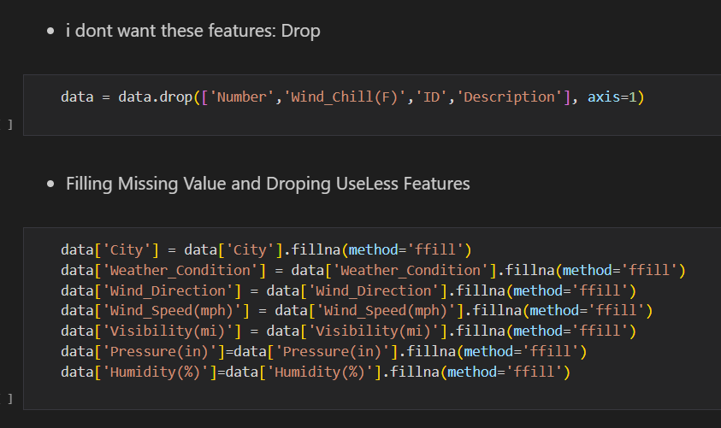

Slide 10
Think !
Think about power of ai and use your creation to suggest a new way for handling missing values.

Slide 11
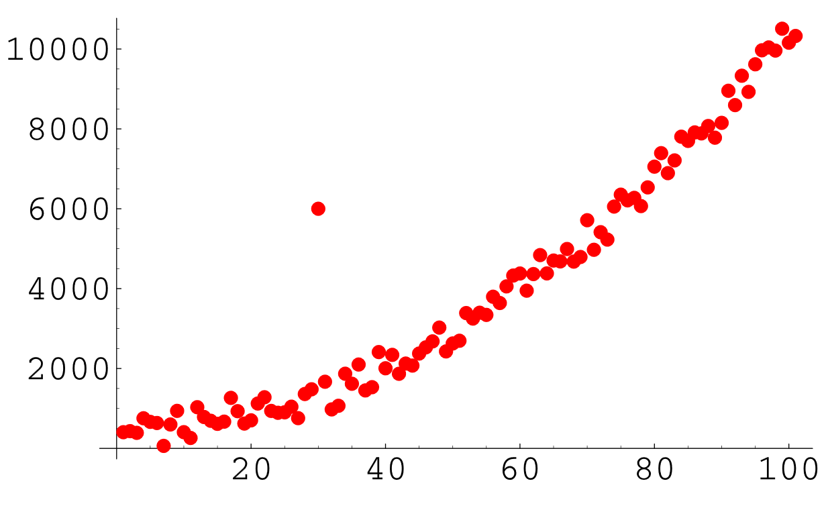
Detecting and Handling Outliers
Outliers are data points that deviate significantly from the rest of the dataset. They can distort analysis results and adversely affect model performance. Identifying and handling outliers is crucial to ensure the accuracy and reliability of our analyses.

Slide 12
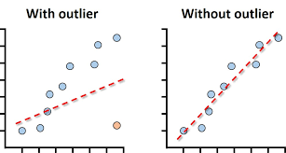

Slide 13
Outlier Detection and handling
Z-Score: Calculating the z-score for each data point to identify those that fall beyond a certain threshold.
Interquartile Range (IQR): Using the IQR to identify and remove data points beyond a specified range.
Visualization Techniques: Creating box plots, scatter plots, or histograms to visually identify outliers.

Slide 14
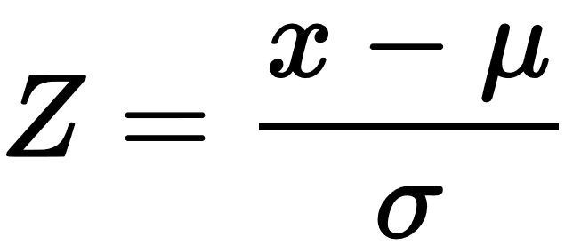
Z-Score
A z-score less than -3 or greater than 3 is often used as a threshold for identifying outliers. These z-scores correspond to data points that are more than 3 standard deviations away from the mean in a normal distribution.
x: The individual data point you want to calculate the z-score for.
μ: The mean (average) of the dataset.
σ: The standard deviation of the dataset.

Slide 15
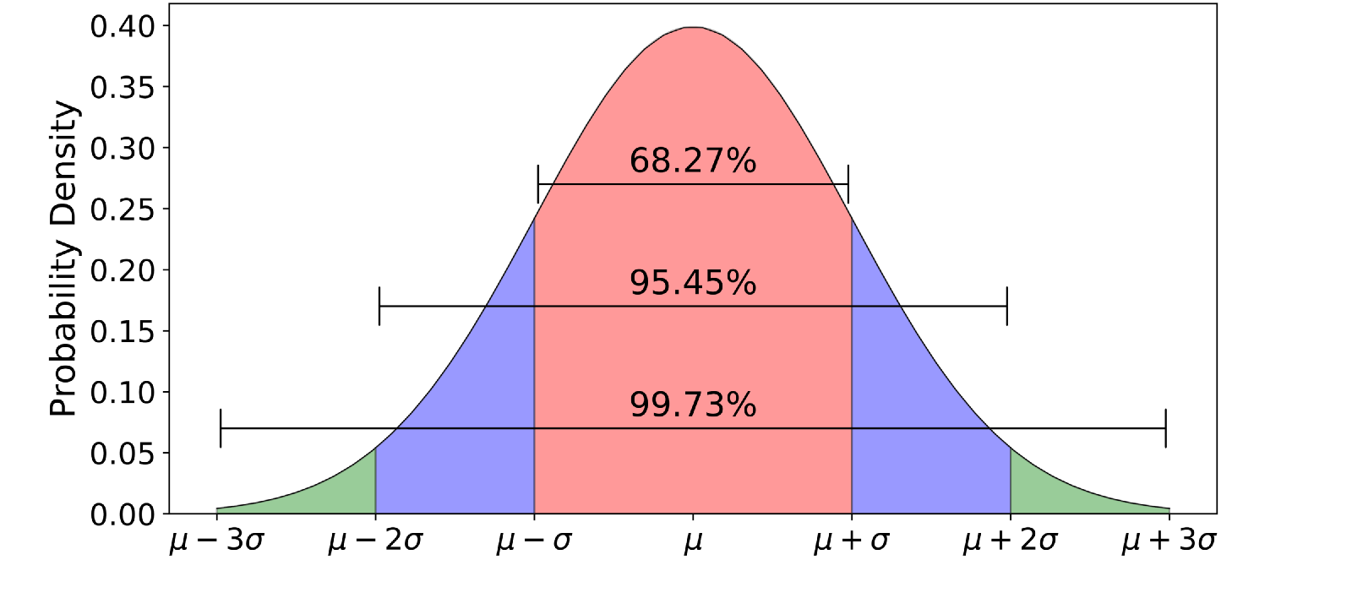

Slide 16
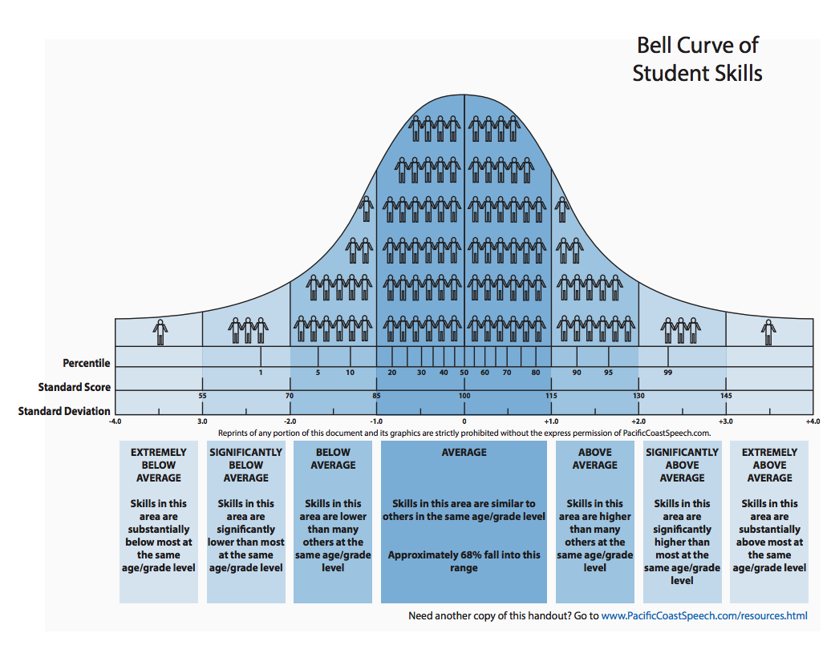
Keep in mind that the z-score assumes a normal distribution of data. If your data is not normally distributed, other techniques, such as the interquartile range (IQR), may be more appropriate for identifying outliers.

Slide 17
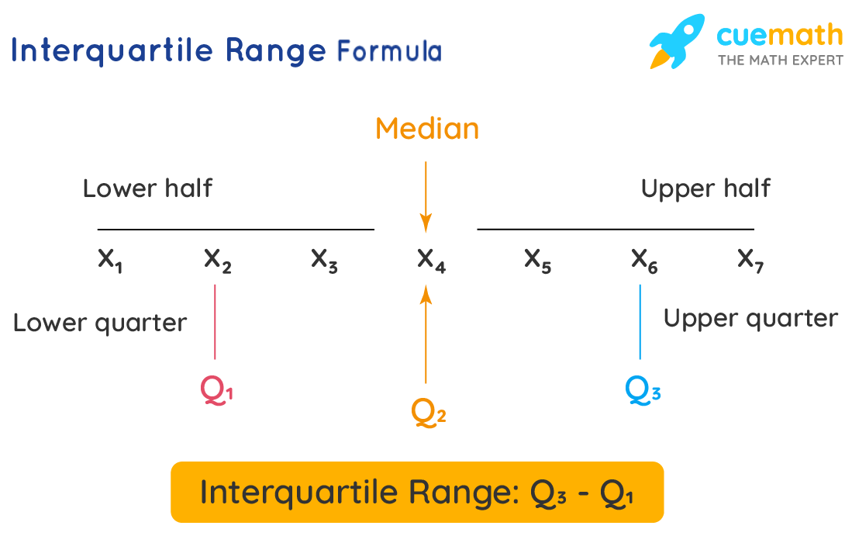
Interquartile Range (IQR):
The Interquartile Range (IQR) is a statistical measure that represents the spread or variability of a dataset. It is particularly useful for identifying and handling outliers in non-normally distributed data. which divide the data into four equal parts.

Slide 18
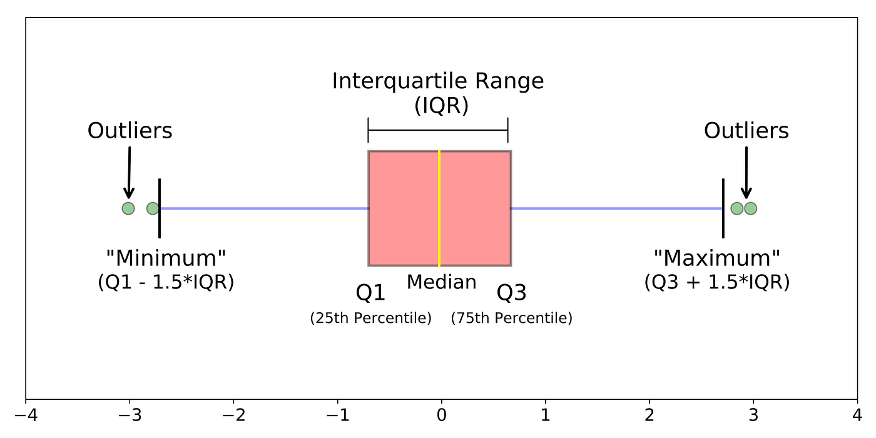
IQR for Outlier

Slide 19
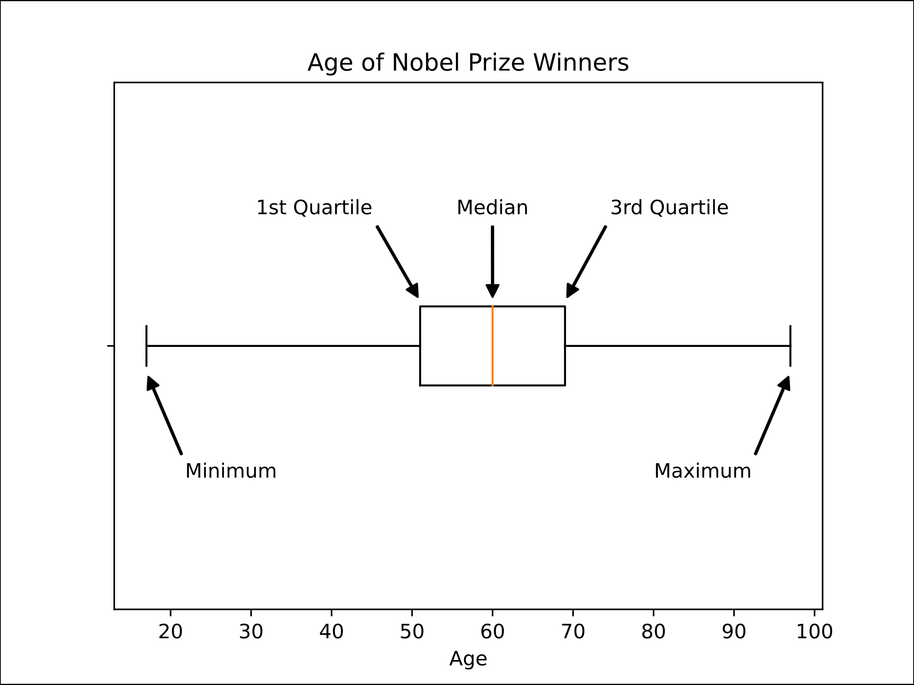
Visualization Techniques
Box Plots: Outliers are often shown as individual points beyond the "whiskers" (lines extending from the box), which are typically set at a certain multiple of the interquartile range (IQR).

Slide 20
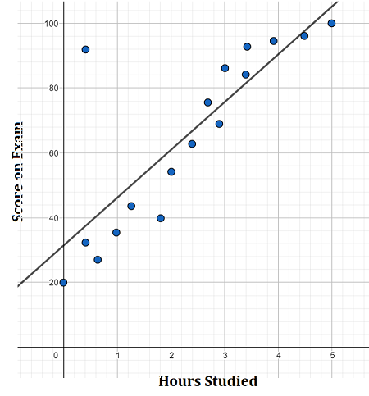
Visualization Techniques
Scatter Plots: Scatter plots are effective for identifying outliers in bivariate data. Outliers may appear as points that deviate significantly from the general pattern of the data.

Slide 21
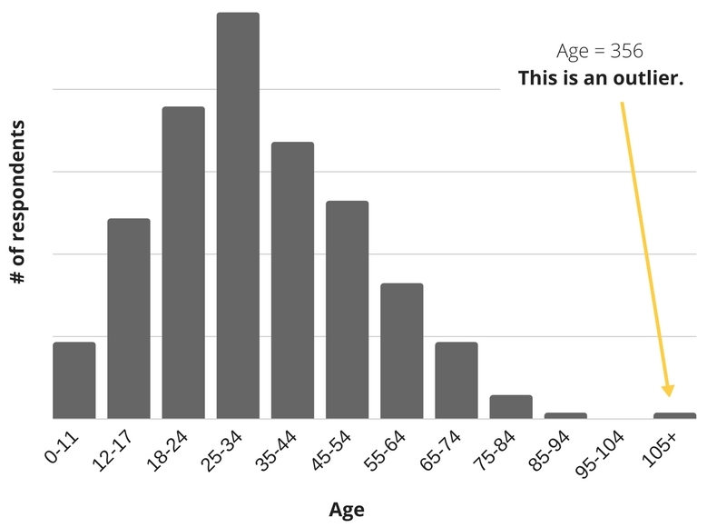
Visualization Techniques
Histograms: Histograms display the frequency distribution of data. Unusual spikes or gaps in the histogram can indicate the presence of outliers.

Slide 22

Advanced Technics
PCA (Principal Component Analysis) for Outlier Detection:
High-dimensional data
Visualizing outliers
Autoencoders
NMF (Non-Negative Matrix Factorization) for Outlier Detection:
robust to noise and minor variations.

Slide 23
Data Integrity
Duplicate records:
can also compromise the integrity of our analyses. Identifying and removing duplicate entries is an essential step to ensure that our dataset accurately represents the underlying reality.
Feature Inconsistencies:
Feature inconsistencies occur when the values or attributes within a specific feature deviate from the expected patterns, leading to discrepancies or conflicts that can affect data quality and analysis.

Slide 24

Feature Inconsistencies:
Causes:
Errors during data collection, entry, or integration from multiple sources.
Mismatched units, scales, or formats in numerical features.
Contradictory or conflicting information within categorical features.
Impact: Feature inconsistencies can mislead analyses, introduce noise, and hinder accurate model predictions.

Slide 25
Examples of Feature Inconsistencies:
1. Date Format Inconsistency:
Suppose you're analyzing a dataset that includes a "Date of Birth" feature. Inconsistent date formats (e.g., "MM/DD/YYYY" vs. "YYYY-MM-DD") can lead to data entry errors and confusion during analysis.
Example:
"Date of Birth": "05/15/1990" (MM/DD/YYYY)
"Date of Birth": "1990-05-15" (YYYY-MM-DD)
2. Unit Mismatch:
Imagine a dataset with a "Product Weight" feature recorded in pounds and another feature, "Product Price," recorded in euros. Such inconsistencies in units can lead to incorrect analysis and model predictions.
Example:
"Product Weight": 10 pounds
"Product Price": 20 euros

Slide 26
Examples of Feature Inconsistencies:
3. Categorical Contradiction:
Consider a dataset with a "Customer Gender" feature and another "Is Pregnant" feature. If the "Customer Gender" is recorded as "Male" but "Is Pregnant" is marked as "True," this is a categorical contradiction that needs resolution.
4. Inconsistent Spelling:
In textual data, inconsistent spelling or variations of the same word can create discrepancies. For instance, "USA," "U.S.A.," and "United States" may refer to the same entity.
5. Missing Data Handling Inconsistencies:
Different missing data indicators (e.g., "NA," "Missing," "None") within the same feature can complicate data preprocessing and model training.
Example:
"Income": NA
"Income": Missing

Slide 27
Data Transformation Techniques
Scaling and Normalization
Handling Categorical Data (Covered in Feature engineering)

Slide 28
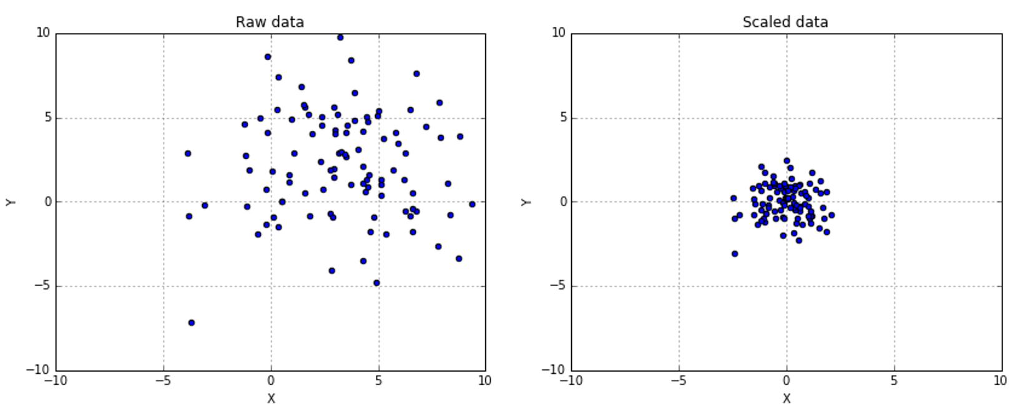
Why Scaling and Normalization
Scaling is a fundamental data transformation technique used to bring numerical features to a common scale. It's an essential step in data preprocessing, especially when working with algorithms that are sensitive to the magnitude of features. Scaling ensures that each feature contributes equally to the analysis and prevents features with larger values from dominating the learning process.

Slide 29
Why Scaling and Normalization
Convergence Speed: Algorithms like gradient descent converge faster when features are on a similar scale, as they take more balanced steps toward the optimal solution.
Distance-Based Algorithms: Algorithms like k-means clustering and hierarchical clustering are affected by the distance between data points. Scaling ensures that features with larger magnitudes do not dominate the distance computation.
Regularization: Regularization techniques, such as Ridge and Lasso regression, penalize large coefficients. Scaling prevents certain features from being overly penalized due to their larger values.
Model Performance: Scaling can improve the performance and stability of algorithms like support vector machines (SVMs) and neural networks.

Slide 30
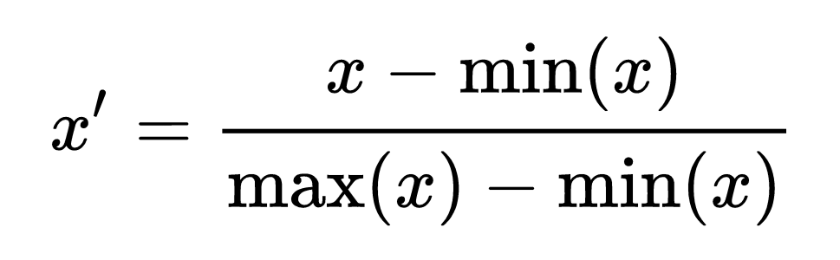
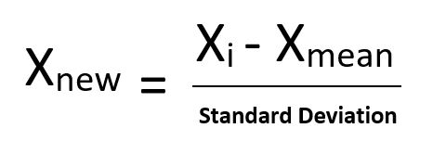
Scaling Methods
Min-Max Scaling (Normalization):
Scales features to a specified range (usually [0, 1]).
Suitable when features have a defined minimum and maximum, and you want to maintain interpretability.
Standard Normalization:
also known as Z-score normalization or standardization, is a data transformation technique used to scale numerical features so that they have a mean of 0 and a standard deviation of 1. It's a common method in data preprocessing and is particularly useful when dealing with features that have different units of measurement or scales.

Slide 31
Feature Engineering
Feature engineering is a critical phase in the data preprocessing journey that involves crafting and refining features to optimize the performance of machine learning models. In this session, we will explore the art and science of feature engineering, delving into techniques that empower us to extract meaningful information from raw data, improve model interpretability, and enhance overall predictive accuracy.
Feature Creation
Feature Selection
Feature Extraction
Encoding Categorical Features

Slide 32
Feature Creation
Ratio Features: Creating new features by calculating ratios between numerical variables. For example, calculating a debt-to-income ratio.
Aggregation: Aggregating data to create summary statistics, such as mean, median, and sum, for specific groups or time intervals.
Date/Time Features: Extracting components like day, month, year, and time of day from timestamps.

Slide 33
Feature Selection
Challenges of high-dimensional data.
Enhance model performance and interpretability.
Recursive Feature Elimination (RFE): Iteratively removing least important features.
Correlation Analysis: Analyzing feature correlations.
Feature Importance from Tree-Based Models: Assessing feature importance using ensemble models.

Slide 34
Encoding Categorical Features
Transform categorical data into numerical form for models.
One-Hot Encoding:
Convert categories to binary vectors.
Each category becomes a separate column
Label Encoding:
Assign unique integer labels to categories.
Suitable for ordinal categorical variables.

Slide 35
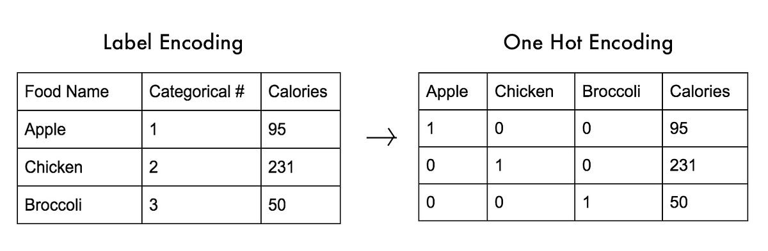
Label Encoding VS One Hot Encoding

Slide 36
One-Hot Encoding
Advantages:
Prevents ordinality issues: One-hot encoding avoids falsely introducing ordinal relationships between categories.
Compatible with most algorithms: Many machine learning algorithms expect numerical input, making one-hot encoding a suitable choice.
Limitations:
Dimensionality increase: One-hot encoding increases the dimensionality of the dataset, especially for variables with many categories.
Collinearity: The new columns might be correlated, which can affect the performance of certain algorithms.

Slide 37
Label Encoding
Advantages:
Compact representation: Label encoding reduces the dimensionality of the categorical variable to a single column of integers.
Preserves ordinality: Suitable for ordinal categorical variables where order matters.
Limitations:
Misleading magnitude: Some algorithms may misinterpret the integer labels as ordinal magnitudes, leading to incorrect assumptions.
When to Use:
For ordinal categorical variables where the order of categories has significance.

Slide 38
Feature Extraction
Transforming high-dimensional data into lower-dimensional representation.
Reduce dimensionality, remove noise, capture patterns.
Principal Component Analysis (PCA):
Identify orthogonal components with maximum variance.
Eigenvalues, eigenvectors, explained variance.
Non-Negative Matrix Factorization (NMF):
Decompose non-negative data into additive components.
Application in topic modeling, image processing.

Slide 39
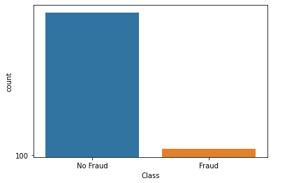
Imbalanced Data
Definition: Class imbalance occurs when the distribution of classes in a dataset is uneven, with one class significantly outnumbering the others.
Impact: Class imbalance can lead to biased model predictions, poor generalization, and inaccurate results, as models tend to favor the majority class.

Slide 40
Resampling
Resampling is a critical technique in data preprocessing used to address class imbalance and enhance the performance of machine learning models. This session explores the intricacies of resampling methods and how they can mitigate issues stemming from imbalanced datasets.
Oversampling
Undersampling

Slide 41
Oversampling
Oversampling: Oversampling involves increasing the representation of the minority class by generating synthetic samples or replicating existing ones.
Potential overfitting on duplicated samples.
Methods:
Random Oversampling: Replicate minority class samples randomly.
Synthetic Minority Over-sampling Technique (SMOTE): Generate synthetic samples along line segments between existing minority class samples.

Slide 42
Undersampling
Oversampling: Undersampling involves reducing the representation of the majority class by removing samples.
Risk of underfitting due to reduced training data.
Methods:
Random Undersampling: Randomly remove majority class samples.
Edited Nearest Neighbors (ENN): Remove majority class samples that are misclassified by their k-nearest neighbors.
Evaluation Considerations !

Slide 43
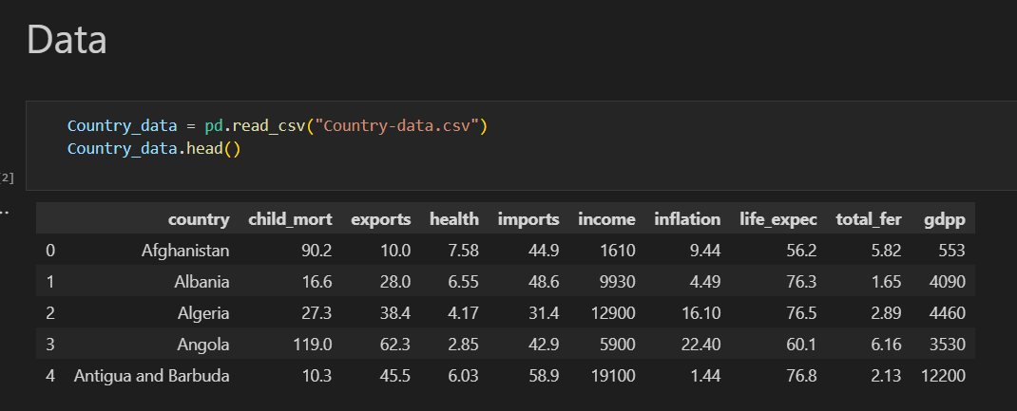
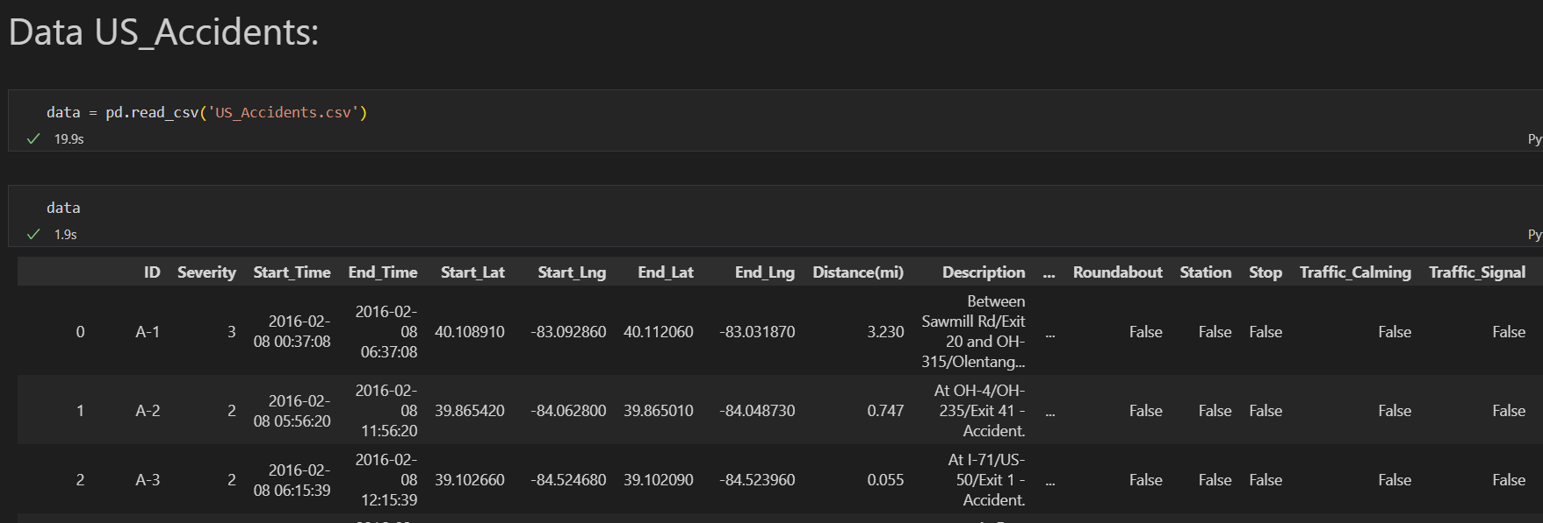
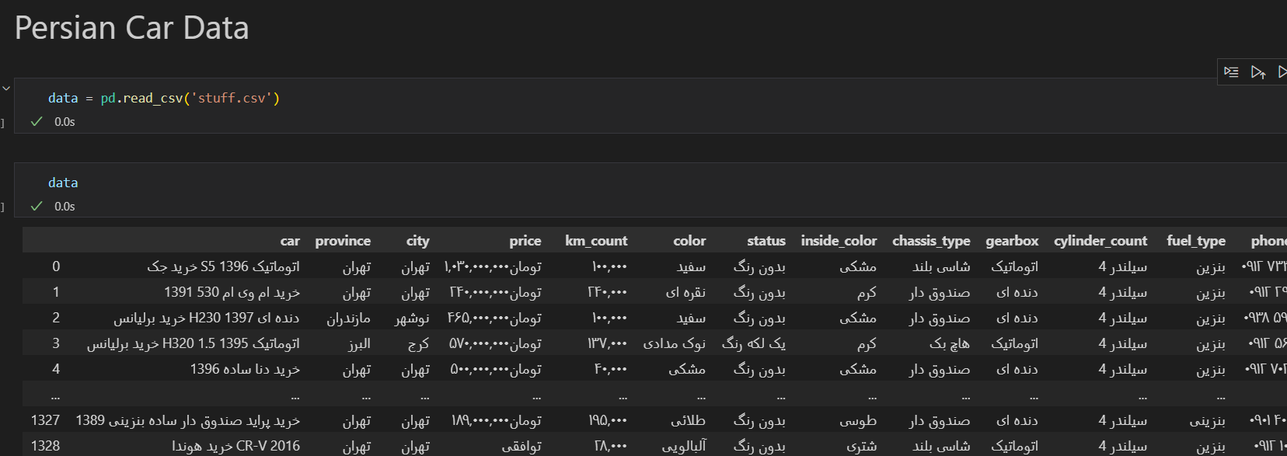
Real-world Challenges and Best Practices

Slide 44




Special Thanks
For gathering a relevant data and Designing the Summer School

Slide 45

THANK YOU FOR YOUR ATTENTION
WISH YOU LUCK
Your Journey is beginning

