Slide 1
Transforming Education Through Technology
SMART-CAMPUS: Enterprise Management System for NPIC

Slide 2
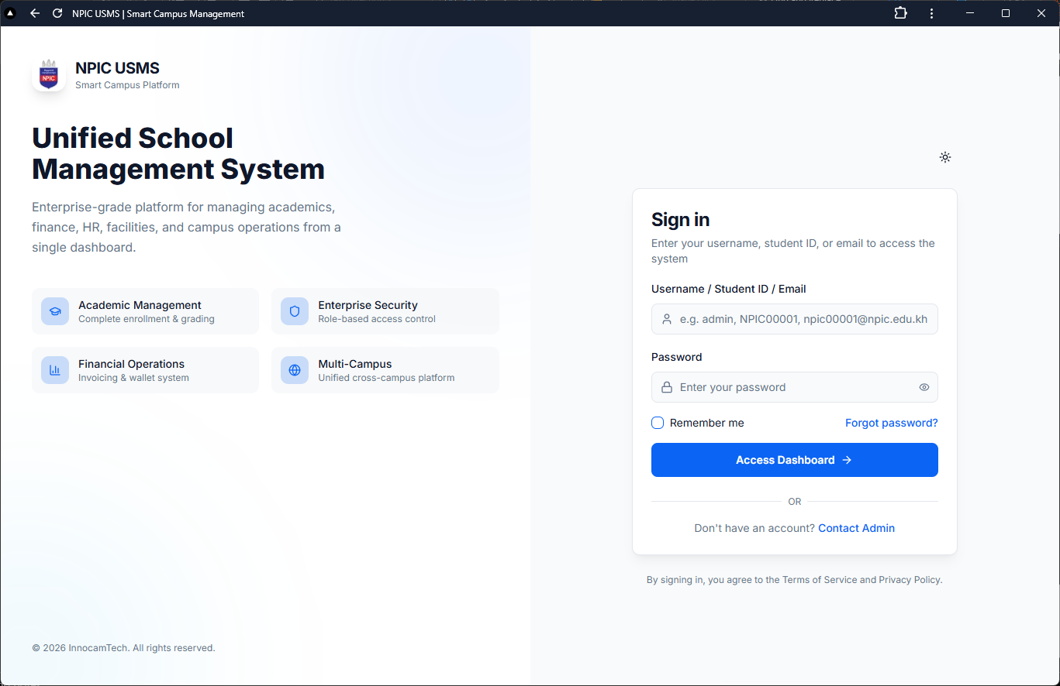
The Cost of Inaction vs. Digital Transformation
• Status Quo: Fragmented data, manual inefficiencies, revenue leakage
• Rising student expectations demand seamless digital experiences
• Competitive pressure: Modern institutions leverage technology
• The Future: Unified ecosystem, real-time insights, automated workflows

Slide 3
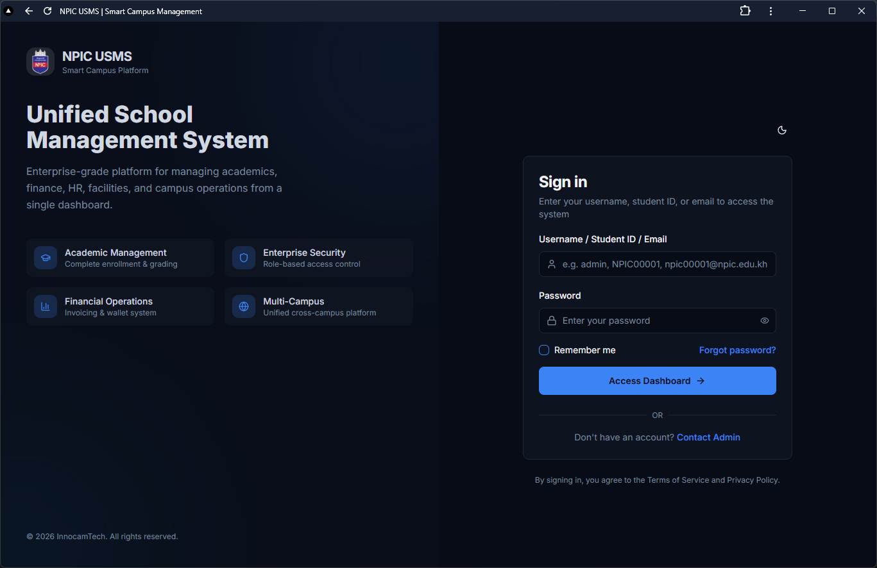
One Platform. Every Operation.
• Unified Ecosystem: Admissions, Academics, Finance, HR in one system
• Role-Based Access: Granular permissions for all stakeholders
• Real-Time Analytics: Instant visibility into institutional performance
• Scalable Architecture: Grows with NPIC's ambitions

Slide 4
Measurable Impact. Immediate ROI.
85%
$0
100%
Reduction in Administrative Processing Time
Revenue Shrinkage Through Automation
Data Integrity & Audit Trail

Slide 5
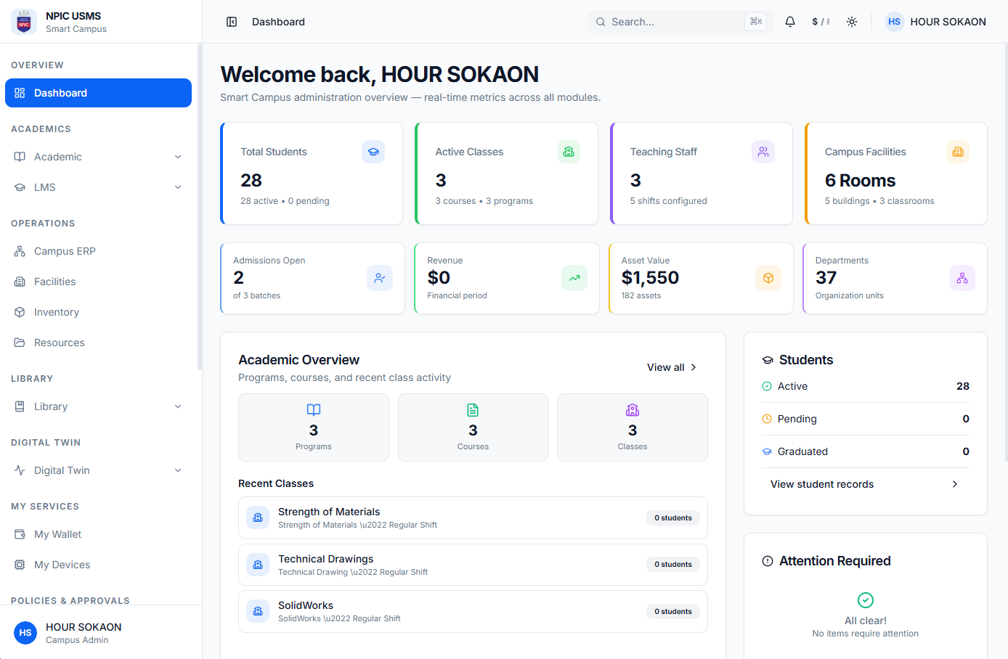
Academic Excellence: Enrollment to Graduation
• Digital admissions pipeline with document verification
• Automated course registration and scheduling
• Real-time grade management and transcript generation
• Comprehensive student lifecycle tracking

Slide 6
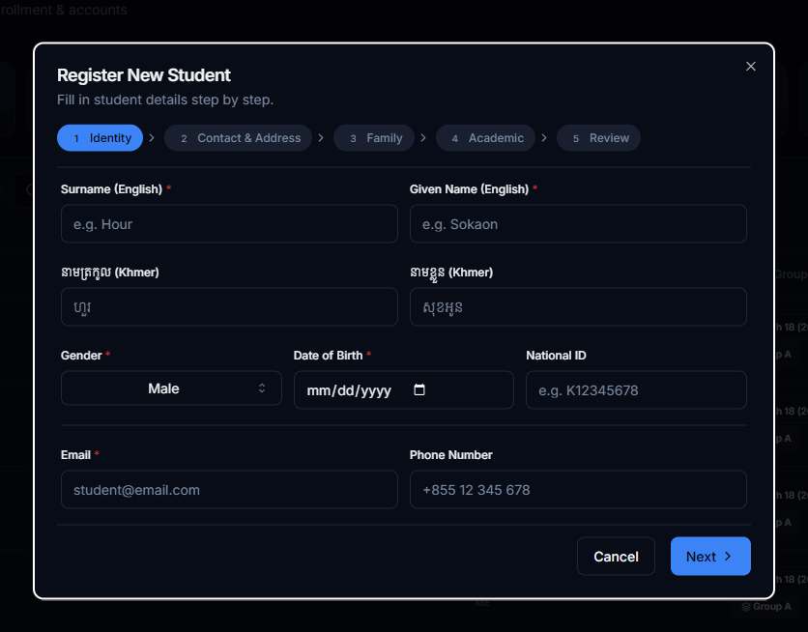
Facilities & Asset Management
• Digital twin infrastructure monitoring
• IoT-enabled dormitory access control
• Preventive maintenance scheduling
• Asset tracking with QR code integration

Slide 7
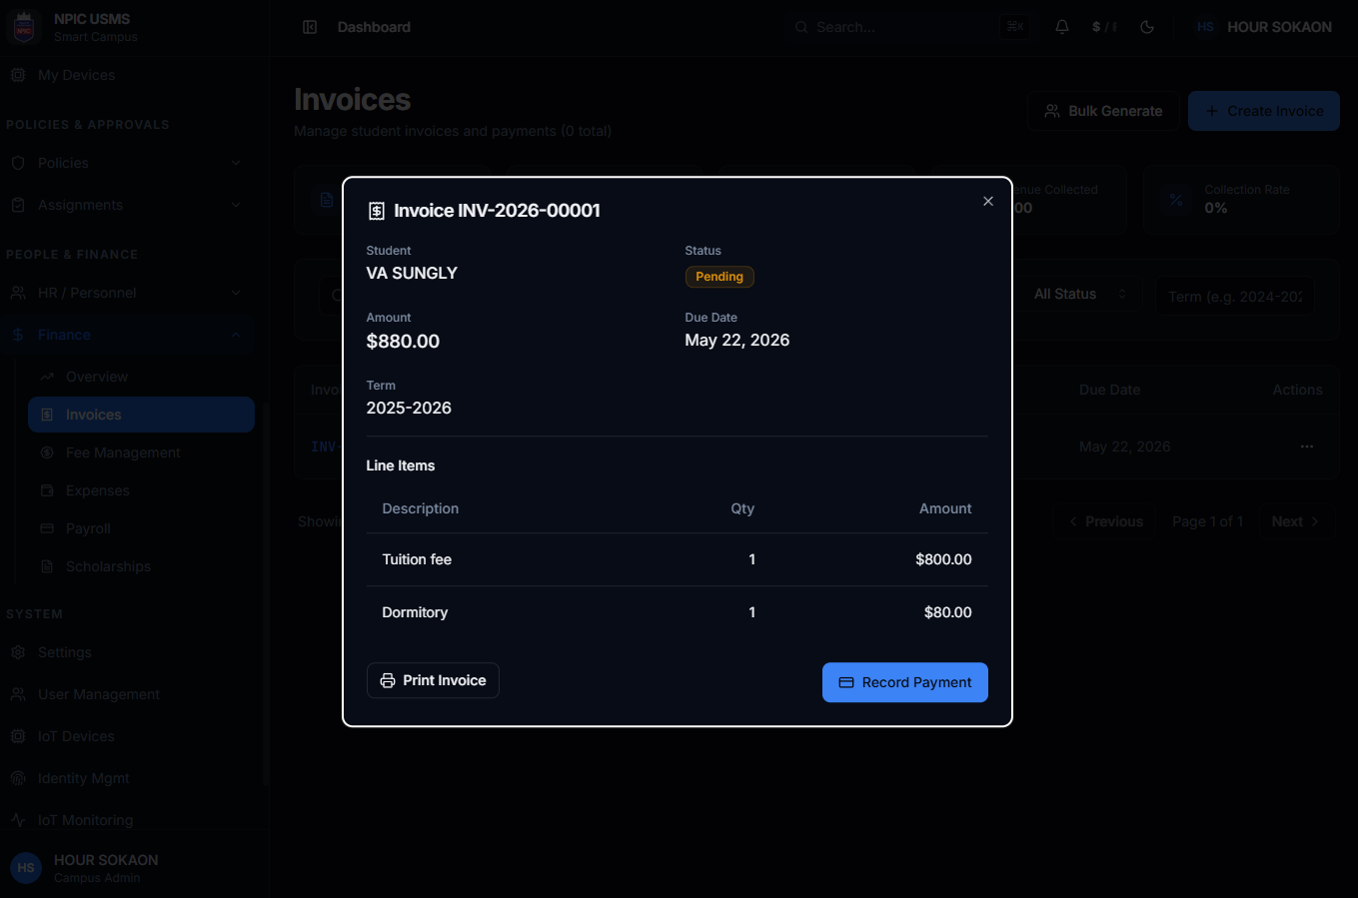
Integrated Financial Management
• Auto-generated invoices with Bakong KHQR integration
• Real-time payment reconciliation
• Budget tracking and financial reporting
• Zero manual cash handling reduces risk

Slide 8
Cloud vs. On-Premise Deployment
Factor | Cloud Deployment | On-Premise
Upfront Costs | Low (Pay-as-you-go) | High (Hardware investment)
Scalability | Instant elasticity | Fixed capacity
Maintenance | Zero upkeep (managed) | 24/7 internal IT required
Security | Built-in compliance | Your responsibility
Uptime | 99.9%+ SLA guaranteed | Infrastructure dependent
Updates | Automatic, seamless | Manual, risky

Slide 9
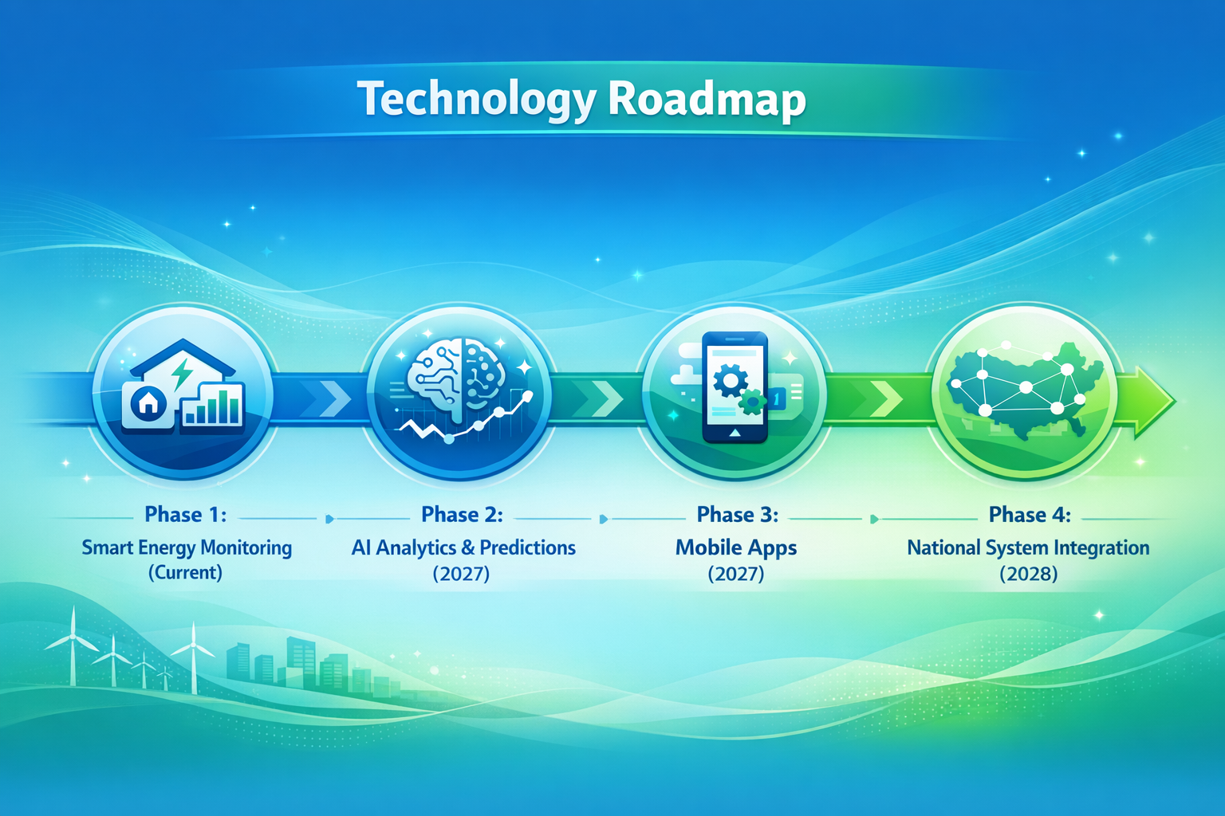
Enterprise-Grade Technology Stack
• Next.js: Lightning-fast responsive interface
• NestJS: Robust, scalable backend architecture
• Docker Containers: Consistent deployment, 99.9% uptime
• MQTT Protocol: Real-time IoT device communication
• RBAC Security: Military-grade access control

Slide 10
Strategic 9-Month Rollout Plan
1
2
3
Core Module Deployment Months 1-3 Admissions, Registration, Finance
Full Integration Months 4-6 HR, Facilities, IoT sensors
Go-Live & Optimization Months 7-9 Training, rollout, refinement

Slide 11
Approve Phase 1 Implementation
Authorize Cloud Deployment Initiation
✓ Immediate 85% reduction in administrative overhead
✓ Zero revenue leakage through automated billing
✓ Future-ready cloud infrastructure
✓ Enhanced institutional reputation

