Slide 1


Switch Attention
Towards Dynamic and Fine-grained
Hybrid Transformers
Yusheng Zhao¹, Hourun Li¹, Bohan Wu¹, Yichun Yin²,
Lifeng Shang², Jingyang Yuan¹, Meng Zhang², Ming Zhang¹
¹ Peking University / PKU-Anker LLM Lab
² Huawei Technologies Co., Ltd.
Notes:
Time: 0:00–0:20
Hello everyone. Today I will present Switch Attention. Our question is simple: can a transformer decide when it needs global context, separately for each token and each layer? We study this through dynamic routing between full attention and sliding window attention.
讲述提示：0:00–0:20。开场直接抛出研究问题，不口述全部作者与单位。
Talk: 9:30. Q&A: 2:30. Total: 12:00, per presenter confirmation.
Paper authors and affiliations: supplied PDF, page 1.
First three authors contributed during internships at Huawei. Corresponding authors: Jingyang Yuan, Meng Zhang, Ming Zhang.
https://arxiv.org/abs/2603.26380
Official conference assets: https://drive.google.com/drive/folders/1_IX04T09KVmBr1rF9LOv11slD-ZmH5ne?usp=sharing
Speaker guidelines: https://docs.google.com/presentation/d/1csfkuRIhVSjRX_zn3f1SBgvjuzoXyye_Cjx9QW44e4E/edit

Slide 2
Attention cost depends on how far we look
Attention | Context available | Prefill cost
Full attention | All previous tokens | O(N²)
Sliding window | Last w tokens | O(Nw)
Static hybrids fix the attention type by layer
The need for distant context can change from token to token.
02
Notes:
Time: 0:20–1:05 (45 seconds)
Full attention lets a token access the entire preceding context, but its cost grows with context length. Sliding window attention limits this access to recent tokens, making local computation cheaper. The tradeoff is losing direct access to distant information. A common compromise assigns full attention to some layers and sliding windows to others. But this schedule is fixed before seeing the input. It spends the same pattern of global computation on an easy local continuation and on a question that requires retrieving something far away.
讲述提示：0:20–1:05。指向 global / local，再指向固定层交替模式；落点是输入变化而计算分配不变。
Sources: Paper §1–2, pages 1–3. Complexity here refers to attention computation during prefill, for fixed model dimensions.
Paper: /Users/hourunli/Documents/会议资料/EMNLP2026/switchAttention.pdf
https://arxiv.org/abs/2603.26380
Conference logo: https://drive.google.com/drive/folders/1_IX04T09KVmBr1rF9LOv11slD-ZmH5ne?usp=sharing

Slide 3
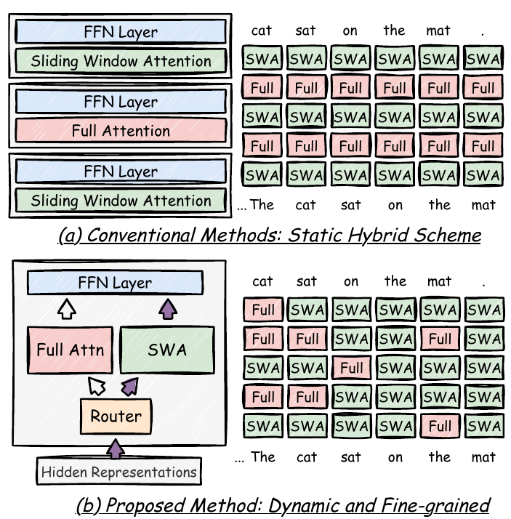
A content-dependent choice at every token and layer
One routing
decision
Full attention
for global context
Sliding window
for local context
03
Notes:
Time: 1:05–1:50 (45 seconds)
Switch Attention changes the unit of this decision. Instead of assigning an attention type to a whole layer, we make a separate choice for each token at each layer. In this diagram, the static model uses the same pattern across tokens. In our model, the pattern can change across both dimensions. A token can receive global information at one layer and use a local window at another. The aim is to retain access to distant information while learning where that access is actually useful for prediction.
讲述提示：1:05–1:50。沿图的 token 轴与 layer 轴各指一次。不要把颜色解读为独立专家或不同参数组。
Sources: Paper Figure 1, page 1. Diagram reused from the supplied paper.
Paper: /Users/hourunli/Documents/会议资料/EMNLP2026/switchAttention.pdf
https://arxiv.org/abs/2603.26380
Conference logo: https://drive.google.com/drive/folders/1_IX04T09KVmBr1rF9LOv11slD-ZmH5ne?usp=sharing

Slide 4
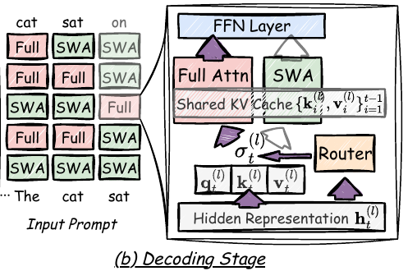
At inference, the router selects one branch
p = sigmoid(R(h))
p > 0.5: full attention
p ≤ 0.5: sliding window
Shared QKV projections
One shared KV cache
Only the selected branch runs.
04
Notes:
Time: 1:50–2:45 (55 seconds)
At inference, the router is a linear mapping of the current hidden representation, followed by a sigmoid. A probability above one half selects full attention; otherwise, it selects the sliding window. Both branches share the query, key, and value projections and one KV cache. During decoding, we compute only the selected attention branch for the current token. The decision therefore does not require first evaluating both alternatives. The selected branch still performs its usual attention operation. What changes is which context range this token reads, based on information already available in its hidden representation.
讲述提示：1:50–2:45。按 hidden state → router → selected branch 讲。强调 only selected branch 指推理，避免与下一页训练混淆。
Sources: Paper §3.2, Equations 1–6 and Figure 2(b), pages 3–4. One scalar gate for each token at each layer, shared across heads.
Paper: /Users/hourunli/Documents/会议资料/EMNLP2026/switchAttention.pdf
https://arxiv.org/abs/2603.26380
Conference logo: https://drive.google.com/drive/folders/1_IX04T09KVmBr1rF9LOv11slD-ZmH5ne?usp=sharing

Slide 5
Adaptive regularization encourages local attention
Router penalty = γ · softplus(R(h))
γ = base weight / (ε + NLL + α · MSE)
Easy prediction
Similar branch outputs
Hard prediction
Different branch outputs
Stronger pressure to use SWA
Weaker pressure to use SWA
NLL and branch disagreement are training signals. Inference uses only R(h).
05
Notes:
Time: 2:45–3:50 (65 seconds)
How do we encourage efficiency without forcing every token into the local branch? We add a softplus penalty to the router logit. Reducing this penalty term pushes the router toward sliding window attention. Its weight is adaptive. The numerator is a fixed base weight; the denominator combines a small constant, the token prediction loss, and the disagreement between the two attention outputs. If prediction is difficult, or the branches disagree strongly, the denominator grows and the efficiency penalty becomes weaker. This gives the model more freedom to choose full attention. These signals are used only during training. At inference, routing uses the hidden representation alone, with no ground truth or future tokens.
讲述提示：2:45–3:50。只解释分母变大→惩罚减弱这一条因果链，不逐符号朗读公式。训练标签与推理信息边界必须说清。
Sources: Paper §3.3, Equations 7–9, pages 4–5. MSE denotes the squared difference between full and SWA branch outputs. NLL uses the teacher-forced target only in CPT.
Paper: /Users/hourunli/Documents/会议资料/EMNLP2026/switchAttention.pdf
https://arxiv.org/abs/2603.26380
Conference logo: https://drive.google.com/drive/folders/1_IX04T09KVmBr1rF9LOv11slD-ZmH5ne?usp=sharing

Slide 6
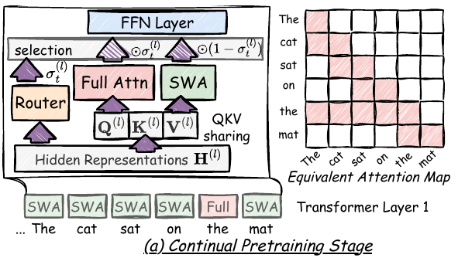
Continual pretraining converts a full-attention model
Train both branches with STE
Initialize from a pretrained model
Update the whole hybrid model
Context | Added CPT tokens
4K | 20B
32K | 8B
1.5B model 22 layers 1,024-token window 23 benchmark datasets
06
Notes:
Time: 3:50–4:40 (50 seconds)
We initialize from a pretrained full attention model and update the whole model through continual pretraining. During training, both attention branches are computed. A hard gate selects the output, and a straight-through estimator lets the router receive gradients. Our main model has one point five billion parameters, twenty-two layers, and a window of one thousand twenty-four tokens. Conversion uses twenty billion tokens for the four-K setting and eight billion tokens for the thirty-two-K setting. Evaluation covers twenty-three datasets, including commonsense reasoning, in-context retrieval, and long-context understanding. I will focus on the results that require longer-range access.
讲述提示：3:50–4:40。training computes both 与 inference computes selected 对应起来。参数和训练量指表格带过。
Sources: Paper §3.4 and §4.1, pages 5–7. 4K: 240B-token full-attention pretraining plus 20B CPT. 32K: 192B at 4K, 24B context extension, then 8B CPT. Whole hybrid transformer updated. Original Figure 2(a).
Paper: /Users/hourunli/Documents/会议资料/EMNLP2026/switchAttention.pdf
https://arxiv.org/abs/2603.26380
Conference logo: https://drive.google.com/drive/folders/1_IX04T09KVmBr1rF9LOv11slD-ZmH5ne?usp=sharing

Slide 7
SwiAttn matches FullAttn on in-context retrieval
Average score across 6 datasets, up to 4K context
+2.3 points over the static hybrid
07
Notes:
Time: 4:40–5:30 (50 seconds)
First, consider retrieval within a four-K context. Some questions need information beyond the local window, so using sliding windows everywhere can lose useful evidence. Across the six datasets in this comparison, Switch Attention and the full attention baseline both have a reported average of fifty-two point nine. The static hybrid baseline scores fifty point six. That is a gain of two point three points over the fixed schedule. Individual datasets show different tradeoffs, but the aggregate result suggests that learned routing can preserve retrieval quality better than this static allocation of attention.
讲述提示：4:40–5:30。先指 Full 与 Swi 的同值，再指 SH 的差距。说 points，不说 percent。
Sources: Paper Table 2, page 7. Six-dataset average. 52.9 − 50.6 = 2.3 score points. FullAttn does not receive the same extra CPT as the adapted models.
Paper: /Users/hourunli/Documents/会议资料/EMNLP2026/switchAttention.pdf
https://arxiv.org/abs/2603.26380
Conference logo: https://drive.google.com/drive/folders/1_IX04T09KVmBr1rF9LOv11slD-ZmH5ne?usp=sharing

Slide 8
The same LongBench-E average with dynamic routing
Average score across 7 datasets, up to 32K context
+2.2 points over SH (3:1)
08
Notes:
Time: 5:30–6:20 (50 seconds)
The same pattern appears on LongBench-E, where inputs can reach thirty-two thousand tokens. Switch Attention and full attention both report an average score of thirty-seven point four. The static hybrid scores thirty-five point two, and DuoAttention scores thirty-three point nine. Relative to the static hybrid, our gain is two point two points. These equal averages do not mean that every task has the same outcome, or establish statistical equivalence by themselves. They show that, under this evaluation setup, the overall long-context score is preserved while the model can choose cheaper local attention.
讲述提示：5:30–6:20。限定为 reported average parity；不要宣称每项一致或由平均数证明统计等价。
Sources: Paper Table 3, page 7. Seven-dataset average: 37.4 for both FullAttn and SwiAttn after rounding. Improvements vary across tasks. Table 10: 37.4±0.35 versus 35.2±0.44 for SH (3:1), p<0.01. Failure to reject a difference with FullAttn is not an equivalence proof.
Paper: /Users/hourunli/Documents/会议资料/EMNLP2026/switchAttention.pdf
https://arxiv.org/abs/2603.26380
Conference logo: https://drive.google.com/drive/folders/1_IX04T09KVmBr1rF9LOv11slD-ZmH5ne?usp=sharing

Slide 9
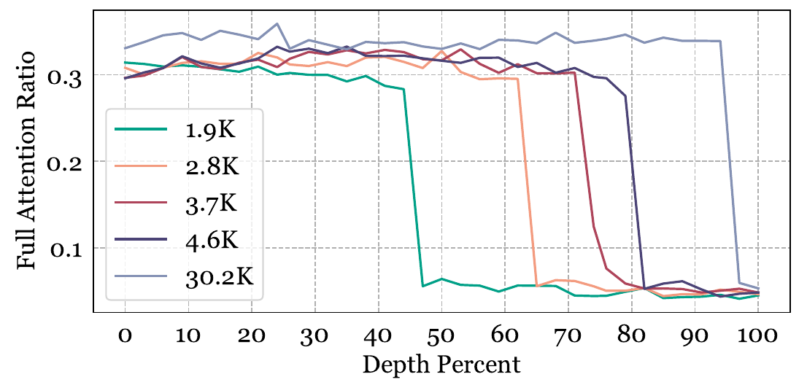
Routing responds to where the needed information is
~30%
Full attention when the
needle is outside the window
~5%
When the needle is
inside the window
100% retrieval accuracy in the tested NIAH grid through 32K context
09
Notes:
Time: 6:20–7:25 (65 seconds)
Does routing actually respond to the input? In needle-in-a-haystack retrieval, we move the target information to different positions and measure routing while the model generates the answer. When the needle lies outside the local window, full attention is used about thirty percent of the time. When it lies inside the window, that falls to about five percent. The model achieves one hundred percent retrieval accuracy over the tested grid. The horizontal axis moves the needle toward the end of the prompt. The different curves use different context lengths, so they enter the local window at different depths. The drop in global attention follows this change in where the relevant information is available.
讲述提示：6:20–7:25。讲清横轴是needle位置，越往右越靠近prompt末端。不同长度进入window的深度不同。100%仅限测试网格。
Sources: Paper Figure 6, page 9, reused without digitizing. Full-attention ratios approximately 30% outside the window and 5% inside during answer generation. Tested NIAH accuracy: Table 7, page 20. This distribution differs from Figure 5 CPT routing statistics.
Paper: /Users/hourunli/Documents/会议资料/EMNLP2026/switchAttention.pdf
https://arxiv.org/abs/2603.26380
Conference logo: https://drive.google.com/drive/folders/1_IX04T09KVmBr1rF9LOv11slD-ZmH5ne?usp=sharing

Slide 10
At 32K, standard decoding reads 4.4× fewer KV tokens
Average KV tokens accessed per layer (thousands), at 32K
4.4×
fewer KV reads
standard distribution
~12×
in the simple setting
KV access reduction. The full cache remains stored. End-to-end speedup is unmeasured.
10
Notes:
Time: 7:25–8:25 (60 seconds)
The efficiency result is easiest to interpret as the number of KV tokens accessed during decoding. At a thirty-two-K position, full attention accesses thirty-two-K tokens. Switch Attention averages seven point three-K in the standard setting, or about four point four times fewer. In the simple setting, this falls to two point six-K, about twelve times fewer. The difference between these settings is consistent with input-dependent routing. Global reads are concentrated where the learned router chooses to use them, rather than following a fixed schedule. These figures measure the amount of KV access, not the capacity of the stored cache. They also do not directly measure end-to-end speedup. Actual latency depends on the implementation, hardware, and the rest of the model.
讲述提示：7:25–8:25。逐组解释32/7.3和32/2.6。必须说 KV access，不能说 cache memory reduction 或12倍速度。
Sources: Paper Figure 4(b), page 8. Average tokens accessed per layer at 32K decode: FullAttn 32K, standard SwiAttn 7.3K, simple SwiAttn 2.6K. Ratios 32/7.3≈4.4 and 32/2.6≈12.3. Simple is NIAH with needle inside the sliding window. This metric is not end-to-end latency or KV-cache storage.
Paper: /Users/hourunli/Documents/会议资料/EMNLP2026/switchAttention.pdf
https://arxiv.org/abs/2603.26380
Conference logo: https://drive.google.com/drive/folders/1_IX04T09KVmBr1rF9LOv11slD-ZmH5ne?usp=sharing

Slide 11
The savings come with a modest CPT overhead
CPT at 32K
Practical limits
+8.4%
Full history stays in the KV cache
Forward time per layer
Savings depend on the input
and the learned routing
+7.9%
Evidence covers models up to 3B
Backward time per layer
11
Notes:
Time: 8:25–9:00 (35 seconds)
There are practical costs and limits. In the reported thirty-two-K training measurement, computing both branches adds eight point four percent forward overhead and seven point nine percent backward overhead per layer. The model still stores the full KV history for possible future global reads. Experiments cover models up to three billion parameters, and this study does not report a measured end-to-end inference speedup.
讲述提示：8:25–9:00。限制直接说明；不展开 kernel 推导。若被问硬件实现，转备份页。
Sources: Paper Tables 8–9, pages 20–21; Limitations, page 9. CPT numbers are measured per layer at 32K: forward0.0595→0.0645 s (+8.4%), backward0.1459→0.1574 s (+7.9%). No inference latency results are reported. Models tested up to3B.
Paper: /Users/hourunli/Documents/会议资料/EMNLP2026/switchAttention.pdf
https://arxiv.org/abs/2603.26380
Conference logo: https://drive.google.com/drive/folders/1_IX04T09KVmBr1rF9LOv11slD-ZmH5ne?usp=sharing

Slide 12
Switch Attention
Choose full or local attention
for each token at each layer
FullAttn-level averages on retrieval and LongBench-E
4.4× fewer KV reads in standard 32K decoding
github.com/YushengZhao/SwitchAttentionKernels
Thank you. Questions?
12
Notes:
Time: 9:00–9:30 (30 seconds)
The main takeaway is that global attention can be allocated according to the input, at the level of individual tokens and layers. Switch Attention learns this allocation through continual pretraining and adaptive regularization, while preserving the reported average quality on retrieval and long-context benchmarks. Our kernel implementation is available at the link on this slide. Thank you. I am happy to take questions.
讲述提示：9:00–9:30。停在结论与代码链接页，保留最后2分30秒问答。代码地址不逐字符朗读。
Sources: Paper conclusion, Tables 2–3, Figure 4(b), pages7–9. Main talk concludes at9:30. Reserve2:30 for audience questions. Backup slides13–18 support Q&A. Kernel link is from paper abstract.
Paper: /Users/hourunli/Documents/会议资料/EMNLP2026/switchAttention.pdf
https://arxiv.org/abs/2603.26380
Conference logo: https://drive.google.com/drive/folders/1_IX04T09KVmBr1rF9LOv11slD-ZmH5ne?usp=sharing

Slide 13
Hard routing and straight-through training
p = sigmoid(R(h))
g = 1[p > 0.5] + p − stopgrad(p)
o = g · o_full + (1 − g) · o_SWA
Training: compute both branches and backpropagate through p
Inference: use the hard gate and compute only the chosen branch
Backup 1
Notes:
Backup for Q&A. Excluded from the 9:30 talk.
Paper Equations1–6, pages4–5. The STE identity has hard forward values and soft sigmoid gradients. At inference no NLL, target token, or MSE is needed.
Paper: /Users/hourunli/Documents/会议资料/EMNLP2026/switchAttention.pdf
https://arxiv.org/abs/2603.26380
Conference logo: https://drive.google.com/drive/folders/1_IX04T09KVmBr1rF9LOv11slD-ZmH5ne?usp=sharing

Slide 14
Adaptive regularization ablations
Variant | GovReport | MultiNews | SAMSum | Average
Without adaptive weight | 24.1 | 20.7 | 30.0 | 24.9
Without NLL | 24.3 | 20.9 | 30.7 | 25.3
Without branch MSE | 23.9 | 20.6 | 29.5 | 24.7
SwiAttn | 25.0 | 21.3 | 32.4 | 26.2
Scores cover three summarization datasets. Compute-matched ablations are not reported.
Backup 2
Notes:
Backup for Q&A. Excluded from the 9:30 talk.
Paper Table4, page8. Average of GovReport, MultiNews, SAMSum. The reported ablations do not include matching routing or compute budgets, so this is not an equal-compute comparison.
Paper: /Users/hourunli/Documents/会议资料/EMNLP2026/switchAttention.pdf
https://arxiv.org/abs/2603.26380
Conference logo: https://drive.google.com/drive/folders/1_IX04T09KVmBr1rF9LOv11slD-ZmH5ne?usp=sharing

Slide 15
3B results provide a limited scaling check
Evaluation | FullAttn | SwiAttn
Commonsense accuracy | 55.9 | 55.9
In-context retrieval, 6 tasks | 55.4 | 55.8
LongBench-E, 5 tasks | 37.2 | 36.6
The long-context average drops by 0.6 points at 3B
Same training schedule and hyperparameters. Larger industrial scales remain unverified.
Backup 3
Notes:
Backup for Q&A. Excluded from the 9:30 talk.
Paper AppendixI, Tables5–6, pages20–21. 3B:28layers, hidden2048,16queryheads,4KVheads,FFN9216. Same hyperparameters and training schedule as1.5B without scale-specific tuning. LongBench-E here has five datasets, unlike seven in main1.5B results.
Paper: /Users/hourunli/Documents/会议资料/EMNLP2026/switchAttention.pdf
https://arxiv.org/abs/2603.26380
Conference logo: https://drive.google.com/drive/folders/1_IX04T09KVmBr1rF9LOv11slD-ZmH5ne?usp=sharing

Slide 16
NIAH accuracy under the same test configuration
35 context lengths × 35 needle depths × 3 repeats, through 32K
Backup 4
Notes:
Backup for Q&A. Excluded from the 9:30 talk.
Paper Figure3 and §4.4, page8; Table7 AppendixJ,page20. Grid:35contextlengths ×35depths ×3repeats=3,675cases per method under the reported setting. Generalization outside the tested setting is not established.
Paper: /Users/hourunli/Documents/会议资料/EMNLP2026/switchAttention.pdf
https://arxiv.org/abs/2603.26380
Conference logo: https://drive.google.com/drive/folders/1_IX04T09KVmBr1rF9LOv11slD-ZmH5ne?usp=sharing

Slide 17
Query tiling makes KV reuse independent of GQA group size
Group routed query positions by branch
Keep each list in position order
Process Bq query positions per tile
Kernel pattern | Dominant arithmetic intensity
Q-outer sparse attention | G · S / (G + S) ≈ G
SwiAttn query tiling | Bq · S / (Bq + S) ≈ Bq
G: GQA group size. S: KV span. Approximation when S is large. No latency claim.
Backup 5
Notes:
Backup for Q&A. Excluded from the 9:30 talk.
Paper §3.5, Equations10–11,pages6; AppendixB,pages15–16. Approximate BF16 arithmetic intensity excludes lower-order traffic. Query-head thread blocks each issue their own KV loads under the same accounting. Kernel implementation does not establish end-to-end latency speedup.
Paper: /Users/hourunli/Documents/会议资料/EMNLP2026/switchAttention.pdf
https://arxiv.org/abs/2603.26380
Conference logo: https://drive.google.com/drive/folders/1_IX04T09KVmBr1rF9LOv11slD-ZmH5ne?usp=sharing

Slide 18
LongBench-E results vary by task
Method | GvR | MNs | MFQA | Qas | TQA | SSM | TRec | Avg
SH (3:1) | 22.6 | 20.0 | 29.6 | 14.5 | 68.1 | 32.3 | 59.3 | 35.2
FullAttn | 24.9 | 20.9 | 33.9 | 18.6 | 69.3 | 30.2 | 63.7 | 37.4
SwiAttn | 25.0 | 21.3 | 35.3 | 18.0 | 69.9 | 32.4 | 60.0 | 37.4
Three reported runs: SwiAttn 37.4 ± 0.35, SH (3:1) 35.2 ± 0.44
p < 0.01 vs SH (3:1). A non-significant difference vs FullAttn does not prove equivalence.
Backup 6
Notes:
Backup for Q&A. Excluded from the 9:30 talk.
Paper Table3,page7 and Table10,AppendixL,page21. Full results for the seven1.5BLongBench-E datasets. Aggregate rounded averages do not imply equal scores per task. Table10reports three runs and two-sidedWelcht-tests.
Paper: /Users/hourunli/Documents/会议资料/EMNLP2026/switchAttention.pdf
https://arxiv.org/abs/2603.26380
Conference logo: https://drive.google.com/drive/folders/1_IX04T09KVmBr1rF9LOv11slD-ZmH5ne?usp=sharing

