Slide 1
V3.3-V3.4
Generalization Study
Meeting question
Which training changes improve performance across independent seeds and future markets?
Replicated evidence on training diversity, branch credit, and drawdown control
Evidence base
Weekly meeting update | 3 October 2026
Three-seed V3.4 comparisons and 100 matched one-year holdout markets per checkpoint.
Constraint-Aware Portfolio RL | 3 October 2026
1
Notes:
Today I will focus on generalization rather than the highest validation score. In V3.3 I explored several changes to the training market and policy. Those results suggested useful directions, but most comparisons used one seed and changed more than one factor. V3.4 therefore used paired experiments and three training seeds for the central questions. I then evaluated every policy on the same 100 independent one-year markets. This gives us stronger evidence about which effects repeat and which effects remain uncertain.
Sources:
- reports/simplex_v33_v34_generalization_meeting_20261003.md

Slide 2
WHAT CHANGED: V3.3
First, vary the training data and policy design
Market exposure
Algorithm variants
Compare 2 versus 8 training markets and 5,040, 10,080, or 20,160 steps per market. Test the professor's fewer-but-longer-market hypothesis.
Explore Gaussian and Dirichlet simplex policies, PPO and RCPO, plus counterfactual-reward and soft allocation-penalty variants.
11 configurations | one training seed each
Purpose: identify promising hypotheses, not declare a winning configuration.
Constraint-Aware Portfolio RL | 3 October 2026
2
Notes:
I will first explain what changed, before showing any evaluation result. In V3.3, I tested the idea that fewer but longer training markets might improve generalization. The market-design cases changed the number of markets between two and eight and the market length from 5,040 to 10,080 or 20,160 steps. I also explored policy and constraint variants, including Gaussian versus Dirichlet simplex policies, PPO versus RCPO, counterfactual reward, and a soft allocation-penalty comparison. These eleven configurations used only one training seed each, so they were intended to generate hypotheses rather than establish a robust winner.
Sources:
- evaluation/v3.3_v3.4_professor_meeting/evaluation_manifest.csv

Slide 3
WHAT CHANGED: V3.4
Turn V3.3 hypotheses into paired, replicated tests
Factorial core
Credit ablation
Exploratory sweeps
2 or 8 markets x 3 or 4 epochs. Three matched training seeds per condition isolate both factors and their interaction.
Standalone versus counterfactual branch reward, at both epoch settings and the same three seeds.
One-seed observation windows of 20/30/40/60 steps and drawdown margins of 0.90/0.85/0.80.
22 new seed-runs + 2 reused V3.3 controls
Paired seeds and shared market paths reduce confounding; one-seed sweeps remain exploratory.
Constraint-Aware Portfolio RL | 3 October 2026
3
Notes:
V3.4 changes the experimental design rather than replacing the core portfolio algorithm. The central comparison is a two-by-two factorial: two or eight markets, crossed with three or four optimizer epochs. Each cell uses seeds zero, one, and two, with market paths paired where the factor permits. I then compare the standalone branch reward with counterfactual branch reward under both epoch settings. The window and drawdown-margin sweeps test separate ideas, but each has one seed and therefore remains exploratory. This creates twenty-two new seed-runs and reuses two exact V3.3 controls. The purpose is to isolate effects and measure whether they repeat across seeds.
Sources:
- evaluation/v3.3_v3.4_professor_meeting/evaluation_manifest.csv

Slide 4
CONTROLLED COMPARISON
Hold the portfolio task fixed; change one factor at a time
3 epochs
4 epochs
Training markets
2 x 5,040
2 x 5,040
Credit study
2 markets
Seeds 0, 1, 2
Seeds 0, 1, 2
Standalone vs counterfactual reward
8 x 5,040
8 x 5,040
Exploratory
8 markets
Seeds 0, 1, 2
Seeds 0, 1, 2
Lookback 20/30/40/60 and margin 0.90/0.85/0.80
Fixed: 252-step episodes, 60,000 updates, 8 risky assets + cash, allocation constraints
Constraint-Aware Portfolio RL | 3 October 2026
4
Notes:
The central V3.4 design is a two-by-two factorial experiment. I compare two versus eight training markets and three versus four optimization epochs. Each of the four conditions uses the same three seeds. I also compare standalone branch reward against counterfactual branch reward at both epoch settings. Finally, I run smaller exploratory sweeps for the observation window and drawdown margin. These last two sweeps have one seed, so I treat them as hypotheses rather than stable recommendations.
Sources:
- evaluation/v3.3_v3.4_professor_meeting/evaluation_manifest.csv

Slide 5
TRAINING HISTORY | V2.6 AND V3.2
First establish the algorithm baseline, then isolate branch credit
V2.6 | six baseline arms
V3.2 | six branch-credit arms
8 markets x 5,040 steps; lookback 20; 60,000 updates.
Simplex PPO/RCPO x Gaussian/Dirichlet (four arms).
Two softmax RCPO comparisons: allocation penalty alone, and allocation + drawdown penalty.
Keep the V2.6 market setup and RCPO.
Gaussian/Dirichlet x counterfactual reward, counterfactual cost, or both (six arms).
Gaussian uses 3 epochs; Dirichlet uses 4. Compare each with the V2.6 standalone-credit counterpart.
Key distinction: V3.2 changes the branch learning signal, not the training-market design.
Constraint-Aware Portfolio RL | 3 October 2026
5
Notes:
Before discussing V3.3 and V3.4, I want to make the earlier training groups explicit. V2.6 used eight training markets of 5,040 steps, a 20-step lookback, and 60,000 updates. Four simplex arms crossed PPO or RCPO with Gaussian or Dirichlet policies. Two additional softmax RCPO arms penalized allocation violations, either alone or together with drawdown. V3.2 kept the same market design and focused on credit assignment. For Gaussian and Dirichlet RCPO, I tested counterfactual reward, counterfactual cost, and both together. The relevant comparator is the V2.6 standalone-reward, global-cost policy of the same distribution. Gaussian used three optimizer epochs and Dirichlet four, so a cross-distribution difference is not a pure distribution effect.
Sources:
- evaluation/v3.3_v3.4_professor_meeting/evaluation_manifest.csv

Slide 6
TRAINING CHANGES | FOUR VERSIONS
Each version answers a different question
Version
Training variable / question
Coverage
V2.6
Algorithm and constraint baselines
6 arms; seed 0
V3.2
Branch credit: counterfactual reward / cost / both
6 arms; seed 0
V3.3
Market count 2/8; length 5,040/10,080/20,160; method probes
11 arms; seed 0
V3.4
2/8 markets x 3/4 epochs; credit, window, margin sweeps
22 new seed-runs; core seeds 0-2
All use the same 8-risky-asset + cash task; V3.3/V3.4 test generalization, not a new environment.
Constraint-Aware Portfolio RL | 3 October 2026
6
Notes:
This map summarizes the question asked by each version. V2.6 established the simplex and soft-penalty baselines. V3.2 changed the branch credit signal while keeping the market design fixed. V3.3 then tested the professor's market-diversity and market-length ideas, alongside a few method probes, but only at seed zero. V3.4 selected the most important questions for a more controlled study: a two-by-two market-count and epoch factorial with three matched seeds, a paired counterfactual-reward test, and separate single-seed lookback and drawdown-margin sweeps. The portfolio universe and hard allocation constraints remain the same. This sequence tells us which results are algorithm comparisons, which are market-design comparisons, and which have replicated evidence.
Sources:
- evaluation/v3.3_v3.4_professor_meeting/evaluation_manifest.csv

Slide 7
EVALUATION PROTOCOL
Every checkpoint faces the same 100 matched future markets
5
20
252
100
2
independent anchors
branches per anchor
future steps
matched markets
checkpoint objectives
Common comparison rules
Checkpoint labels
Relative terminal wealth uses the constrained-neutral CAOSD baseline. Risk is recomputed with margin 0.90, floor 0.05, cost scale 0.10, and alpha-budget ratio 0.05.
Best-return maximizes validation return. Robust-feasible-selected ranks validation feasible-branch rate first and return second. It is not a safety guarantee.
Constraint-Aware Portfolio RL | 3 October 2026
7
Notes:
The evaluation uses a shared set of future markets. For each of five anchor histories, I generate 20 independent one-year continuations. Every policy sees exactly the same risky-asset returns. Return is reported relative to the constrained-neutral CAOSD baseline, which already satisfies the hard allocation constraints. For risk, I recompute every policy under one common drawdown rule so that different training margins remain comparable. I evaluate the return-selected and robust-feasible-selected checkpoints separately. The robust label refers to validation selection and is not a safety guarantee on unseen markets.
Sources:
- evaluation/v3.3_v3.4_professor_meeting/comparison_summary.json

Slide 8
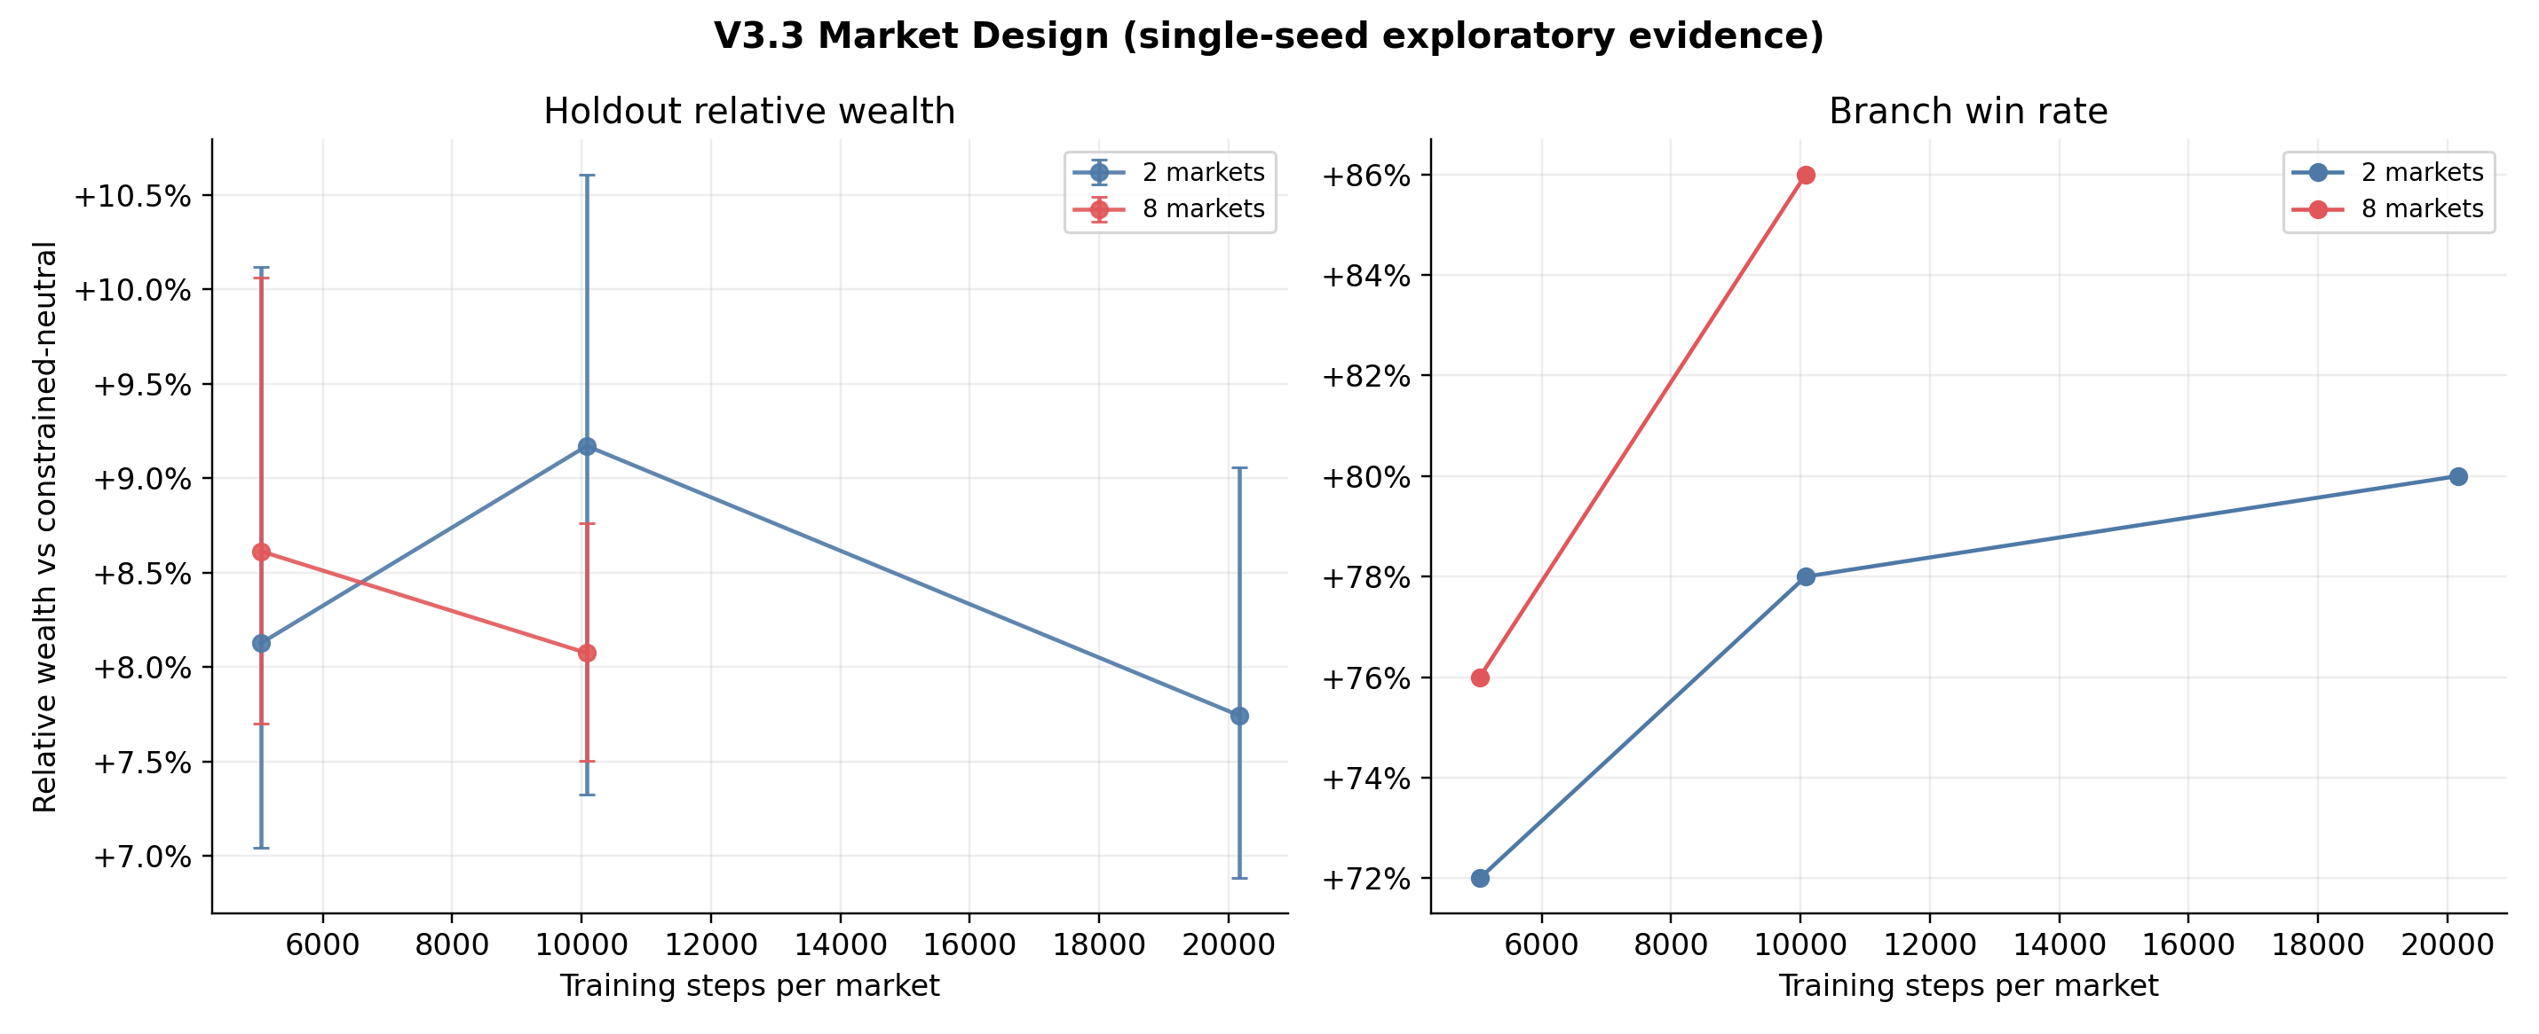
V3.3 EXPLORATORY EVIDENCE
Longer training paths did not improve generalization monotonically
Highest return
2 x 10,080 steps reached +9.17% relative wealth.
Best market-design risk
8 x 10,080 reached 42% common feasibility and 14.17% mean maximum drawdown.
Conclusion | exploratory
Longer paths are not always better; return and risk favor different settings. One seed cannot rank them reliably.
Constraint-Aware Portfolio RL | 3 October 2026
8
Notes:
V3.3 first tested the professor's suggestion to use fewer but longer markets. With two markets, moving from 5,040 to 10,080 steps improved holdout return from 8.13 to 9.17 percent. Extending again to 20,160 steps reduced return to 7.74 percent. Therefore, longer training histories did not provide a monotonic benefit. The eight-market, 10,080-step condition produced a more favorable risk profile, with 42 percent common feasibility and 14.17 percent mean maximum drawdown. However, these are one-seed findings, so I use them to motivate V3.4 rather than rank final models.
Sources:
- evaluation/v3.3_v3.4_professor_meeting/v33_01_market_design_return.png
- evaluation/v3.3_v3.4_professor_meeting/v33_02_market_design_risk.png

Slide 9
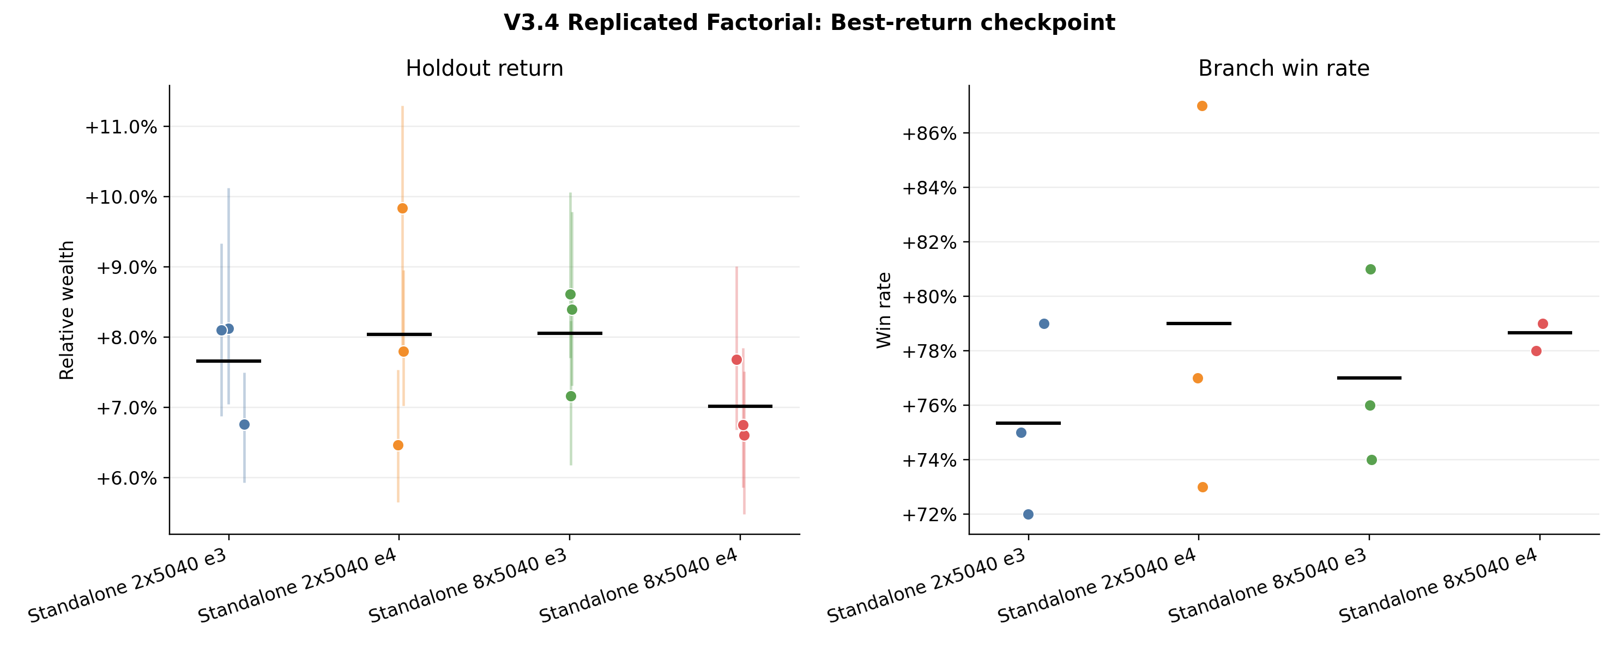
V3.4 REPLICATED FACTORIAL
Condition means are close compared with the spread across seeds
8 markets, 3 epochs
+8.06% return, 27.7% common feasibility, 15.50% drawdown.
2 markets, 4 epochs
+8.03% return, 30.7% common feasibility, 15.09% drawdown.
Conclusion | replicated
No universal winner: condition means are close relative to seed-to-seed spread.
Constraint-Aware Portfolio RL | 3 October 2026
9
Notes:
The three-seed factorial does not identify one setting that dominates all metrics. Eight markets with three epochs produces the highest mean return at 8.06 percent, while two markets with four epochs is very close at 8.03 percent. Eight markets with four epochs has the lowest return at 7.01 percent, but its common feasibility is slightly higher. The seed points matter because the condition differences are often smaller than the spread between seeds. I therefore focus on paired effects rather than selecting the largest mean alone.
Sources:
- evaluation/v3.3_v3.4_professor_meeting/v34_01_factorial_best_return.png
- evaluation/v3.3_v3.4_professor_meeting/seed_summary.csv

Slide 10
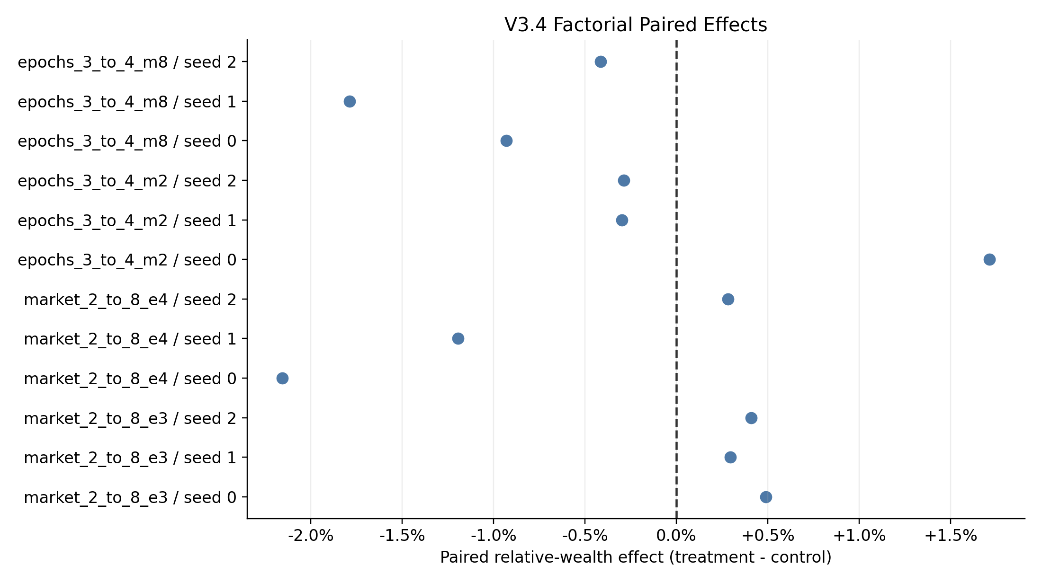
PAIRED EFFECTS
Market diversity helps at 3 epochs but reverses at 4 epochs
2 to 8 markets
3 to 4 epochs
+0.40 pp (3 epochs); -1.02 pp (4 epochs).
+0.38 pp (2 markets); -1.04 pp (8 markets).
Constraint-Aware Portfolio RL | 3 October 2026
10
Notes:
The paired analysis changes the interpretation. At three epochs, increasing the market count from two to eight improves return for all three seeds, but the average gain is only 0.40 percentage points. At four epochs, the same market-count change reduces return by 1.02 percentage points. The fourth epoch gives a small average gain with two markets, but only one seed improves. With eight markets, all three seeds become worse. This suggests an interaction between data diversity and optimization intensity. A fourth epoch is not a generally better setting.
Sources:
- evaluation/v3.3_v3.4_professor_meeting/v34_04_factorial_paired_effects.png
- evaluation/v3.3_v3.4_professor_meeting/paired_effects.csv

Slide 11
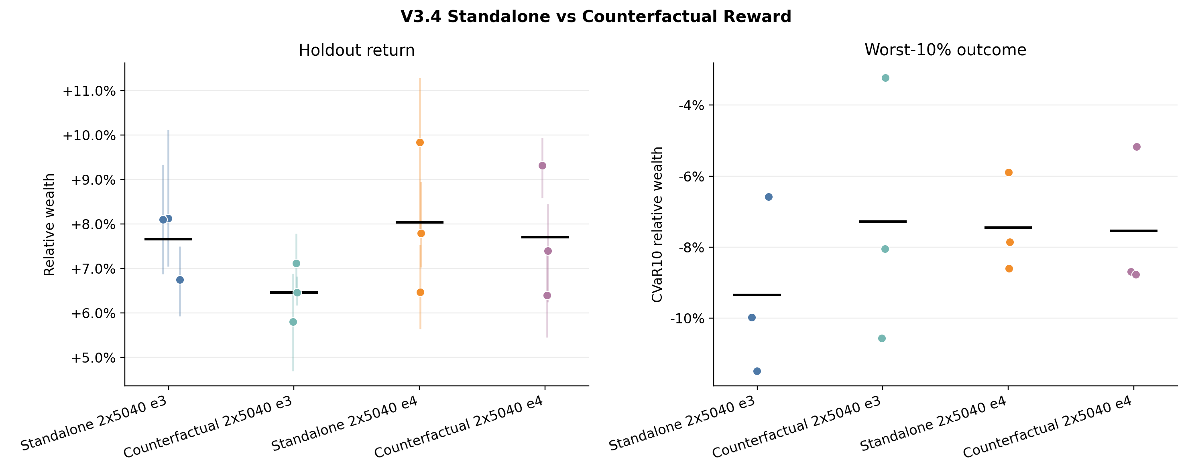
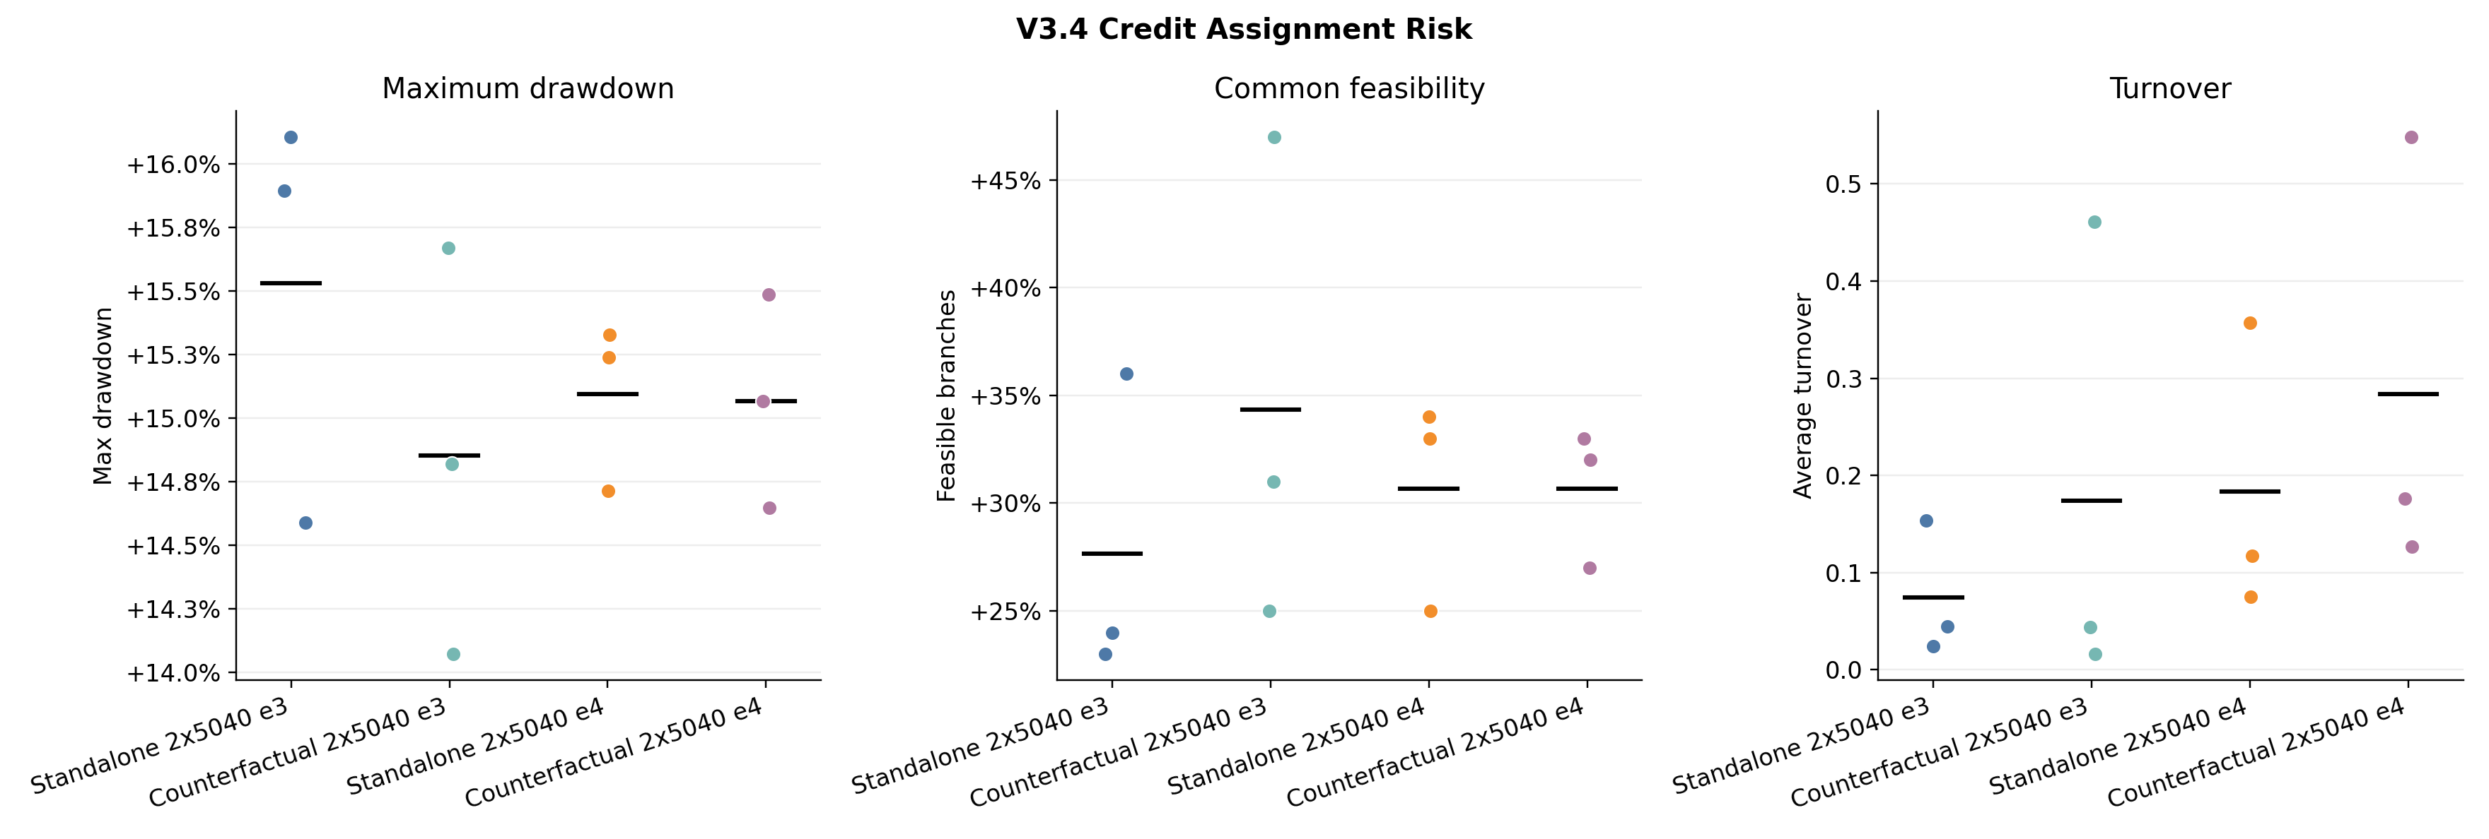
COUNTERFACTUAL REWARD
The current credit signal trades return for risk improvement at 3 epochs
Conclusion: no return gain; at 3 epochs, -1.20 pp return buys +6.7 pp feasibility.
Constraint-Aware Portfolio RL | 3 October 2026
11
Notes:
The counterfactual reward experiment tests whether branch-specific marginal reward improves credit assignment. It does not produce a replicated return gain. At three epochs, all three seeds lose return and the mean reduction is 1.20 percentage points. At the same time, common feasibility improves by 6.7 percentage points and maximum drawdown decreases by 0.68 percentage points. At four epochs, the return cost is smaller but still negative for all seeds, while risk changes are inconsistent. I interpret this as a return-risk trade-off, not evidence that the present counterfactual method learns a better return policy.
Sources:
- evaluation/v3.3_v3.4_professor_meeting/v34_05_credit_return.png
- evaluation/v3.3_v3.4_professor_meeting/v34_06_credit_risk.png
- evaluation/v3.3_v3.4_professor_meeting/paired_effects.csv

Slide 12
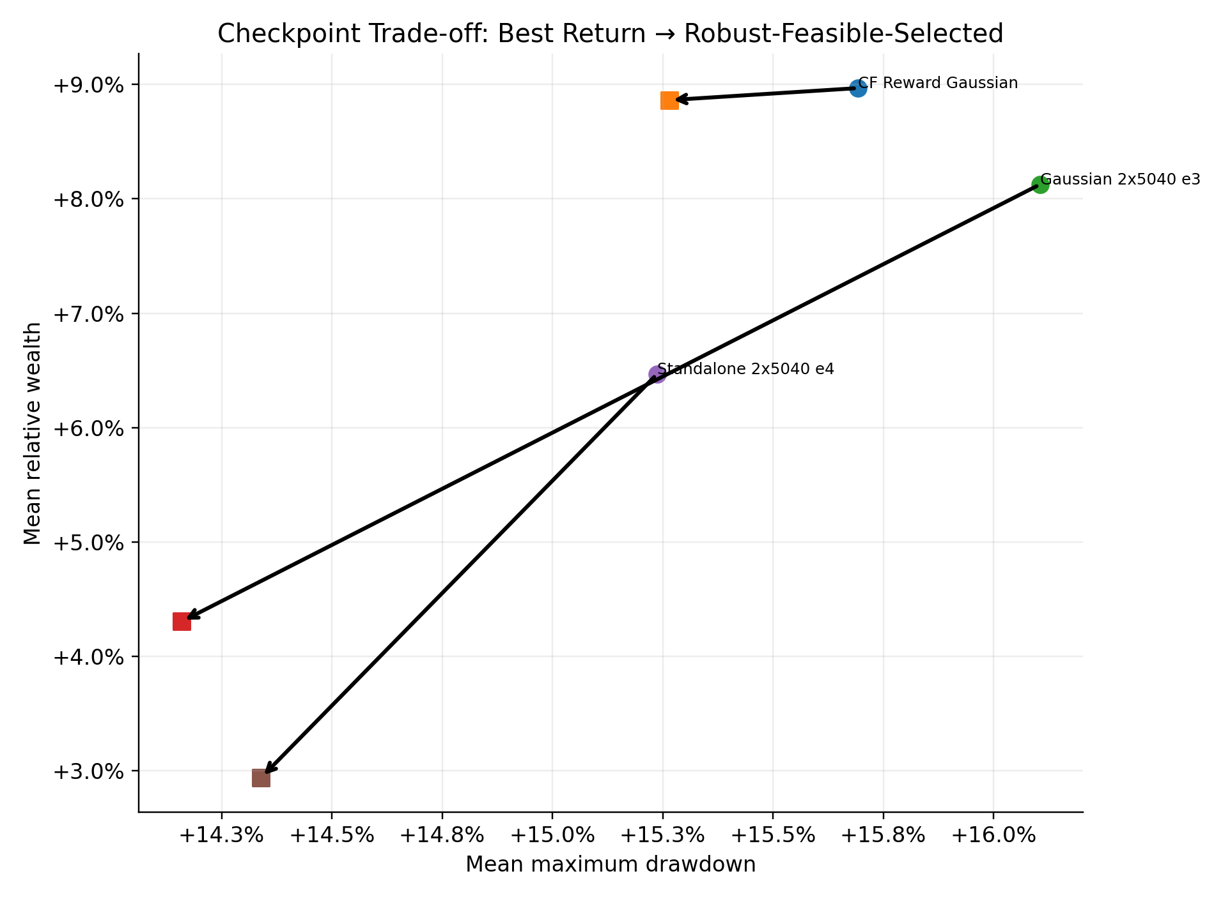
CHECKPOINT SELECTION
Risk-oriented selection improves holdout risk but gives up return
Best-return checkpoints
+7.49% relative wealth
30.7% common feasibility
15.17% mean max drawdown
Robust-feasible-selected
+3.58% relative wealth
45.4% common feasibility
14.35% mean max drawdown
Conclusion: better risk transfer, but holdout feasibility remains below 50%.
Constraint-Aware Portfolio RL | 3 October 2026
12
Notes:
Checkpoint selection creates the clearest return-risk trade-off in the study. Return-selected checkpoints average 7.49 percent relative wealth and 30.7 percent common feasibility. Robust-feasible-selected checkpoints average 3.58 percent relative wealth and 45.4 percent feasibility, with lower mean maximum drawdown. This shows that validation-based risk selection has some transfer value. However, fewer than half of the holdout branches satisfy the common rule, so I should not call these checkpoints feasible without qualification. The correct label is robust-feasible-selected.
Sources:
- evaluation/v3.3_v3.4_professor_meeting/overview_02_checkpoint_tradeoff.png
- evaluation/v3.3_v3.4_professor_meeting/comparison_summary.json

Slide 13
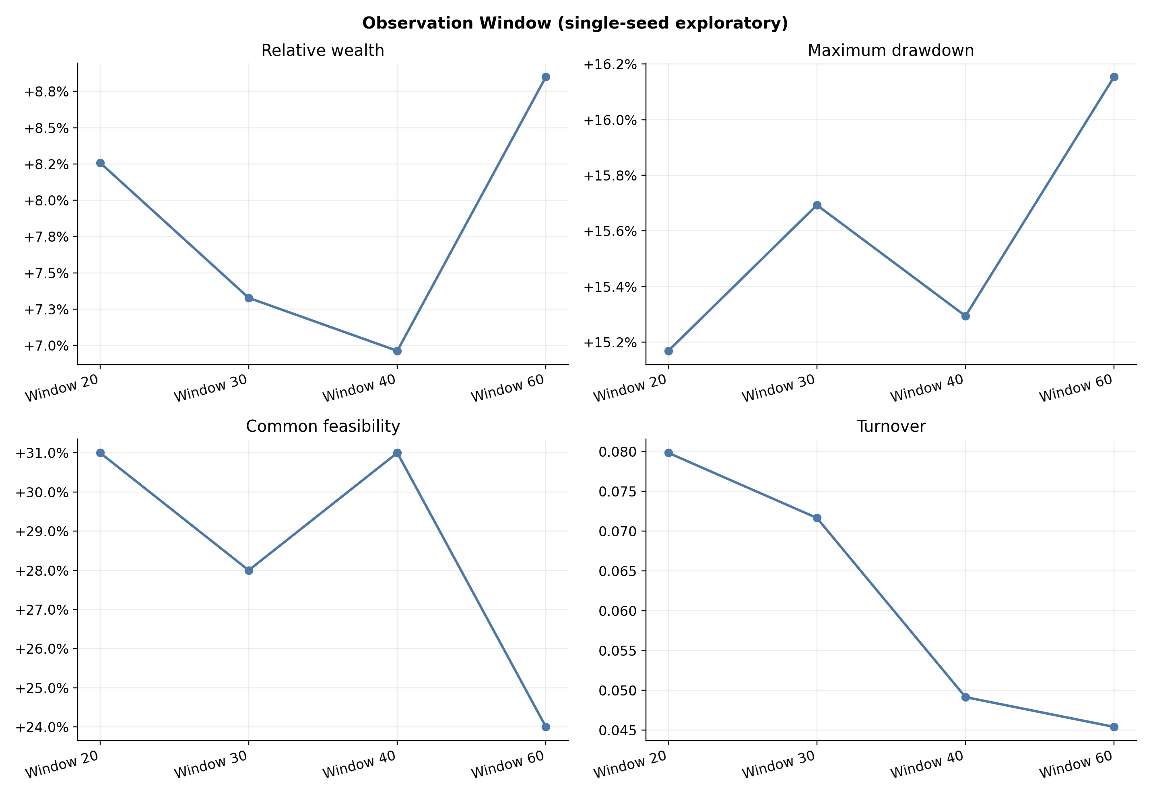
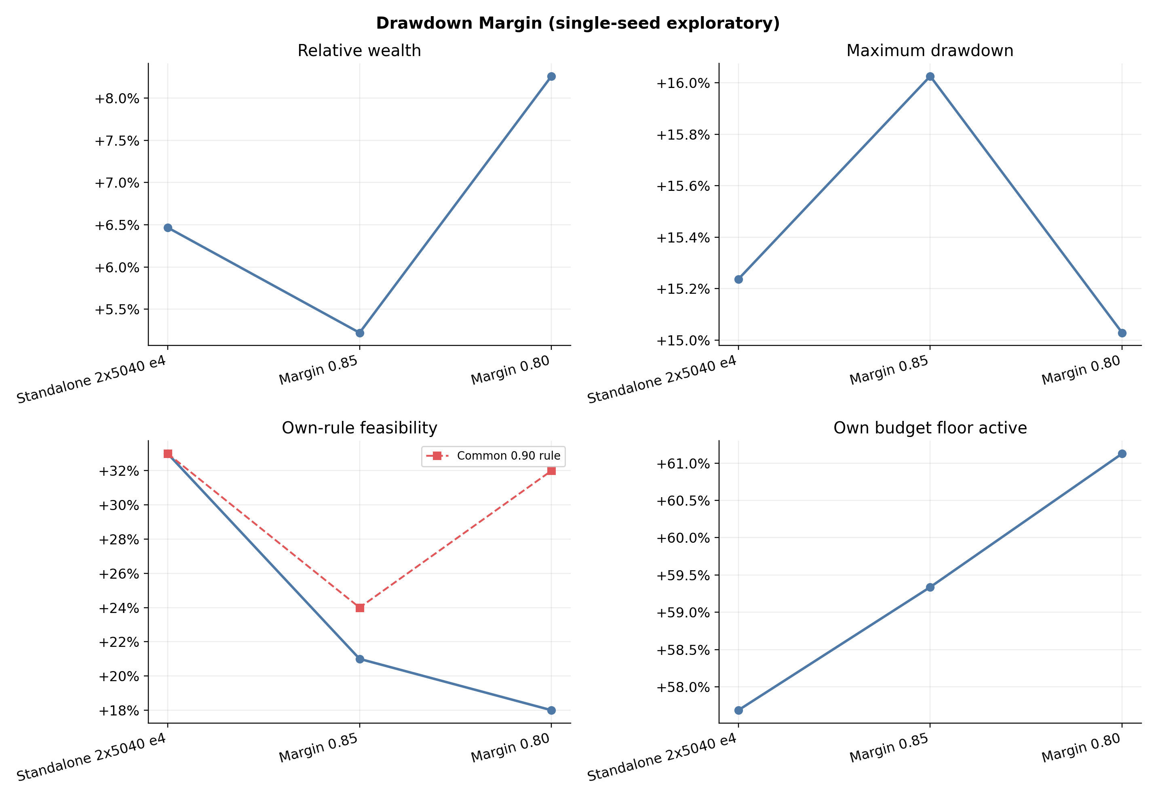
EXPLORATORY SWEEPS
Longer context raises return and risk; stricter margins do not transfer
Window conclusion: more return, more risk (single seed)
Margin conclusion: stricter setting did not transfer (single seed)
Constraint-Aware Portfolio RL | 3 October 2026
13
Notes:
The observation-window sweep suggests that more history can increase return, but the policy also becomes riskier. The 60-step model reaches 8.85 percent relative wealth, while maximum drawdown rises to 16.15 percent and common feasibility falls to 24 percent. The margin sweep gives another caution. Training with stricter margins of 0.85 or 0.80 does not improve feasibility when every model is evaluated under the same 0.90 rule. The stricter settings also reduce return. Because both sweeps use one seed, I treat these patterns as hypotheses for a later replicated study.
Sources:
- evaluation/v3.3_v3.4_professor_meeting/v34_08_window_sweep.png
- evaluation/v3.3_v3.4_professor_meeting/v34_09_margin_sweep.png

Slide 14
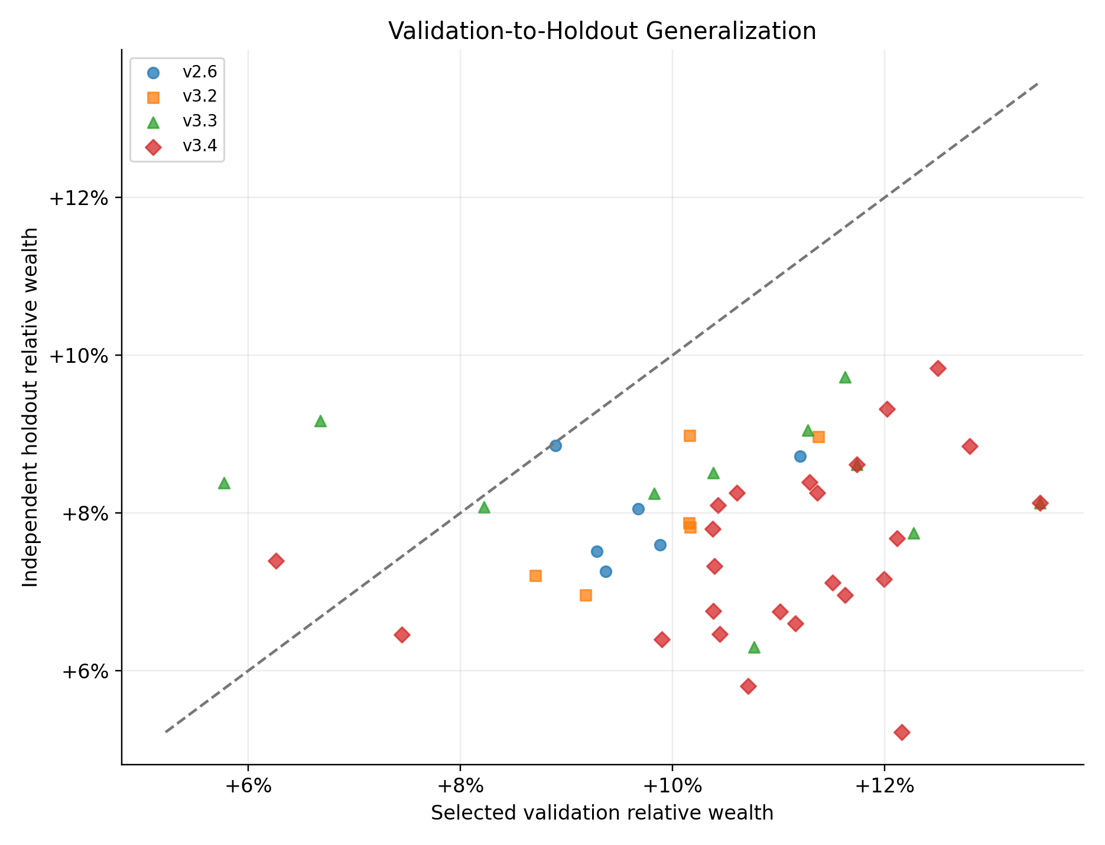
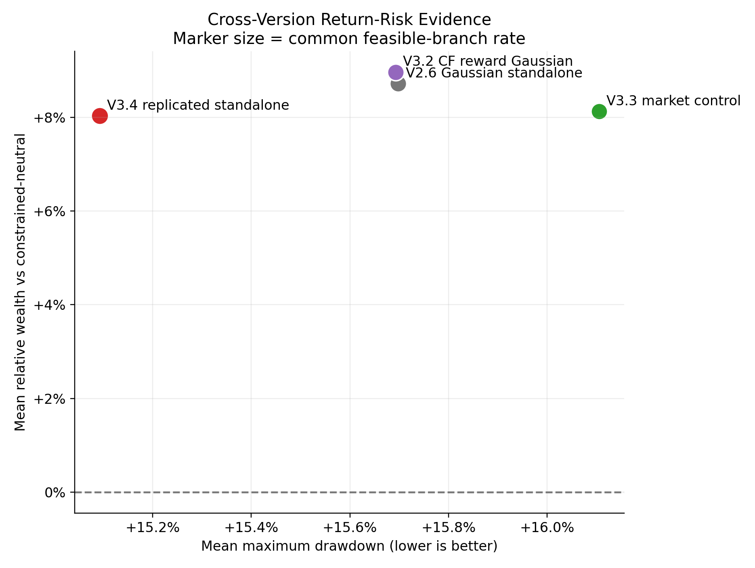
GENERALIZATION DIAGNOSTICS
V3.4 strengthens the diagnosis but does not remove validation optimism
Conclusion: validation optimism persists; V3.4 holdout gap is -3.50 pp.
Constraint-Aware Portfolio RL | 3 October 2026
14
Notes:
The broader comparison shows that the validation-to-holdout gap persists across versions. V2.6, V3.2, and V3.3 lose about 1.7 to 2.0 percentage points when moving from selected validation performance to the independent holdout. V3.4 loses 3.50 percentage points on average. The more rigorous V3.4 experiment therefore improves our confidence in the diagnosis, but it does not solve checkpoint-selection optimism. The next design should consider rotating validation anchors, a larger checkpoint-selection set, or a selection criterion that explicitly balances return and risk across independent branches.
Sources:
- evaluation/v3.3_v3.4_professor_meeting/diagnostics_03_validation_to_holdout_gap.png
- evaluation/v3.3_v3.4_professor_meeting/overview_01_cross_version_return_risk.png

Slide 15
CURRENT CONCLUSIONS
The strongest findings are conditional effects and a persistent selection gap
Replicated finding
Credit finding
Selection finding
Eight markets help modestly at 3 epochs, but the effect reverses at 4 epochs. A fourth epoch is not reliably better.
Counterfactual reward does not improve return across seeds. At 3 epochs it exchanges return for better risk metrics.
Robust-feasible selection improves holdout risk, but validation optimism and low feasibility remain unresolved.
Discussion
1 Improve validation and checkpoint selection first?
2 Refine counterfactual credit as a risk-oriented method?
3 Use 8 markets and 3 epochs as the next replicated default?
4 Replicate the window study or move toward real-market data?
Constraint-Aware Portfolio RL | 3 October 2026
15
Notes:
My current conclusion is that the main algorithm can beat the constrained-neutral baseline on average, but the training choices have conditional effects and the risk constraint does not transfer strongly enough. The most repeatable market-count result appears at three epochs, where all three seeds improve when moving from two to eight markets, although the gain is small. Four epochs do not provide a stable advantage. Counterfactual reward reduces return in every paired seed, but it may be useful as a risk-oriented credit mechanism at three epochs. The largest remaining methodological issue is checkpoint selection. I would like to discuss whether the next experiment should first improve the validation and selection protocol, refine the counterfactual credit design, or begin a carefully controlled real-market study.
Sources:
- reports/simplex_v33_v34_generalization_meeting_20261003.md

