Slide 1


Slide 2
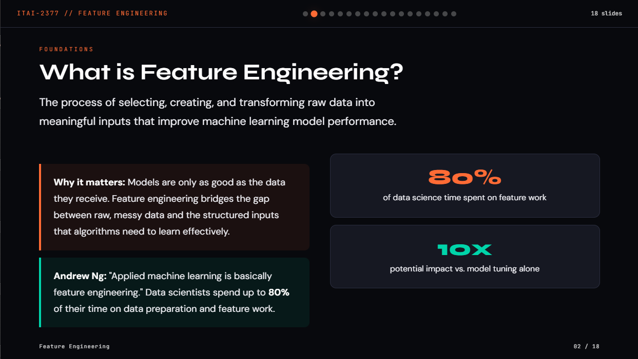

Slide 3
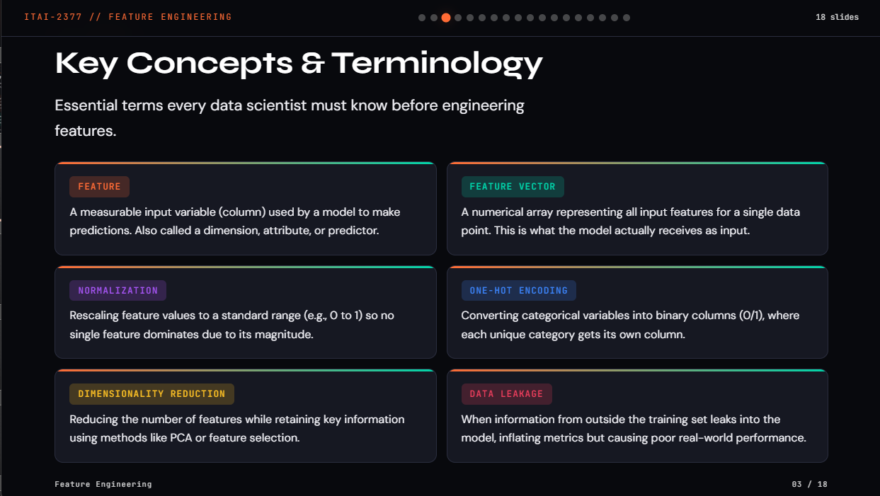

Slide 4
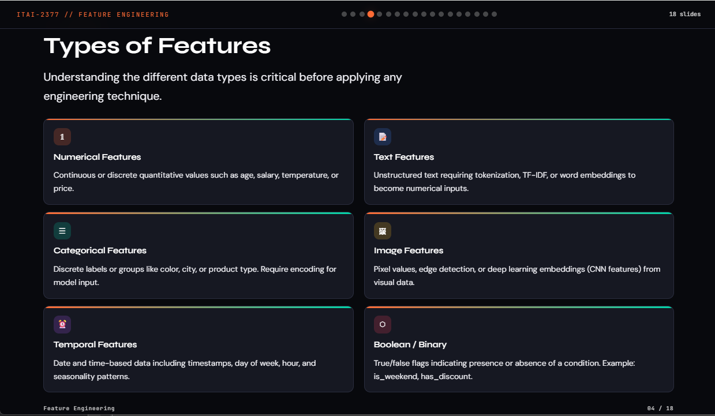

Slide 5
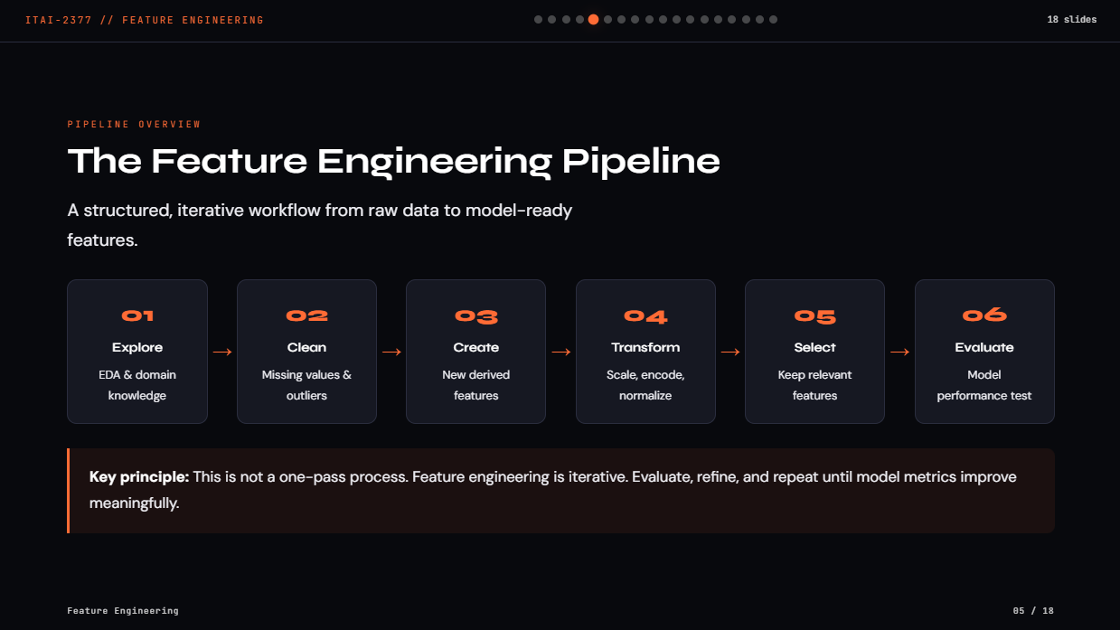

Slide 6
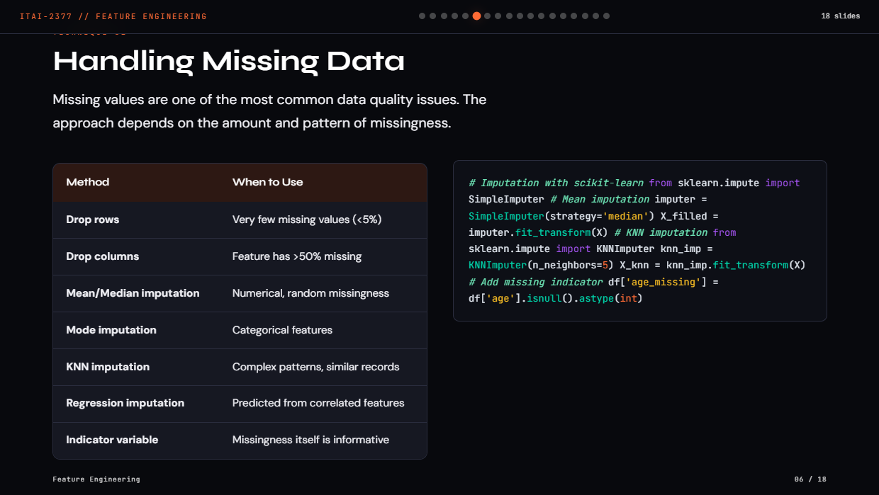

Slide 7
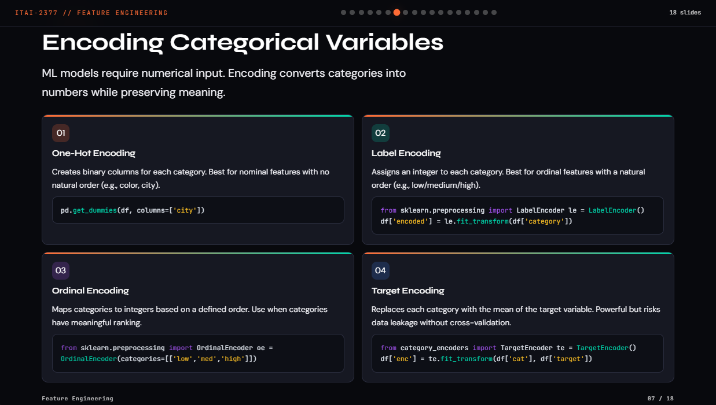

Slide 8
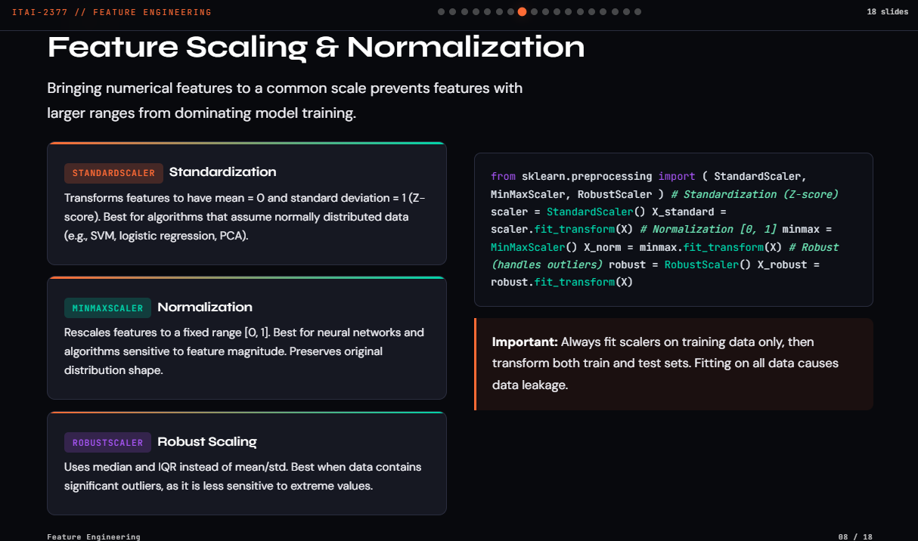

Slide 9
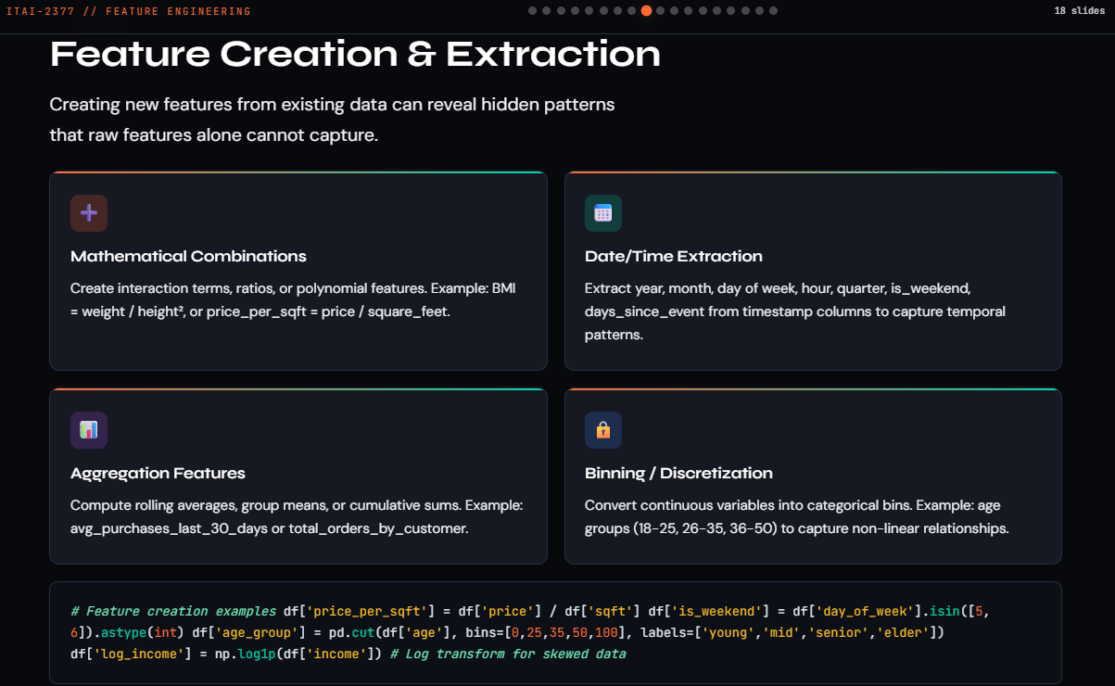

Slide 10
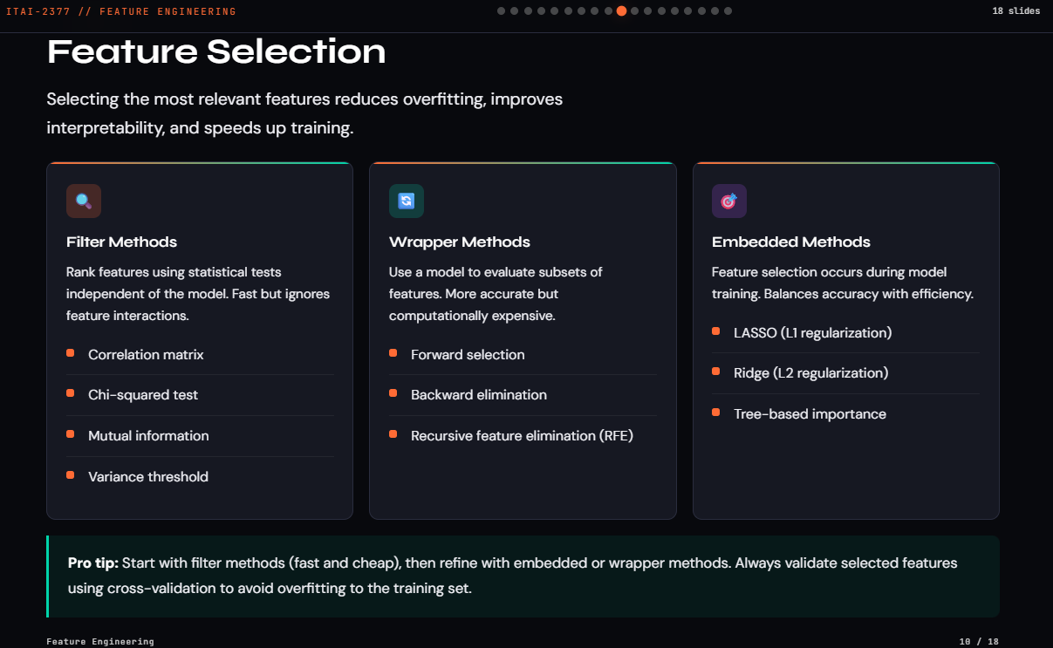

Slide 11
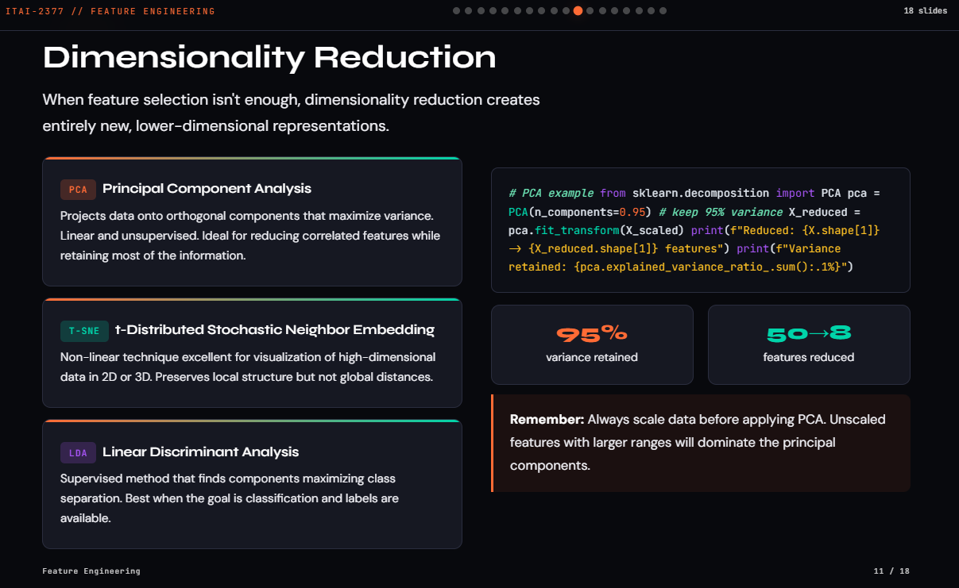

Slide 12
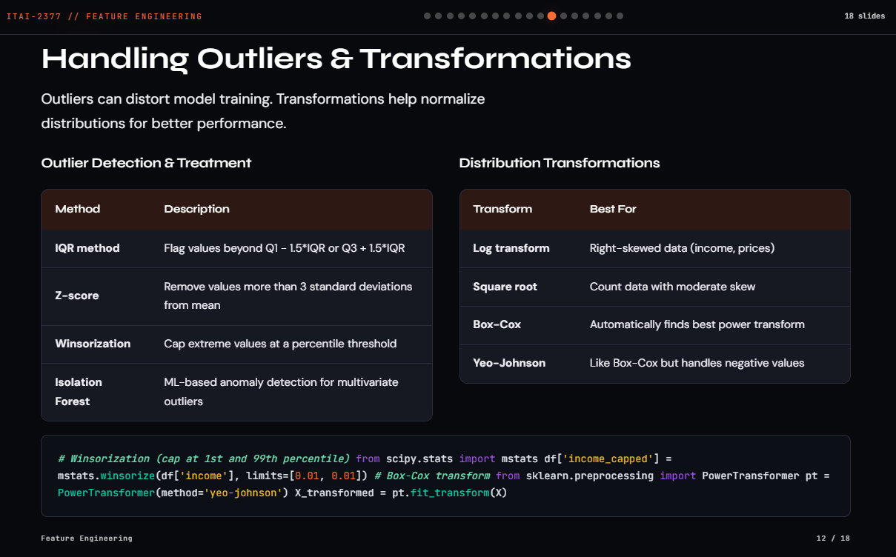

Slide 13
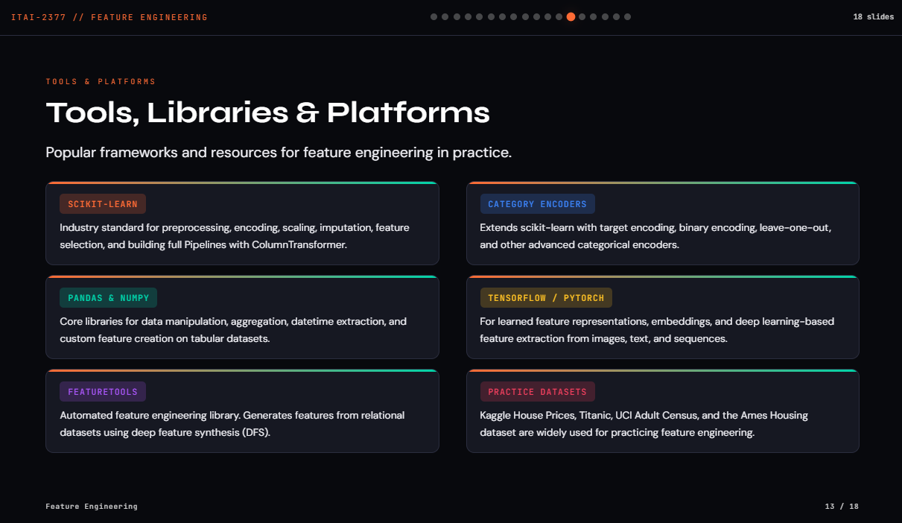

Slide 14
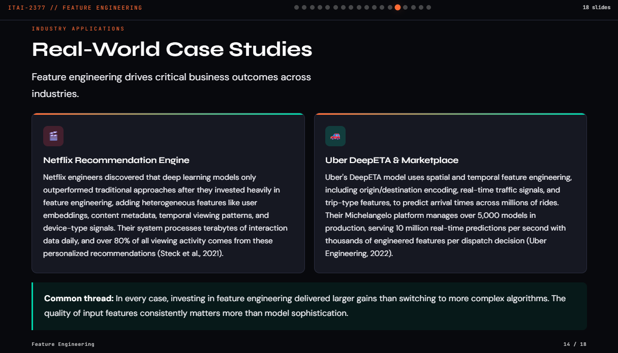

Slide 15
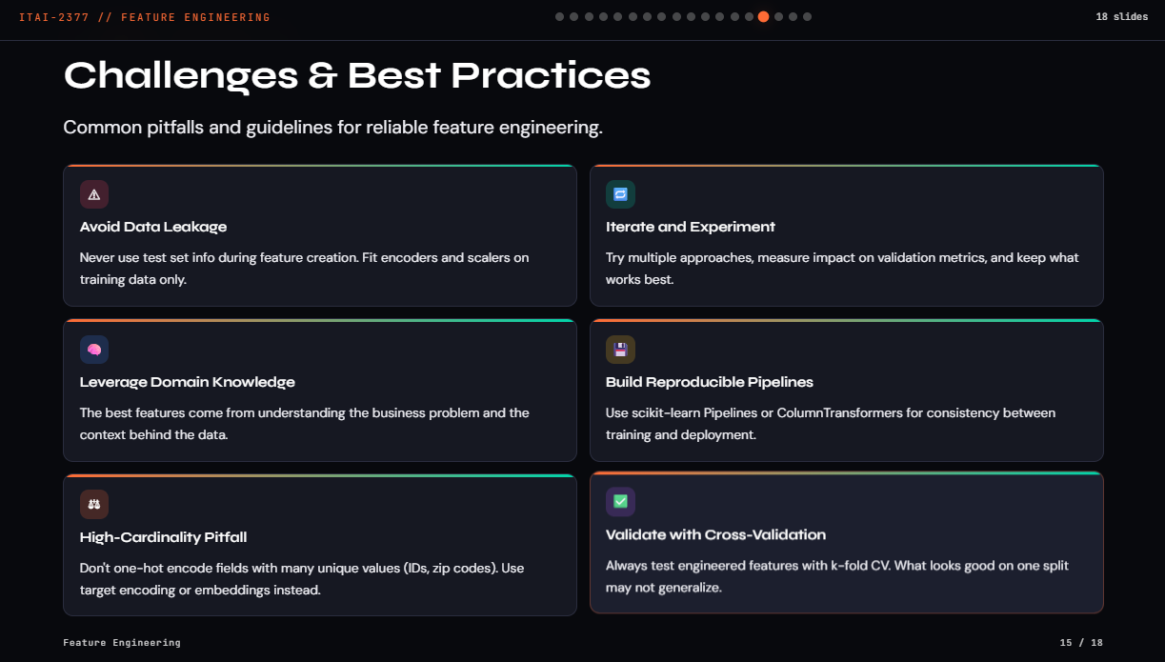

Slide 16
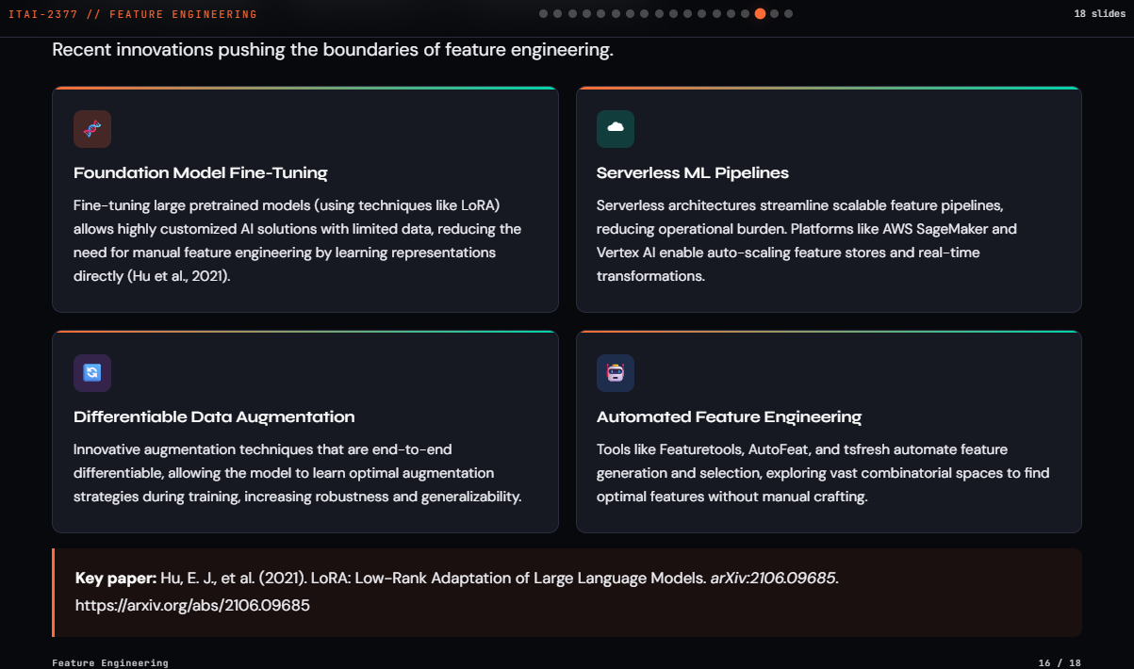

Slide 17
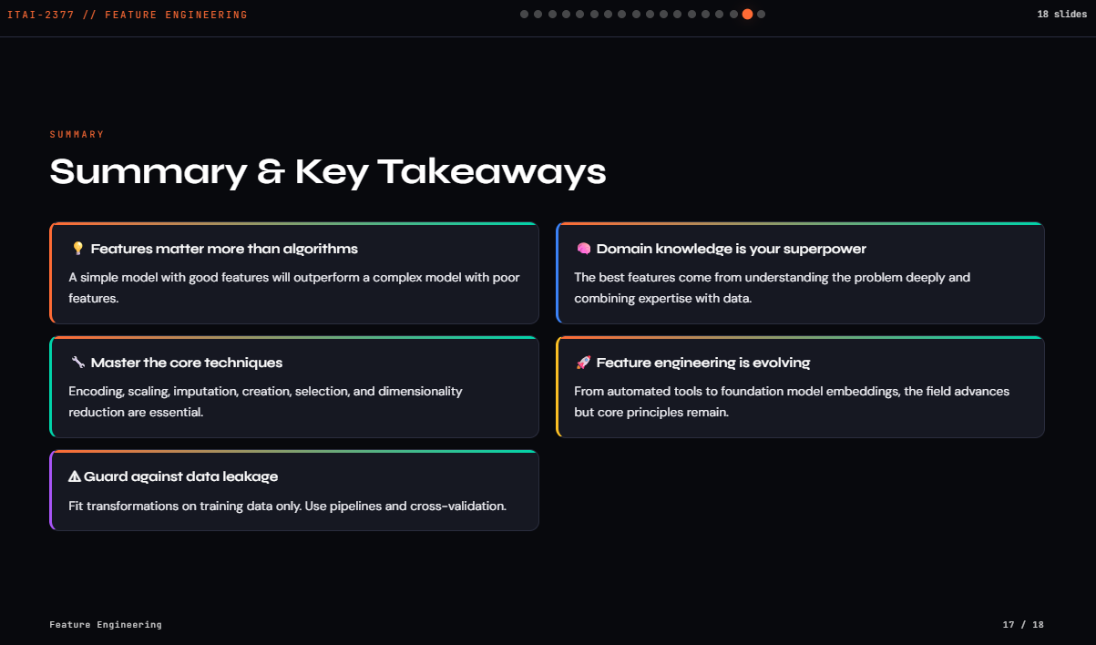

Slide 18
References
Brownlee, J. (2020). Data preparation for machine learning. Machine Learning Mastery.
Domino Data Lab. (n.d.). What is feature engineering? https://domino.ai/data-science-dictionary/feature-engineering
GeeksforGeeks. (2025). What is feature engineering? https://www.geeksforgeeks.org/machine-learning/what-is-feature-engineering/
Hu, E. J., Shen, Y., Wallis, P., Allen-Zhu, Z., Li, Y., Wang, S., Wang, L., & Chen, W. (2021). LoRA: Low-rank adaptation of large language models. arXiv:2106.09685. https://arxiv.org/abs/2106.09685
IBM. (2025). What is feature engineering? https://www.ibm.com/think/topics/feature-engineering
Provost, F., & Fawcett, T. (2013). Data science for business. O'Reilly Media.
Scikit-learn. (n.d.). Preprocessing data. https://scikit-learn.org/stable/modules/preprocessing.html
Steck, H., Baltrunas, L., Elahi, E., Liang, D., Raimond, Y., & Basilico, J. (2021). Deep learning for recommender systems: A Netflix case study. AI Magazine, 42(3), 7-18. https://doi.org/10.1609/aimag.v42i3.18140
Uber Engineering. (2022). DeepETA: How Uber predicts arrival times using deep learning. Uber Engineering Blog. https://www.uber.com/blog/deepeta-how-uber-predicts-arrival-times/
VanderPlas, J. (2016). Feature engineering. Python Data Science Handbook. O'Reilly Media. https://jakevdp.github.io/PythonDataScienceHandbook/05.04-feature-engineering.html
Zheng, A., & Casari, A. (2018). Feature engineering for machine learning. O'Reilly Media.
Thank You!
Questions & Discussion

