Slide 1
Preprocessing Data for Deep Learning
Department of Computer Science
Houston City College
Data Science in Artificial Intel - ITAI-2376
Professor: Sitaram Ayyagari
Group Members: Juphens Cherfils, Yoana Cook, Kaden Glover, Richard Rodriguez
Notes:
AI-generated content may be incorrect. ---

Slide 2

Intro to Preprocessing Data
• Preprocessing prepares raw data for neural networks
• Happens before model training
• Ensures consistency and quality
• Reduces noise and improves generalization
• Impacts accuracy and training stability
• Reduces bias and unintended patterns in the data
Deep learning models are sensitive to messy data, so preprocessing is essential for stable and accurate learning.
Notes:
--- In the early stages of machine learning, data cleaning was a largely manual and ad hoc process focused on removing duplicates, handling missing values, and correcting obvious errors. Techniques such as simple imputation, outlier detection, and basic normalization were implemented without automation. The lack of standardization often led to inconsistent data quality, impacting model outcomes. These foundational practices set the stage for more sophisticated automated preprocessing as data complexity increased. Image source: AI-generated

Slide 3
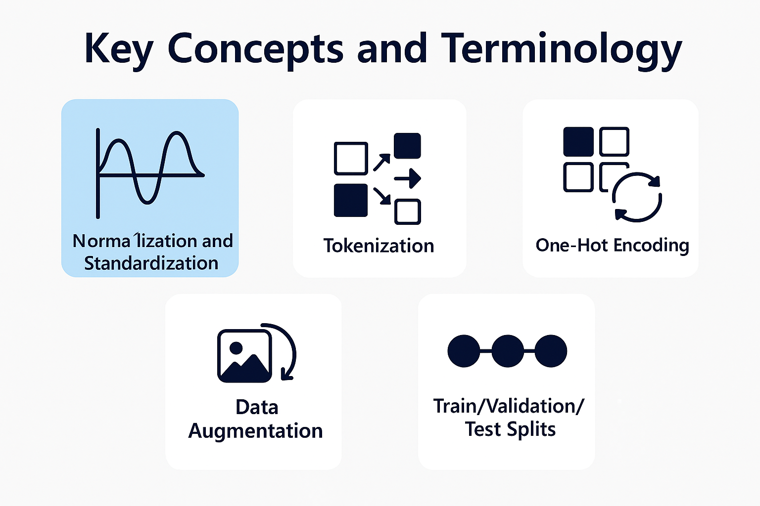
Key Concepts & Terminology
Normalization and Standardization:
Techniques that scale numerical features to a consistent range
Helps stabilize training and prevents features with large values from dominating
Tokenization:
Converts text into smaller units (words, subwords, or characters)
Allows models to process language as numerical sequences
One‑Hot Encoding:
Represents categorical variables as binary vectors
Ensures categories are treated as distinct, non‑ordered values
Data Augmentation:
Creates modified versions of existing data (e.g., flips, rotations, noise)
Increases dataset diversity and reduces overfitting
Train/Validation/Test Splits
Divides data into separate sets for training, tuning, and evaluating
Ensures fair performance measurement and prevents data leakage

Slide 4
Techniques & Approaches
Missing Values
Mean/median (numeric) - stable, random missingness
Mode/“Unknown” (categorical) - avoids invalid categories Problem solved: Missing values breaking training Example code: imputer.fit(X_train); imputer.transform(X_test)
Scaling Numerical Features
Standardize - good for linear models, neural nets
Min‑Max - good for bounded activations Problem solved: Large‑magnitude features dominating Example code: scaler.fit(X_train); scaler.transform(X_val)
Encoding Categories
One‑hot - low cardinality
Embeddings - high cardinality, semantic structure Problem solved: converting labels to usable numeric form Example code: encoder.fit(X_train)
Avoid Data Leakage
Fit all transformers only on the training data
Use consistent pipelines across splits Problem solved: inflated accuracy, poor generalization Example code: pipeline.fit(X_train, y_train)

Slide 5
Real-World Examples
Healthcare Medical Imaging Tumor Detection
(Based on industry applications such as MRI/X‑ray preprocessing in medical AI)
What Was Done:
Hospitals used deep learning models to detect tumors in MRI and X‑ray scans.
Preprocessing included:
Normalization of pixel intensities
Noise reduction
Image resizing & standardization
Data augmentation (rotations, flips) to increase dataset diversity
Impact:
Up to 22% improvement in diagnostic precision when lighting/noise inconsistencies were corrected.
Faster radiologist workflows; reduced false negatives.
More consistent model performance across hospitals and imaging devices.
Finance — Credit Risk Assessment
(From deep learning case studies in financial modeling)
What Was Done:
A financial analytics company built a deep learning model to predict credit risk.
Preprocessing included:
Imputing missing income & employment fields
Scaling numerical features (income, debt ratios)
Encoding high‑cardinality categories (job titles, industries) using embeddings
Strict anti‑leakage pipelines to ensure fair evaluation
Impact:
30% improvement in prediction accuracy for high‑risk borrowers.
Reduced loan default rates and improved customer segmentation.
Faster model convergence due to clean, scaled inputs.

Slide 6
Tools, Libraries, & Platforms
Core ML Frameworks
Scikit‑learn — preprocessing, pipelines, encoders, scalers
NLP & Model Hubs
Avoid Data Leakage
TensorFlow / Keras — deep learning models + data pipelines
PyTorch — flexible deep learning + custom preprocessing
Hugging Face Transformers — tokenizers, embeddings, pretrained models
Data Engineering & Pipelines:
Apache Beam / Spark — large‑scale preprocessing
Snowflake / BigQuery — data storage + feature pipelines
CIFAR‑10 (images)
IMDB Reviews (text)
UCI ML Repository (tabular)
MNIST (images)

Slide 7
Challenges & Best Practices
Handling Missing Data: Requires strategies like imputation or removal to maintain dataset integrity
Balancing Data: Avoiding class imbalances in classification problems
Scaling Large Datasets: Efficiently managing extensive, high-dimensional data
Data Privacy Concerns: Complying with data protection regulations like GDPR and CCPA

Slide 8

Emerging Trends / Research Directions
Automated Data Preprocessing: AI-driven tools for faster, more accurate preprocessing
Federated Learning and Privacy-Preserving Techniques: Secure preprocessing in distributed environments
Real-Time Data Preprocessing: Handling streaming data for immediate insights

Slide 9
Video on Preprocessing Data
Why Is Data Preprocessing Important For Data Mining? - AI and Machine Learning Explained
https://www.youtube.com/watch?v=dfTgPCb4FPg

Slide 10
Conclusion
Preprocessing is essential for deep learning success
Different data types require different strategies
Tools streamline workflows
Best practices prevent instability
Trends point toward automation

Slide 11
References
Dilmegani, C. (2025, November 18). *Top 50 deep learning use case & case studies in 2026*. AIMultiple. https://research.aimultiple.com/deep-learning-applications/
Crudu, V., & MoldStud Research Team. (2025, September 15). *How data preprocessing impacts AI model training and performance: Key insights for success*. MoldStud. https://moldstud.com/articles/p-how-data-preprocessing-impacts-ai-model-training-and-performance-key-insights-for-success
DigitalDefynd Team. (2026). *Top 20 deep learning case studies [Detailed analysis]*. DigitalDefynd. https://digitaldefynd.com/IQ/deep-learning-case-studies/
Denodo Technologies. (n.d.). *Data preprocessing: Definition, importance, and key techniques*. Denodo. https://www.denodo.com/en/glossary/data-preprocessing-definition-importance-key-techniques?gad_source
StatQuest with Josh Starmer. (2020, April 14). StatQuest: Data cleaning – Handling missing data [Video]. YouTube. https://www.youtube.com/watch?v=dfTgPCb4FPg
Notes:
Image source: Microsoft 365 content library References provide credibility to your work by citing reliable sources. They allow readers to verify information and explore topics further. Properly formatted references demonstrate academic integrity and help avoid plagiarism, ensuring transparency in research and presentations.

