Slide 1


Foosball society Project
Team members :
Supervisors :
DADOUCHE Abdel Halim
BOUZBOUZ Fadoua
KOUFERIDJI Oumar
MO Yinchuan
AZEDDINE Housna
WEI Yi
Large Scale Processing ~ 2020

Slide 2
Foosball society Project
Planning :
- Project’s presentation
- Project’s main architecture
- Other Architectures and difficulties encountered
- Members experiences

Slide 3
Project’s presentation
Purpose :
Foosball Videos analysis using Large Scale Processing module’s knowledge.
Objectives :
Ball’s Detection
Goal’s Detection
Speed and trajectory’s calculation
Input Data :
- 3 mkv videos (120 fps)
- 39 mp4 videos (30 fps)

Slide 4


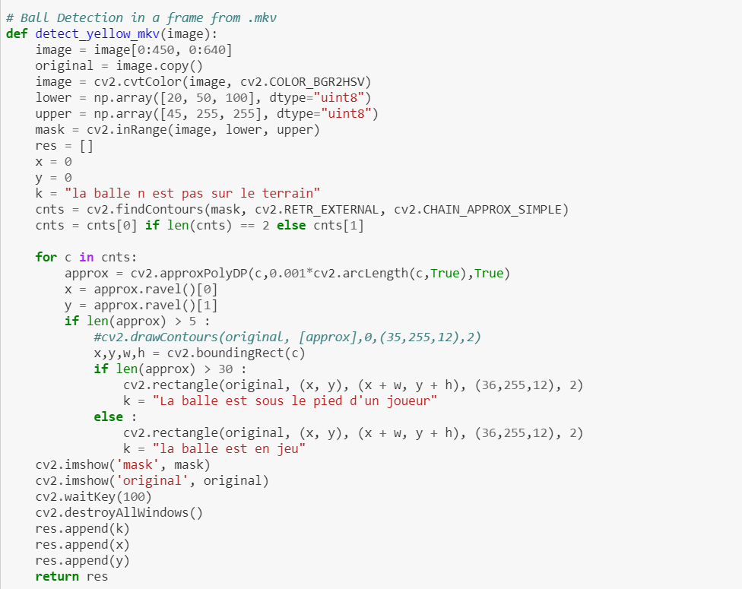
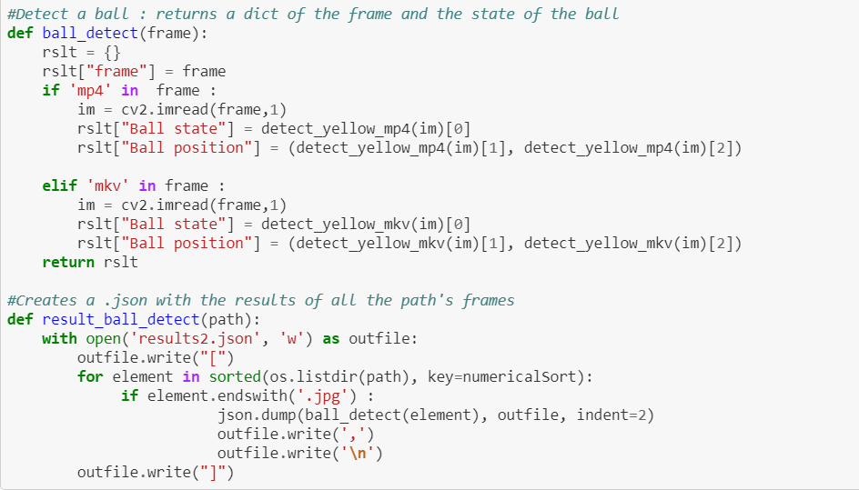
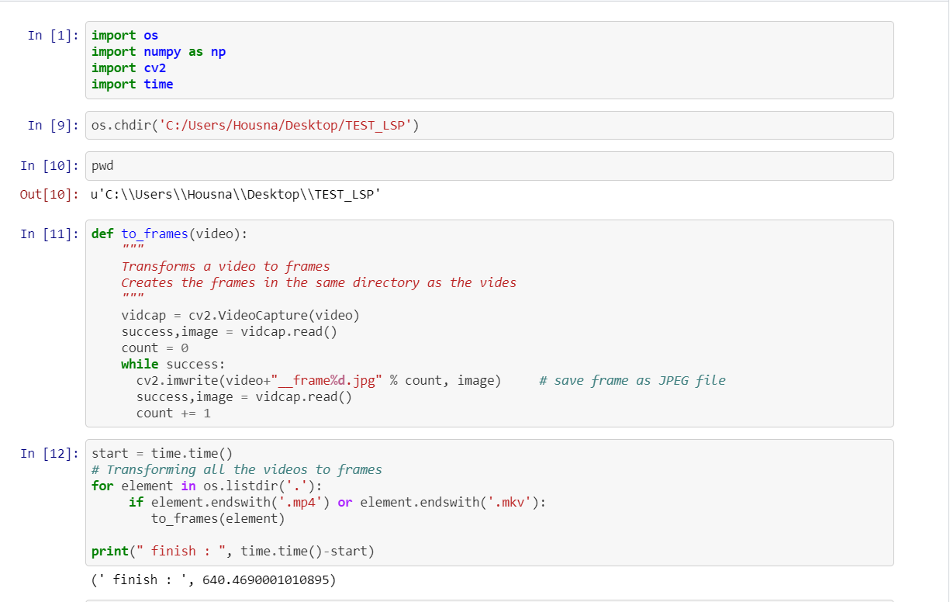
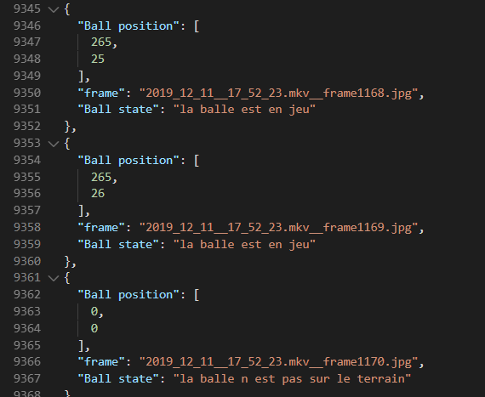
Project’s main architecture
Part 1 : In local
Input :
Frames :
JSON :
1 MKV video :
- 88,3 Mo
- 4min 14s
29167 frames
Ball and Positions detection

Slide 5


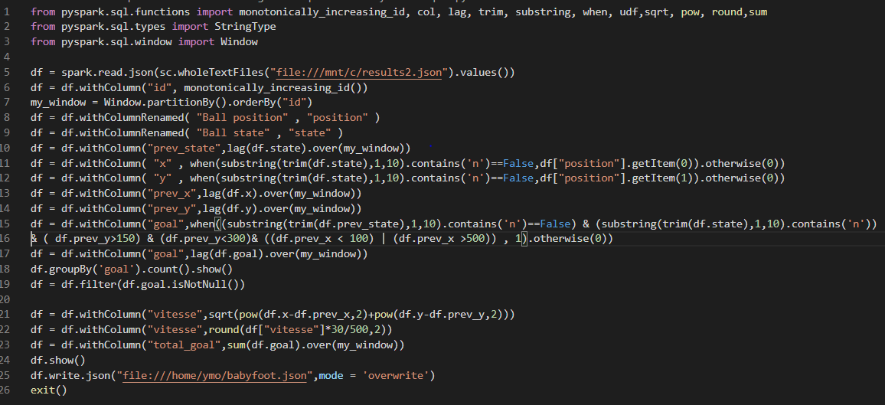
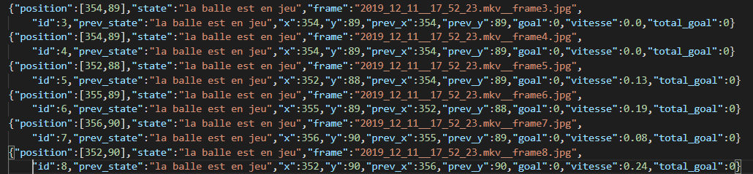
Project’s main architecture
Part 2 : In local & HDFS
JSON :
Ball and Positions detection
JSON :
Goal detection
Speed and trajectory calculation

Slide 6
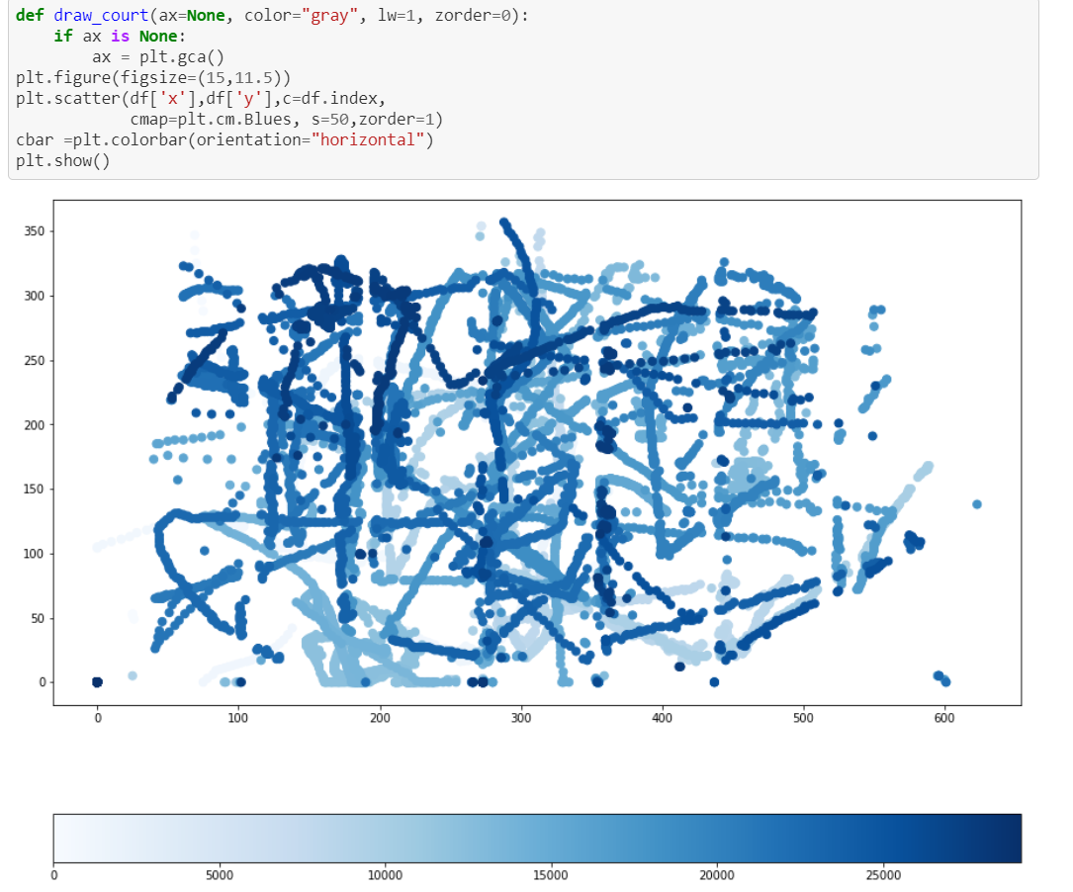
Project’s main architecture
Part 3 : In local
JSON :
Figure :
Goal detection
Speed and trajectory calculation
Figure of the ball’s trajectory the whole video
Time ( Number of frame)

Slide 7

Other Architectures and difficulties encountered
First trial :
A Spark job to load frames into Hadoop
Using Spark.dl or Spark.mlib to read frames and extract features
Difficulty :
Couldn’t find an OpenCV library in Spark, or equivalent
Second trial :
Compute a MapReduce job to automatize features extraction process in frames :
First in Python
- Secondly in Java using OpenCV
Difficulty :
Python : Not able to use OpenCV in a Python MapReduce Job
Java : Variable environnement problems

Slide 8
Members experiences
MO Yinchuan
WEI Yi
In this project, I learned how to use pySpark to convert a local (and hdfs) json file with a large amount of data into a usable dataframe and perform data analysis and data processing : comparison calculation of front and back column data, string inclusion relationships, etc.
(In our project, the calculate of speed and the judgement of goal for each frame).
And finally save the processing result into the original dataframe and output it locally.
In this project, firstly i practiced the basic method of processing large volumes of data through spark. In order to pursue the accuracy of image detection, we cut a four-minute video into nearly 30,000 frames to analyze, which resulted in a huge final data file. Using pyspark, the time for data calculation and processing is greatly reduced.
Secondly, we also tried hdfs to store our pending files. The replicas on multiple nodes also ensured better data security. In the analysis of the final data, we specifically tried different visualization toolkits to compare their style and functionality. Some of them are suitable for internal use in HTML, some provide a variety of static analysis functions, and some are suitable for analyzing time series.

Slide 9
Members experiences
AZEDDINE Housna
KOUFERIDJI Oumar
Using Spark to read different types of files especially pictures​
We can use OpenCv to compute a MapReduce job in Java but not easily in python​
We can't use openCV in a sparkJob directly​
Spark is very fast in calculation, algorithms but not in preprocessing in the case of our project​
- We can use a python library hdfs client to interact with files stored in hadoop
Using OpenCV in a Python Script :
Videos transformation into frames
Ball detection
Using OpenCV in a JAVA MapReduce Job
Spark’s difficulties with Image processing

