Slide 1
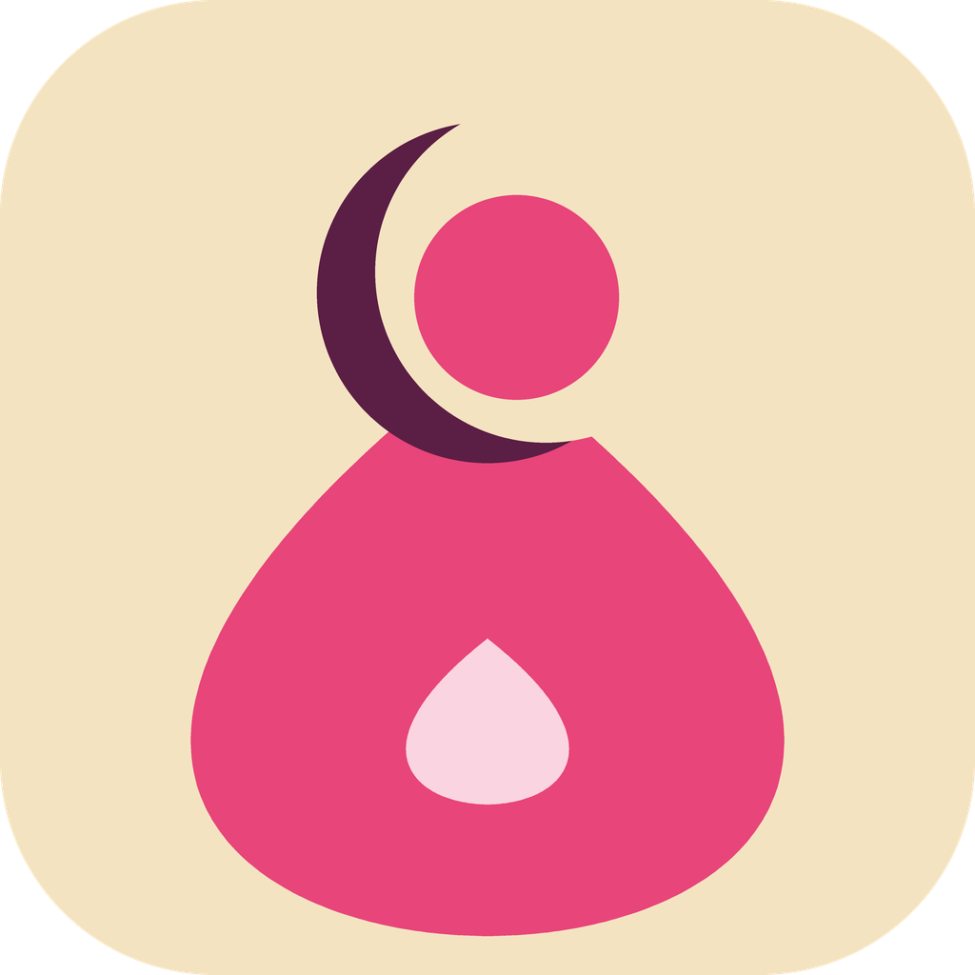
Housnia
Understanding periods, following pregnancy and caring for yourself after childbirth
A free, offline mobile app for women and girls in Chad
Founder: Housna Mahamat Ali · housnia.tchad@gmail.com · October 2026
Notes:
Housnia means beauty and goodness. The app supports women from puberty to the postpartum period, without internet.

Slide 2
In Chad, vital health information is missing
860
38%
22%
maternal deaths per 100,000 live births
of births attended by skilled health personnel
of people aged 15+ can read and write
WHO Chad, 2022
UNICEF, 2022
CIA World Factbook
Period taboos, early pregnancies, unrecognised danger signs and scarce mobile coverage: information must reach women in their own language, without internet.

Slide 3




Housnia: a midwife in your pocket
Works without network
French and Arabic text
All content stays on the phone after installation
Audio and video also in Chadian Arabic
Text, audio and video
Validated by health workers
For women who read and women who cannot
Chadian medical committee reviews all content

Slide 4




Who is it for?
Girls
Young women
New mothers
Community health workers
Aged 10–17
Aged 18–35
All ages
Adults
Puberty, first periods, hygiene
Cycle, preparing for and following pregnancy
Recovery, breastfeeding, baby care
Group awareness sessions

Slide 5




Four modules and an emergency button
My Periods
My Pregnancy
Cycle calendar, symptoms, discreet reminders
Week-by-week follow-up, antenatal visit reminders
Emergency
Always visible: illustrated danger signs, number to call, "go to the health centre"
After Baby
Learn
42 days after birth, breastfeeding, vaccines
Videos, guides, quizzes, myths and facts

Slide 6

Written in 2 languages, spoken in 3
 | Texts (guides, screens) | Audio and video
French | Yes | Yes
Arabic | Yes | Yes
Chadian Arabic | No | Yes
Why Chadian Arabic only as audio?
It is mainly spoken, rarely written: voice also reaches women who cannot read.
At first launch, the user chooses her text language, then her audio and video language.

Slide 7
Short, medically validated content
Puberty and periods
60
written guides
My body is changing · First period · Hygiene · Pain
Pregnancy
French and Arabic
Antenatal visits · Eating well · Malaria · Danger signs
After childbirth
30
Bleeding · Breastfeeding · Vaccines · Birth spacing
videos of 2–4 min
Rights and protection
French, Arabic, Chadian Arabic
My body belongs to me · Early marriage · Where to find help
Every item: written by a midwife, validated by the medical committee, reviewed by community leaders.

Slide 8
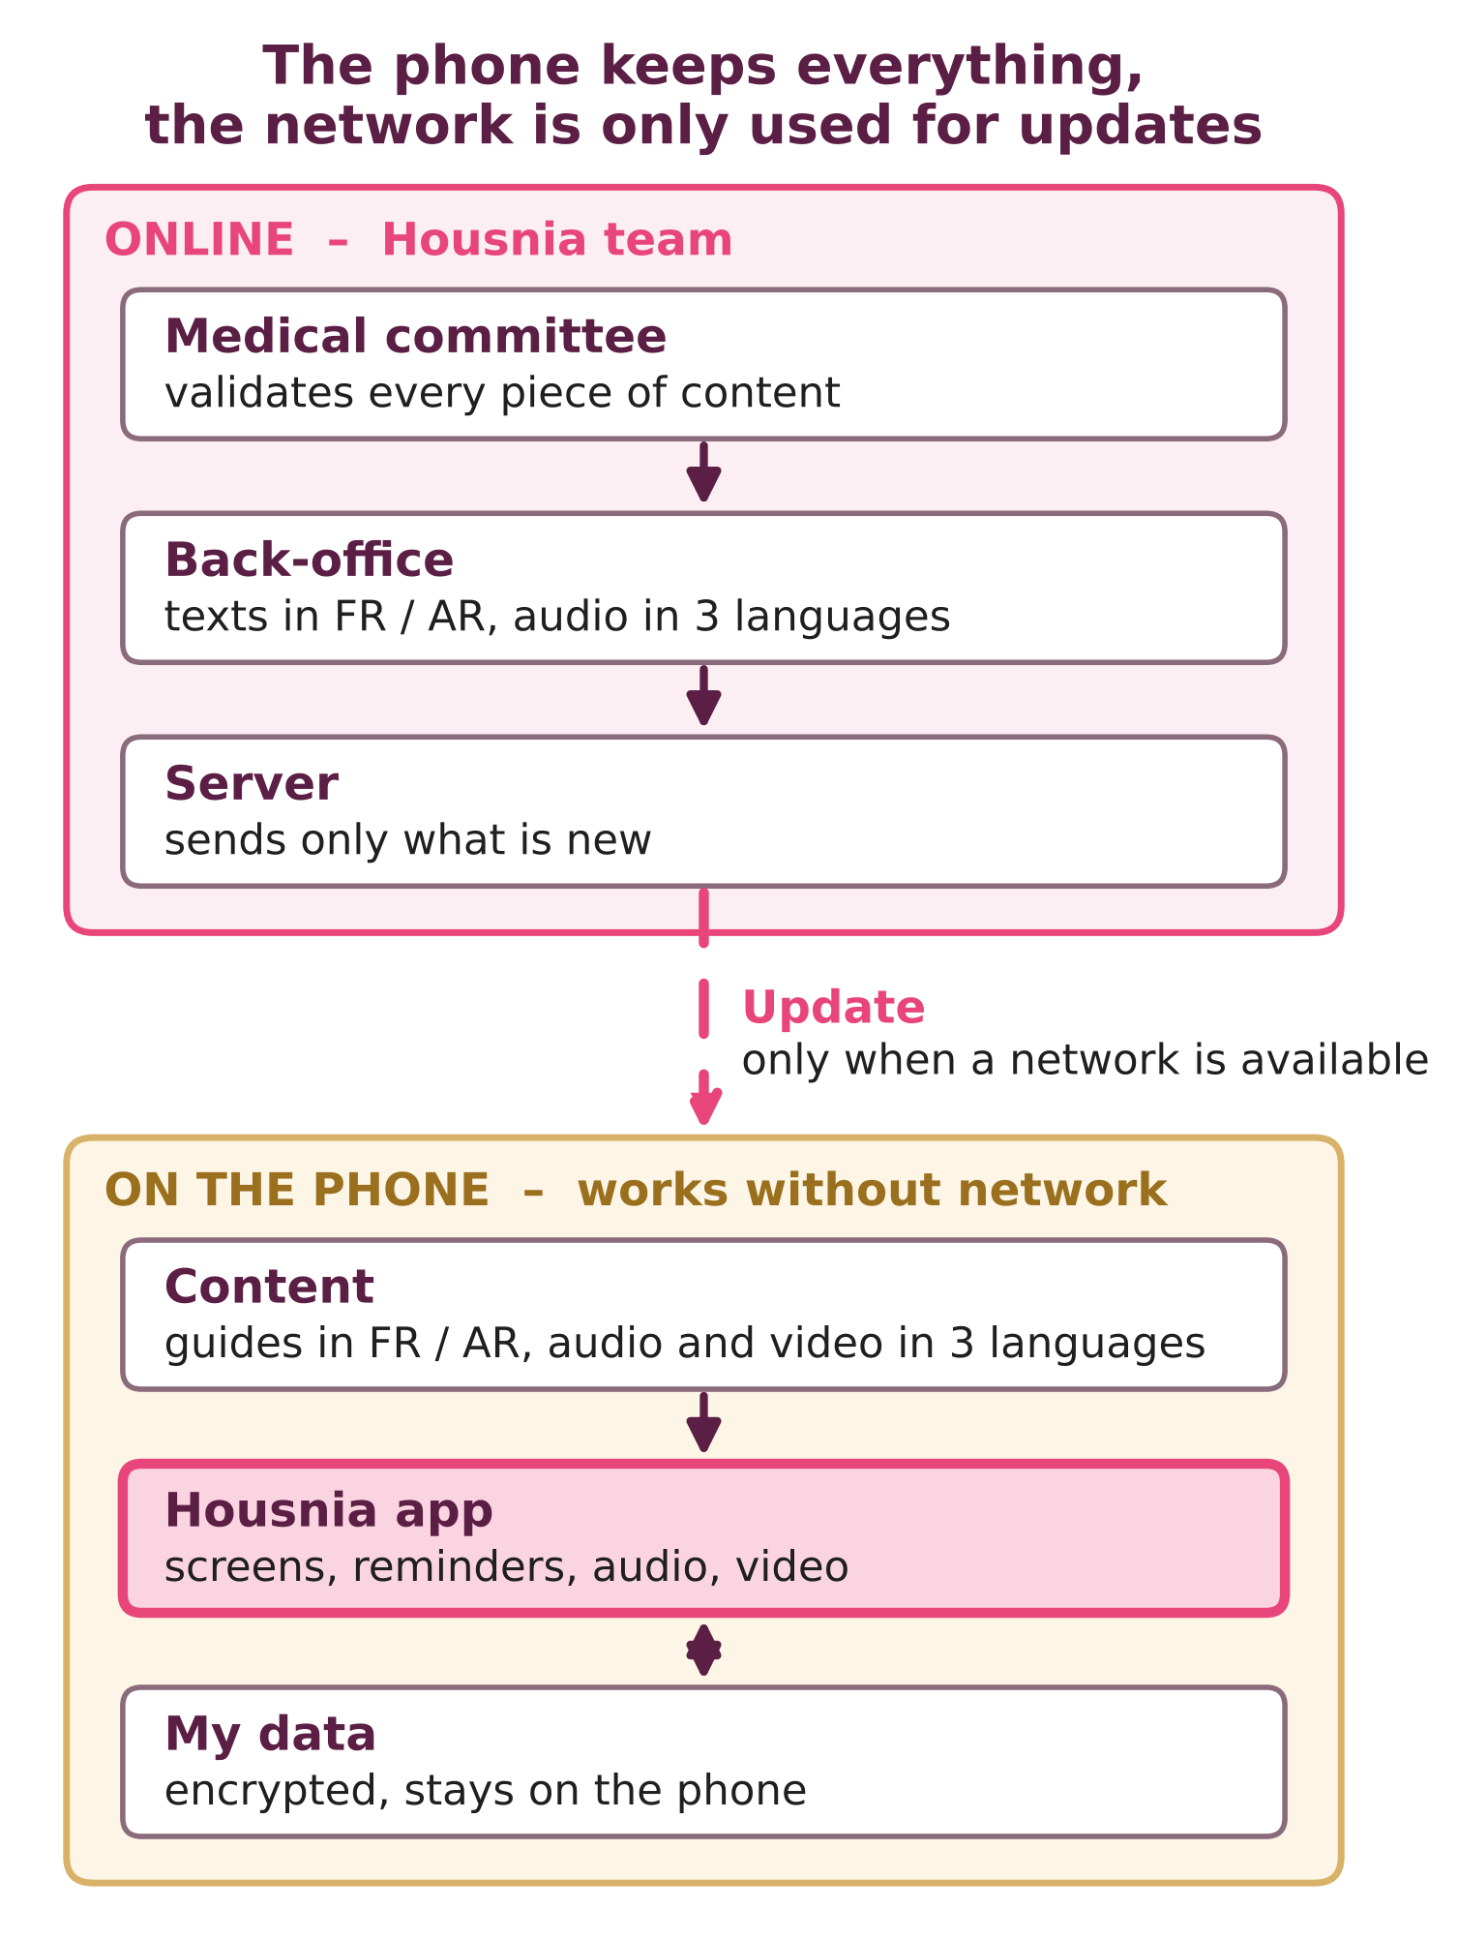
Offline first, progressive updates
1
Content split into packs by topic and language
2
When a network is available, the app checks for updates
3
Only new content is downloaded, with resume
4
Activated once the pack is complete and verified
5
Also shared by Bluetooth, SD card or "Housnia Points"
Core app ≈ 40 MB · video packs of 50 to 100 MB

Slide 9

Simple, robust and private
App
Flutter, Android 6+ (1–2 GB RAM phones), iOS later
Privacy
Storage
Encrypted local database, audio and video on the phone
No account, no name
Health data stays on the phone
PIN code and neutral icon
"Erase my data" button
Reminders
Local notifications, no server needed
Code
Open source, reusable by partners and other countries

Slide 10
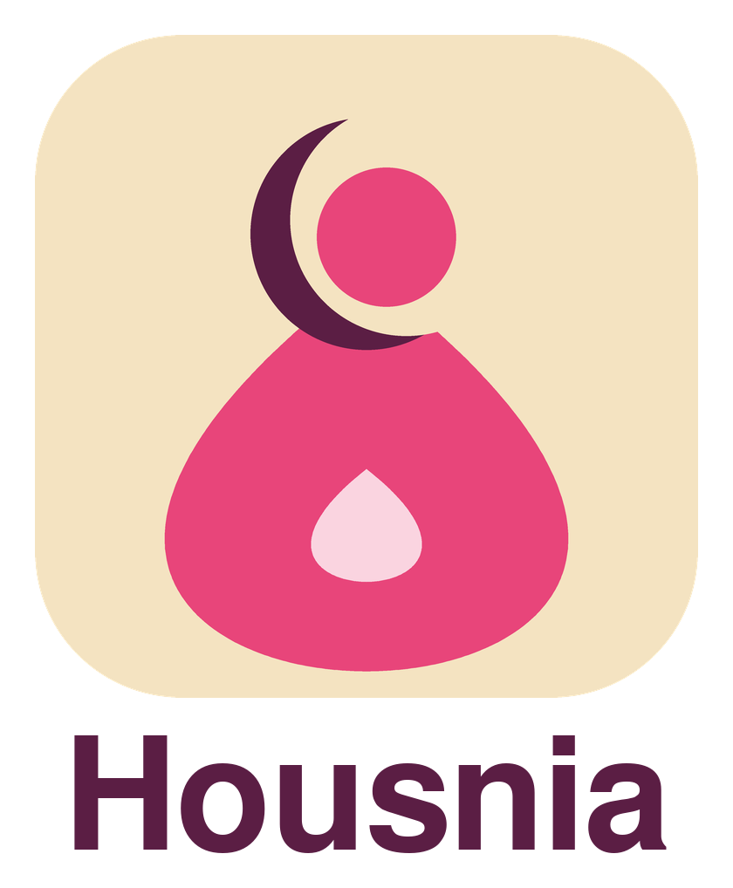
Visual identity
Housnia Pink
Powder Pink
Plum
Sahel Sand
#E8457A · Primary
#FAD4E0 · Backgrounds
#5B1E44 · Text
#F4E3C1 · App background
Coral
Teal
Emergency Red
Crescent: veil and protection · Drop: body and cycle · Small drop: growing life
#F28C6B · Pregnancy
#4FB5A5 · After Baby
#C62828 · Danger

Slide 11
Launch in 9 months
M1
M2
M3
M4
M5
M6
M7
M8
M9
Field research
Design
Content
Development
Pilot (300 women)
Launch
Then: new content packs every 2 to 3 months, iOS version and new languages.

Slide 12
Year-1 budget
Total
€174k
114.4 M FCFA
Seed ask: ≈ US$100k
Phase A (prototype + pilot) fits a seed grant; estimates to refine with local quotes.

Slide 13
2-year targets
100,000
30,000
20,000
active installations
adolescent girls completing "My Periods"
pregnant women with visit reminders
+30 pts
70%
500
quiz score before / after a module
can name 3 danger signs
community health workers trained

Slide 14

Built in Chad, designed to scale
1
Years 1–2
2
Years 2–4
3
Year 5+
Chad
Sahel and Central Africa
Africa and beyond
Chadian Arabic, then Sara and Kanembu
Niger, Mali, Burkina Faso, Cameroon, CAR, Sudan, Mauritania
East Africa, South Asia, other low-resource settings
Adding a country means adding language and country packs, not rebuilding the app. Few apps work offline, speak local languages and serve women who cannot read.

Slide 15

The founder
Student midwife
Second-year student in Obstetric Care (Midwifery), Faculty of Human Health Sciences, University of N'Djamena, Chad.
Why Housnia
Housna Mahamat Ali
Through her training she sees how many women and girls lack basic information on periods, pregnancy and postpartum care, and how often danger signs are recognised too late. Housnia is a tool designed in Chad, for Chadian women, by a future health professional.
Founder and project lead
housnia.tchad@gmail.com

Slide 16

Let's build Housnia together
Partners we are seeking
Contact
Ministry of Public Health, Chad
UNFPA, UNICEF, WHO Chad
NGOs and women's associations
Grant makers and femtech funds
Mobile operators (Airtel, Moov Africa)
Housna Mahamat Ali
Founder of Housnia
Student midwife (Obstetric Care, Year 2), Faculty of Human Health Sciences, University of N'Djamena
housnia.tchad@gmail.com

