Slide 1
Introduction to Flutter
Flutter is an open-source UI software development kit created by Google. It is used to develop applications for Android, iOS, Linux, Mac, Windows, Google Fuchsia, and the web from a single codebase.
Ha

Slide 2
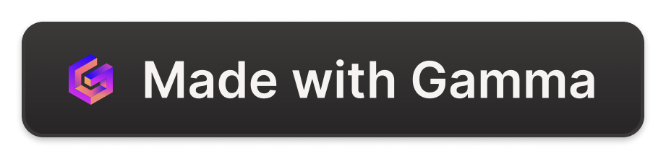
Flutter Architecture
1
Layered Structure
Flutter has a layered architecture where each layer has its specific functionalities and set of classes.
2
Widgets
Widgets are the basic building blocks of a Flutter app's user interface. They can be combined to build complex user interfaces.
3
Rendering System
Flutter uses its own rendering engine to draw widgets, making it fast and providing high-performance apps.

Slide 3
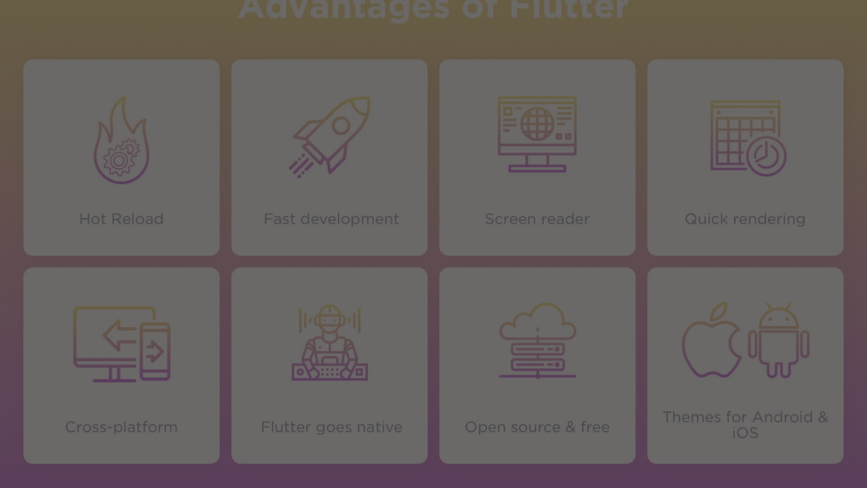
Why Use Flutter?
1
Fast Development
2
Expressive UIs
3
Single Codebase
Hot reload feature allows developers to see changes instantly. It speeds up the development process.
UI is built using a rich set of widgets, and it gives the flexibility to create custom UI designs.
Developers can write code once and deploy it on multiple platforms, saving time and effort.

Slide 4
Building User Interfaces with Flutter
Custom Widgets
Material Design
Animation Support
Developers can create custom widgets or use pre-designed widgets to build complex user interfaces.
Flutter provides an implementation of material design components which gives apps a consistent, recognizable look and feel.
It offers rich motion APIs and supports both simple and complex animations to make UI more interactive.

Slide 5
Flutter Development Tools
Flutter SDK
Integrated with Android Studio
VS Code Support
A complete package with tools that developers need for creating efficient mobile applications.
VS Code provides a lightweight and powerful code editor with great Flutter support and extensions.
Developers can use Android Studio for Flutter app development with ease.

Slide 6
Conclusion
Flutter stands at the forefront of modern app development, offering a powerful toolkit for creating stunning, native-quality experiences across multiple platforms. With its emphasis on speed, flexibility, and beautiful UI, Flutter enables developers to bring their ideas to life more efficiently than ever before. As Flutter continues to evolve and expand its reach to web and desktop platforms, it remains an essential tool for building the next generation of innovative applications. Embrace Flutter, and unlock the full potential of your creativity in the world of cross-platform development.

