Slide 1
Azure Virtual Network Routing Appliance
Lab 240 - Scalable east-west routing in a hub-and-spoke topology using Terraform (azurerm + azapi)
Azure Network Course
github.com/HoussemDellai/azure-network-course

Slide 2
Agenda
▪ What is a Virtual Network Routing Appliance?
▪ Routing appliance vs. NVA / firewall
▪ Lab architecture and address plan
▪ Terraform implementation: hub, appliance, spokes, peering
▪ User Defined Routes steering traffic to the appliance
▪ Traffic flow, deployment and verification
▪ Troubleshooting and key takeaways
Azure Network Course | Lab 240 - Virtual Network Routing Appliance
2

Slide 3
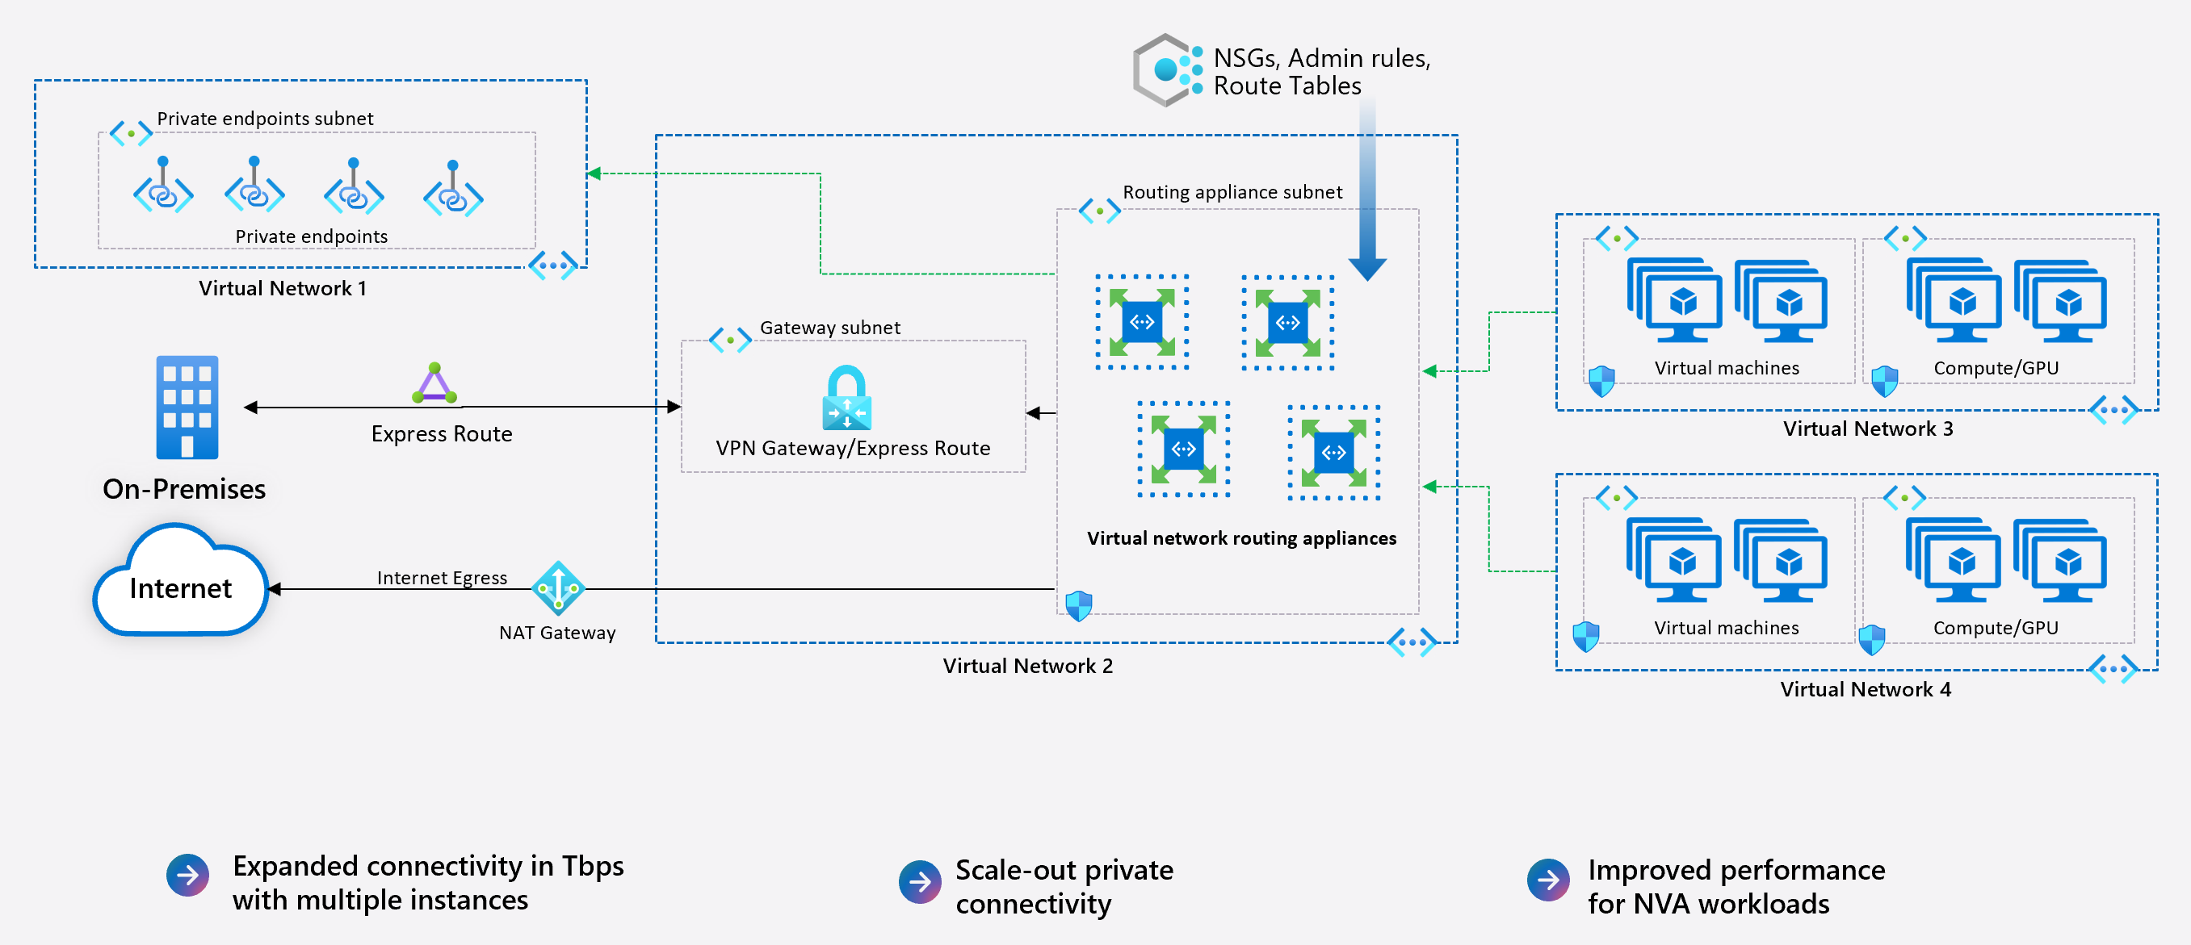
What is a Virtual Network Routing Appliance?
▪ Managed routing service deployed into a dedicated subnet of a VNet (resource type Microsoft.Network/virtualNetworkAppliances).
▪ Advanced routing beyond default Azure routing for traffic between subnets and VNets.
▪ East-west focus manages traffic between subnets; it is not a security enforcement point like a firewall.
▪ Scale-out and performance multiple instances for higher aggregate throughput (up to Tbps) and better NVA workload performance.
▪ Used together with UDRs, NSGs, admin rules, VPN / ExpressRoute gateway and NAT Gateway.
Reference architecture (Microsoft)
Azure Network Course | Lab 240 - Virtual Network Routing Appliance
3

Slide 4
Routing appliance vs. NVA / Firewall
Aspect | Virtual Network Routing Appliance | NVA / Azure Firewall
Primary purpose | Routing and traffic management | Security inspection and filtering
Traffic scope | East-west between subnets / VNets | East-west, north-south, internet egress
Security enforcement | None - use NSGs / admin rules | Yes - FW rules, IDPS, TLS inspection
Scaling | Scale-out, bandwidth set per appliance (10 Gbps in lab) | Depends on SKU / VM size
Next hop type in UDR | VirtualAppliance -> appliance private IP | VirtualAppliance -> NVA / FW private IP
Azure Network Course | Lab 240 - Virtual Network Routing Appliance
4

Slide 5
Lab architecture: hub and spokes
Design points
vnet-hub 172.16.0.0/12
vnet-spoke1 10.1.0.0/16
▪ Hub uses a large 172.16.0.0/12 space
▪ Spokes use 10.x.0.0/16
▪ Spoke-to-spoke traffic has no direct peering
▪ UDRs force it through the appliance
▪ Bastion gives private SSH access
Peering
snet-spoke1-workload 10.1.0.0/24
VirtualNetworkApplianceSubnet
vm-linux-spoke1
hub-routing-appliance
172.16.0.0/24 - 10 Gbps
Peering
AzureBastionSubnet
vnet-spoke2 10.2.0.0/16
Azure Bastion - 172.16.1.0/27
snet_spoke2_workload 10.2.0.0/24
vm-linux-spoke2
Spoke VMs: Ubuntu 24.04 Spot VMs (Standard_D2ads_v7), no public IP. Resource groups: rg-hub-240, rg-spoke1-240, rg-spoke2-240.
Azure Network Course | Lab 240 - Virtual Network Routing Appliance
5

Slide 6
Terraform implementation overview
Lab folder: 240_vnet_routing_appliance
File | Purpose
providers.tf / variables.tf | azurerm >= 4.37, azapi >= 2.12, Terraform >= 1.11; prefix "240"
hub_rg.tf, hub_vnet.tf | Hub resource group, VNet 172.16.0.0/12, appliance and Bastion subnets
hub_routing_appliance.tf | Routing appliance resource (azapi) + private IP output
bastion.tf | Azure Bastion with public IP for SSH access to spoke VMs
spoke1_*.tf / spoke2_*.tf | Resource group, VNet, workload subnet, VM, peering, route table
Azure Network Course | Lab 240 - Virtual Network Routing Appliance
6

Slide 7
Deploying the routing appliance
No azurerm resource yet - the lab uses the azapi provider
resource "azapi_resource" "hub_routing_appliance" {
type = "Microsoft.Network/virtualNetworkAppliances@2026-05-01"
name = "hub-routing-appliance"
location = azurerm_resource_group.rg_hub.location
parent_id = azurerm_resource_group.rg_hub.id
schema_validation_enabled = false
body = {
properties = {
bandwidthInGbps = 10
privateIPAddressVersion = "IPv4"
subnet = {
id = azurerm_subnet.snet_routing_appliance.id
}
}
}
response_export_values = ["*"]
}
▪ Subnet: must be named VirtualNetworkApplianceSubnet (172.16.0.0/24).
▪ Bandwidth: bandwidthInGbps = 10 sets the appliance capacity.
▪ Schema validation off: the API version is newer than the azapi embedded schemas.
▪ Output: the appliance private IP is exported and used as UDR next hop.
Azure Network Course | Lab 240 - Virtual Network Routing Appliance
7

Slide 8
Steering traffic with User Defined Routes
Each spoke workload subnet gets a route table pointing to the appliance
resource "azurerm_route" "route-to-nva-spoke1" {
route_table_name = "route-table-to-nva-spoke1"
address_prefix = "10.0.0.0/8"
next_hop_type = "VirtualAppliance"
next_hop_in_ip_address = azapi_resource.hub_routing_appliance
.output.properties.ipConfigurations.0
.properties.privateIPAddress
}
# route table associated to snet-spoke1-workload
# same pattern for spoke2 (route-table-to-nva-spoke2)
▪ 10.0.0.0/8 covers both spokes (10.1.0.0/16 and 10.2.0.0/16), so spoke-to-spoke traffic goes to the appliance.
▪ Spokes are not peered to each other: the hub peering plus this UDR is the only path between them.
▪ BGP propagation disabled on the route tables (bgp_route_propagation_enabled = false).
Route table | Prefix | Next hop
route-table-to-nva-spoke1 | 10.0.0.0/8 | Appliance IP
route-table-to-nva-spoke2 | 10.0.0.0/8 | Appliance IP
Azure Network Course | Lab 240 - Virtual Network Routing Appliance
8

Slide 9
Hub-spoke VNet peering
resource "azurerm_virtual_network_peering"
"vnet_peering_hub_to_spoke1" {
virtual_network_name = vnet-hub
remote_virtual_network_id = vnet-spoke1
allow_virtual_network_access = true
allow_forwarded_traffic = true
allow_gateway_transit = false
}
# + reverse peering spoke1 -> hub
# + same pair for spoke2
▪ 4 peerings in total: hub<->spoke1 and hub<->spoke2, both directions.
▪ allow_forwarded_traffic = true is required so traffic that the appliance forwards on behalf of another spoke is accepted.
▪ allow_virtual_network_access = true enables basic connectivity between hub and spokes.
▪ No gateway transit in this lab (no VPN / ExpressRoute gateway).
Azure Network Course | Lab 240 - Virtual Network Routing Appliance
9

Slide 10
Traffic flow: spoke1 to spoke2
ping / traceroute from vm-linux-spoke1 to vm-linux-spoke2
1
2
3
4
5
vm-linux-spoke1
UDR in spoke1
Peering to hub
Routing appliance
Peering to spoke2
10.1.0.x sends packet to 10.2.0.x
10.0.0.0/8 matches -> next hop = appliance IP
forwarded traffic allowed
routes packet to the spoke2 address space
packet delivered to vm-linux-spoke2
Expected traceroute: the appliance private IP (172.16.0.x) appears as an intermediate hop between the two spokes.
The return path follows the same logic through the UDR in spoke2.
Azure Network Course | Lab 240 - Virtual Network Routing Appliance
10

Slide 11
Deploy and verify
# Deploy
cd 240_vnet_routing_appliance
terraform init
terraform plan -out tfplan
terraform apply tfplan
# Outputs
routing_appliance_ip = "172.16.0.x"
vm_spoke1_ip = "10.1.0.x"
# Connect with Bastion (azureuser) to
# vm-linux-spoke1, then:
ping <vm_spoke2_ip>
traceroute <vm_spoke2_ip>
# Check effective routes
az network nic show-effective-route-table \
-g rg-spoke1-240 -n nic-vm-spoke1 -o table
▪ Effective routes on the spoke NIC should show 10.0.0.0/8 with next hop type VirtualAppliance.
▪ The VMs install traceroute at boot through custom_data (scripts/install-traceroute.sh).
▪ Spot VMs and an ephemeral NVMe OS disk keep the lab cost low.
Azure Network Course | Lab 240 - Virtual Network Routing Appliance
11

Slide 12
Troubleshooting checklist
▪ Check network interface configuration and IP addresses of the appliance and VMs.
▪ Review route tables / effective routes: is the UDR associated to the workload subnet?
▪ Confirm the peerings are Connected and allow_forwarded_traffic is enabled on both sides.
▪ Inspect appliance logs / diagnostics for errors or misconfiguration.
▪ Test connectivity with ping and traceroute.
▪ Make sure NSGs or firewalls are not blocking the traffic.
▪ Remember: the routing appliance does not filter traffic - security is enforced by NSGs and admin rules.
Azure Network Course | Lab 240 - Virtual Network Routing Appliance
12

Slide 13
Key takeaways
Route, don't inspect
UDR is the glue
Infrastructure as code
The routing appliance focuses on scalable east-west routing; pair it with NSGs for security.
Route tables with next hop VirtualAppliance send spoke traffic to the appliance IP.
azurerm for network plumbing, azapi for the newer virtualNetworkAppliances resource.
Cleanup: terraform destroy
Azure Network Course | Lab 240 - Virtual Network Routing Appliance
13

