Slide 1

Azure Virtual Network Routing Appliance
High-bandwidth, Azure-managed routing for hub and spoke
Houssem Dellai
Cloud Solution Architect, Microsoft

Slide 2
Azure Virtual Network Routing Appliance
An Azure-managed, high-bandwidth forwarding layer for east-west traffic
What is it?
Use cases
A top-level Azure resource deployed in a dedicated subnet named VirtualNetworkApplianceSubnet.
Runs on specialized networking hardware: low latency, high throughput.
Traffic is steered to it with UDRs (next hop type: Virtual appliance).
Pure forwarding: no VM to size, patch or scale. Azure-native management, IPv4 / IPv6 / dual-stack, metrics in Azure Monitor.
Not a security device: it routes, it does not inspect.
Spoke-to-spoke transit
Remove routing bottlenecks
Hub-and-spoke east-west traffic at up to 200 Gbps without a VM-based forwarder.
Replace undersized NVA VMs that cap throughput for data replication, backups, big data.
Low-latency east-west
Simpler spoke routing
Hardware data path reduces latency for chatty, latency-sensitive workloads.
One UDR per spoke: private ranges or even 0.0.0.0/0 to the appliance; hub handles the rest.
2

Slide 3
Offers: choose your bandwidth
Configured at deployment: 10, 50, 100 or 200 Gbps per routing appliance
10
50
100
200
Gbps
Gbps
Gbps
Gbps
Entry
Standard
High
Maximum
Dev / test, smaller hubs, first migration off NVA VMs
Production hubs with several busy spokes
Data-heavy east-west: replication, analytics, backup
Largest hubs and the most demanding throughput needs
Good to know
Current limitations
- Bandwidth cannot be changed in place: delete and redeploy
- One dedicated subnet: VirtualNetworkApplianceSubnet
- Terraform: use AzAPI (AzureRM not supported yet)
- No VNet flow logs yet
- Not behind an internal load balancer; no chaining in same region
- Traffic not covered by virtual network encryption
3

Slide 4
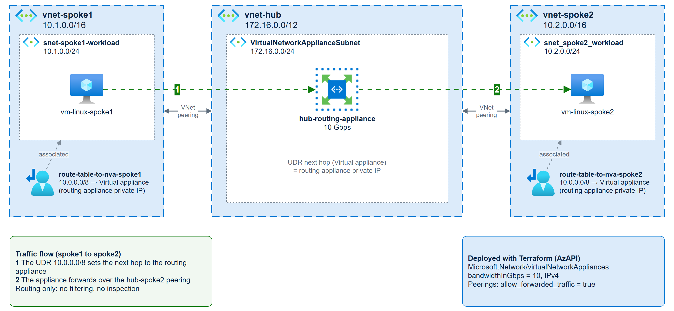
Reference implementation: Hub and Spoke
spoke-to-spoke traffic transits the routing appliance
5

Slide 5
Routing Appliance vs NVA / Firewall
Routing appliance = fast forwarding. NVA / Firewall = security inspection. They are complementary.
Virtual Network Routing Appliance
NVA / Azure Firewall
Main purpose
Scalable routing and forwarding
Security: filtering, inspection, threat protection
Traffic scope
East-west between subnets / VNets
East-west, north-south, internet egress
Security enforcement
None (routing only)
Rules, FQDN, IDPS, TLS inspection (per product)
Performance
Hardware data path, 10 to 200 Gbps
Bound by VM size / firewall SKU
Operations
Azure-managed resource: no OS, no patching
Azure Firewall managed; NVA = you manage VMs & HA
Traffic steering
UDR with next hop Virtual appliance
UDR with next hop Virtual appliance
Rule of thumb: use the routing appliance for fast east-west transit; keep a firewall where you must inspect or filter.
6

Slide 6
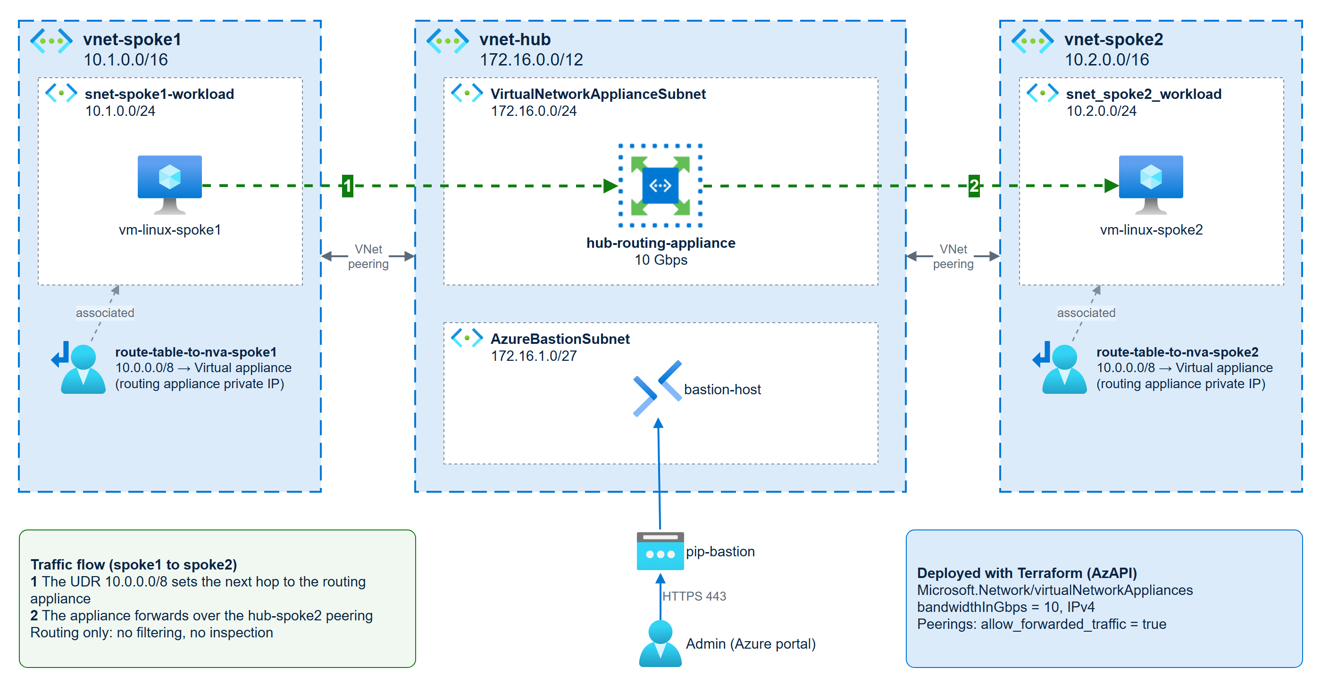
Lab architecture
Hub and spoke with a 10 Gbps routing appliance carrying spoke-to-spoke traffic
5

