Slide 1
Introduction to Databases
ΉoυֆֆƐᘻ Ή∂∱ֆ∂oυι

Slide 2
Définition of RDBM
RDBM stands for « Relational Database Management System » which is designed specifically for relational databases.
A relational database refers to a database that stores data in a structured format, using rows and columns. This makes it easy to locate and access specific values within the database.
It is « relational » because the values within each table are related to each other which let tables also to be related to other tables.
Most well known RDBMS are : MySQL, PostgreSQL and Microsoft SQL server.

Slide 3
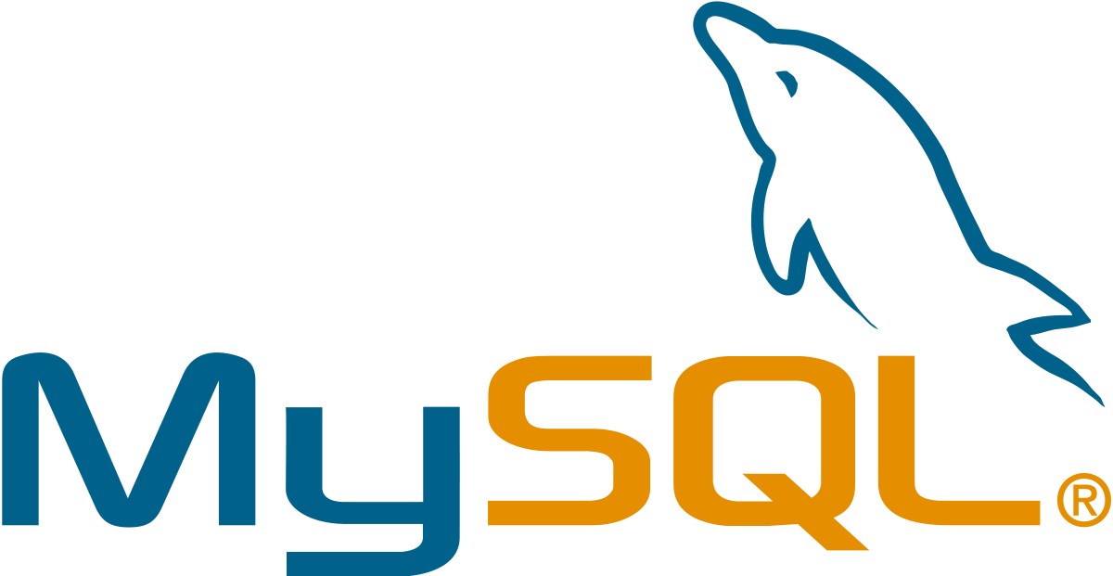
What is MySQL ?
MySQL, pronounced either « My S-Q-L » or « My Sequel » is an open source RDBM. It is based on the structure query language, which is used for adding, removing and modifying information in the database.
MySQL is the most popular open source SQL database. It is typically used for web application development, and often accessed using PHP.
The main advantages of MySQL are that it is easy to use, inexpensive, reliable (has been around since 1995), and has a large community of developers who can help answer questions.
Some of the disadvantages are that it has been known to suffer from poor performance when scaling, open source development has lagged since Oracle has taken control of MySQL,
and it does not include some advanced features that developers may be used to.

Slide 4
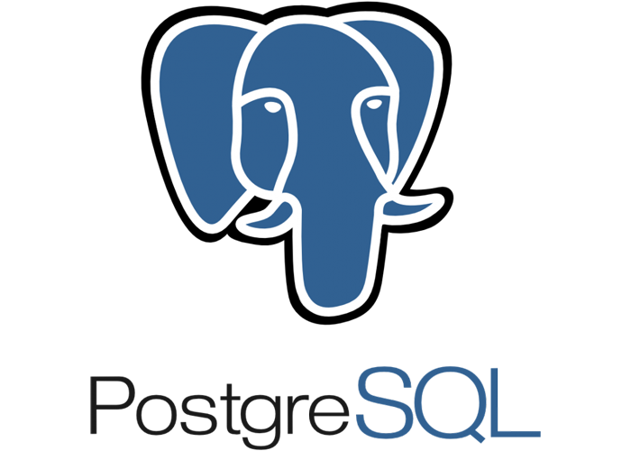
What is PostgreSQL ?
PostgreSQL is an open source SQL database that is not controlled by any corporation. It is typically used for web application development.
PostgreSQL shares many of the same advantages of MySQL. It is easy to use, inexpensive, reliable and has a large community of developers. It also provides some additional features such as foreign key support without requiring complex configuration.
The main disadvantage of PostgreSQL is that it can be slower in performance than other databases such as MySQL. It is also slightly less popular than MySQL

Slide 5
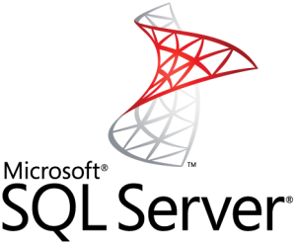
What is SQL SERVER ?
Microsoft SQL Server is a RDBMS (relational database management system) created by Microsoft. It is used as a central location to save and obtain data needed for applications. It uses SQL (structured query language) for queries that store or retrieve data
Microsoft SQL Server also allows user-defined composite types (UDTs) to be defined and used. It also makes server statistics available as virtual tables and views (called Dynamic Management Views or DMVs). In addition to tables, a database can also contain other objects including views, stored procedures, indexes and constraints, along with a transaction log.

Slide 6
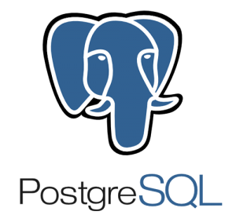

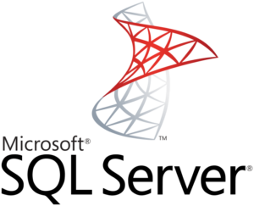
Differences between RDBMS
What are the differences between MySQL vs PostgreSQL vs MS SQL server
The choice between SQL and non-SQL databases usually boils down to differences in the structure. However, when we are looking into several SQL solutions, the criteria are a lot more distorted. Now will consider the aspects more precisely and analyze the underlying functionality. We’ll be taking a look at the three most popular relational databases: MySQL vs Postgresql vs SQL server

Slide 7
A comparison between the three RDBMS
MySQL | PostgreSQL | SQL Server
Open-Source | Open-Source | Licensed
Owned by Oracle | Owned by PostgreSQL Global Development Groupe | Owned by Microsoft
Scalable buffer pool to pull cache | Scalable buffer pool to pull cache | Isolate processes as separate OS processes
Limited functionality regarding tables to deal with complex processes | More functionality regarding temporary tables (divide tables into local and global), Better with complex processes | More functionality regarding temporary tables (divide tables into local and global), Better with complex processes
Organizes index into clusters and tables (not very flexible search) | Rich automated functionality for index management | Flexible search

Slide 8
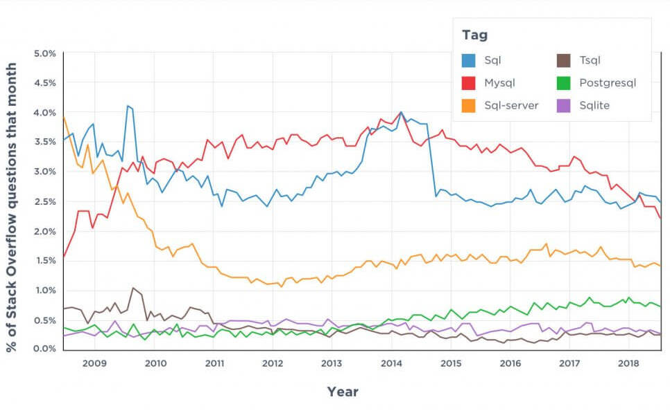
statistics

Slide 9
Conclusion
The choice between the three most popular databases ultimately boils down to the comparison of the functionality, use cases, and ecosystems. Companies that prioritize flexibility, cost-efficiency, and innovation usually choose open-source solutions. They can be integrated with multiple free add-ons, have active user communities, and are continuously updated.

