Slide 1

SEARCH
“When you help one person, you truly
do help change the world”
-Wendi Hay, former SEARCH client

Slide 2
Objectives
Calendar utility for admin/staff and volunteers: creativity, engaging
Reduce administration overhead
Convenient access to training tools
Storytelling: Storytelling for Volunteers
Self-service for volunteers
Gratitude
Creativity: Maps for enhanced visualization, better UX UI
Reduces admin constant checking
Training tools directly on dashboard
Map stories of events under development
Fast volunteer event sign up
Thank you notifications

Slide 3
1 out of 3
volunteers who volunteer in one year do not volunteer the next year.
“Volunteer Retention.” Corporation for National & Community Service, Apr. 2007, pp. 1–4.

Slide 4
Application Features

Slide 5
Easy Log In
Connects to any email account
Do not have to create new information (no registration)
Database:
Store volunteer information
Administrator access to volunteer profiles
Store event archive

Slide 6
Visual Mapping
Administrator adds events via calendar
Automatic map calendar integration
Volunteers can visually locate events easily
Easily find directions
Shows donors the spread out work of SEARCH
Story integration: Heightening connection to each other

Slide 7
Notification Services
Thank you email to volunteer post-event
Email notifications to administrator:
Volunteer signs up for event
Event fills up
Event not filled up before x deadline
Future directions:
Notifications to administrator when volunteer cancels

Slide 8
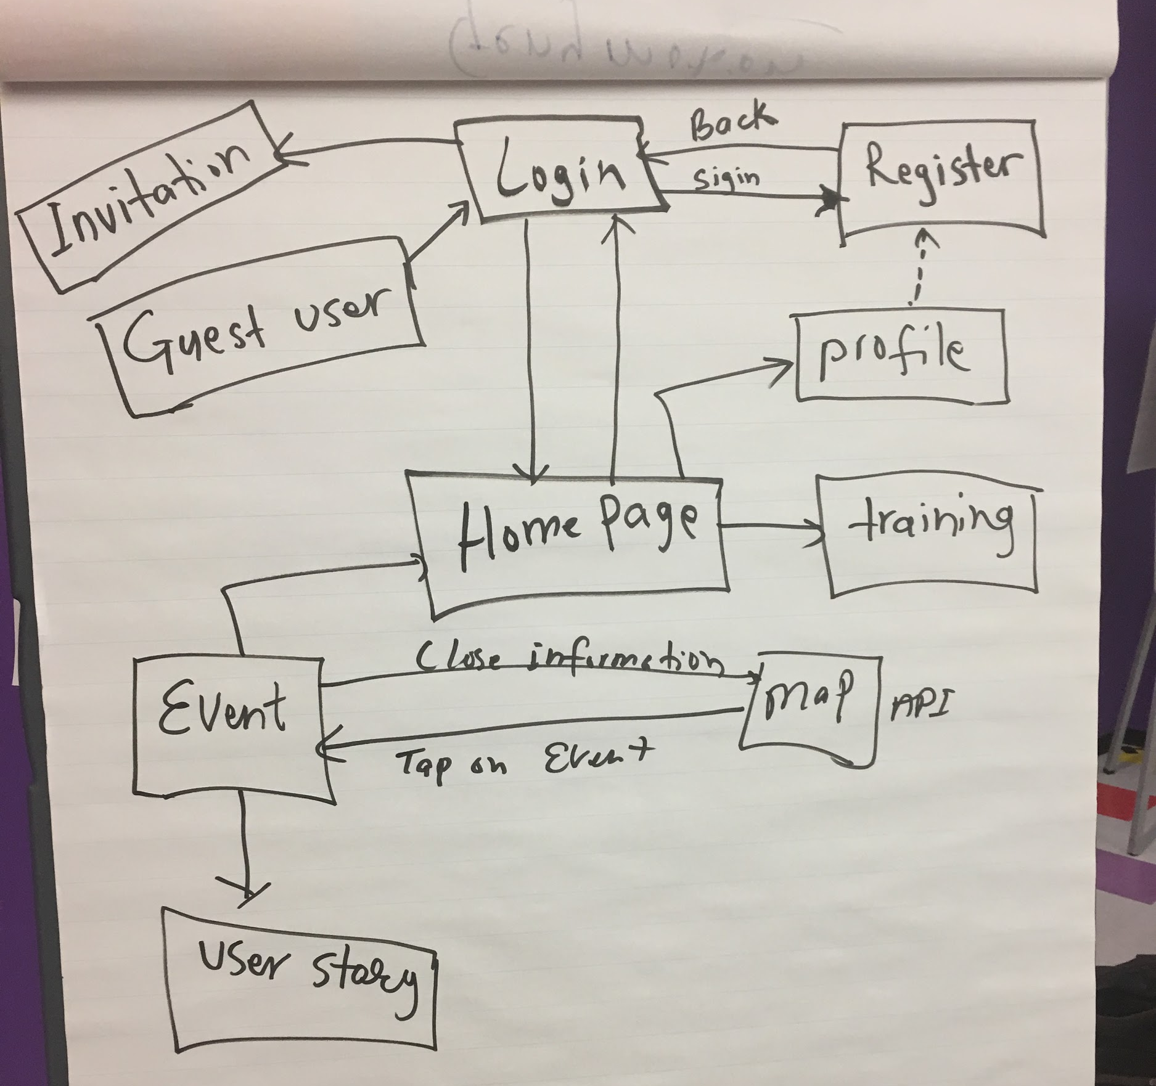






Tools

Slide 9
We’d like to work with you to implement...
Mobile application on both Android and iOS
Personalized thank you notes for volunteers
Approval event system for admin
Map viewer for homeless users
Map viewer for donors to see what event(s) their money is going to
Tracking money flow
Integrate social media directly

Slide 10
Thank you! Questions?

