Slide 1
virtual flip kit CHILDREN’S MUSEUM OF HOUSTON
TEAM HARDCODERS PRESENTS…

Slide 2

overview
We created an application that virtualizes FLIP Kits from the Children’s Museum of Houston
Technologies we used
- Ionic Framework, ASP.NET, MySQL,
Node.js, HTML
Features of “Virtual FLIP Kit”
- Interactive User Interface
- Virtualized Activities
- Data Collection

Slide 3
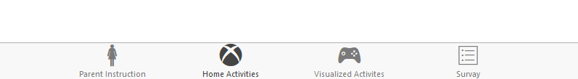
User interface
Mobile Friendly (Ionic Framework)
Intuitive Control Path
Login/Register
Categories Selection
FLIP Kit Selection
Tabular Navigation per Flip Kit

Slide 4
Virtualized activities
Allows users to interact with digital environment
Mixed digital-physical environments

Slide 5
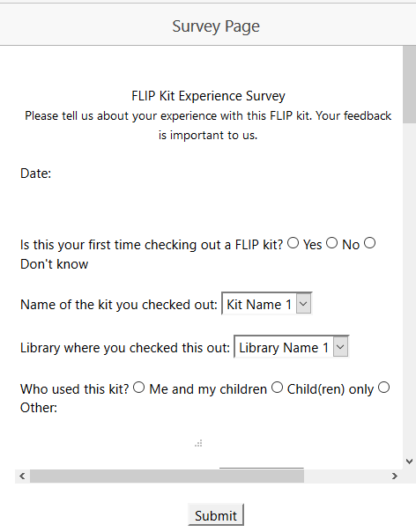
DATA COLLECTION
Survey collection after completion of FLIP Kits
Tracks usage of each FLIP Kit in the database

Slide 6
it’s demo time!

Slide 7
Roadmap to the future
FLIP Kits Recommendations algorithm
Social media sharing

