Slide 1
virtual flip kit CHILDREN’S MUSEUM OF HOUSTON
TEAM HARDCODERS PRESENTS…

Slide 2

overview
We created an application that virtualizes FLIP Kits from the Children’s Museum of Houston
Requirements
User Accounts, Categories Selection,
Virtualization of Kit Activities,
Data Collection, Recommendations,
Social Media Sharing, E-Book
Functionality
Technologies utilized
- Ionic Framework, ASP.NET, MySQL,
Node.js, HTML

Slide 3
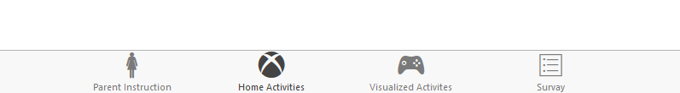
User interface
Mobile Friendly (Ionic Framework)
Intuitive Control Path
Login/Register
Categories Selection
FLIP Kit Selection
Tabular Navigation per Flip Kit

Slide 4
Virtualized activities
Allows users to interact with digital environment
Mixed digital-physical environments
DATA COLLECTION
Survey collection after completion of FLIP Kits
Tracks usage of each FLIP Kit in the database

Slide 5
it’s demo time!

