Slide 1
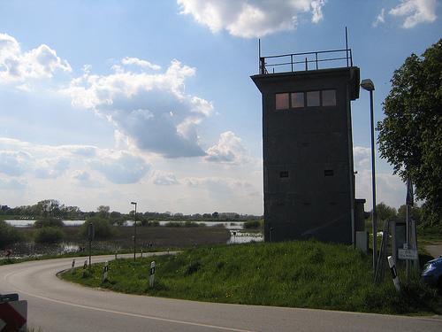
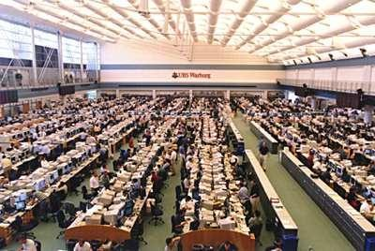
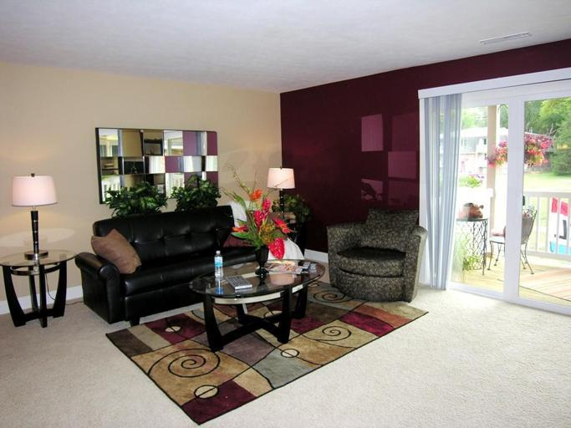
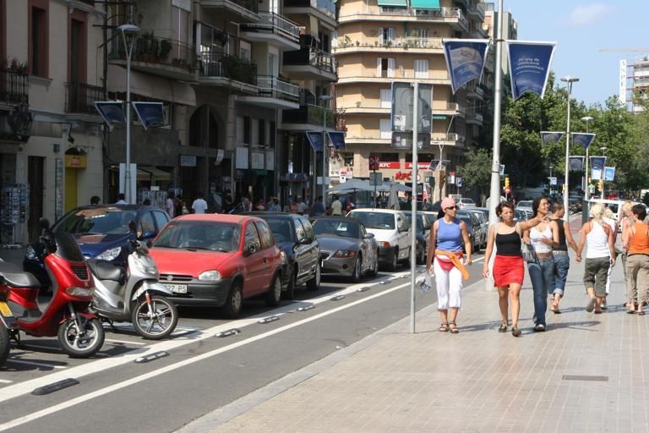
ADE_train_00019769500 x 375
ADE_train_00019309400 x 268
ADE_train_00011492683 x 512
ADE_train_00017618768 x 512

Slide 2
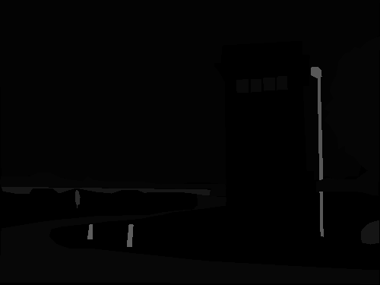
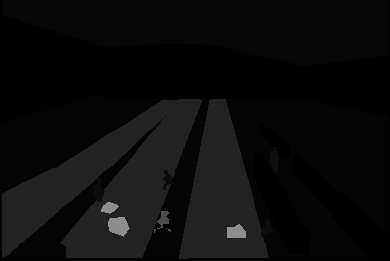
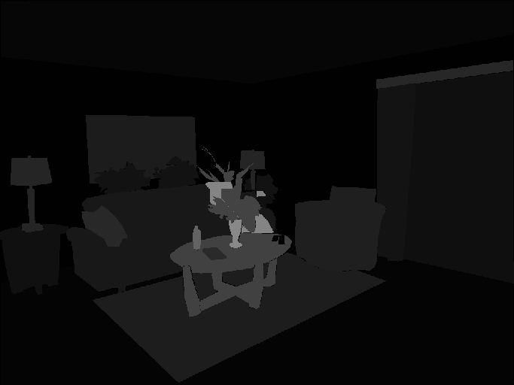
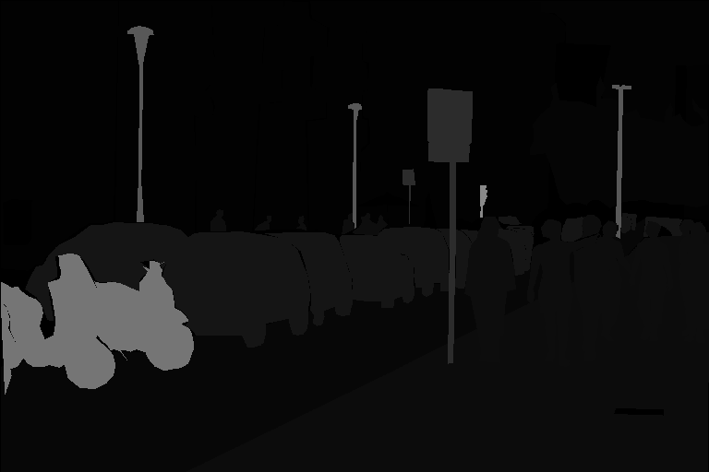
ADE_train_00019769500 x 375
ADE_train_00019309400 x 268
ADE_train_00011492683 x 512
ADE_train_00017618768 x 512

Slide 3
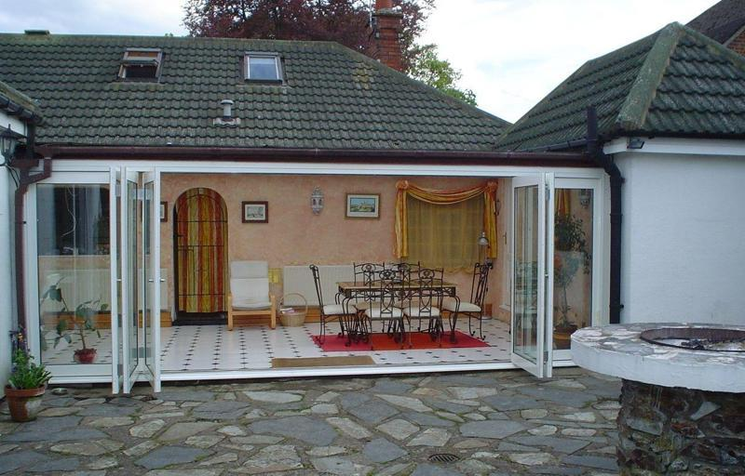
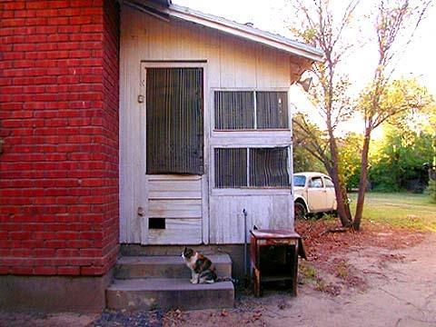
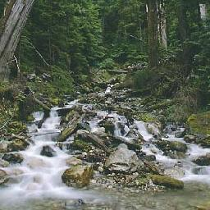
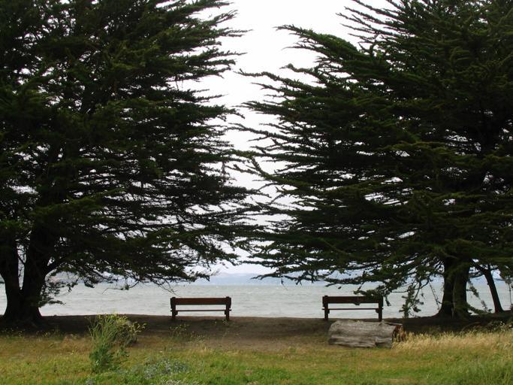
ADE_train_00013533800 x 512
ADE_train_00013484480 x 360
ADE_train_00006496256 x 256
ADE_train_00012798683 x 512

Slide 4
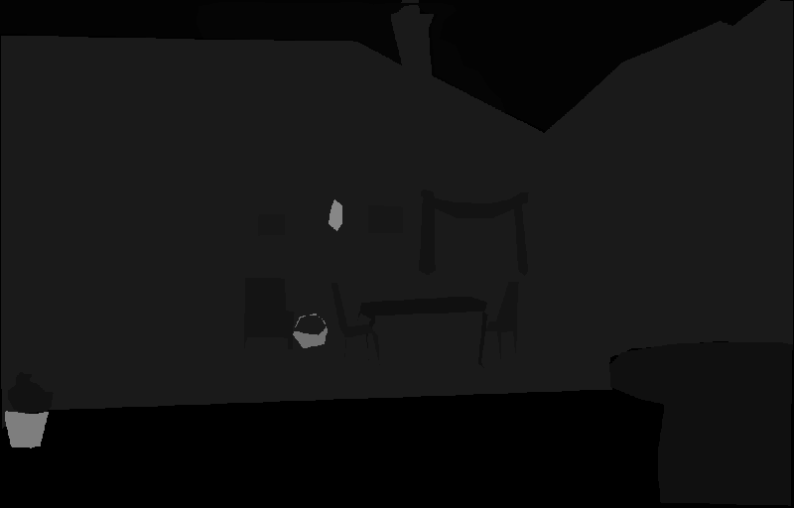



ADE_train_00013533800 x 512
ADE_train_00013484480 x 360
ADE_train_00006496256 x 256
ADE_train_00012798683 x 512

