Slide 1
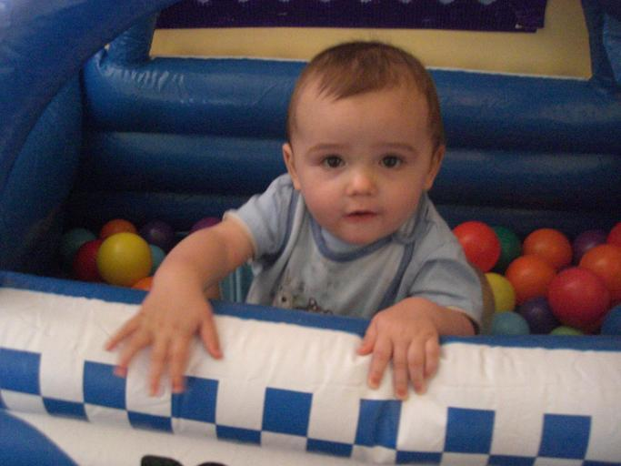
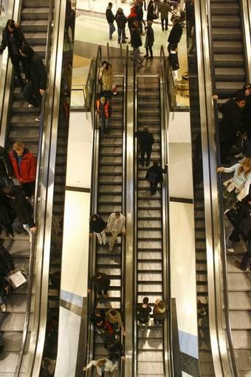
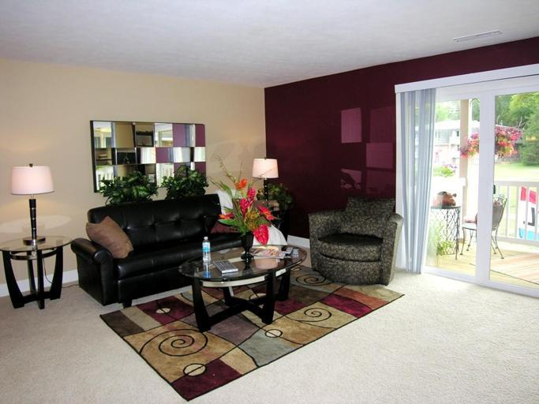
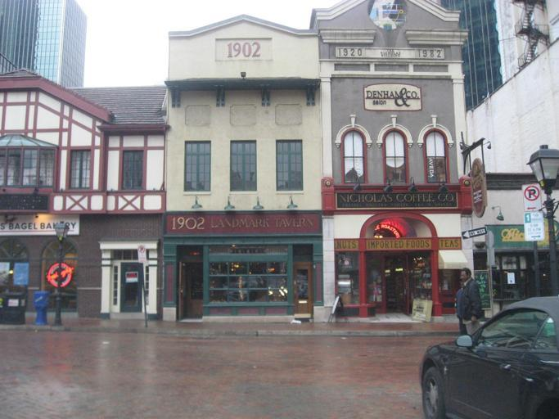
ADE_train_00000005683 x 512
ADE_train_00007617340 x 510
ADE_train_00011492683 x 512
ADE_train_00018243683 x 512

Slide 2
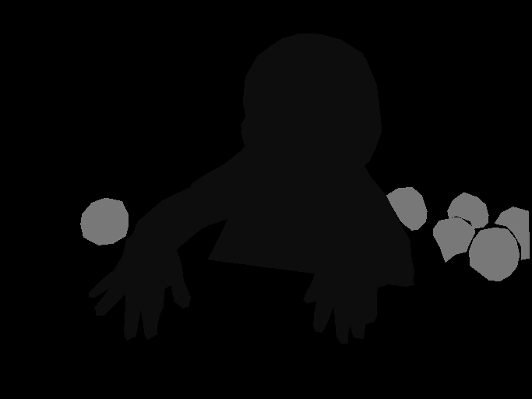
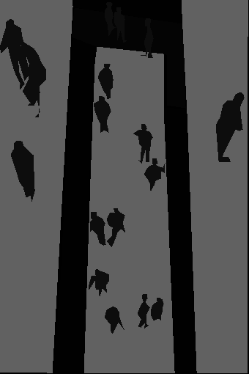
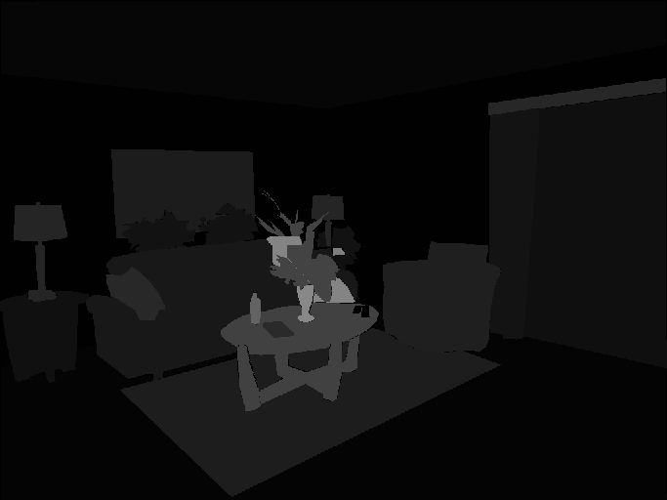
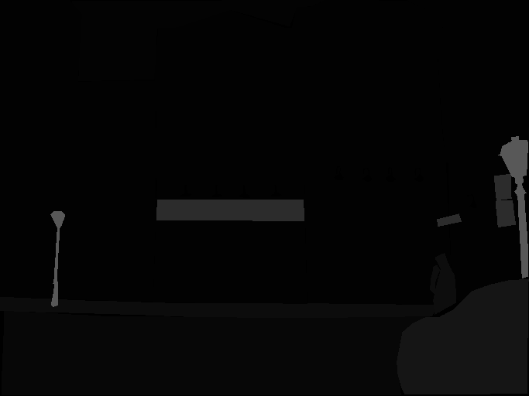
ADE_train_00000005683 x 512
ADE_train_00007617340 x 510
ADE_train_00011492683 x 512
ADE_train_00018243683 x 512

Slide 3
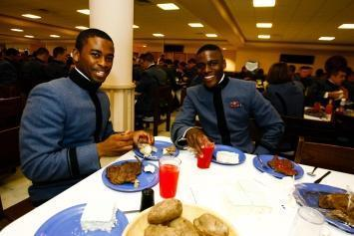
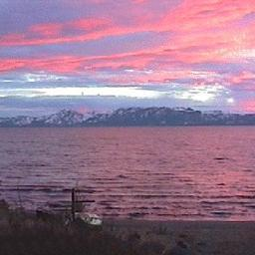
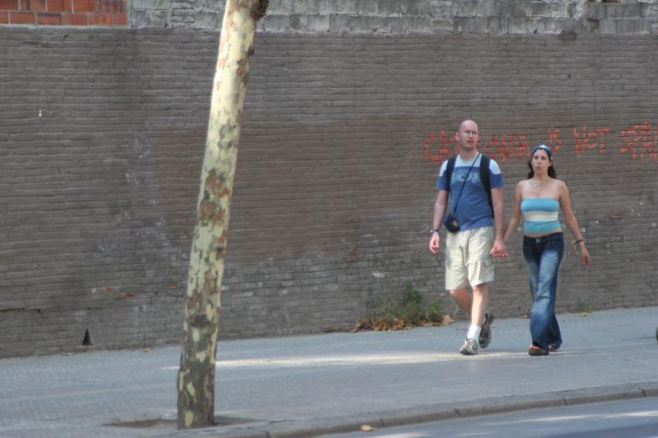
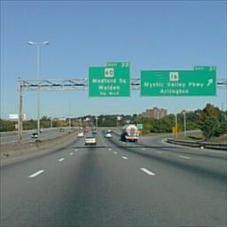
ADE_train_00011772355 x 237
ADE_train_00013582256 x 256
ADE_train_00016924768 x 512
ADE_train_00009074256 x 256

Slide 4
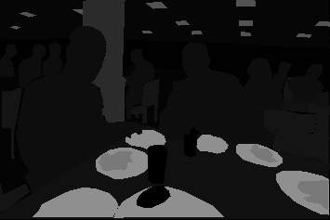


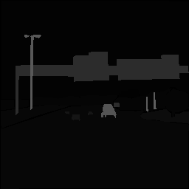
ADE_train_00011772355 x 237
ADE_train_00013582256 x 256
ADE_train_00016924768 x 512
ADE_train_00009074256 x 256

